Slide 1
Linear Search
Collection of data items to be searched is organized in a list x₁, x₂, … x_{n}
Assume = = and < operators defined for the type
Linear search begins with item 1
continue through the list until target found
or reach end of list
Data storage:
array, linked list, vector

Slide 2
Linear Search
Array/Vector based search function

Slide 3
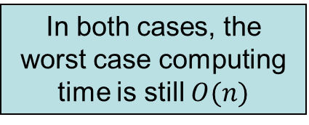
Linear Search
Singly-linked list based search function

Slide 4
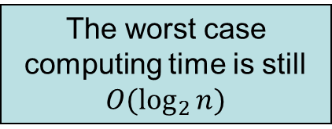
Binary Search
Binary search: searching an ordered list

Slide 5
Binary Search
Usually outperforms a linear search
Disadvantage:
Requires a sequential storage
Not appropriate for linked lists (Why?)
It is possible to use a linked structure which can be searched in a binary-like manner

Slide 6
Binary Search Tree
Consider the following ordered list of integers
Examine middle element
Examine left, right sublist (maintain pointers)
(Recursively) examine left, right sublists
13
28
35
49
62
66
80

Slide 7
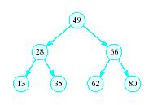
Binary Search Tree
Redraw the previous structure so that it has a treelike shape – a binary tree

Slide 8
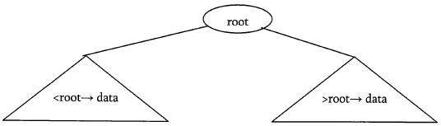
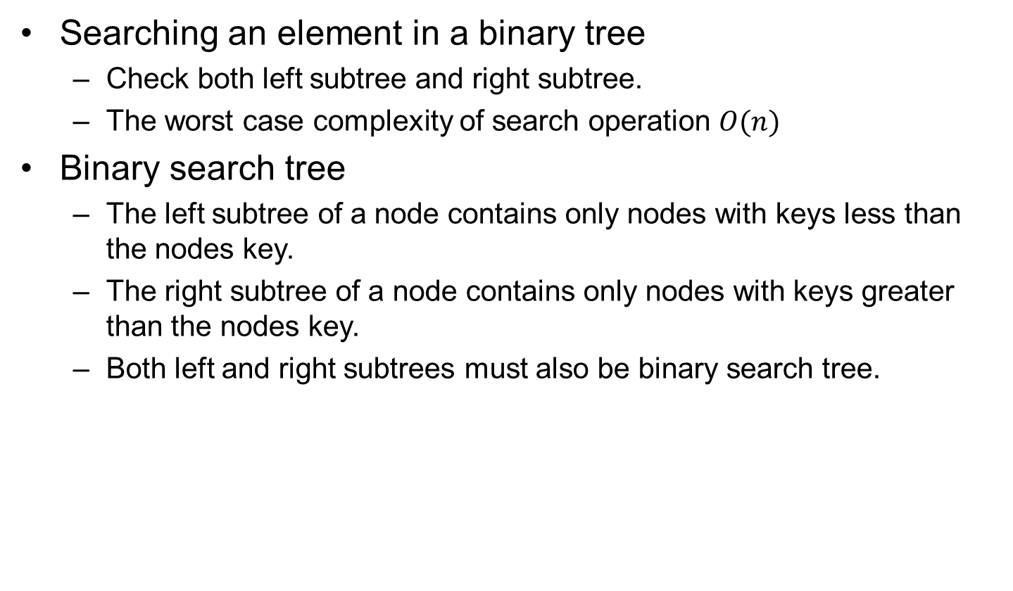
Binary Search Tree
Searching an element in a binary tree
Check both left subtree and right subtree.
The worst case complexity of search operation $O(n)$
Binary search tree
The left subtree of a node contains only nodes with keys less than the nodes key.
The right subtree of a node contains only nodes with keys greater than the nodes key.
Both left and right subtrees must also be binary search tree.
5
3
7
2
5
9

Slide 9
Operations on BST
Find/Find Minimum/Find Maximum element in BSTs
Traverse the BST
Visit each node exactly once
The inorder traversal a BST produces an ascending list
Insert a new item in the BST
Maintain the BST property
Delete an item from the BST
Maintain the BST property

Slide 10
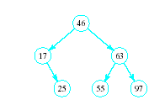

Search an Element in a BST
Search begins at root
If that is desired item, done
If item is less, move down left subtree
If item searched for is greater, move down right subtree
If item is not found, we will run into an empty subtree

Slide 11
Searching for a Key
While (!found && locptr != 0)
{
if (item < locptr->data)
Locptr = locptr->left;
else if (locptr->data < item )
Locptr = locptr->right;
Else
found = true;
}
5
3
7
2
4
9
Running Time: O (h), h – the height of the tree

Slide 12
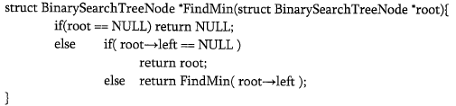
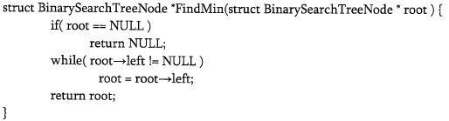
Finding Min Element in BSTs
In BSTs, the minimum element is the left-most node, which does not has left child.
15
6
18
3
7
17
20
2
4
13
Time complexity: O(n). Space complexity: O(n) for recursive stack.
9
Minimum = 2
Time complexity: O(n). Space complexity: O(1).

Slide 13
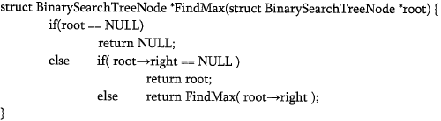
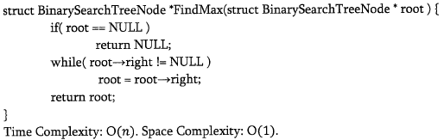
Finding Max Element in BSTs
In BSTs, the maximum element is the right-most node, which does not has right child.
15
6
18
3
7
17
20
2
4
13
9
Time complexity: O(n). Space complexity: O(n) for recursive stack.
Maximum = 20

Slide 14
Traversing a Binary Search Tree
Inorder tree walk:
Root is printed between the values of its left and right subtrees: left, root, right
Keys are printed in sorted order
Preorder tree walk:
root printed first: root, left, right
Postorder tree walk:
root printed last: left, right, root
5
Inorder: 2 3 5 5 7 9
Preorder: 5 3 2 5 7 9
3
7
2
5
9
Postorder: 2 5 3 9 7 5

Slide 15
Traversing a Binary Search Tree
Alg: INORDER-TREE-WALK(x)
if x ≠ NIL
then INORDER-TREE-WALK ( left [x] )
print key [x]
INORDER-TREE-WALK ( right [x] )
E.g.:
Running time:
Θ(n), where n is the size of the tree rooted at x
5
Output: 2 3 5 5 7 9
3
7
2
5
9

Slide 16
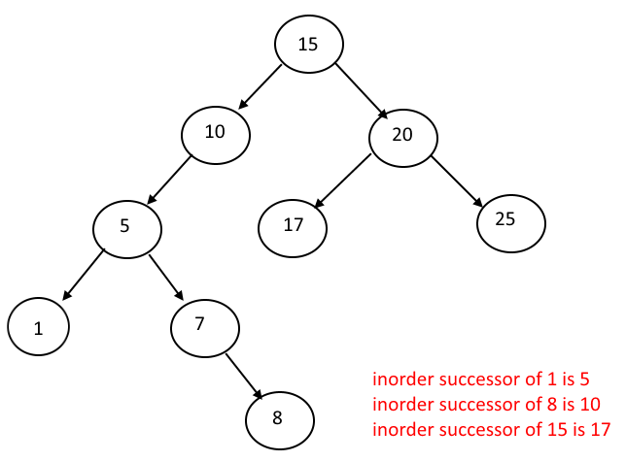
Inorder Successor
Inorder Successor succ(x)
x has a right child: succ(x) is the minimum value in its right subtree.
Otherwise, succ(x) is the closest ancestor, y, of x (if any) such that x is descended from the left child of y.

Slide 17
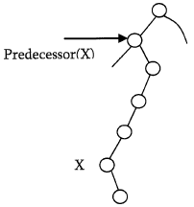
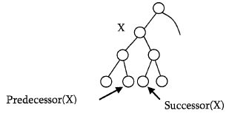
Inorder Predecessor
Inorder Predecessor predecessor(x)
X has a left children: predecessor(x) is the maximum value in its left subtree.
Otherwise, predecessor(x) is the closest ancestor, y, of x (if any) such that x is descended from the right child of y.

Slide 18
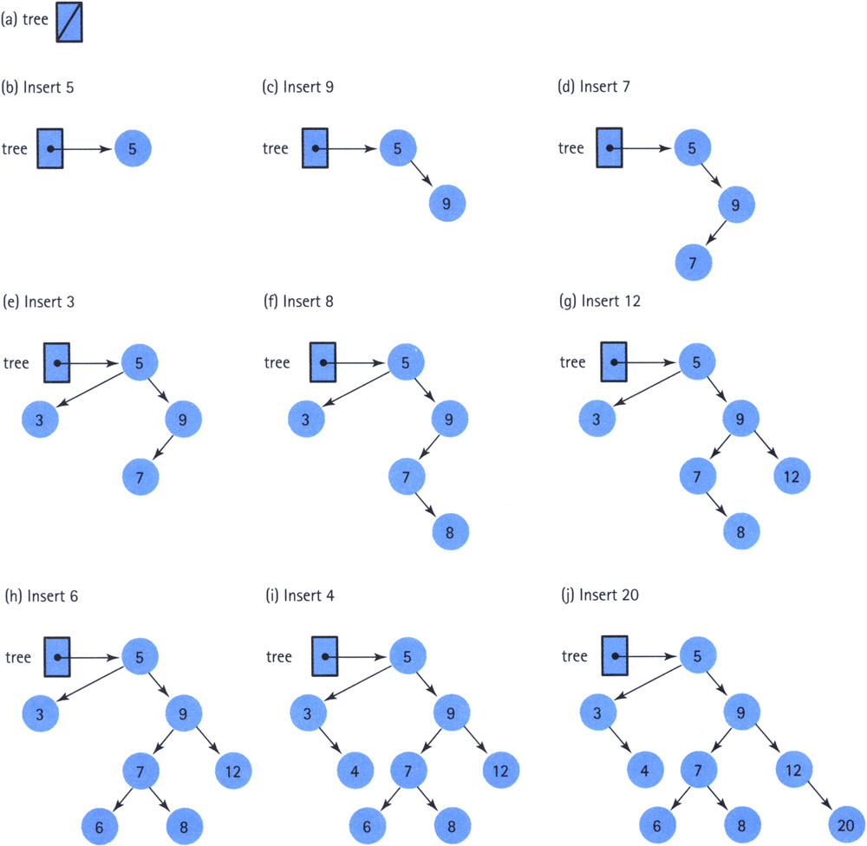
Inserting an Element to a BST

Slide 19
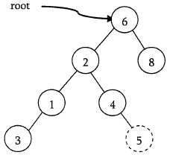
Inserting an Element to a BST
Find the location for the inserted element: following the same mechanism as that of search operation.
If the data is already exist in the BST, simply come out.
Otherwise, insert data at the last location on the path traversed.

Slide 20
Time Complexity: O(h) -> O(n)
Space Complexity: O(1)

Slide 21
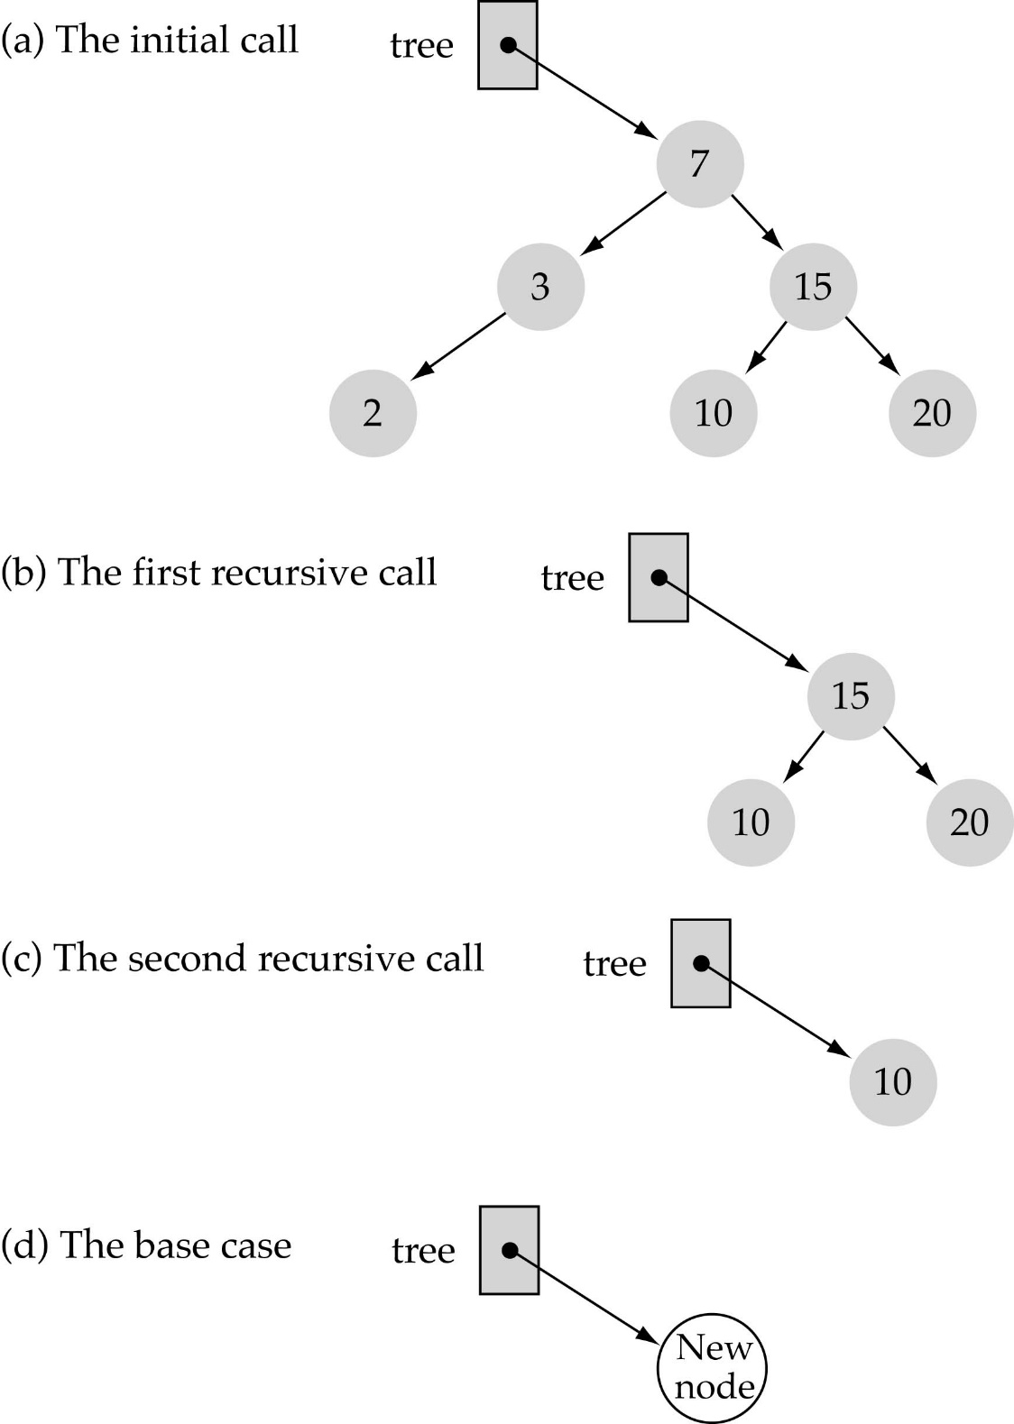
Implementing insertion resursively
e.g., insert 11
What is the base case(s)?
The tree is empty
What is the general case?
Choose the left or right subtree

Slide 22
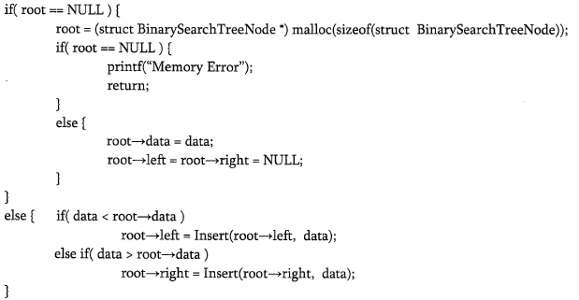
Implementing Insertion Resursively
Time Complexity: O(h) -> O(n)
Space Complexity: O(h) -> O(n) for recursion stack

Slide 23
Deleting an Element from a BST
First, find the item; then, delete it
Binary search tree property must be preserved!!
Three different cases:
(1) Deleting a leaf
(2) Deleting a node with only one child
(3) Deleting a node with two children
15
5
16
3
12
20
10
13
18
23
6
7

Slide 24
Deleting an Element from a BST
Goal:
Delete a given node z from a binary search tree
Idea:
Case 1: z has no children
Delete z by making the parent of z point to NULL
Time Complexity: O(h) -> O(n)
15
15
5
16
5
16
3
12
20
3
12
20
z
10
13
18
23
10
18
23
6
delete
6
7
7

Slide 25
Deleting an Element from a BST
Case 2: z has one child
Delete z by making the parent of z point to z’s child, instead of to z
Time Complexity: O(h) -> O(n)
15
delete
15
z
5
16
5
20
3
12
20
3
12
18
23
10
13
18
23
10
6
6
7
7

Slide 26
Deleting an Element from a BST
Case 3: z has two children
z’s successor (y) is the minimum node in z’s right subtree
y has either no children or one right child (but no left child)
Replace z’s data with y’s.
Delete y from the tree (via Case 1 or 2)
Can replace with maximum element of the left subtree also.
6
15
15
delete
z
5
16
6
16
3
12
20
3
12
20
10
13
18
23
10
13
18
23
y
6
7
7
Time Complexity: O(h) -> O(n)

Slide 27
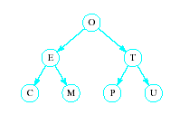
Problem of Lopsidedness
Tree can be balanced
each node except leaves has exactly 2 child nodes

Slide 28
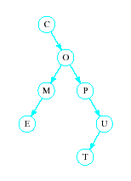
Problem of Lopsidedness
Trees can be unbalanced
not all nodes have exactly 2 child nodes

Slide 29
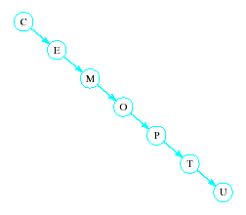
Problem of Lopsidedness
Trees can be totally lopsided
Suppose each node has a right child only
Degenerates into a linked list
Processing time affected by "shape" of tree

