Slide 1
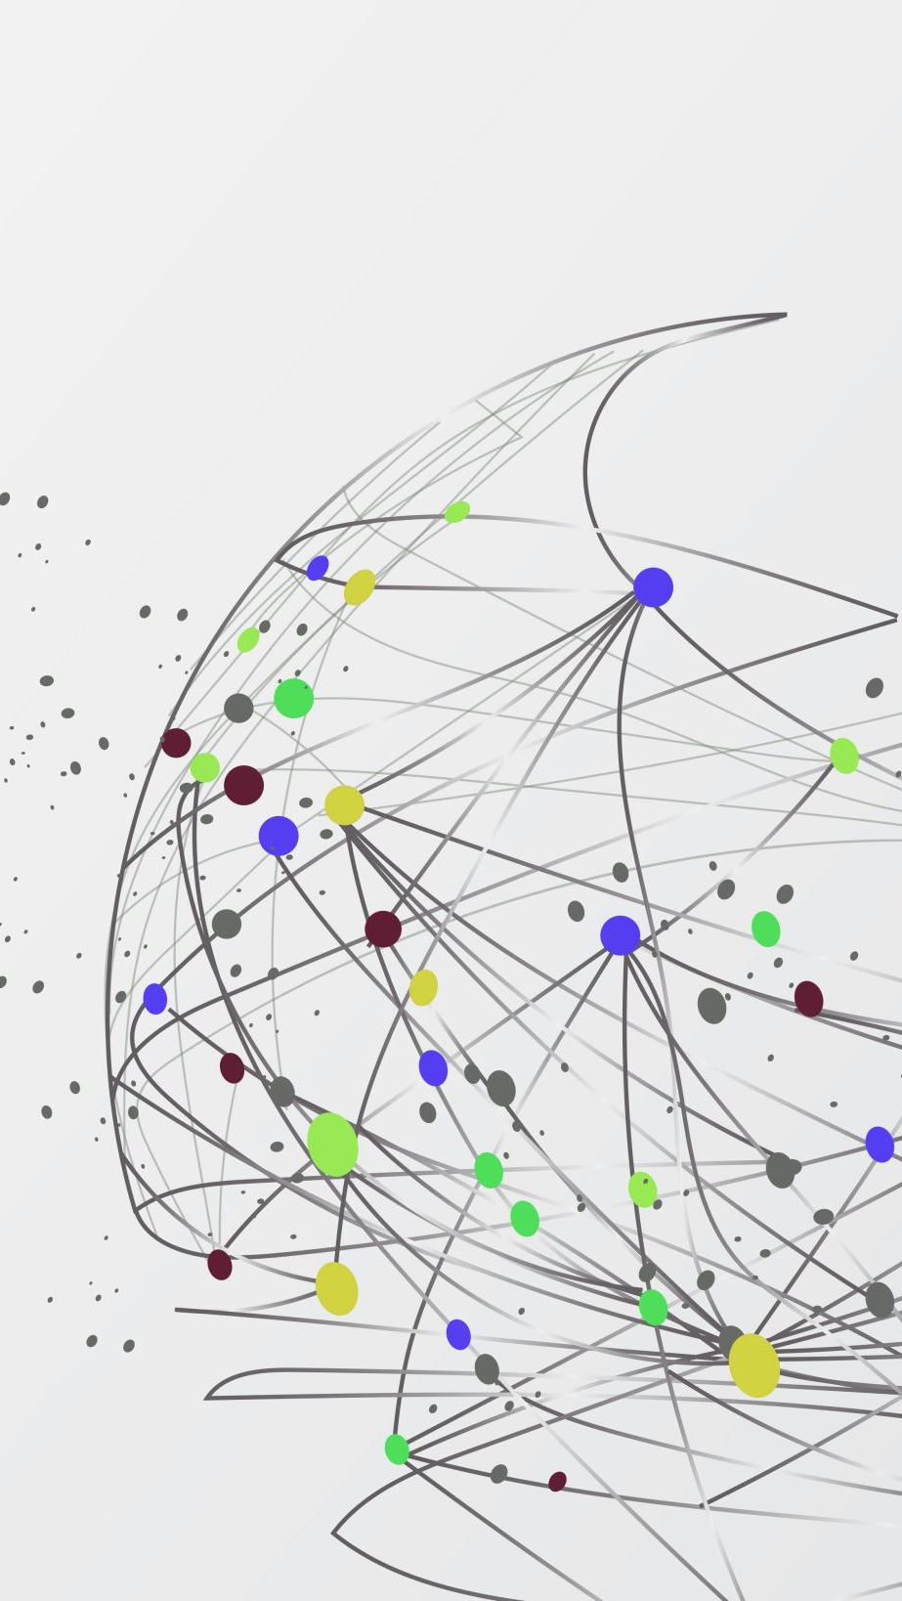
What is data science?
Study of data to return usefull information for their business
Visualizing large amount of data with help of statistics
Combination of math and statistics ,domain business knowledge, computer science/IT

Slide 2
What does a data scientist do?
Find answers to questions businesses have about the data they have.
Apply their programming knowledge into creating usefull analystics of data.
Figure out accurate recommendations for costumers based of data.

Slide 3
What are the most popular data science tools?
Python / Library MatPlotlib (Programming language driven)
MS Excel ( General purpose tool, beginner – non Technical friendly)
Power BI ( Business Intelligence Data science tool, Create stunning data reports and visualisations)
Google Analytics ( Cloud based > web-admin has easy acces, analyze web traffic/data ect.)

