Slide 1
ROCKETRIDE HACKATHON
Compounding Support Desk
An AI IT support assistant that gets faster every time a fix is verified — not just another ticket-triage chatbot.
github.com/Thomaswu32/Data_hackthon

Slide 2
THE PROBLEM
Support teams keep re-solving the same tickets
● Every agent re-diagnoses from scratch, even for a symptom solved last week.
● “Looks similar” gets treated as “is the same” — wrong-system fixes get reused on the wrong ticket.
● AI suggestions get treated as confirmed fixes without a human ever verifying they worked.
● Knowledge lives in one agent's head, not in a form the next agent can trust.
Scenario we solved end-to-end
“Employee reset their password but still can't log in to company systems.”
Compounding Support Desk · RocketRide Hackathon
2

Slide 3
THE SOLUTION
A loop that compounds — not a one-off chatbot
1
Describe
Free-text
+ structured
system/symptom
2
Diagnose
History + live
trends + quick
checks
3
Take action
Run approved
steps in a demo
environment
4
Confirm
Human confirms
it actually
worked
5
Save
Verified fix
becomes a
reusable playbook
6
Reuse
Next similar
ticket reuses it
directly
Guardrail: reuse only fires on system + symptom + prerequisite-checklist match — never on text similarity alone. A wrong-system ticket with near-identical wording is a verified negative control in the check script.
Compounding Support Desk · RocketRide Hackathon
3

Slide 4
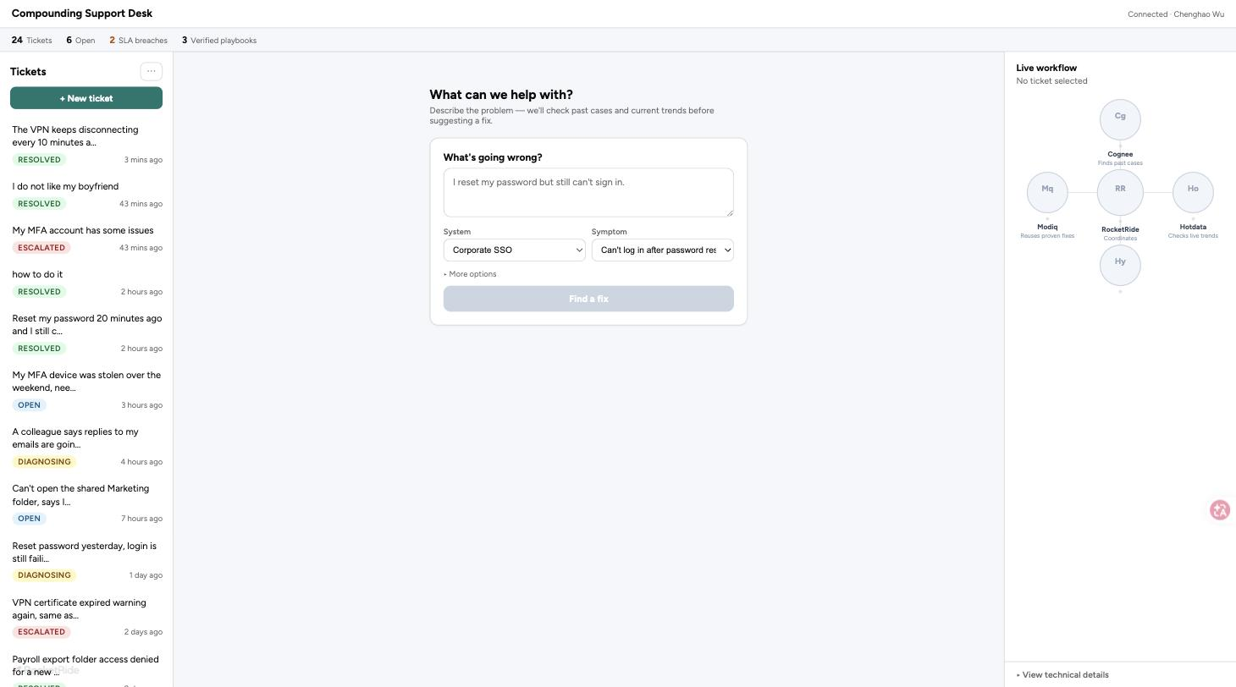
LIVE PRODUCT
Describe → one prompt, not a form
“What's going wrong?” drives ticket creation; system/symptom stay structured pickers so matching stays trustworthy.
Compounding Support Desk · RocketRide Hackathon
4

Slide 5
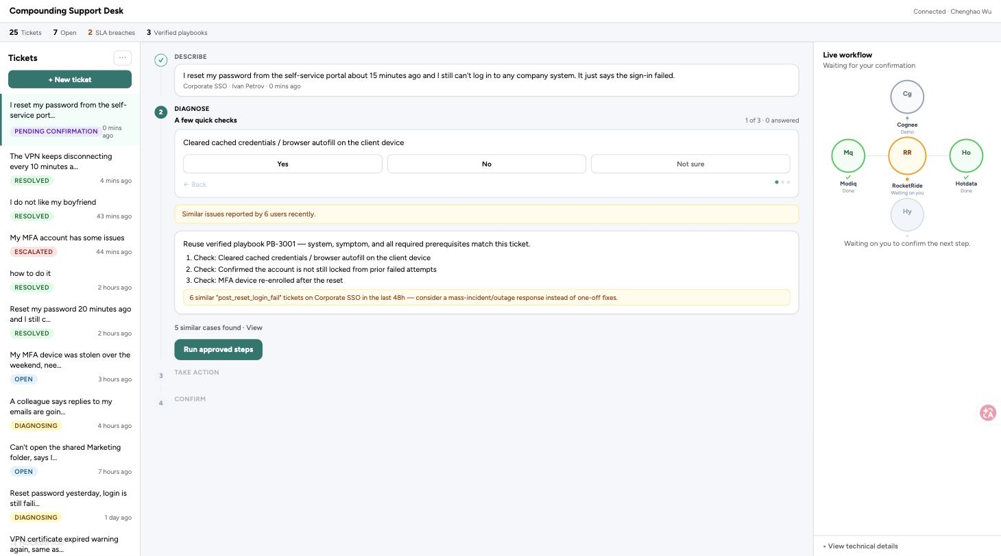
LIVE PRODUCT
Diagnose → quick checks + live workflow
One question at a time, mass-incident alert, playbook match — and the right panel shows which services are actually running.
Compounding Support Desk · RocketRide Hackathon
5

Slide 6
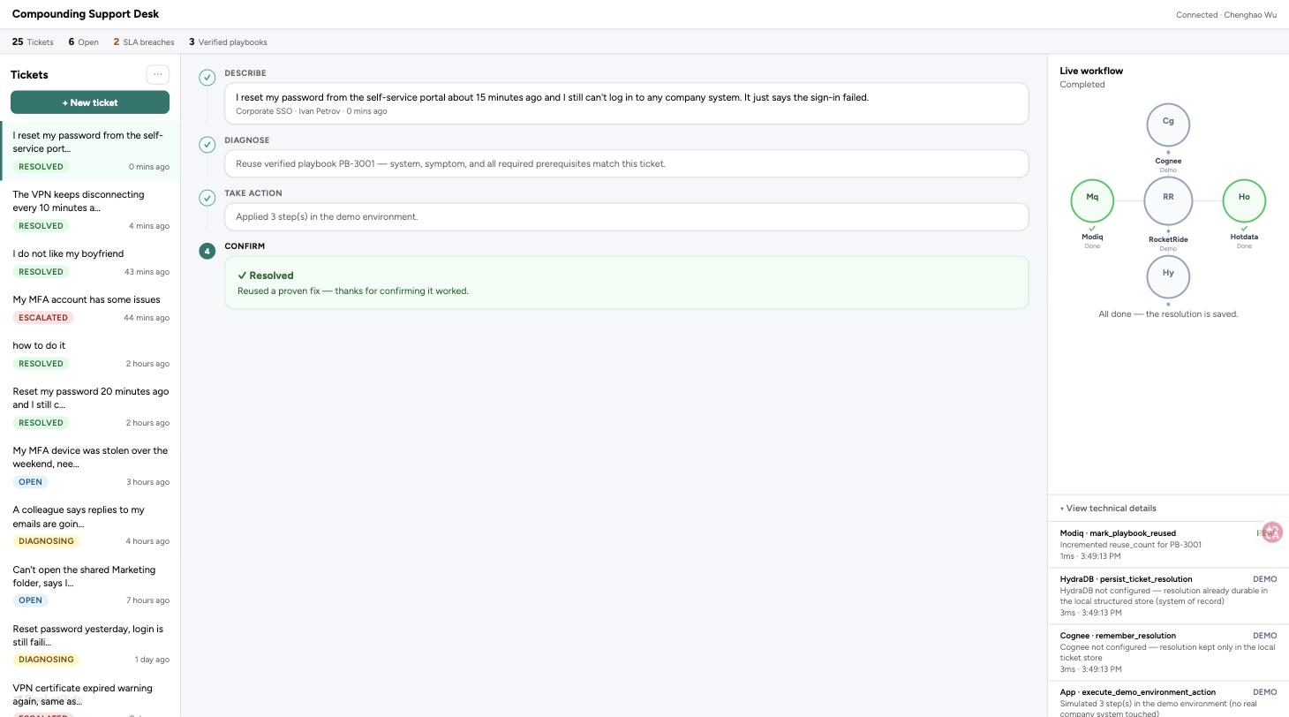
LIVE PRODUCT
Confirm → resolved, saved, logged
“Fix saved for similar issues” only appears when the save genuinely succeeded. Technical details stay one click away, never dumped on the main view.
Compounding Support Desk · RocketRide Hackathon
6

Slide 7
ARCHITECTURE
Five services, one honest status per call
Ro
Co
Hy
Ho
Mo
RocketRide
Hosts the app, coordinates the AI-suggestion pipeline
Cognee
Finds and remembers similar past cases
HydraDB
Cross-session memory for verified resolutions
Hotdata
Real-time ticket volume / SLA / mass-incident signal
Modiq
Saves + matches verified, reusable playbooks
Snyk runs separately as a project-level security scan — not part of the per-ticket workflow.
Every node's state (idle / running / success / error / demo) is derived from the app's own real call log — no fixed timers, no scripted sequencing. Parallel calls light up multiple nodes at once because they really do run in parallel.
Compounding Support Desk · RocketRide Hackathon
7

Slide 8
HONESTY BY DESIGN
What's real, what's demo — no smoke and mirrors
RocketRide
Real
Live connect() + pipeline execution, verified from the CLI
Hotdata
Real
Genuine live computation over the ticket store, always
Modiq
Real
Genuine persistence + eligibility matching, always
Cognee / HydraDB
Real, via CLI
Gemini-backed pipelines proven real from scripts/check-loop
Browser app today
Demo-labeled
Real RocketRide shell package not yet vendored — UI never pretends otherwise
Compounding Support Desk · RocketRide Hackathon
8

Slide 9
VERIFICATION
Proven, not promised
● pnpm --filter local-support-memory-desk run typecheck / build — strict TypeScript, clean Module Federation bundle
● pnpm run check — an 8-step Node harness: create → diagnose → confirm → execute → verify → save → reuse → negative control
● Idempotency: marking resolved twice never duplicates a playbook
● Persistence: closing and reopening the ticket store doesn't lose a saved playbook
● Snyk / pnpm audit: 14 real dependency vulnerabilities found and fixed (undici, adm-zip)
● Recorded live against the real RocketRide staging shell — see docs/demo.gif
Compounding Support Desk · RocketRide Hackathon
9

Slide 10
Every verified fix makes the next similar ticket faster.
github.com/Thomaswu32/Data_hackthon
Thank you — questions?

