Slide 1
POCS:
Formalization of Coinductive Graph Algorithms in Isabelle
By Thomas Bonde Hansen - mvh250

Slide 2
Coinductive representation of graphs
Donnacha Oisín Kidney & Nicolas Wu
Formalized in Agda

Slide 3
Outline
From paper to Isabelle
Issues with implementation (Isabelle vs Agda)
What is left to formalize?

Slide 4
Formalized
Graph representation
Weights (monus)
Weighted set representation
Edge semiring (GraphOf V, ⊞, empty, >=>, return)
Heap and Forest
Monad implementation of wset and Forest
Depth first search on Forest

Slide 5

Graph representation
Neighbours is a weighted set

Slide 6
Weight representation
Semi-semi-ring (S, ⊕, ⊗, 1)
On ℕ, ⊕ is minimum, ⊗ is + and 1 is 0
(S, ⊓, •, ε)

Slide 7
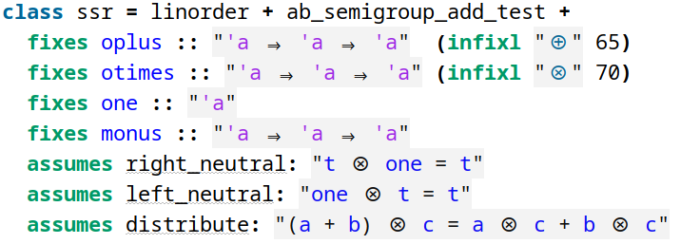
Weight representation

Slide 8
Weighted set presentation
In the paper, list with quotient type
Duplicates → Pick minimum

Slide 9
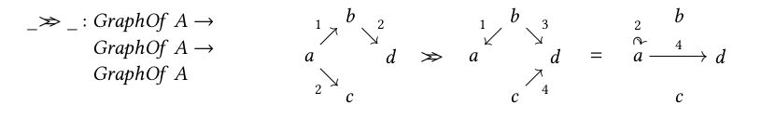
The connect operator

Slide 10
Weighted set representation
Attempt 1: Use functions (v → option w)
Problem with connect-operator:
Function represent infinite set → Infinite search space for predicate
Attempt 2: Use fmap
Is effectively a function
But cannot have recursion on the left of a function arrow
Attempt 3: Custom wset with folding and lifting
(by Mathias)

Slide 11
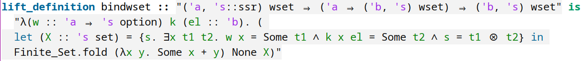
Monad implementation on wset
return is just a singleton

Slide 12
Proving the Monad laws for wset

Slide 13




Heap
S is a weight, and they accumulate
Searching the heap:

Slide 14
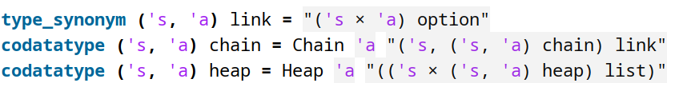
Heap

Slide 15


Forest

Slide 16
Forest
Initial attempt with fmap as wset
Realize that Forest and Weighted^inf are mutually recursive

Slide 17
Monad implementation on Forest
Return is trivial
But bind:
xs >>= k = xs >>=′ ((return′ ∘ ⟪_⟫ ∘ inl ∘ (_>>= k) ▿ k) ∘ out)

Slide 18
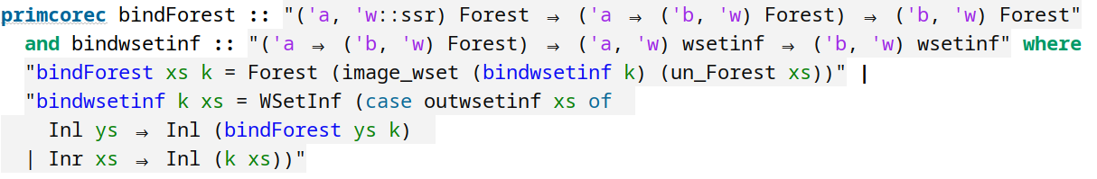
Monad implementation on Forest

Slide 19
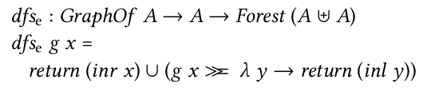
Depth first search

Slide 20
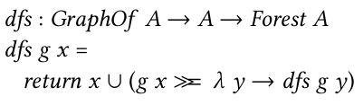
Depth first search

Slide 21
Implementing dfs
Primcorec → Function is not primitive
Corec → Does not support mutual recursion
Used “axiomatization”

Slide 22
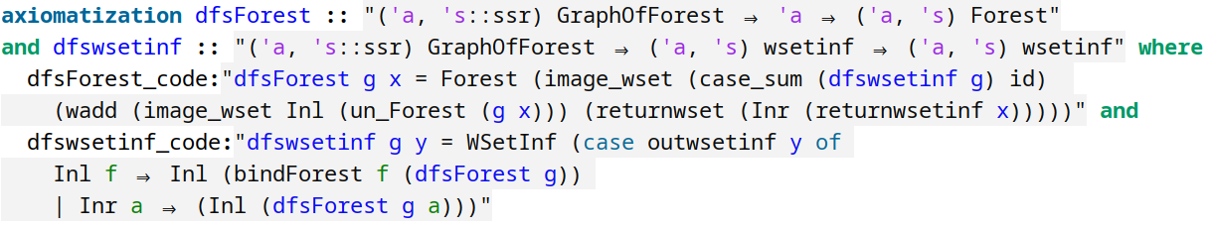
Implementing dfs

Slide 23
Proving that they are equivalent

