Slide 1
The Good Party
Ultimately our ideas are found by you. You define this party.

Slide 2
Government for the people
We are once again trying to make it so the government has to make the majority agree with all of its actions and powers.
We believe that a lot of issues come from two main points.
Not having consent of the governed
Being to broad so individuals feel powerless.

Slide 3
Party for the People
We are pluralistic, based on what works and what can pay for itself provided all powers agree.
We are pro-life and pro-choice in the furthest way possible
We agree to not enforce our biased dogma on others
We do not discriminate

Slide 4
Positive change
Collaborative veto
All accepting
Multiple choice voting
The only way to bring back the individuals power to control the government's actions is to allow change from the local level and beyond.

Slide 5
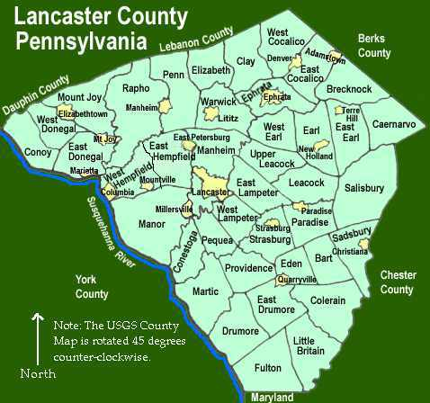
Collaborative Veto
Collaborative veto allows more local governments to have a say in what a broader political power is implementing in the form of a law, regulation, or other government power.
The ability to have local governments to “say no” to a political action from above is a missing check on power.

Slide 6
All accepting
We do not discriminate based on values, race, religion, wealth, gender, sexuality or if your foriegn or domestic.
We believe in finding and embolden the good in everyone.
There are of course exceptions.

Slide 7
Multiple Choice voting
Multiple choice voting would allow you to choose as many candidates in the election which you think would be reasonable to perform the duties of the office.
Why should you be limited to having your opinion for just one candidate. Multiple choice voting system would work the same as our current system; who ever has the most votes wins.

Slide 8
Conclusion
The instability of government will not be tolerated
Government for the people is the only solution
The Good Party is committed to giving a voice to local communities to form their laws, based on the people, not special interest.

