Slide 1
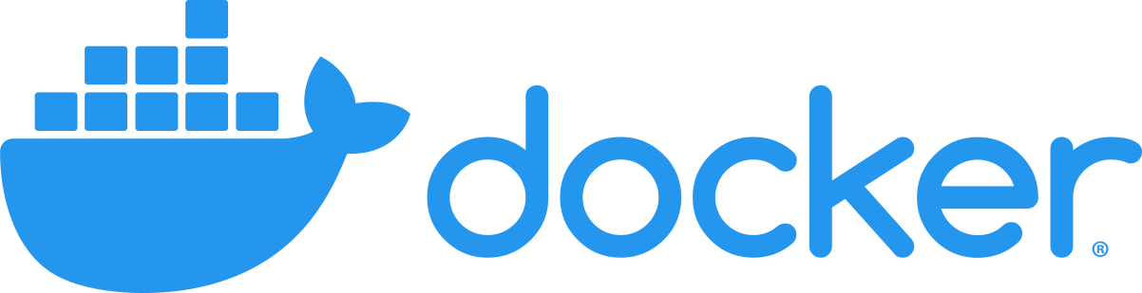
Docker

Slide 2
What is Docker
an open-source project that automates the deployment of software applications inside containers by providing an additional layer of abstraction and automation of OS-level virtualization on Linux.
Docker is a tool that allows developers, sys-admins etc. to easily deploy their applications in a sandbox (called containers) to run on the host operating system i.e. Linux.

Slide 3
What is Docker
The key benefit of Docker is that it allows users to package an application with all of its dependencies into a standardized unit for software development.
Unlike virtual machines, containers do not have high overhead and hence enable more efficient usage of the underlying system and resources.

Slide 4
Containerization

Slide 5
Container
A container is a mechanism for packaging an application(or limited number of processes) with its dependencies so that it runs in its own isolated sandbox.
Containerization helps to ensure the application or set of processes can run reliably regardless of the host environment.
The container shouldn't be able to modify or interact with it anything it doesn't need and, on the whole, changes in the container should not effect the Host or other containers (and vice versa).

Slide 6
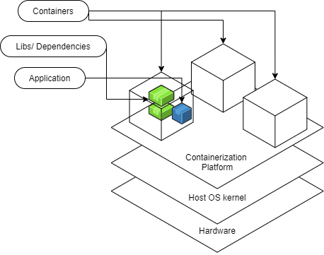
Container
The following diagram illustrates the structure of containers- an application in a container is isolated to just what it needs.

Slide 7
Containers
Built from images (template for the container)
Run on an engine (on the host OS) i.e. Docker Engine
Ideally stateless
State needed to persist for an application should be stored in a way that is essentially "detachable" from the actual container- otherwise state only persists so long as a container is running- volumes-- solve this
Virtualization
Isolation

Slide 8
Containers - Benefits
Secure
Isolation and Virtualization keep your containerized apps more secure
Standardized and thus Portable
Think write once run anywhere
Lightweight
shares the host operating system's kernel
Flexible and Loosely Coupled
Scalable
Easy to spin up and because of this lightweight ease they can be scaled up quickly

Slide 9
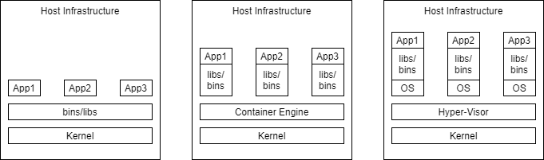
Containers vs. Virtual Machines
Virtual machines and containers provide the ability to isolate processes from one another and provide some kind of virtualization, so that the processes can run in their own sandbox environment on the same host machine.
However, virtual machines and containers do so in differing ways.

Slide 10
Virtual Machines
Virtual Machines simulate a physical server so that multiple "servers" can run on a single machine.
They virtualize the entire supporting OS.
Thus, using virtual machines your host computer could be windows based and you could still run a Linux OS and an application on top of it.
Virtual machines are enabled by hypervisors, software that coordinates between multiple vms and interfaces with the underlying infrastructure. (Some hypervisors interact directly with the hardware, while others run on top of the underlying OS.)

Slide 11
Virtual
Pros
near total isolation
Provides virtualization
virtualizing the entire OS
Ensures an application runs reliably regardless of Host
Cons
considered "bulky", expensive in the context of resources

Slide 12
Containers
Containers bundle together applications with their supporting libraries and dependencies, allowing them to run isolated from one another. However, containers still share the underlying OS kernel and are, therefore, much lighter weight than virtual machines.
Containers provide their processes a virtualized view of the underlying resources. Processes within a container only see a particular version of their environment and have limited access to resources- isolating them from the rest of the processes running on a given host.
Containerization is enabled by an engine running on the host i.e. the Docker Engine.

Slide 13
Containers
Pros
considered "light weight", because they don't require spinning up a whole guest OS
they can enable layers of isolation or partial isolation-- depending on how they are implemented
provide a virtualized view of certain resources.
Package an application in an isolated environment
Ensure an application runs reliably regardless of Host
Cons
having layers of isolation
if you have need of very strict and complete isolation the ability to have layers can be a con

Slide 14
Docker Architecture
Docker adheres to a Client-Server Architecture. The client allows you to run commands and interact with the docker objects managed by the docker daemon, which is in effect the server.
This architecture, consequently, translates into these primary components that allow you to run and interact with Dockerized applications (applications that have been packaged up and run in Docker containers.)
Docker Daemon
Rest API
Docker CLI client
Docker Registries
Docker objects

Slide 15
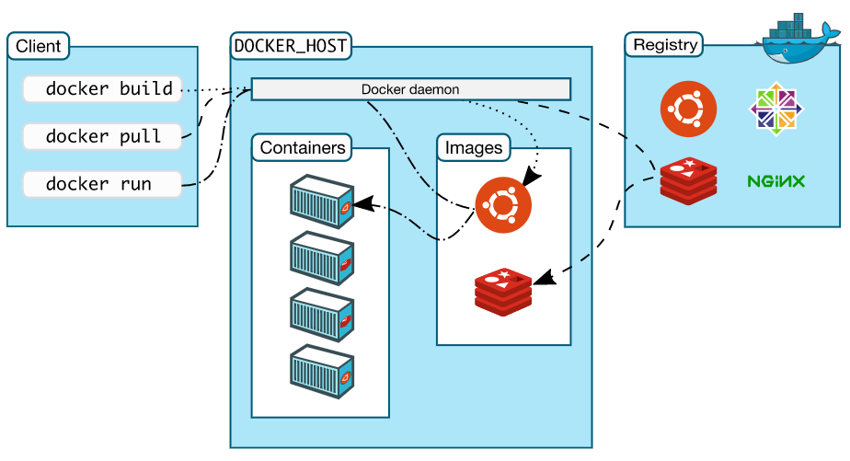
Docker Architecture

Slide 16
Docker Architecture
As you can see from the diagram the client includes the commands that manage docker containers and images.
The docker host is the computer on which the docker daemon runs, and the docker daemon is responsible for managing the docker objects i.e. containers and images.
The registry is an additional/optional component that provides a centralized place to share docker images.
Finally, while the REST API is not labeled in the diagram it's effectively the lines connecting the client and docker daemon.

Slide 17
Docker CLI (Command Line Interface) client
The command line interface is what Docker developers typically use for interactions with the Docker daemon.
It's prefaced by the docker command.
The CLI client may be on the same host machine as the Docker daemon with which it communicates, but it doesn't have to be.

Slide 18
Docker Daemon
The docker daemon is the long running process on the docker host that does all the heavy lifting of managing Docker objects- containers, images, etc.
The docker daemon is at the core of running dockerized applications.

Slide 19
Rest API
These are the underlying commands used by the CLI and other applications to interact with the Docker Daemon.

Slide 20
Docker registries
Docker registries provide a centralized place to store images, allowing you to easily share images between docker hosts.
The Docker Hub is a public registry managed by Docker that docker hosts can pull images from and push images to by default.

Slide 21
Docker objects
Docker objects are the building blocks that are managed by the docker daemon.
The most fundamental docker objects are images and containers.
Images are the templates that outline all dependencies for a particular container and it's primary process.
Meanwhile the container is the runnable instance of a set of processes and their dependencies.

Slide 22
Typical Flow
Using CLI commands (in your command line, Terminal, Command Prompt etc.) such as docker build ... or docker pull ..., acquire an image. This image lays out everything needed to create and run a container.
Behind the scenes the Docker daemon either pulls your image from a registry(repository of images) or it creates the image. (Depending on the command you gave.)
Then you use the CLI again with a command such as docker run .... (Note if you don't already have the image you were trying to run then the command will include that first step of pulling the image implicitly.) If you didn't already do this during the installation process, try the following command. docker run hello-world

Slide 23
Typical Flow
Thus, the CLI once again instructs the daemon. This time it tells the daemon to spin up a container from the image.
The application or set of processes in the container are tied to its life cycle and have started with its instantiation.
Finally, it's just a matter of using additional CLI commands to manage the now running container, unless the primary process of the container has already finished. In that case the container will exit on it's own.

Slide 24
Docker Daemon
Long running process that is responsible for managing Docker objects.
dockerd command allows you to run and configure the docker daemon (working with flags and config files)
Listens for calls from the exposed REST API to manage containers, images, volumes etc.
Can communicate w/other Docker daemons -- in the case of Docker Services -- can be used to set up a swarm. (A swarm allows you to set up multiple docker daemons the behave like a cluster.)

Slide 25
Docker Images
Blueprint for a container
Images form a kind of hierarchy.
One image will be "From" another with added info, dependencies, commands, applications, etc.
The added info and command each form a new layer on the image.
With each of these layers being indicated in a the Dockerfile that defines what's needed for the image.
Images are named and tagged with the version.
They also have an id which uniquely identifies them.

Slide 26
Existing Docker Images
Pull images from some existing registry(repository of images).
The default configuration is from the DockerHub.
docker pull *image name*
docker run *image name* (this will pull the image if it doesn't already exist in the local system)

Slide 27
Building Our Own Images
Dockerfile
From existing container
docker commit
We can then push our images to a given registry including DockerHub

Slide 28
Managing Images
We can use the docker CLI to manage the images on our local system.
We can list out the existing images, get their details, remove and update them.
Additionally, we can use the CLI to aid in connecting to a registry to quickly and easily distribute changes.
In this case updating the software is as simple as updating the image.
Users can easily pull new images and spin up containers/applications with the modifications made.

Slide 29
Docker Containers
Runnable isolated instance of a set of processes and their dependencies.
A Docker container is built from a Docker image.
The image lays out everything the processes that run in the container will need.
Docker Containers are managed by the Docker Daemon as part of the Docker Engine.
The Docker Engine allows Docker containers to be standardized and very portable.

Slide 30
Docker Containers - Benefits
Secure
Isolation and Virtualization keep your containerized apps more secure
Standardized and thus Portable
Think write once run anywhere
Lightweight
shares the host operating system's kernel
Flexible and Loosely Coupled
Scalable
Easy to spin up and because of this lightweight ease they can be scaled up quickly

Slide 31
States of a container
created
restarting
running
paused
exited
dead

Slide 32
Docker Volumes
Typically the goal is to have containers exist as mostly stateless. However, sometimes you need information for a container to remain even if the container stops.
Volumes are managed using the CLI and the Docker API.
They facilitate
sharing data between many different containers
decoupling of host and container
storing data remotely
moving data between hosts or backing up data between hosts
Volumes are also helpful because they allow Docker to keep the containers slim by saving data in the volume rather than the writable layer that disappears with the container.

Slide 33
Docker Best Practices
Docker Guide- Dockerfile Best Practices
Docker Guide- Docker Best Practices

Slide 34
Dockerfile Keywords

Slide 35
FROM image name
specifies the parent image from which the new image should be based.
forms the first layer of this new image.
FROM ubuntu

Slide 36
RUN
There are two forms of the command.
RUN <command>
Runs the command in a shell by default (the particular shell depends on whether the parent image defines a Linux or windows container)
RUN ["executable", "param1", "param2" ]
Runs the command in the executable form without using a shell
RUN will be used to set up your image- the state of the image after each run command is committed- forming a new layer
i.e. If we wanted to install some programs as part of the image, you might have:
RUN apt-get update RUN apt-get -y dist-upgrade RUN apt-get -y install default-jdk

Slide 37
ADD <src> <destination>
adds files from build context or url to the image
copy is preferred over add
The following command would copy HelloWorld.java into a file of the same name in the container's working directory.
ADD HelloWorld.java HelloWorld.java

Slide 38
COPY <src> <destination>
adds files from the build context to the image -i.e. The following command would copy HelloWorld.java into a file of the same name in the container's working directory.
COPY HelloWorld.java HelloWorld.java

Slide 39
EXPOSE
outlines the ports that the are being listened on by processes in the container-- i.e. it suggests what ports to bind to host ports when running the image -The following example would inform the host to bind to port 80 in the container
EXPOSE 80

Slide 40
VOLUME ["/nameofdir"]
creates a mount point in the image and thus container with a particular name- it indicates that the files in this directory will be shared with the resources outside of the container
it indicates what directory to connect a volume to when running the docker container -i.e. The following suggests that we should connect a volume to the data directory in the container when we spin it up.
VOLUME ["/data"]

Slide 41
WORKDIR <nameofdirectory>
sets the working directory in the image and eventual container of commands that follow. i.e.
WORKDIR /example
RUN mkdir a
Would make a directory a inside of the example folder. example/a

Slide 42
CMD
used to run the app, processes etc. needed inside of your container
only the last CMD will run when the built image is launched as a container
CMD ["executable","param1","param2"] (exec form, this is the preferred form)
invokes the command with out a shell
CMD ["param1","param2"] (as default parameters to ENTRYPOINT)
the ENTRYPOINT instruction must be specified if you use the default format, it's another way you can specify the first commands to be run upon spinning up a
CMD command param1 param2 (shell form)
invokes the command inside of a shell in /bin/sh -c
i.e. The last line of a docker file might be a command running a java program:
CMD ["java", "HiWorld"]

Slide 43
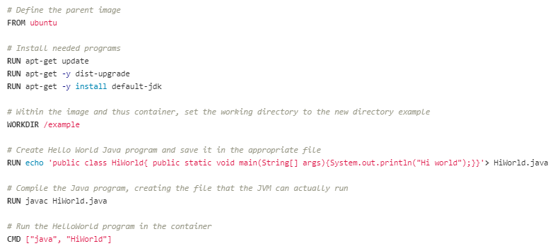
Dockerfile Examples

Slide 44
Building an Image

Slide 45
Create image with build
> docker build anyflags PATH
docker build indicates to the CLI that you are going to create a new image. You have the option of adding flags for additional information and configuration. A couple flags to note:
-f path indicates that the dockerfile to be used is in the location indicated from the subsequent path (it will be used when that path is different from the build context.)
-t name:version allows you to name the image being created and indicate the version. If you were to just have -t name it would default to having the version marked as latest.
The path specified at the end of the docker build command will be understood as the build context. It will often just be . to indicate the current directory. Though it could be a git url or even a path to another part of your filesystem.

Slide 46
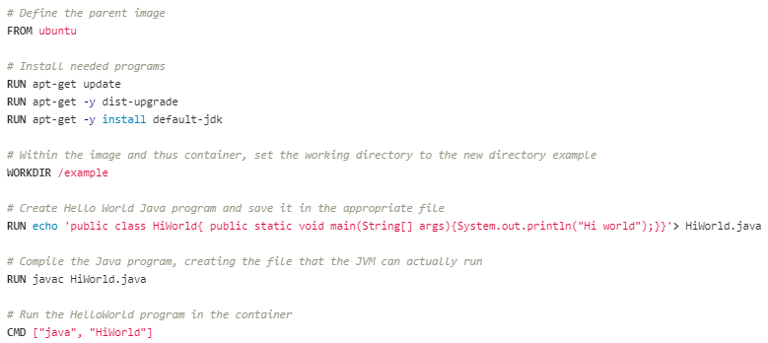
Example

Slide 47
Example
From the same directory in which the dockerfile has been saved run the subsequent command.(If you saved it in the directory as described above then you would need to run cd Documents\docker-examples)
> docker build -t java-hello-world .
Do not forget the . at the end.

Slide 48
Create image with commit
Assume that you have a container that is already running, and you have made some changes to it. Maybe you have installed needed software or changed some configuration.
Then you can commit these changes to a new image that can be used to spin up even more containers.
Note the new image won't include any data saved in the volumes of your container.
> docker commit flags CONTAINER imagename

Slide 49
Image management
To list all the images.
docker images
docker images -a
-a allows you to list even hidden images.

Slide 50
Docker compose
Docker compose is the tool that makes creating and managing multi-container applications easier.
It's fundamental use is based around the docker-compose file.
The docker-compose file allows you to run multiple containers in a way that eases otherwise cumbersome configuration.
Moreover it makes it easy to set up those containers to talk to one another. It's a YAML file(.yaml or .yml) that includes key information including environment variables, ports, volumes etc.
The file is typically named docker-compose.yml or docker-compose.yaml.
The file can be used simply with the docker-compose up command. This searches the current directory for the appropriate file and spins up the containers outlined.

Slide 51
Docker-compose file components
Docker compose files have an overarching format that has evolved from version to version.
There are three overarching versions of the docker-compose file, 1.x, 2.x and 3.x, with smaller upgrades constituting the second part of the version number.
There are just some differences in the options/parameters available between the two versions.
Each service definition is analogous to the docker run command.
Meanwhile the networks and volumes definitions are analogous to docker network create and docker volume create.

Slide 52
Compose file options
version
services
Options for a service
image
build
ports
environment
env_file
volumes
networks

Slide 53
Version declaration
The docker-compose file begins with the version declaration.
It's the first line of the file and helps the docker compose tool understand/process the file correctly.
For example if we were to use version 3.8. Then we would have:
version: '3.8'

Slide 54
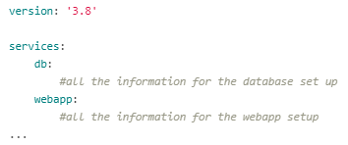
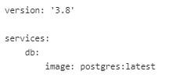
services
The various docker containers that you spin up via a docker compose file each constitute a particular service.
At the top level of the docker compose file, you specify a services option and then all the information for each service definition is specified under that service's name

Slide 55
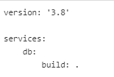
build
The build option allows you to outline how to build a service from a dockerfile.
It allows you to specify the configuration needed at build time.
This includes information like context, arguments and dockerfile.
For example, in the simplest case, where the dockerfile and context are the same as the directory of the compose file, you might have:
This indicates to build the database from the context of the current directory and a dockerfile within it.

Slide 56
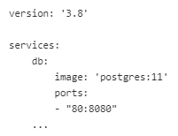
ports
Allows you to expose ports in the container for the particular service and to map them to ports on the host.
The short version of the option syntax is ports: host:container.
So for example, the declaration might look like this, if postgres was listening in the container on port 8080:

Slide 57
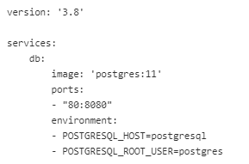
environment
Allows you to specify environment variables for a particular service.
For example, you might have

Slide 58
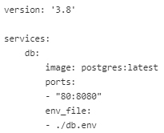
env_file
Allows you to specify environment variables for a particular service as the contents of a file.
Each line of the file will be an environment variable. (Variables defined under the environment option override environment variables from the env_file)
For example, you might have a file called db.env that contains:

Slide 59
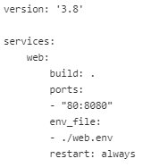
restart
The restart option indicates the conditions upon which to restart a container.
The possibilities are:
no
the default and indicates not to restart the container under any circumstances
always
always tries to restart the container
on-failure
when there is an on-failure error
unless-stopped
restart unless the container has been stopped (regardless of whether it's manual or not)

Slide 60
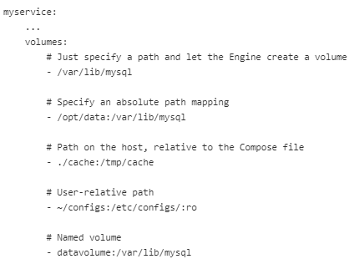
volumes
Volumes is both a top level option and part of the service definition.
It allows you to specify how the container might interact with some shared and persistent portion of memory.
For a particular service definition the volumes option outlines that service's named volumes or mount host paths.

Slide 61
networks
Networks were introduced with version 2 of docker compose and they enable containers to easily communicate with one another in a controlled way.
By default all services specified in a docker compose file are considered part of the same network.
The network is by default named after the directory in which the docker-compose file can be found.
Containers on the same network are by default reachable and discoverable by one another using the name of the service and the container.

Slide 62
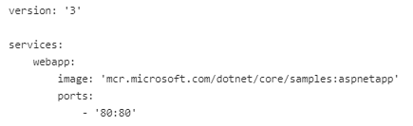
Examples
The following is a simple example of a web application.
While we wouldn't typically use a docker compose file to spin up such a simple application, it illustrates a basic version of using docker compose.
Save the following file as docker-compose.yaml.
Then from the commandline in the directory in which the file is saved.
Run the following command.
docker-compose up -d
(The -d flag indicates to do it in detached mode, so that all the standard output and error information isn't printing to the shell from which you executed the command.)

Slide 63
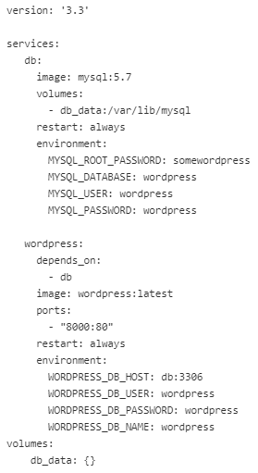
Examples
The file outlines using a volume to persist data for the database and application that connects to it.
The environment variables allow you to spin up the container in such a way that you have the default credentials set up.
You'll also notice that the wordpress web application depends on the database. This ensures the order that the services spin up.
Save the file into a new directory and from that directory run the command docker-compose up -d.
Then after a giving it a few seconds check out your site at http://localhost:8000/.

