Slide 1
GIT

Slide 2
What is Git?
Git is a distributed version control system.
This means that the entire codebase and history of a project is available on every developer’s computer as a local repository , which allows for easy branching and merging.
This repository contains all the information that the remote repository has, based on the last time that you synced those two together.
Even if you don't have access to the remote repository, you can still view all of the changes that have been made, and contributers can maintain a copy of this record on their own machines.

Slide 3
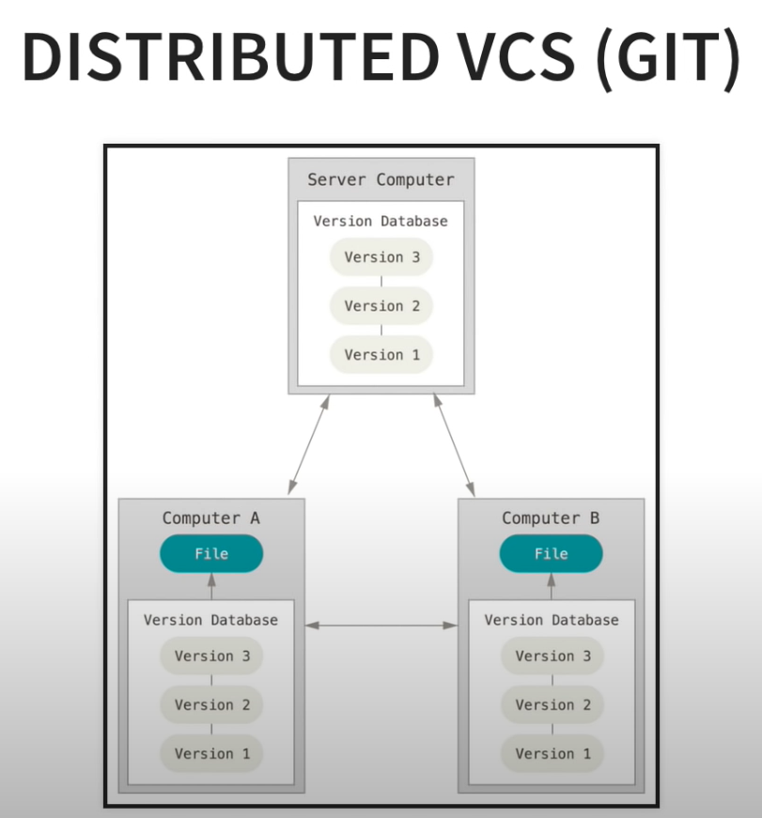
What is Git?

Slide 4
What is GitHub?
Before we get started with installing and configuring Git, you must first create a profile on GitHub.
GitHub is a website and cloud-based service that helps developers store and manage their code, as well as track and control changes to their code.
GitHub is a Git repository hosting service, but it adds many of its own features.
While Git is a command line tool, GitHub provides a Web-based graphical interface.
It also provides access control and several collaboration features, such as a wikis and basic task management tools for every project.

Slide 5
Installing and Configuring Git

Slide 6
Initialize a Repository From Existing Code
We initialize a local repository by running the command git init

Slide 7
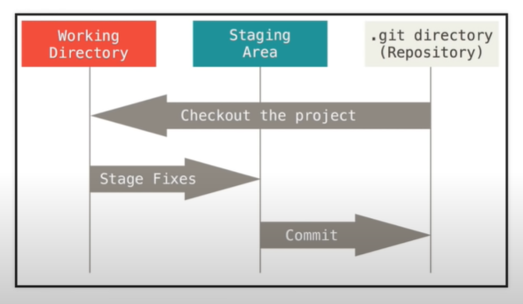
Working Directory, Staging Area, Repository

Slide 8
Working Directory, Staging Area, Repository
Untracked and modified files will exisit within the Working Directory.
The files in the Working Directory are listed when we run git status.
The Staging Area is where we organize what we want to be committed to our repository.
The Staging Area allows us to pick and choose which files we want to commit and when.
Commits should be details regarding what changes were made in individual files.
To add files to the Staging Area run the command git add <file-name>.
To add all of the changes we've just made, run the following command. git add *
To commit these changes run: git commit -m "initial commit"

Slide 9
Committing to a Remote Repository

Slide 10
Git Branching
Branching is a feature available in most modern version control systems.
Instead of copying files from directory to directory, Git stores a branch as a reference to commit.
The branch itself represents the HEAD of a series of commits.
The default branch name in Git is master, which commonly represents the official, working version of your project.
As you start making commits, the master branch points to the last commit you made.
Every time you commit, the master branch pointer moves forward automatically.
Think of a branch as a timeline of versions of a project as it progresses.
Branching is a strategy that allows developers to take a snapshot of the master branch and test a new feature without corrupting the project in production.
If the tests are successful, that feature can be merged back to the master branch and pushed to production.

Slide 11
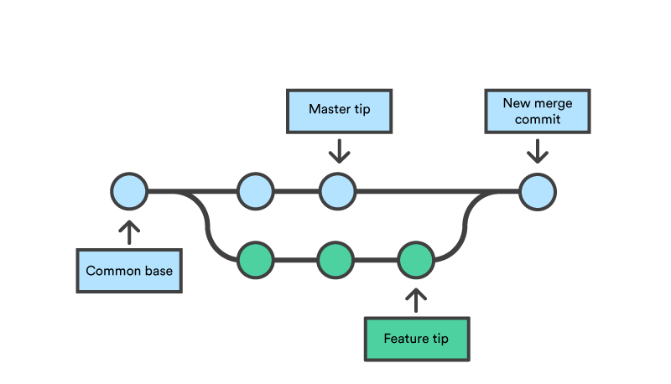
Git Branching

Slide 12
Git Branching
To create a new branch called login git branch login
To checkout to the newly created branch, git checkout login
git checkout -b new_branch (Creates a new branch and checkout on that branch)

