Slide 1

JDBC

Slide 2
Topics
Intro to JDBC
Establishing a Connection
Loading Drivers
Connection Object
Statement
PreparedStatement
ResultSet
Transactions
Commit/Rollback

Slide 3
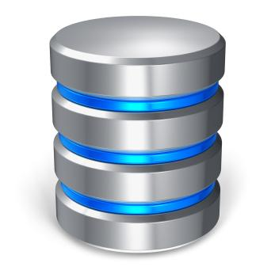


Intro to JDBC
Java Database Connectivity
Standard framework for handling tabular/relational data
Located in java.sql package
JDBC

Slide 4
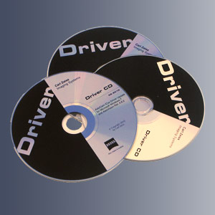
Establishing a Connection
The first thing to do is establish a connection with the DBMS
This involves two steps:
Loading the driver
Making the connection

Slide 5



Loading Drivers
Loading a driver is very simple
One line of code
You also need the respective JAR file in your build
Drivers can be easily downloaded online
Notes:
MySQL documentation recommends creating a new instance, which fixes a few broken implementations in the driver.

Slide 6
Connection Object
To make the driver connect to the database:
One line of code
What’s my URL?
Every vendor is different

Slide 7
Statement
Once connected, you can execute SQL statements
A Statement object wraps and executes SQL (including DDL, DML, etc.)
For a SELECT statement, the method to use is executeQuery
To INSERT or UPDATE, use executeUpdate
Review other methods of the Statement class

Slide 8
PreparedStatement
Precompiled SQL statement
Reduce execution time for repetitious SQL statements
Parameterized inputs using ‘?’ placeholders
Easier to read
Database reserved characters automatically escaped
SQL Injection prevention
pstmt.method(Placeholder position, value to insert)

Slide 9
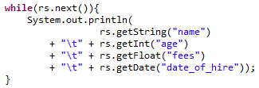
ResultSet
Object that wraps the rows returned by the query
Return type of a query
Loop over the ResultSet to inspect each row
Select each column by “column_name” or column_index
At end of loop, ResultSet points to the next row

Slide 10
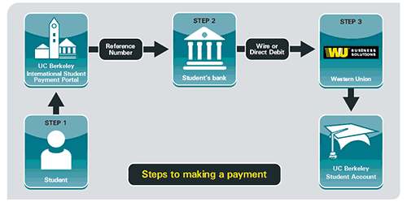
Transactions
ACID: Atomic, Consistent, Isolation, Durable

Slide 11
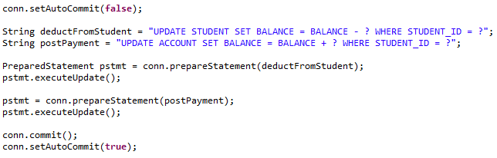
Transactions
JDBC is in auto-commit mode by default
Each Statement is immediately committed
Disable auto-commit mode to execute Statements as a unit
Re-enable auto-commit mode at the end of transaction

Slide 12
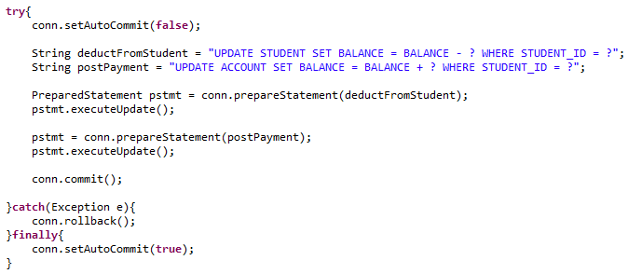
Commit/Rollback
To make changes permanent, use commit( ) method
To return to the previous state, use rollback( ) method

Slide 13

Just like Files…
Always close resources after using them
All JDBC resources have a close( ) method

Slide 14
Review
Intro to JDBC
Establishing a Connection
Loading Drivers
Connection Object
Statement
PreparedStatement
ResultSet
Transactions
Commit/Rollback

Slide 15
Assignment
Create a Connection where the database URL, username, and password is retrieved from a Properties file.
Create a table with at least 3 columns within the Java application.
Insert test data into the table.
Query the test data using Statement and PreparedStatement.
Study CallableStatement for calling stored procedures in your database (PL/SQL, T-SQL, etc.)

