Slide 1

Exception Handling

Slide 2
Topics
Intro to Exception Handling
Try/Catch Blocks
Exception Messages
The Stack Trace
Handling Multiple Exceptions
Throws Clause
Throw Statement
Custom Exceptions
Finally Block

Slide 3
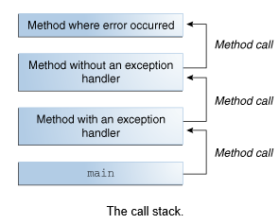
Intro to Exceptions
Exceptions are “exceptional events”
Exceptions disrupt normal execution flow
Methods create Exception objects for the JRE
Exception objects contain important information:
Exception type
State
Stack trace
JRE searches down the stack for an appropriate handler
If one is not found, the application terminates

Slide 4
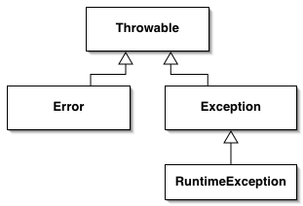
Exception Hierarchy
All Exceptions extend the Throwable class
Applications can recover from Exceptions
The compiler can anticipate Checked Exceptions
FileNotFoundException
IOException
The compiler cannot anticipate Unchecked Exceptions
ClassCastException
ArrayIndexOutOfBoundsException
Applications cannot reasonably recover from Errors
OutOfMemoryError
StackOverflowError
Checked
Unchecked

Slide 5
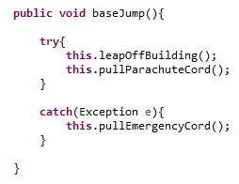

Try/Catch Blocks
Risky behavior is enclosed in a try block
Recovery procedures are in a catch block
If an exception is thrown:
Try block execution halts
JRE moves to the catch block
JRE must find a handler in the call stack
No handler = application termination

Slide 6
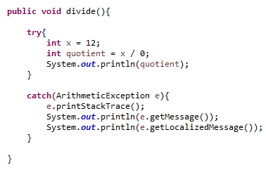
Exception Messages
Exception objects have many uses
Print a Stack Trace to the console
Get the Exception’s message
Get a Localized message
Used for internationalization

Slide 7
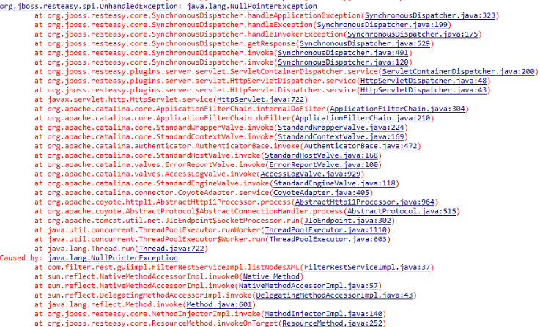
The Stack Trace
Get used to seeing me….

Slide 8
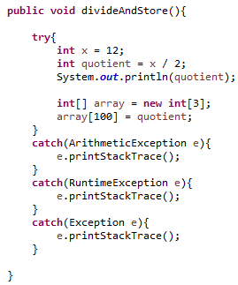
Handling Multiple Exceptions
Each try block can have multiple catch blocks
You can have as many as you want
The JRE checks from top to bottom
It will pick the first one that can catch the Exception
Always use specific Exception subclasses first!
More general exceptions must be last
RuntimeException
Exception

Slide 9




Throws Clause
Two choices when an exception is thrown:
Catch it
Duck it
Let someone else handle it.
Got it, bruh.

Slide 10
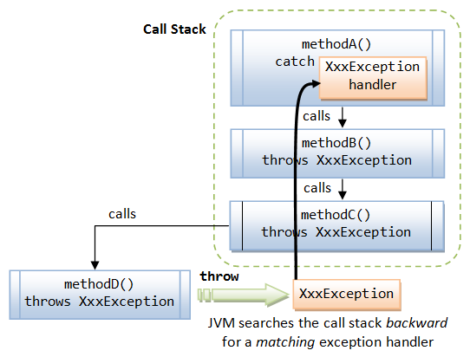
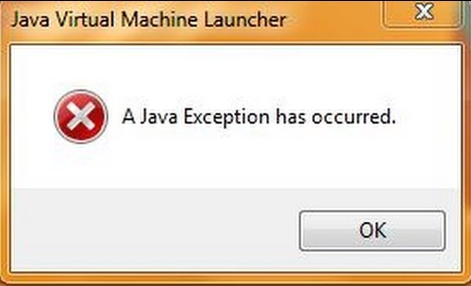
Ducking Exceptions
When a method ducks an exception:
JRE moves down the call stack
Searches for an appropriate handler
You can duck an exception many times
A handler must be reached somewhere, or:
The application terminates

Slide 11


Throw Statement
To manually throw an Exception
Creates an Exception-type object
Passes the object to the JRE
Is treated like any other exception occurrence
Useful when testing your code
Needed to throw custom exceptions

Slide 12
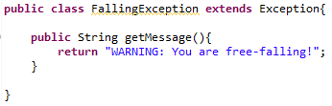
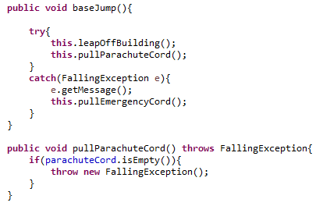
Custom Exceptions
Tailored to your application
Custom Exceptions are useful when:
The Exception type is not in Java API
Differentiation is necessary
Code throws too many related exceptions
Give users access to exceptions
Custom Exceptions are easy!
Create a class that extends any Exception type
Override any Throwable methods you want
Throw the exception in your code

Slide 13
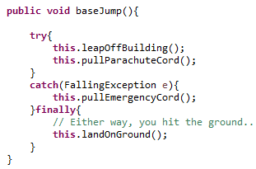
Finally Block
A finally block follows a try or catch block
Executes if an exception is thrown
Executes if an exception is NOT thrown
Used to close resources gracefully
Files
Databases
Network Connections
Optional block
But… a try block must have either a catch and/or a finally block

Slide 14

When Finally Does NOT Execute
If System.exit(0) is called in either try or catch block
Catastrophic error occurs
OutOfMemoryError
StackOverflowError
Fatal deployment environment
Other extreme hardware/software failures

Slide 15
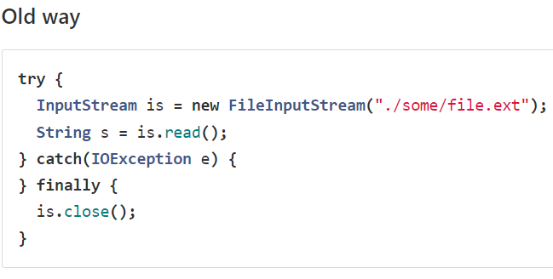
Try-with-resources
When using try/catch blocks, often times some object used in the code is a resource that should be closed after it is no longer needed to prevent memory leaks - for example a FileReader, InputStream, or a JDBC Connection object.
With Java 7, we can use a try-with-resources block which will automatically close the resource for us:

Slide 16
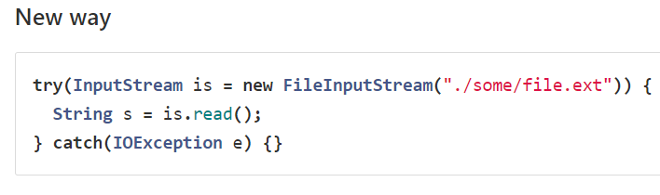
Try-with-resources
Whatever is placed within the parenthesis of the try statement will be closed automatically - thus, we don't need to explicitly call it within our finally block above.
This new format requires the object in the try statement to implement the AutoCloseable interface.

Slide 17
Review
Intro to Exception Handling
Try/Catch Blocks
Exception Messages
The Stack Trace
Handling Multiple Exceptions
Throws Clause
Throw Statement
Custom Exceptions
Finally Block

Slide 18
Assignment
Create a custom exception class that overrides the getMessage( ) method
Create a class that manually throws an exception of your custom type
Use System.out.println( ) to note where you are in the control flow. Example: “Starting try block”, “Ending try block”, “Starting catch block”, etc.
Duck the exception at least once
Implement a finally block that prints a graceful goodbye message
Use the System.exit(0) command in the try block and rerun the application. Note the console output to see if the finally block executes.

