Slide 1
Fetch API

Slide 2
Fetch API
Instead of using XMLHttpRequest enabled Ajax, we can use Fetch API, which is modern and versatile.
The Fetch API provides a fetch() method defined on the window object.
This method used to send requests and returns a Promise that retrieved from the response.
A Promise object represents a value that may not be available now but, will be resolved in the future.
It allows us to write asynchronous code.
The syntax for fetch() method: let promise = fetch(url, [options])

Slide 3
Fetch API
The browser requests the server and returns a promise as a response.
When the request unable to make HTTP-request due to network problems or response has failure HTTP-status code is 404 or 500, then the Fetch API rejects the Promise object.
When we get a response successfully form the server, the promise object returned in the Response Body.

Slide 4
Fetch API
The methods to access the response body in various formats:
response.text() – read the response and return as text.
response.json() – parse the response as JSON.
response.formData() – return the response as FormData object .
response.blob() – return the response as Blob (binary data with type).
response.arrayBuffer() – return the response as ArrayBuffer(low-level representation of binary data).

Slide 5
Fetch API
We also use the async and await keyword with the fetch() method.
The async keyword is added to functions to tell them to return a promise rather than directly returning the value.
The await keyword only works inside async functions, used to pause the code on that line until promise gets complete.

Slide 6
POST Request
To make a POST request, we need to mention the HTTP method (method)and request the body (body) inside the fetch method.
The request body can be string, FormData object, or blob.
If the request body is a string, then Content-Type header is set to text/plain;charset=UTF-8.
If the request body is a JSON, then Content-Type header is set to application/json;charset=UTF-8.
We don't set Content-Type manually for blob object.

Slide 7
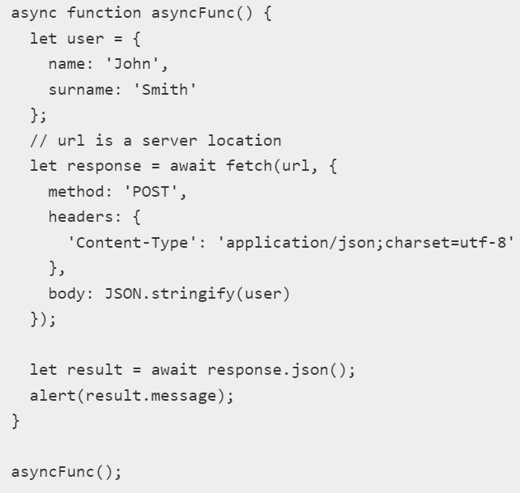
POST Request

