Slide 1
Javalin
A simple web framework for Java and Kotlin

Slide 2
Javalin
Javalin is a lightweight web framework written for Java and Kotlin.
It's written on top of the Jetty web server, which makes it highly performant.
lightweight framework to develop lightweight web applications with less or no effort.

Slide 3
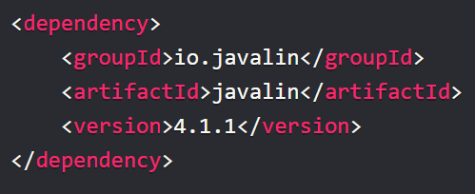
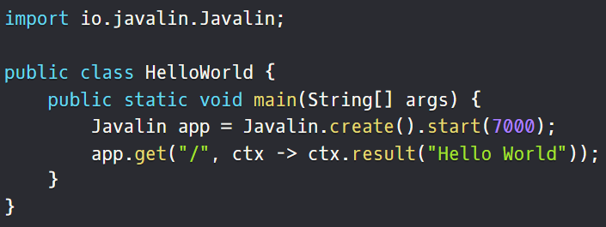
Getting started
Create a maven application and add the following dependency.
And start coding

Slide 4
Handlers
Javalin has three main handler types: before-handlers, endpoint-handlers, and after-handlers.
There are also exception-handlers and error-handlers
The before-, endpoint- and after-handlers require three parts:
A verb - one of: before, get, post, put, patch, delete, after (… head, options, trace, connect)
A path - ex: /, /hello-world, /hello/{name}
A handler implementation - ex ctx -> { ... }, MyClass implements Handler, etc

Slide 5
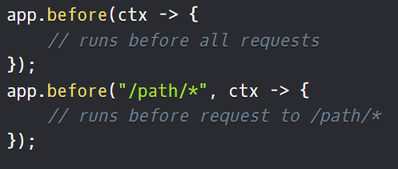
Before handlers
Before-handlers are matched before every request

Slide 6
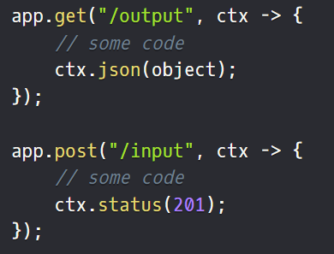
Endpoint handlers
Endpoint handlers are the main handler type and defines your API.
You can add a GET handler ,POST handler .
Common methods are supported directly on the Javalin class (GET, POST, PUT, PATCH, DELETE, HEAD, OPTIONS), uncommon operations (TRACE, CONNECT) are supported via Javalin#addHandler.
Endpoint-handlers are matched in the order they are defined.

Slide 7
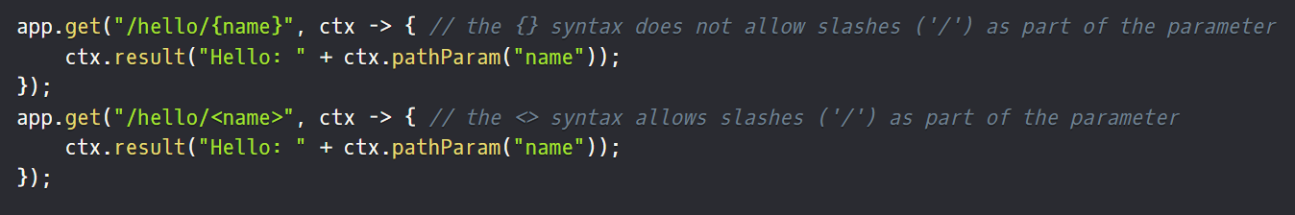
Endpoint handlers
Handler paths can include path-parameters.
These are available via ctx.pathParam("key"):

Slide 8
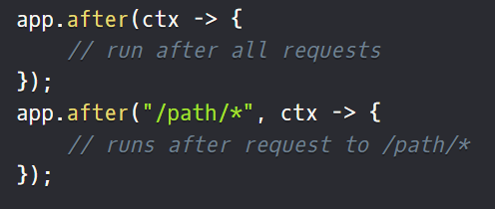
After handlers
After-handlers run after every request (even if an exception occurred)

Slide 9
Context
The Context object provides you with everything you need to handle a http-request.
It contains the underlying servlet-request and servlet-response, and a bunch of getters and setters.
https://javalin.io/documentation#context

Slide 10
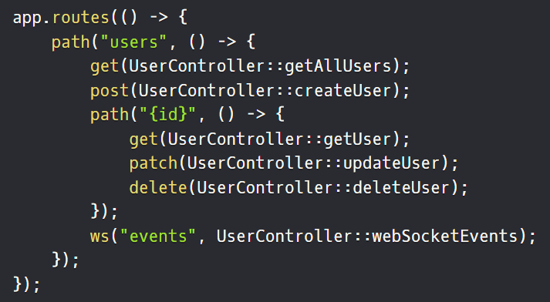
Handler groups
You can group your endpoints by using the routes() and path() methods. routes() creates a temporary static instance of Javalin so you can skip the app. prefix before your handlers.

Slide 11
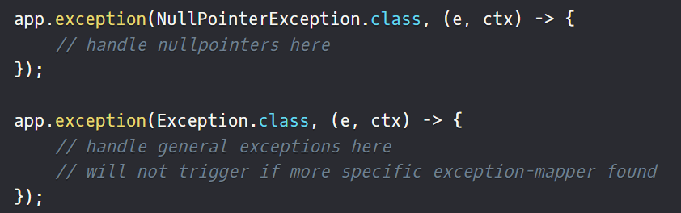
Exception Mapping
All handlers (before, endpoint, after) can throw Exception (and any subclass of Exception).
The app.exception() method gives you a way of handling these exceptions

Slide 12
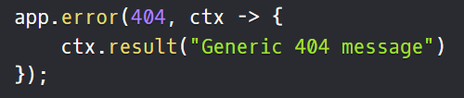
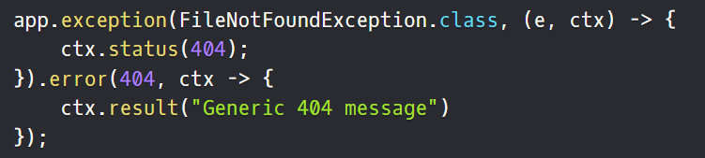
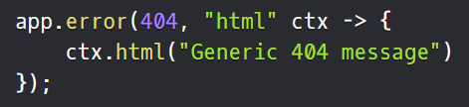
Error Mapping
HTTP Error mapping is similar to exception mapping, but it operates on HTTP status codes instead of Exceptions
It can make sense to use them together
You can also include the content type when declaring your error mappers

