Slide 1
Maven

Slide 2
What is Maven
Maven is essentially a project management and comprehension tool and as such provides a way to help with managing:
Builds
Documentation
Reporting
Dependencies
SCMs
Releases
Distribution

Slide 3
Project Object Model (POM)
The POM is the basic unit of work in Maven.
POM contains every important piece of information about your project and is essentially one-stop-shopping for finding anything related to your project

Slide 4
Maven Coordinates
The POM defined above is the bare minimum that Maven allows. groupId:artifactId:version are all required fields
The three fields act much like an address and timestamp in one.
This marks a specific place in a repository, acting like a coordinate system for Maven projects
groupId: This is generally unique amongst an organization or a project.
artifactId: The artifactId is generally the name that the project is known by.
version: It is also used within an artifact's repository to separate versions from each other.
The three elements given above point to a specific version of a project, letting Maven know who we are dealing with, and when in its software lifecycle we want them.

Slide 5
Project Object Model (POM)
Project
modelVersion
groupId
artifactId
packaging
version
name
url
description

Slide 6
Maven Commands
mvn compile
mvn test
mvn package
mvn install (Local Repo)
mvn clean

Slide 7
Maven Build Lifecycle
Maven is based around the central concept of a build lifecycle.
What this means is that the process for building and distributing a particular artifact (project) is clearly defined.
A Build Lifecycle is Made Up of Phases

Slide 8
Build Lifecycle Phases
validate - validate the project is correct and all necessary information is available
compile - compile the source code of the project
test - test the compiled source code using a suitable unit testing framework. These tests should not require the code be packaged or deployed
package - take the compiled code and package it in its distributable format, such as a JAR.
verify - run any checks on results of integration tests to ensure quality criteria are met
install - install the package into the local repository, for use as a dependency in other projects locally
deploy - done in the build environment, copies the final package to the remote repository for sharing with other developers and projects.

Slide 9
Maven Build Goals
A build phase is made up of a set of goals.
Maven goals represent a specific task that contributes to the building and managing of a project.

Slide 10
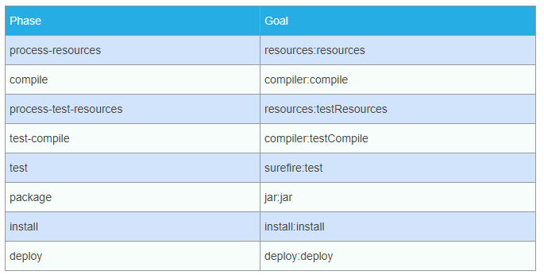
Maven Build Goals

