Slide 1
DBMS Concepts

Slide 2
Data Integrity
The term data integrity refers to the accuracy and consistency of data.
In the database world, data integrity is often placed into the following types:
Entity integrity : Entity integrity defines each row to be unique within its table. No two rows can be the same.
Referential integrity : Referential integrity is concerned with relationships.
Domain integrity : Domain integrity concerns the validity of entries for a given column.
User-defined integrity : User-defined integrity allows the user to apply business rules to the database that aren’t covered by any of the other three data integrity types.

Slide 3
Referential Integrity
Referential integrity refers to the accuracy and consistency of data within a relationship.
In relationships, data is linked between two or more tables.
This is achieved by having the foreign key (in the associated table) reference a primary key value (in the primary – or parent – table).
Because of this, we need to ensure that data on both sides of the relationship remain intact.
So, referential integrity requires that, whenever a foreign key value is used it must reference a valid, existing primary key in the parent table.

Slide 4
Referential Integrity
Referential integrity will prevent users from:
Adding rows to a related table if there is no associated row in the primary table.
Changing values in a primary table that result in orphaned records in a related table.
Deleting rows from a primary table if there are matching related rows.

Slide 5
What are Keys in DBMS?
KEY in DBMS is an attribute or set of attributes which helps you to identify a row(tuple) in a relation(table).
They allow you to find the relation between two tables.
Keys help you uniquely identify a row in a table by a combination of one or more columns in that table.
Key is also helpful for finding unique record or row from the table.

Slide 6
Types of Keys in DBMS
Super Key
Primary Key
Candidate Key
Alternate Key
Foreign Key
Compound Key
Composite Key
Surrogate Key

Slide 7
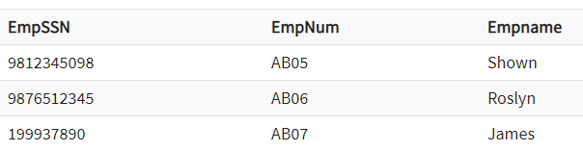
Super key
A superkey is a group of single or multiple keys which identifies rows in a table.
A Super key may have additional attributes that are not needed for unique identification.

Slide 8
Primary Key
PRIMARY KEY is a column or group of columns in a table that uniquely identify every row in that table.
The Primary Key can't be a duplicate meaning the same value can't appear more than once in the table.
A table cannot have more than one primary key.
Rules for defining Primary key:
Two rows can't have the same primary key value
It must for every row to have a primary key value.
The primary key field cannot be null.
The value in a primary key column can never be modified or updated if any foreign key refers to that primary key.

Slide 9
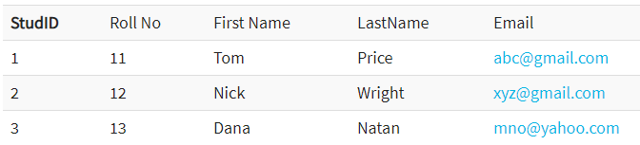
Primary Key
StudID is a Primary Key.

Slide 10

Alternate key
ALTERNATE KEYS is a column or group of columns in a table that uniquely identify every row in that table.
A table can have multiple choices for a primary key but only one can be set as the primary key.
All the keys which are not primary key are called an Alternate Key.
StudID, Roll No, Email are qualified to become a primary key.
Since StudID is the primary key, Roll No, Email becomes the alternative key.

Slide 11
Candidate Key
CANDIDATE KEY is a set of attributes that uniquely identify tuples in a table.
Candidate Key is a super key with no repeated attributes.
The Primary key should be selected from the candidate keys.
Every table must have at least a single candidate key.
A table can have multiple candidate keys but only a single primary key.

Slide 12
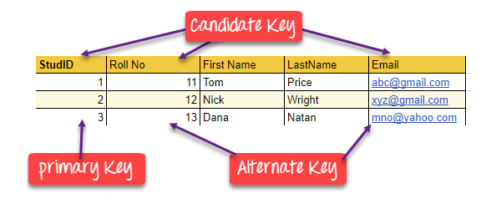
Candidate Key
Properties of Candidate key:
It must contain unique values
Candidate key may have multiple attributes
Must not contain null values
It should contain minimum fields to ensure uniqueness
Uniquely identify each record in a table

Slide 13
Foreign key
FOREIGN KEY is a column that creates a relationship between two tables.
The purpose of Foreign keys is to maintain data integrity and allow navigation between two different instances of an entity.
It acts as a cross-reference between two tables as it references the primary key of another table.

Slide 14
Composite key
A composite key is a specific type of primary key which uses the contents of two or more fields from a table to create a unique value.

Slide 15
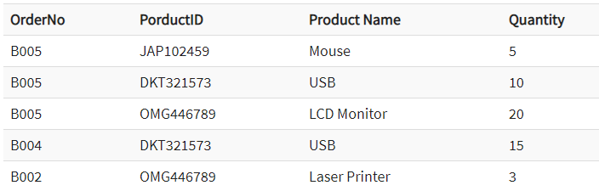
Compound key
A compound key is similar to a composite key in that two or more fields are needed to create a unique value.
However, a compound key is created when two or more primary keys from different tables are present as foreign keys within an entity. The foreign keys are used together to uniquely identify each record.

Slide 16
Surrogate key
A surrogate key (or synthetic key, pseudokey, entity identifier, system-generated key, database sequence number, factless key, technical key, or arbitrary unique identifier) in a database is a unique identifier for either an entity in the modeled world or an object in the database.
The surrogate key is not derived from application data, unlike a natural (or business) key which is derived from application data

Slide 17
Database Normalization

Slide 18
Database Normalization
Database normalization is the process of structuring a relational database in accordance with a series of so-called normal forms in order to reduce data redundancy and improve data integrity.
It was first proposed by Edgar F. Codd as part of his relational model.

Slide 19
Database Normalization
Normalization entails organizing the columns (attributes) and tables (relations) of a database to ensure that their dependencies are properly enforced by database integrity constraints.
It is accomplished by applying some formal rules either by a process of synthesis (creating a new database design) or decomposition (improving an existing database design).

Slide 20
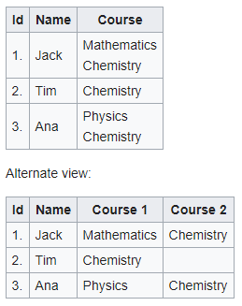
Unnormalized form

Slide 21
First Normal Form (1NF)
First normal form (1NF) is a property of a relation in a relational database.
A relation is in first normal form if and only if the domain of each attribute contains only atomic (indivisible) values, and the value of each attribute contains only a single value from that domain.
First normal form enforces these criteria:
Eliminate repeating groups in individual tables
Create a separate table for each set of related data
Identify each set of related data with a primary key

Slide 22
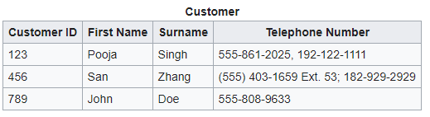
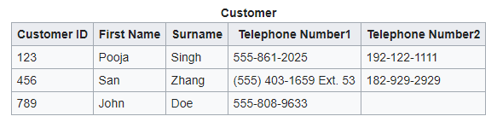
First Normal Form (1NF)

Slide 23
Second Normal Form (2NF)
A relation is in the second normal form if it fulfills the following two requirements:
It is in first normal form.
It must not contain any partial dependency, i.e., all non-prime attributes are fully functionally dependent on the primary key.

Slide 24
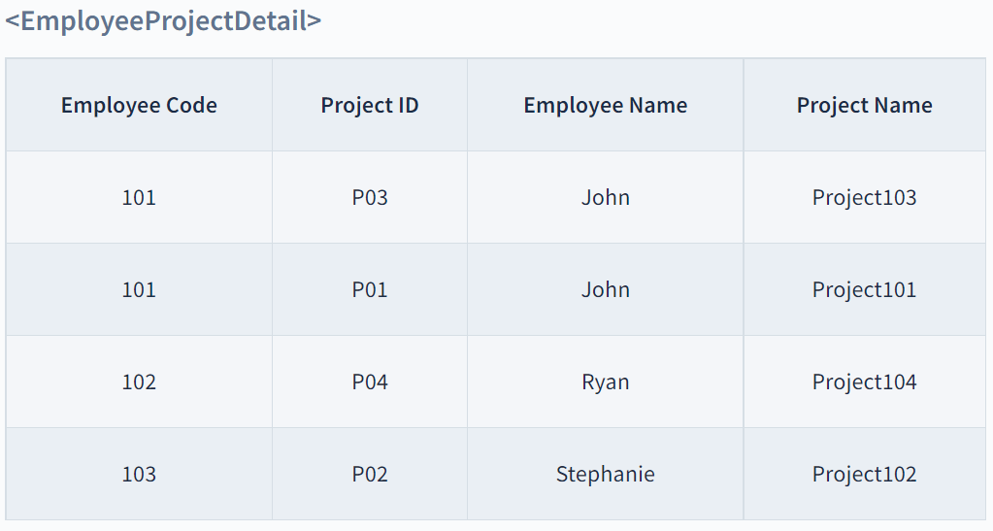
Second Normal Form (2NF)
In the above table, the prime attributes of the table are Employee Code and Project ID.
We have partial dependencies in this table because Employee Name can be determined by Employee Code and Project Name can be determined by Project ID.
Thus, the above relational table violates the rule of 2NF.

Slide 25
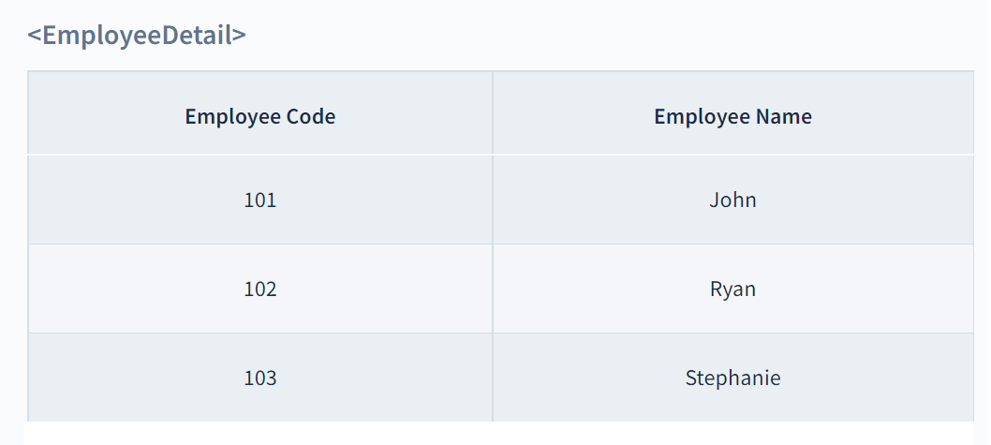
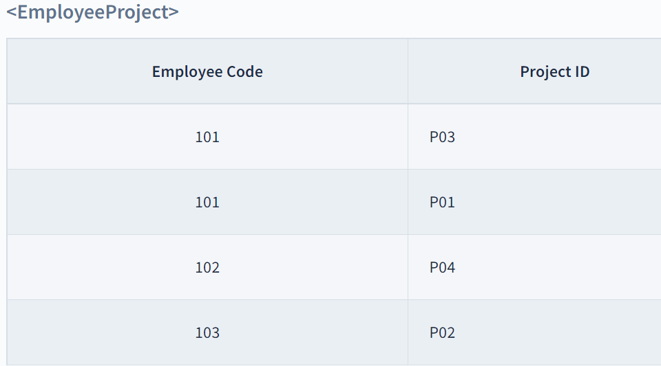
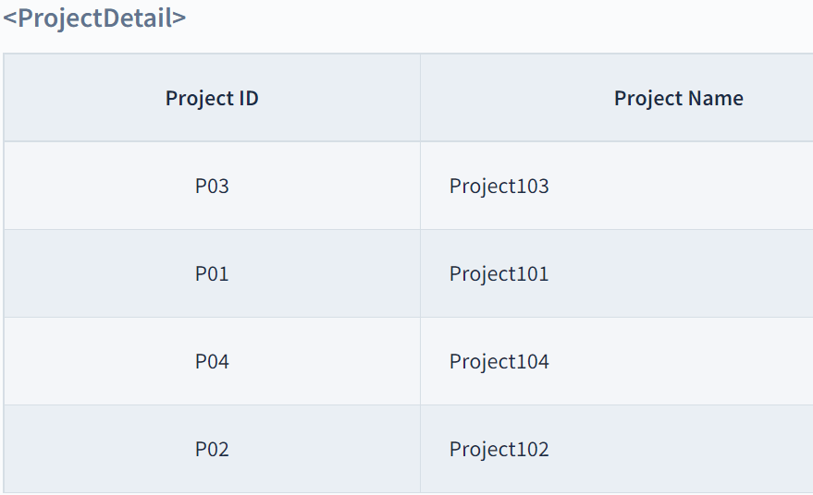
Second Normal Form (2NF)

Slide 26
Third Normal Form (3NF)
Rule 1- Be in 2NF
Rule 2- Has no transitive functional dependencies
Notes:
A transitive dependency is a functional dependency in which X → Z (X determines Z) indirectly, by virtue of X → Y and Y → Z (where it is not the case that Y → X).

Slide 27
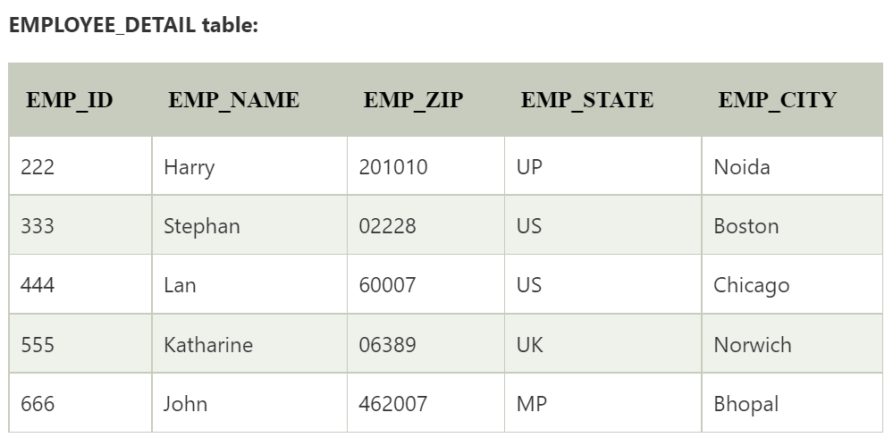
Third Normal Form (3NF)

Slide 28
Third Normal Form (3NF)
Super key in the table
{EMP_ID}, {EMP_ID, EMP_NAME}, {EMP_ID, EMP_NAME, EMP_ZIP}....so on
Candidate key: {EMP_ID}
Non-prime attributes: In the given table, all attributes except EMP_ID are non-prime.
EMP_STATE & EMP_CITY dependent on EMP_ZIP and EMP_ZIP dependent on EMP_ID.
The non-prime attributes (EMP_STATE, EMP_CITY) transitively dependent on super key(EMP_ID). It violates the rule of third normal form.

Slide 29
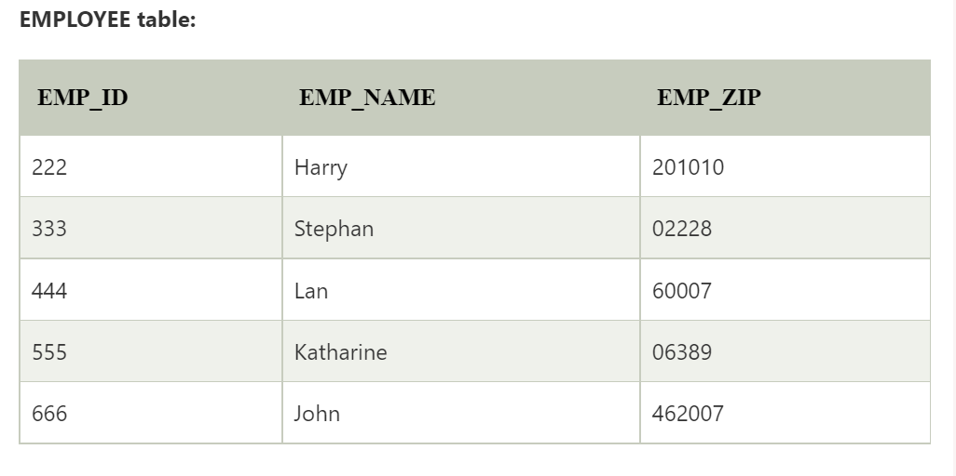
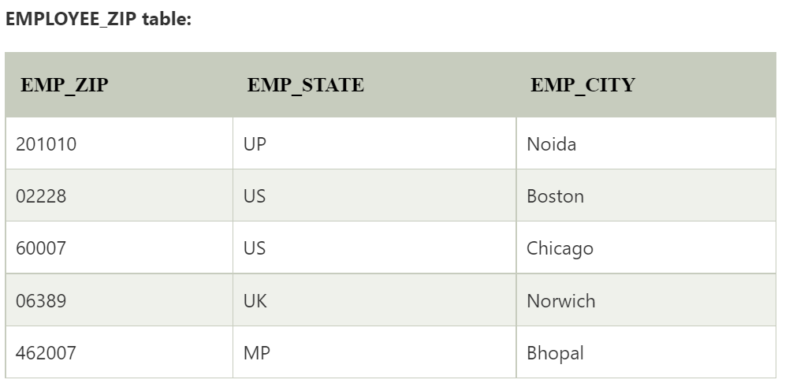

Slide 30
Database Transaction
A Database Transaction is a logical unit of processing in a DBMS which entails one or more database access operation.
All types of database access operation which are held between the beginning and end transaction statements are considered as a single logical transaction in DBMS.
During the transaction the database is inconsistent.
Only once the database is committed the state is changed from one consistent state to another.

Slide 31
Concurrency in Transactions
A database is a shared resource accessed.
It is used by many users and processes concurrently.
For example, the banking system, railway, and air reservations systems, stock market monitoring, supermarket inventory, and checkouts, etc.

Slide 32
ACID Properties
ACID Properties are used for maintaining the integrity of database during transaction processing.
Atomicity: A transaction is a single unit of operation. You either execute it entirely or do not execute it at all. There cannot be partial execution.
Consistency: Once the transaction is executed, it should move from one consistent state to another.
Isolation: Transaction should be executed in isolation from other transactions. During concurrent transaction execution, intermediate transaction results from simultaneously executed transactions should not be made available to each other. (Level 0,1,2,3)
Durability: · After successful completion of a transaction, the changes in the database should persist. Even in the case of system failures.

Slide 33
Isolation Levels
An isolation level represents a particular locking strategy employed in the database system to improve data consistency.
The higher the isolation level, the more complex the locking strategy behind it. The isolation level provided by the database determines whether a transaction will encounter the following behaviors in data consistency

Slide 34
Isolation Levels
Dirty reads | User 1 modifies a row. User 2 reads the same row before User 1 commits. User 1 performs a rollback. User 2 has read a row that has never really existed in the database. User 2 may base decisions on false data.
Non-repeatable reads | User 1 reads a row, but does not commit. User 2 modifies or deletes the same row and then commits. User 1 rereads the row and finds it has changed (or has been deleted).
Phantom reads | User 1 uses a search condition to read a set of rows, but does not commit. User 2 inserts one or more rows that satisfy this search condition, then commits. User 1 rereads the rows using the search condition and discovers rows that were not present before.

Slide 35
Isolation Levels
Isolation levels represent the database system’s ability to prevent these behaviors.
The American National Standards Institute (ANSI) defines four isolation levels:
Read uncommitted (0)
Read committed (1)
Repeatable read (2)
Serializable (3)
In ascending order (0–3), these isolation levels provide an increasing amount of data consistency to the transaction.
At the lowest level, all three behaviors can occur. At the highest level, none can occur

Slide 36
Isolation Levels
The success of each level in preventing these behaviors is due to the locking strategies they use, which are as follows:
Read uncommitted (0) | Locks are obtained on modifications to the database and held until end of transaction (EOT). Reading from the database does not involve any locking.
Read committed (1) | Locks are acquired for reading and modifying the database. Locks are released after reading but locks on modified objects are held until EOT.
Repeatable read (2) | Locks are obtained for reading and modifying the database. Locks on all modified objects are held until EOT. Locks obtained for reading data are held until EOT. Locks on non-modified access structures (such as indexes and hashing structures) are released after reading.
Serializable (3) | All data read or modified is locked until EOT. All access structures that are modified are locked until EOT. Access structures used by the query are locked until EOT.

Slide 37
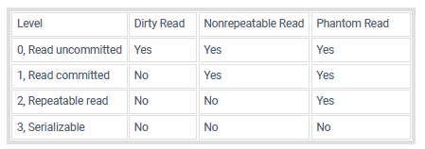
Isolation Levels and Data Consistency

