Slide 1
Gherkin

Slide 2
Gherkin
Cucumber allows developers to create feature files as a first step in implementing behavior-driven development.
A feature file, which uses the .feature extension, is a file that contains several scenarios and steps associated with those scenarios.
The scenarios within this file are ideally associated with the same feature, though this association is not a requirement.
Feature files are written in plain text in a special language called Gherkin.
This language is specific to Cucumber, though it is not unlike the languages used in combination with other BDD tools.
Gherkin is simple and built on top of standard BDD keywords.
The language has its own syntax and grammar rules.
It even has support for multiple languages as the Cucumber grammar has been translated into over 70 languages.
These rules make plain text structured so that the Cucumber tool can understand the scenarios written within the file in order to produce the appropriate glue code.

Slide 3
Gherkin
Feature: provides a high-level description of some feature of the system under development or test. It is used to logically group scenarios.
Scenario: a representation of a concrete example of the behavior of the system that is in development or under test.
Step: scenarios are composed of steps. There are three types of steps: given, when, and then:
Given: specifies a precondition to an event that will or should or occur during a scenario.
When: specifies the occurrence of the event itself.
Then: specifies the expected outcome of the event that has occurred.
Background: used when all of the scenarios within a feature share at least one precondition. The preconditions defined using the background keyword apply to all scenarios within a feature.
Scenario Outline: used to create a data-driven driven scenario that is run several times around different sets of data.
Examples: used to define data sets for scenario outlines.
And/But: used to replace given, when, or then. If, for instance, there are multiple preconditions for a scenario, a developer may choose to use and or but for every precondition following the first precondition. For example:

Slide 4
How To Write A Feature File
In order to write a feature file, a developer only has to create a file that uses the .feature extension.
If the developer is creating the feature file in an integrated development environment, they should also download the appropriate Cucumber extension for their environment.
After creating the file, the developer can immediately start filling it with scenarios.

Slide 5
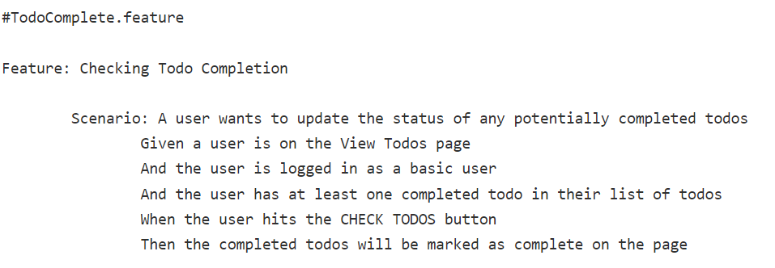
example of a basic feature file called TodoCompletion.feature
This feature file makes use of most of keywords we saw above. It defines a feature and one scenario related to that feature.
There are several steps associated with this feature.
As you can see, the entire focus is on the behavior of the system under development or test, and that behavior is described using a language that everyone on a development team can understand.

