Slide 1
Page Object Model

Slide 2
Page Object Model
Page Object Model or POM is a design pattern or a framework that we use in Selenium using which one can create an object repository of the different web elements across the application.
To simplify, in the Page Object Model framework, we create a class file for each web page.
This class file consists of different web elements present on the web page.
Moreover, the test scripts then use these elements to perform different actions.
Since each page's web elements are in a separate class file, the code becomes easy to maintain and reduces code duplicity.

Slide 3
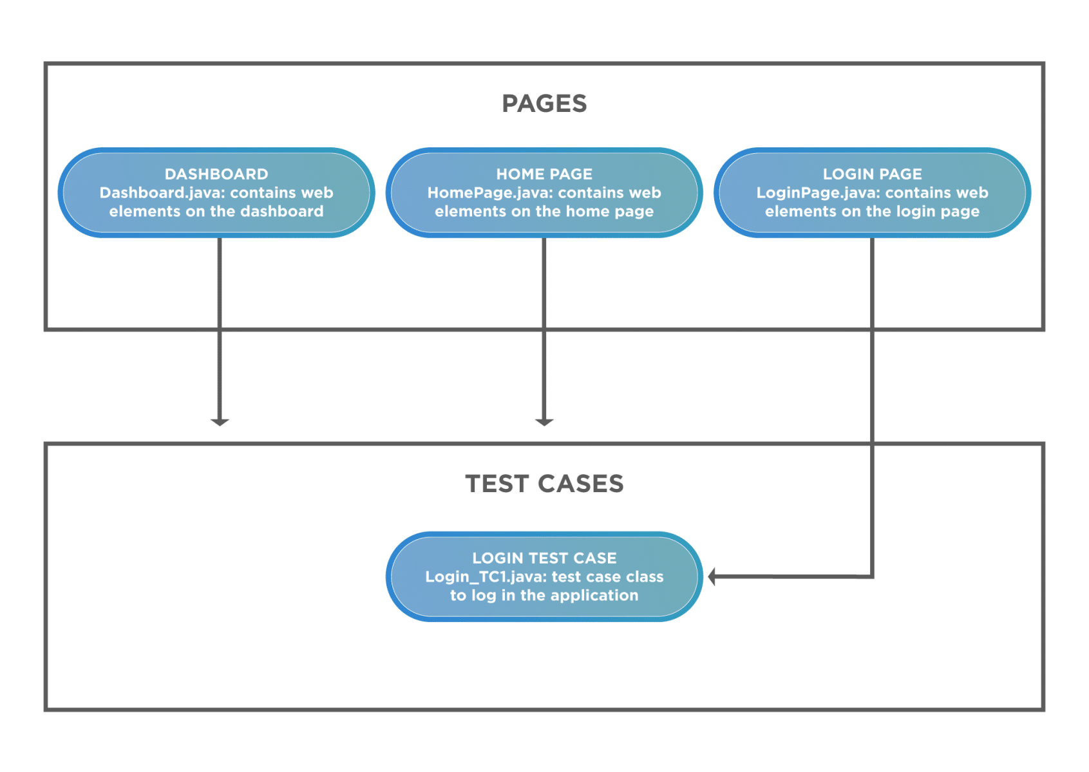
Page Object Model

Slide 4
Advantages of the Page Object Model
Makes code maintainable- Since the test classes are separate from the classes containing the web elements and the operation on them, updating the code is very easy if any web element updates or a new one adds.
Makes code readable- User can easily read through the project and test scripts due to a fine line between the test classes and the different web pages.
Makes code reusable- If multiple test scripts use the same web elements, then we need not write code to handle the web element in every test script. Placing it in a separate page class makes it reusable by making it accessible by any test script.

Slide 5
Page Factory in Selenium
Page Factory is a class provided by Selenium WebDriver to support Page Object Design patterns.
In Page Factory, testers use @FindBy annotation. The initElements method is used to initialize web elements.

Slide 6
@FindBy
@FindBy: An annotation used in Page Factory to locate and declare web elements using different locators.
@FindBy(id="elementId")
WebElement element;
Similarly, one can use @FindBy with different location strategies to find web elements and perform actions on them.
Below are locators that can be used:
ClassName
CSS
Name
Xpath
TagName
LinkText
PartialLinkText

Slide 7
initElements()
initElements is a static method in Page Factory class.
Using the initElements method, one can initialize all the web elements located by @FindBy annotation.

