Slide 1
Advanced Selenium Concepts

Slide 2
What is Alert in Selenium?
An Alert in Selenium is a small message box which appears on screen to give the user some information or notification.
It notifies the user with some specific information or error, asks for permission to perform certain tasks and it also provides warning messages as well.
Here are few alert in Selenium types:
Simple Alert
Prompt Alert
Confirmation Alert

Slide 3
How to handle Alert in Selenium WebDriver
Alert interface provides the below methods which are widely used in Selenium Webdriver.
void dismiss() // To click on the ‘Cancel’ button of the alert.
driver.switchTo().alert().dismiss();
void accept() // To click on the ‘OK’ button of the alert.
driver.switchTo().alert().accept();
String getText() // To capture the alert message.
driver.switchTo().alert().getText();
void sendKeys(String stringToSend) // To send some data to alert box.
driver.switchTo().alert().sendKeys("Text");

Slide 4
Handle DropDown in Selenium

Slide 5

Select Class in Selenium
The Select Class in Selenium is used to implement the HTML SELECT tag.
The Select class is an ordinary class so new keyword is used to create its object and it specifies the web element location.

Slide 6
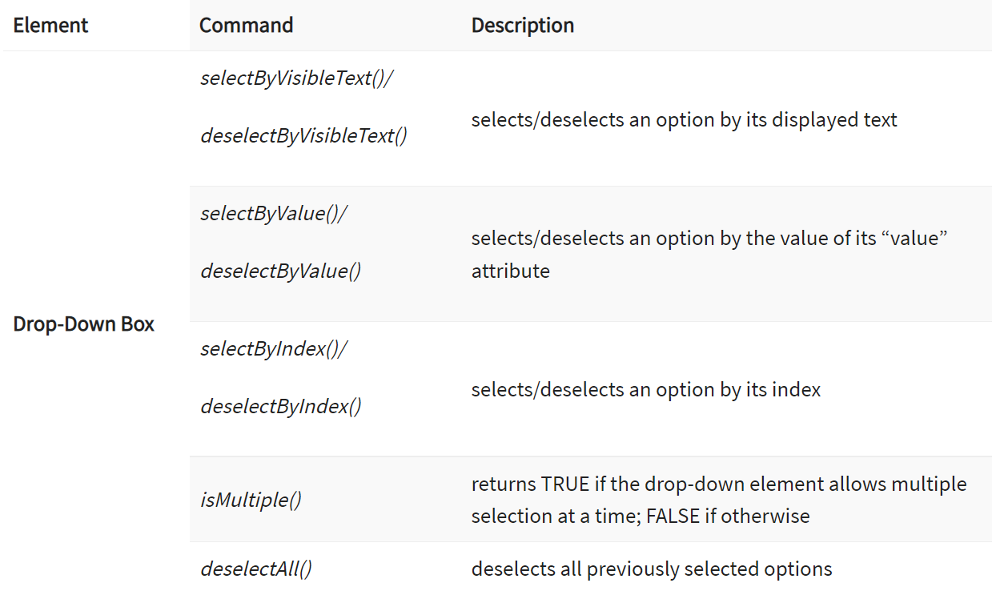
Select Methods

Slide 7
Screenshot in Selenium Webdriver
A Screenshot in Selenium Webdriver is used for bug analysis.
If users need to capture a screenshot, they need to use the TakeScreenshot which notifies the WebDriver to take the screenshot and store it in Selenium.

Slide 8
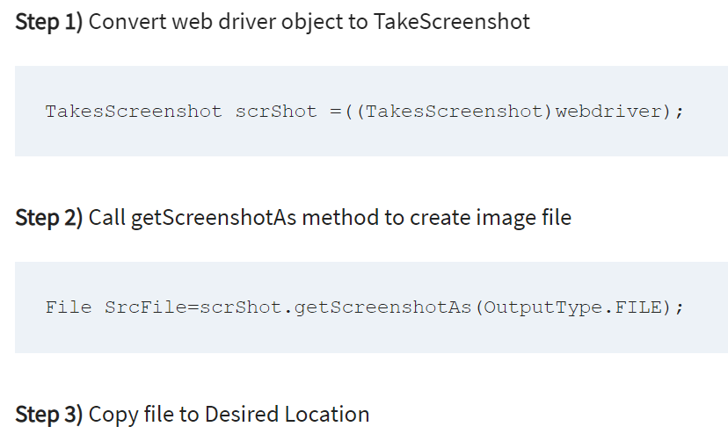
Taking Screenshot
Taking Screenshot in Selenium is a 3 Step process

Slide 9
Selenium Wait – Implicit, Explicit and Fluent Waits

Slide 10
Why Do We Need Waits In Selenium?
Most of the web applications are developed using Ajax and Javascript.
When a page is loaded by the browser the elements which we want to interact with may load at different time intervals.
Not only it makes this difficult to identify the element but also if the element is not located it will throw an “ElementNotVisibleException” exception.
Using Selenium Waits, we can resolve this problem.

Slide 11
Implicit Wait in Selenium
The Implicit Wait in Selenium is used to tell the web driver to wait for a certain amount of time before it throws a “No Such Element Exception”.
The default setting is 0.
Once we set the time, the web driver will wait for the element for that time before throwing an exception.

Slide 12
Explicit Wait in Selenium
The Explicit Wait in Selenium is used to tell the Web Driver to wait for certain conditions (Expected Conditions) or maximum time exceeded before throwing “ElementNotVisibleException” exception.
It is an intelligent kind of wait.
It gives better options than implicit wait as it waits for dynamically loaded Ajax elements.
Once we declare explicit wait we have to use “ExpectedConditions” or we can configure how frequently we want to check the condition using Fluent Wait.
using Thread.Sleep() generally it is not recommended to use
WebDriverWait wait = new WebDriverWait(WebDriverRefrence,TimeOut);

Slide 13
Fluent Wait in Selenium
The Fluent Wait in Selenium is used to define maximum time for the web driver to wait for a condition, as well as the frequency with which we want to check the condition before throwing an “ElementNotVisibleException” exception.
It checks for the web element at regular intervals until the object is found or timeout happens.
Frequency: Setting up a repeat cycle with the time frame to verify/check the condition at the regular interval of time

Slide 14
Difference Between Implicit Wait Vs Explicit Wait
Implicit Wait | Explicit Wait
Implicit Wait time is applied to all the elements in the script | Explicit Wait time is applied only to those elements which are intended by us
In Implicit Wait, we need not specify “ExpectedConditions” on the element to be located | In Explicit Wait, we need to specify “ExpectedConditions” on the element to be located
It is recommended to use when the elements are located with the time frame specified in Selenium implicit wait | It is recommended to use when the elements are taking long time to load and also for verifying the property of the element like(visibilityOfElementLocated, elementToBeClickable,elementToBeSelected)

Slide 15
Action Class in Selenium – Mouse Click & Keyboard Events

Slide 16
Action Class in Selenium
Action Class in Selenium is a built-in feature provided by the selenium for handling keyboard and mouse events.
It includes various operations such as multiple events clicking by control key, drag and drop events and many more.
These operations from the action class are performed using the advanced user interaction API in Selenium Webdriver.

Slide 17
Handling Keyboard & Mouse Events
Handling special keyboard and mouse events are done using the Advanced User Interactions API.
It contains the Actions and the Action classes that are needed when executing these events.
The following are the most commonly used keyboard and mouse events provided by the Actions class.

Slide 18
Handling Keyboard & Mouse Events
Method | Description
clickAndHold() | Clicks (without releasing) at the current mouse location.
contextClick() | Performs a context-click at the current mouse location. (Right Click Mouse Action)
doubleClick() | Performs a double-click at the current mouse location.
dragAndDrop(source, target) | Performs click-and-hold at the location of the source element, moves to the location of the target element, then releases the mouse. Parameters: source- element to emulate button down at. target- element to move to and release the mouse at.
dragAndDropBy(source, x-offset, y-offset) | Performs click-and-hold at the location of the source element, moves by a given offset, then releases the mouse. Parameters: source- element to emulate button down at. xOffset- horizontal move offset. yOffset- vertical move offset.

Slide 19
Handling Keyboard & Mouse Events
Method | Description
keyDown(modifier_key) | Performs a modifier key press. Does not release the modifier key – subsequent interactions may assume it’s kept pressed. Parameters: modifier_key – any of the modifier keys (Keys.ALT, Keys.SHIFT, or Keys.CONTROL)
keyUp(modifier _key) | Performs a key release. Parameters: modifier_key – any of the modifier keys (Keys.ALT, Keys.SHIFT, or Keys.CONTROL)
moveByOffset(x-offset, y-offset) | Moves the mouse from its current position (or 0,0) by the given offset. Parameters: x-offset- horizontal offset. A negative value means moving the mouse left. y-offset- vertical offset. A negative value means moving the mouse down.

Slide 20
Handling Keyboard & Mouse Events
Method | Description
moveToElement(toElement) | Moves the mouse to the middle of the element. Parameters: toElement- element to move to.
release() | Releases the depressed left mouse button at the current mouse location
sendKeys(onElement, charsequence) | Sends a series of keystrokes onto the element. Parameters: onElement – element that will receive the keystrokes, usually a text field charsequence – any string value representing the sequence of keystrokes to be sent

Slide 21
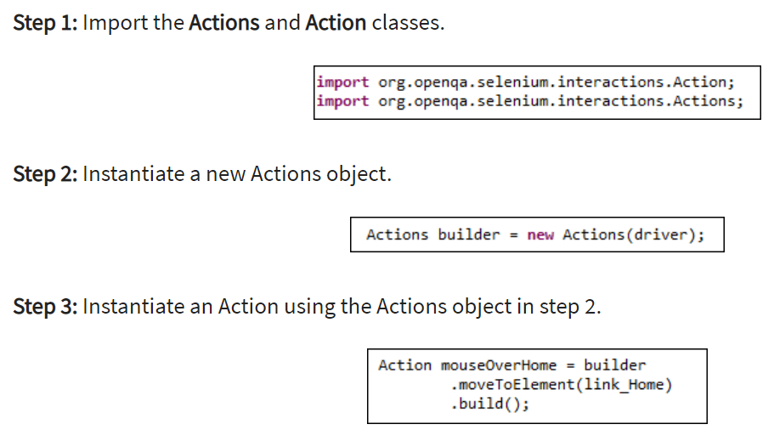
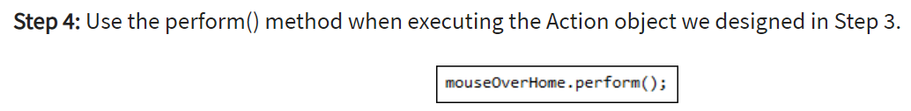
Steps to use Action Class

Slide 22
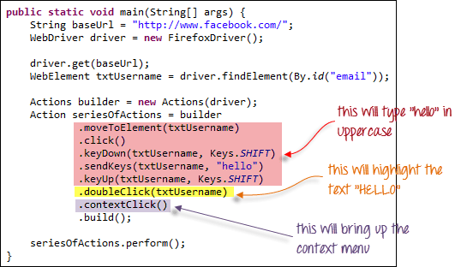
Building a Series of Multiple Actions
You can build a series of actions using the Action and Actions classes.
Just remember to close the series with the build() method.

