Slide 1
Work Order - Brakes
NATEF Task A5A1,2

Slide 2
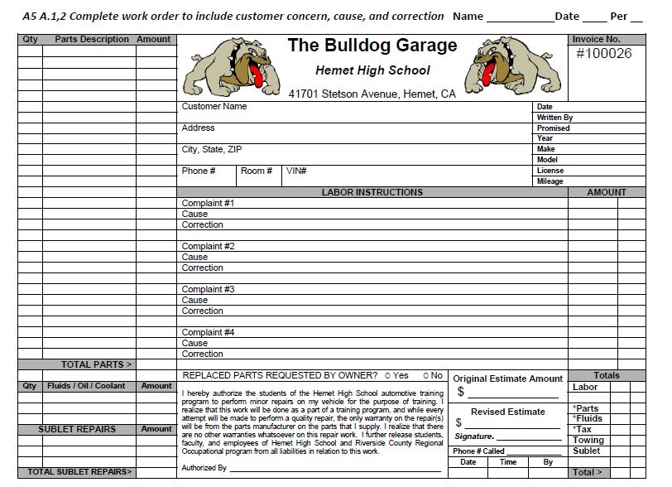
How do I do this Task?
You are going to create a complete estimate to repair some common brake problems on a vehicle.
(this is how most dealers and repair shops prepare an estimate)
Your work order will include the three “C”s:
Complaint (Concern)
Cause
Correction

Slide 3
Which vehicle should I choose?
Your instructor will assign a vehicle to complete this assignment
You fill out your name, the date, and your period at the top, and again your name and date in the work order field shown below.
Name
Date
Period

Slide 4
Which vehicle should I choose?
Your instructor will assign a vehicle to complete this assignment
You will enter the Year, Make, and Model of the vehicle on your Work order.
Year
Make
Model

Slide 5
What information do I fill out?
You will enter the owner’s name,
address,
phone #,
and VIN #.
Name
Address
VIN-phone

Slide 6
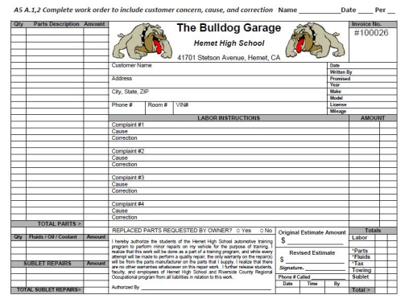
Customer Concerns- Write them down!
Brake pedal drops to floor while sitting at a stop sign
Front of vehicle shakes while braking on freeway off-ramp
Grinding sound from front wheels when stopping

Slide 7
Cause – What is actually wrong?
Concern/Complaint #1 – “Brake pedal drops to floor while sitting at a stop sign“
The most common reason for the brake pedal to do this is a defective brake master cylinder. The technician would inspect the hydraulic system on the vehicle to determine the actual problem. For this work order put “defective master cylinder” as the cause.
Brake pedal drops to floor while sitting at a stop sign
Defective Master Cylinder

Slide 8
Cause – What is actually wrong?
Concern/Complaint #2 – “Front of vehicle shakes while braking on freeway off-ramp“
The most common reason for the front of the vehicle to shake when braking would be warped brake rotors. The technician would inspect the rotors and pads on the vehicle to determine the actual problem. For this work order put “warped rotors” as the cause.

Slide 9
Cause – What is actually wrong?
Concern/Complaint #3 – “Grinding sound from front wheels when stopping“
The most common reason for the brakes to make a grinding sound is that the brake pads are worn out. The technician would inspect the brake pads and rotors on the vehicle to determine the actual problem. For this work order put “worn out brake pads” as the cause.

Slide 10
Correction #1 – How do we fix this?
Correction for Complaint #1 – “Brake pedal drops to floor while sitting at a stop sign“
When you have a defective brake master cylinder, two choices for repairing it would be either to rebuild or replace the master cylinder and then bleed the brake hydraulic system. For this work order, put “replace the master cylinder” as the correction.
Brake pedal drops to floor while sitting at a stop sign
Defective Master Cylinder
Replace master cylinder and bleed brakes

Slide 11
Correction #2 – How do we fix this?
Correction for Complaint #2 – “Front of vehicle shakes while braking on freeway off-ramp“
When you have warped brake rotors, two choices for repairing it would be either to machine or replace the brake rotors. For this work order, put “replace the brake rotors” as the correction.

Slide 12
Correction #3 – How do we fix this?
Correction for Complaint #3 – “Grinding sound from front wheels when stopping“
When you have worn-out brake pads, the only choice for repairing it would be to replace the brake pads. For this work order, put “replace the brake pads” as the correction.

Slide 13
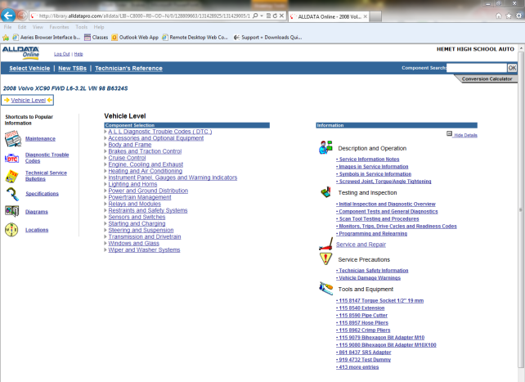
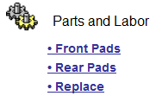
Parts - prices
Look up your vehicle on All-Data and then find the parts prices for the parts you are going to replace.
After entering the vehicle information in All-Data, type the part name (pad, rotor, master cylinder, etc…) in the search bar in the upper right hand of the All-Data screen.
Click on part name and then click on the part name near the gears to go to the parts prices page.
Search Bar
Parts prices

Slide 14
Put the parts prices on your work order!
For example:
Set Brake pads 96.48
2 Brake rotors 192.44
(96.22 ea)
Quantities
Part names
& Prices
Go in these columns
Don’t forget to multiply the part price by the number of parts that will be used ☺

Slide 15
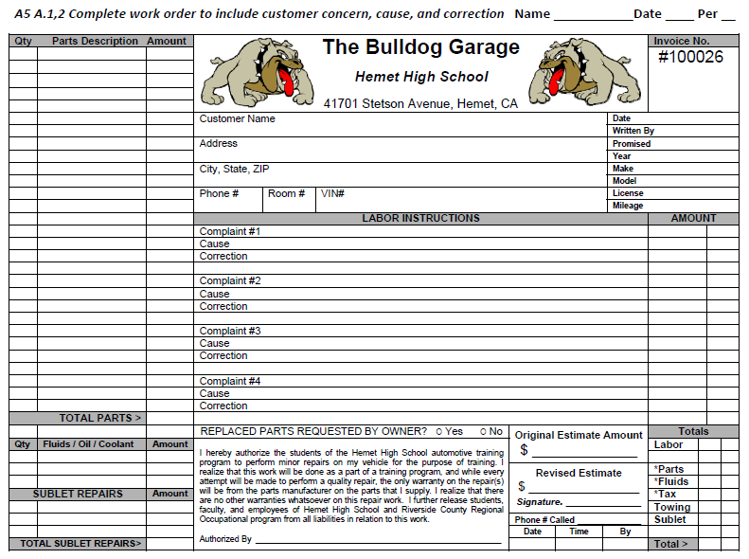
Put the labor prices on your work order!
Look up the labor times in All-Data Should be right next to the parts prices where the gears are.
Labor hours and dollars Go here

Slide 16

Put the labor prices on your work order!
Look up the labor times in All-Data. They should be right next to the parts prices where the gears are.
Labor hours and dollars go here………..
Bulldog Garage Shop Rate is $100/hour
Write the labor time and $$$
to the right of the Correction like sample below
Brake pedal drops to floor while sitting at a stop sign
Defective Master Cylinder
Replace master cylinder and bleed brakes 1.75hrs 175 00

Slide 17
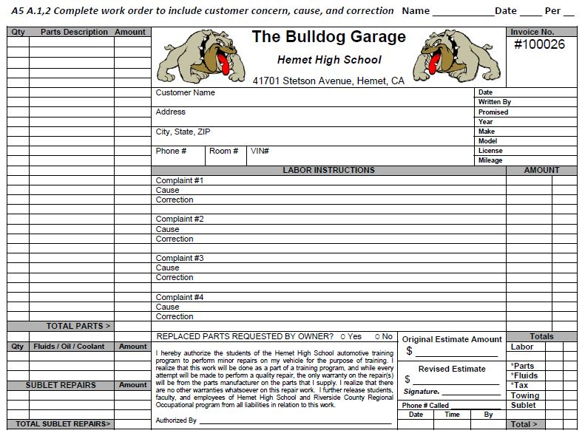
Total up Parts $$$ column
Put parts total here
Put parts total here

Slide 18
Total up Labor $$$ column
Put labor total here

Slide 19
Calculate sales tax (only on parts and fluids)
Sales tax is calculated using this formula:
Parts total x 0.0875= Tax
Round the answer to the nearest penny ☺
Tax goes here

Slide 20
Now Total up your Work Order
Work order total is the labor total
+ the parts total
+ the sales tax
Total goes here

Slide 21
Now the Estimate!
Round your grand total on the work order up to the nearest $10.
Place your estimate amount in the “Original Estimate Amount Field”

Slide 22
Now get Customer Signature (Instructor)
Authorizing Estimate

Slide 23
Questions?
Review this power-point again
Ask three other students in the class
Finally, Ask the Instructor
A5A1-2_Work_Order-Brakes / 01-29-2014 / vdb

Slide 24
The End!

