Slide 2
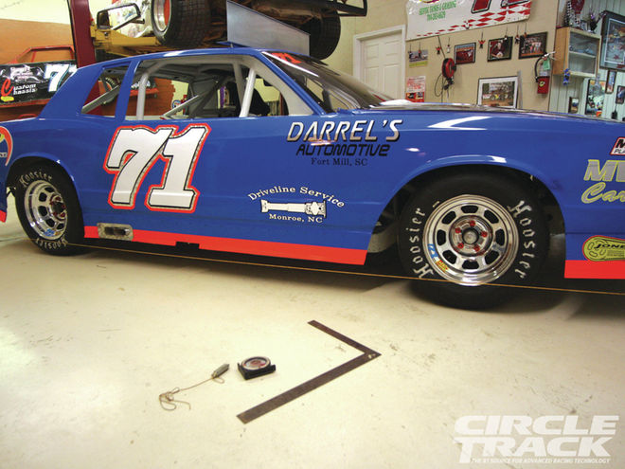
Stringing your car to determine wheel alignment is decidedly old school, but it's also effective, efficient and cheap.
Begin by placing your car in a level area of your shop with the suspension set up so that it is sitting at ride height. You also need to have mounted up a set of relative new tires on unbent rims.

Slide 3
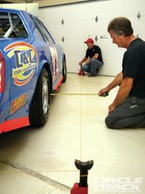
Tie a length of string a few feet longer than the wheelbase of your car to two jackstands. Technically, what you tie your string to doesn’t have to be a jackstand, but they are the best height and weight and extras are almost always lying around in every race shop. Whatever you use, just make sure they are stable, heavy enough to keep good tension on the string yet light enough to move around relatively easily.
Position the two jackstands so that the string runs along the side of the car, between 6 and 12 inches away and at a height at the middle of the wheel hubs. Whether you begin on the right or left side of the car doesn’t really matter, but the uniform height of the string does.

Slide 4
Another string is placed on the opposite side of the car, but instead of squaring it off the tire on that side, it’s aligned off of the first string so that they are parallel. This way, if the rear end is bent or has some toe built in, it won’t throw off your measurements.
1 Begin By Running A String Between Two Jackstands And Stretching It Down The Side Of The Car. Begin At The Rear Wheel And Move The Jackstand Until The Measurement Is The Same At Both Sides Of The Same Wheel. As You Can Probably Tell By Now, This Is Really A Two Person Job Because Getting The String Perfectly Parallel To The Wheel Can Be A Bit Of A Tedious Task.

Slide 5
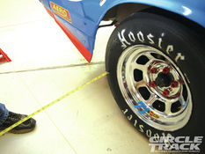
2 Measure From The Sidewall Of The Tire—just Avoid Any Lettering, Obviously. Set The String Height At The Center Point Of The Wheel Or Slightly Below. Just Don’t Go Too Low Because You Need To Measure Across The Width Of The Wheel Where It’s Still Fairly Wide To Make Getting The String Parallel To The Entire Length Of The Car As Accurate As Possible.

Slide 6
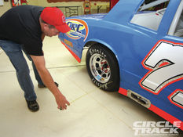
3 How Far Away You Place The String From The Car Is Really Up To You. Davis (pictured Here) And Wallace Prefer To Keep The String Far Enough Away That They Can Comfortably Work On The Suspension If Necessary. Just Make Sure You Don’t Get The String So Far Away That The Tape Measure Bends On You.

Slide 7
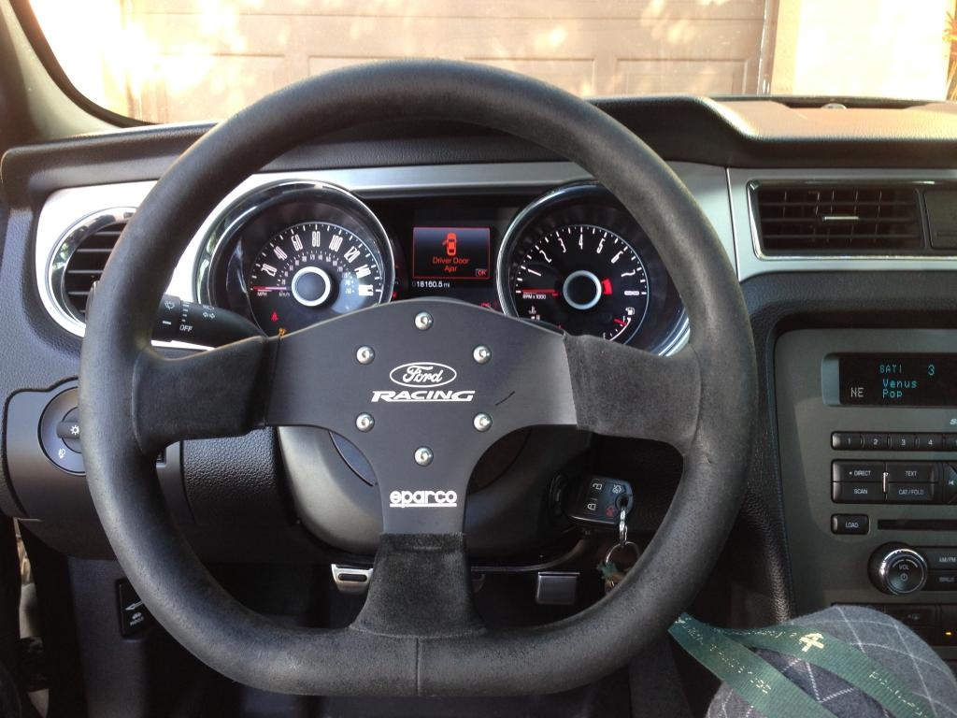
4 Before Moving To The Front End, You Need To Make Sure The Steering Is Centered As Precisely As Possible. One Method is to Turn The Steering Wheel From Lock To Lock And Then Halve That To Find The Approximate Center. Or You Can Take An X Measurement Between The Pivot Points On The Pitman Arm To The Drag Link. If The Two Measurements Are The Same, The Steering Should Be Centered.

Slide 8
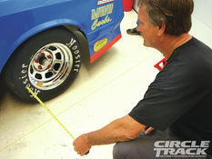
5 Once The String Is Confirmed To Be Parallel To The Rear Wheel You Can Move To The Front Wheel On The Same Side. If Your Measurements On Both Sides Of The Front Wheel Are The Same, Then The Wheel Is In Alignment (pointed In The Same Direction) With The Rear Wheel. If The Distance From The String To The Front Of The Wheel Is Longer Than The Same Measurement At The Rear Of The Wheel, Then That Wheel Is Toed In. If Both Measurements Are Larger Than The Same Measurements To The String At The Rear Wheel, Then The Front Wheel Is Sitting Inside The Track Of The Rear Wheel Which Can Cause Handling Issues You Should Be Aware Of. Obviously, If The Measurements Are Smaller, The

Slide 9
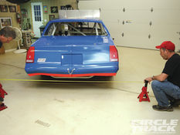
6 Now You Can Set Up A Parallel String On The Opposite Side Of The Car. To Do This, You Essentially Create A Box. Instead Of Placing The String Based Off The Rear Tire, Measure From The First String You’ve Run. This Is Why The String Needs To Extend Beyond The Body Of The Car.

Slide 10
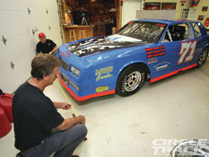
7 Move To The Front To Make Sure The String Is The Same Distance Front To Back. Now You Know The Second String Is Parallel To The First, And Because Of That You Also Know It Is Parallel To The Rear Tire On The Opposite Side. Now You Can Measure The Distances On Either Side Of The Rear Tire On The Side You Are Working On To Make Sure The Rear Is Straight. If The Rear end Has Some Toe Built In, You Can Check That Too.

Slide 11
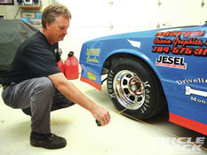
8 Repeat The Process On The Front Wheel And Compare Your Measurements To The Front Wheel On The Opposite Side. The Distance Between The String And The Wheel Doesn’t Have To Be Equal. For Example, The String On One Side Can Be 8 Inches From The Tires While It’s 10 Inches On The Other. That’s OK, What You Want To Be Able To Compare Is The Distances From Front To Back. If You Want To Know The Track Width, Simply Subtract The Distances From The Strings To The Center Of The Tires On Either Side From The Total Distance Between The Two Strings. What You’re Left With Is Your Track Width.

Slide 12
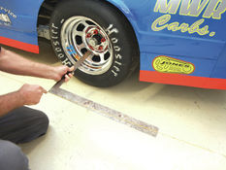
9 Measuring Wheelbase With The String Method Is Also Simple. Use A Framing Square As You See Here. The Angle This Photo Was Taken Makes It Look Misleading, But Here Wallace Has One End Of The Square Aligned With The String And The Outside Edge Of The Other Pointing To The Center Of The Hub. Now Using A Magic Marker He Marks The String And Repeats The Process At The Back Of The Car. Once Those Two Marks Are Made, He Can Measure The Distance Between The Two To Determine His Wheelbase. Alternatively, You Can Hang A Plumb Bob From The Center Of The Hub And Mark The Spot It Points To On The Floor. Determining The Wheelbase Can Help You Achieve Proper Rear Alignment Which Is Critical To A Good Setup. Proper Alignment Is A Squared Rear End To The Center Of The Chassis. Of Course, We’re Only Talking About Small Movements Here—usually In The Range Of 1/8 To 1/4 Inch At Most.

Slide 13
Questions?
Watch this power point again
Ask three other students for assistance
Finally, ask your instructor for assistance

