Slide 1
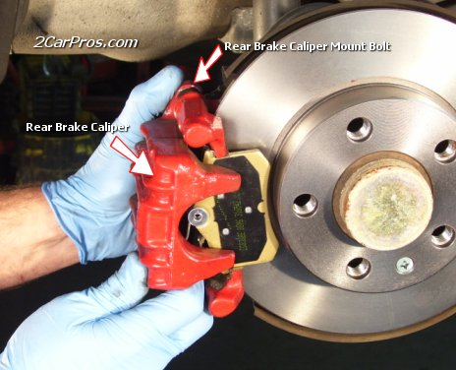
Disc Brakes

Slide 2
Objectives
List the advantages of disc brakes.
List disc brake components and describe their functions.
Explain the differences between the three types of calipers commonly used on disc brakes.
continued…

Slide 3
Objectives
Describe the two types of parking brake systems used with disc brakes.
Describe the causes of common disc brake problems.
Explain what precautions should be taken when servicing disc brake systems.
continued…

Slide 4
Objectives
Describe the general procedure involved in replacing disc brake pads.
List and describe five typical disc brake rotor problems.
continued…

Slide 5
Disc Brake Advantages
Resistance to heat fade
Resistance to water fade
Increased straight-line stopping ability
Automatic adjustment
continued…

Slide 6
Disc Brake Components
Rotor
  Including hub on some vehicles
Caliper assembly
  Including piston, seal, and dust boot
Pads
Antisqueal hardware
Attaching hardware
continued…

Slide 7
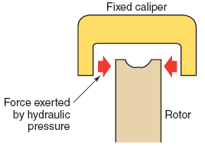
Designs
Fixed caliper
  The caliper is bolted in a fixed position and does not move.
continued…

Slide 8
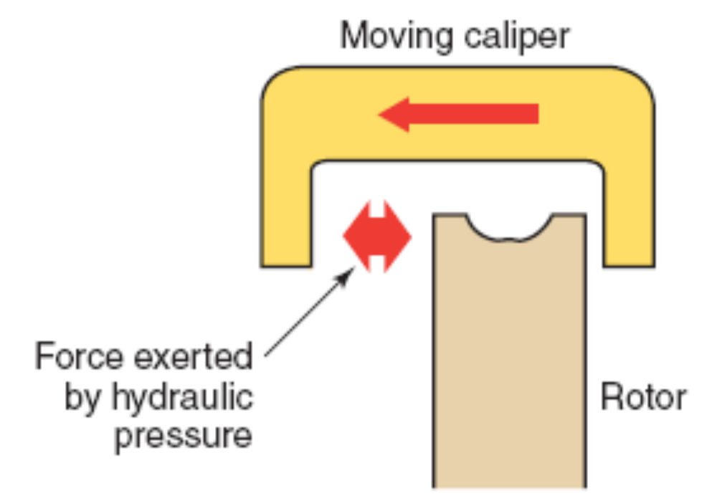
Designs
Floating caliper
  The caliper moves on locating pins.
continued…

Slide 9
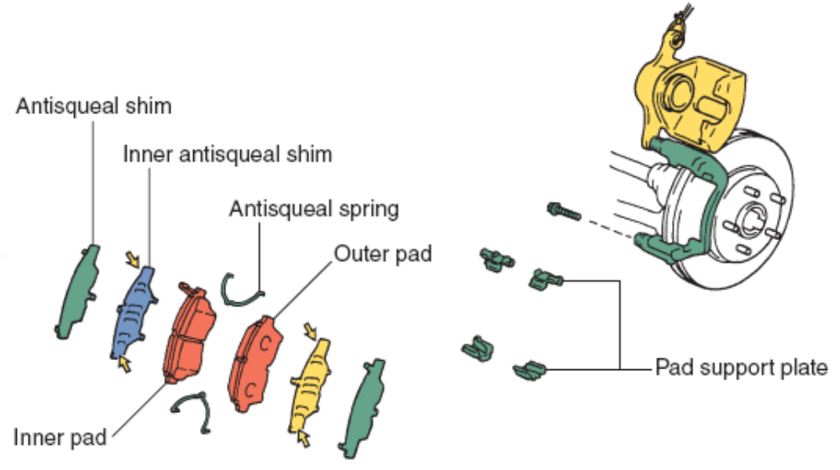
Designs
Sliding caliper
  Similar to the floating type, but it does not use pins.
continued…

Slide 10
Caliper Self-Adjustment
As the disc brake pads wear, the seal allows the piston to move farther out to adjust automatically for the wear, without allowing fluid to leak.
Since the brake pads need to retract only slightly after they have been applied, the deformation of the pistons square-cut seal retracts the piston only slightly into its bore.
continued…

Slide 11
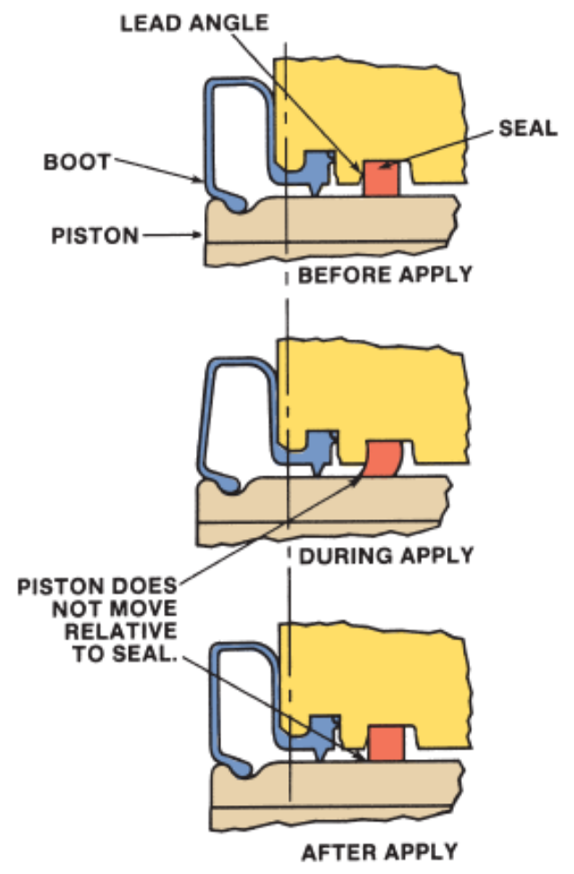
Caliper Self-Adjustment
continued…

Slide 12
Common Disc Brake Problems
Pulsating pedal
  Commonly caused by warped rotors
Spongy pedal
  Commonly caused by air in the system
Hard pedal
  Commonly caused by a power booster problem
Dragging brakes
  Commonly caused by sticking or seized pistons
continued…

Slide 13
Common Disc Brake Problems
Grabbing brakes
  Commonly caused by contaminated brake linings
Noise
  Commonly caused by improper pad installation
Pulling
  Commonly caused by one wheel doing more of the braking
continued…

Slide 14
Pre-Service Checks
Tires - for wear and improper inflation
Wheels - for bent or warped rims
Wheel bearings - for wear or looseness
Suspension components - for wear or looseness
Brake fluid - level
Hydraulic system - for leaks
continued…

Slide 15
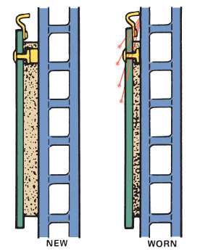
Brake Pad Wear Indicators
Disc Pad Wear Sensors
  Some brake shoe pads have wear sensing indicators.
  The 3 most common designs are audible, visual (indicator light), and tactile (touch).
continued…

Slide 16
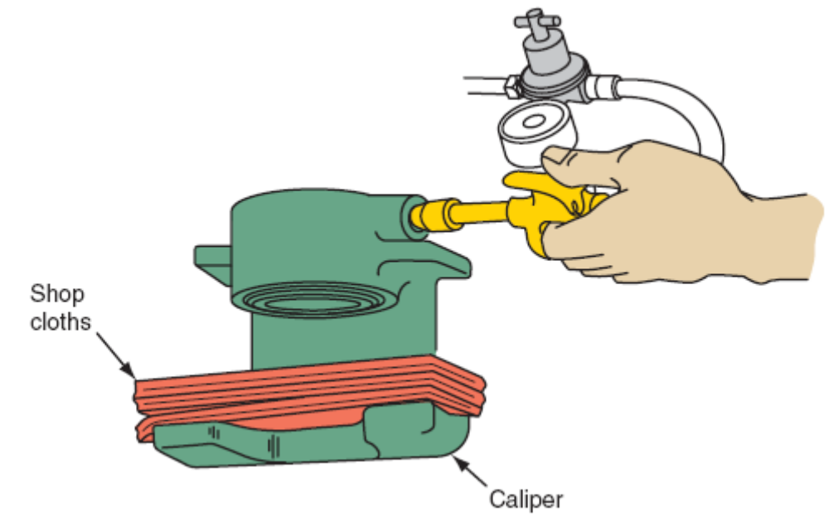
Caliper Service Tips
Carefully use air to remove the caliper piston from it’s bore
continued…

Slide 17
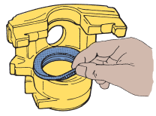
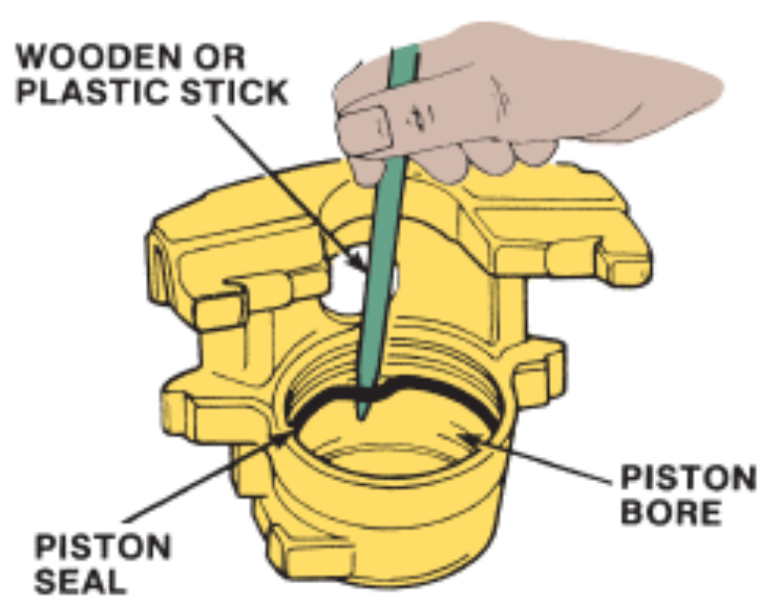
Caliper Service Tips
Carefully remove the dust boot and piston seal
continued…

Slide 18
Caliper Service Tips
Make sure the correct caliper is mounted on the correct anchor plate.
Lubricate rubber insulators with silicone dielectric compound.
If copper washers are used, always use new ones.
continued…

Slide 19
Caliper Service Tips
Fill the master cylinder and bleed the hydraulic system.
Check for leaks under maximum pedal pressure.
Road test the vehicle.
continued…

Slide 20
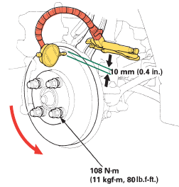
Common Rotor Checks
Lateral runout or side to side wobble
continued…

Slide 21
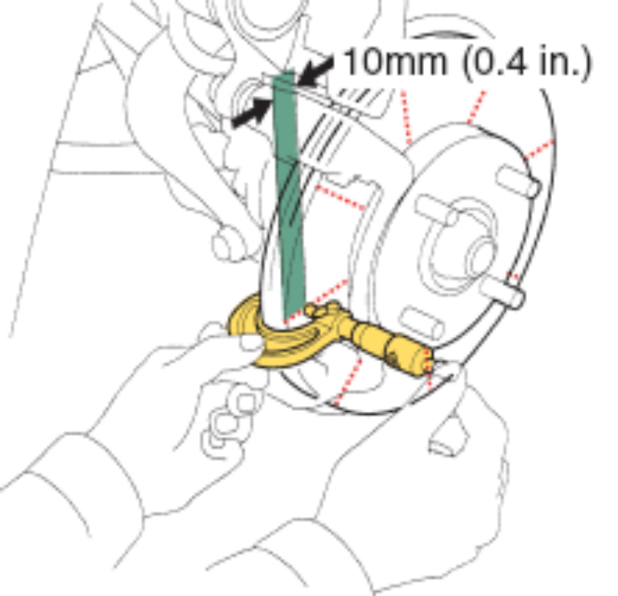
Common Rotor Checks
Lack of parallelism or variations in the rotor thickness (check in 8 places)
continued…

Slide 22
Common Rotor Checks
Minimum thickness
Scoring
Heat checking (bluing)
Rusty rotor
Collapsed vents
Mounting flange rust
continued…

Slide 23
Rear Disc Park Brakes
A rear disc/drum or auxiliary drum parking brake arrangement uses the inside of each rear wheel hub and rotor assembly as a parking brake drum.
Other designs have mechanisms that force the pads against the rotor mechanically.
Common methods include a ball-and-ramp arrangement and high-lead screws.
continued…

Slide 24
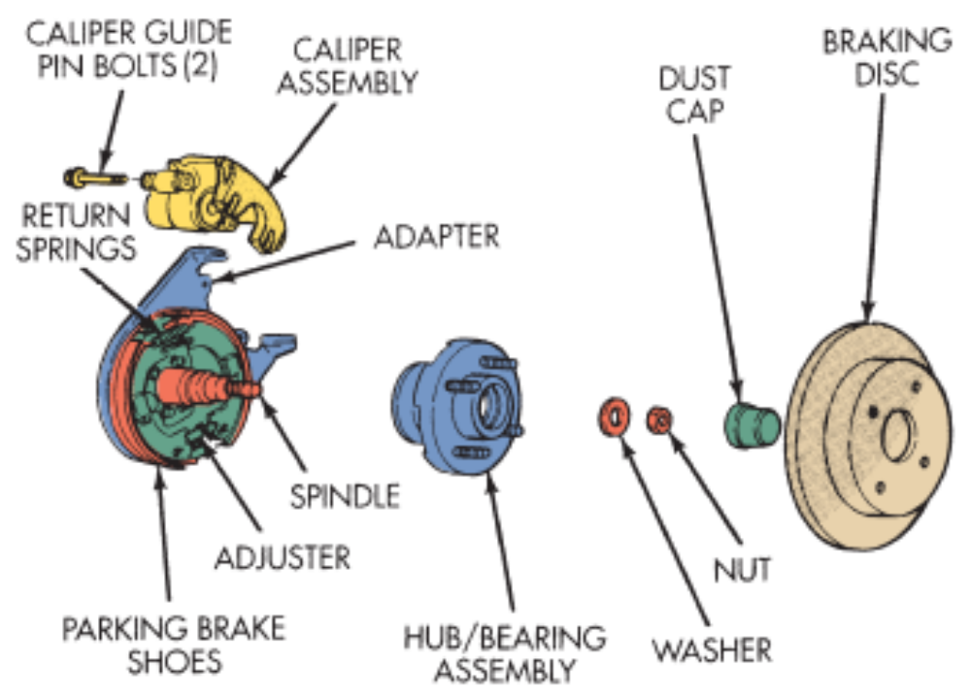
Rear Disc Park Brakes
A rear disc/drum brake assembly
continued…

Slide 25
Summary
Disc brakes offer four major advantages over drum brakes: resistance to heat fade, resistance to water fade, increased straight-line stopping ability, and automatic adjustment.
The caliper assembly includes cylinder bores and pistons, dust boots, and piston hydraulic seals.
continued…

Slide 26
Summary
Fixed calipers do not move when the brakes are applied.
Floating calipers slide back and forth on pins or bolts.
On some rear disc brake systems, the inside of the rear rotor is used as the parking brake drum.
continued…

Slide 27
Summary
Some rear disc parking brakes have a mechanism that forces the pads against the rotor mechanically.
Disc brakes should be checked periodically or whenever the wheels are removed.
Disc brake rotor defects include lateral runout, lack of parallelism, scoring, heat checking, and rust.

