Slide 1
COOLING SYSTEM:
CHECK CONDITION AND CONCENTRATION OF COOLANT
CS1
A.1 D. 7 P-1

Slide 2
Objective:
Student will check engine coolant, determine concentration, condition, boiling and freezing points, and make recommendations needed to bring coolant up to factory specifications.

Slide 3
Materials Needed:
    EYE PROTECTION
    Coolant Tester
    Vehicle

Slide 4
Procedure:
    WEAR EYE PROTECTION! With engine cool! Locate and remove radiator cap. Using coolant tester draw out enough coolant to fill tester almost full. Check readings on both sides of tester and note on skill sheet:
    Boiling Point and Freezing Point.
    Look inside of radiator neck and at coolant in tester and note appearance on skill sheet.
    (Dirty, Contaminated, Color, All water, etc...)

Slide 5

STEP ONE
WEAR EYE PROTECTION!

Slide 6
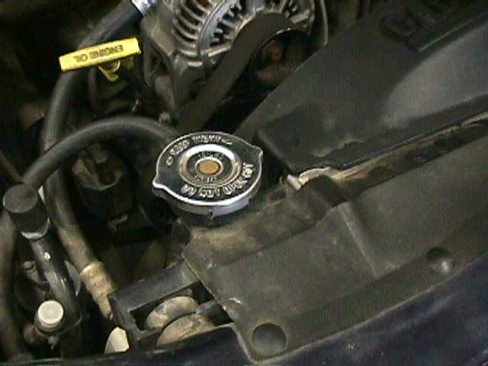
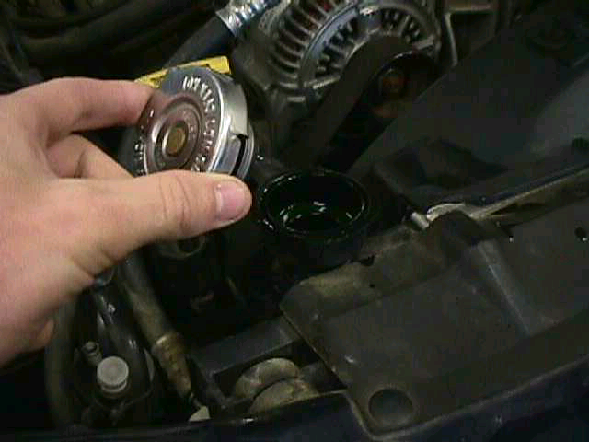
STEP TWO
With engine cool! Locate and remove radiator cap.

Slide 7
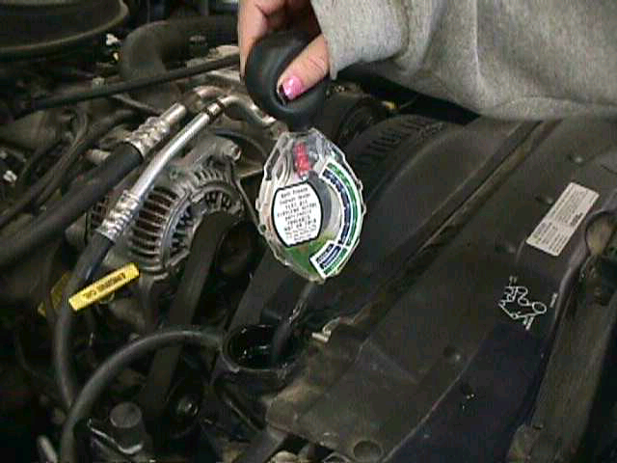
STEP THREE
Using coolant tester draw out enough coolant to fill tester almost full.

Slide 8
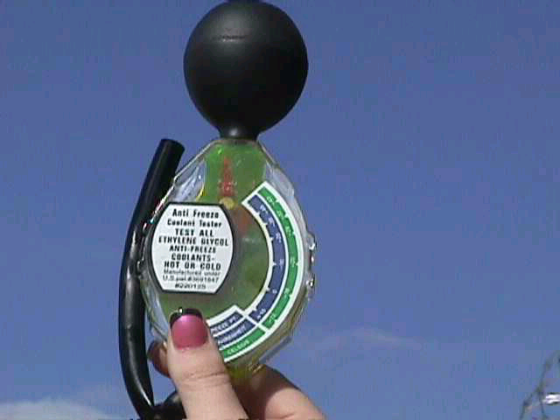
STEP FOUR
Check readings on both sides of tester and note Boiling Point and Freezing Point.

Slide 9
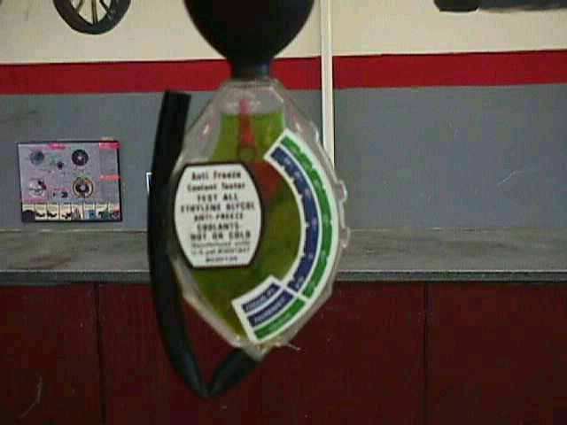
STEP FIVE
Look inside of radiator neck and at coolant in tester and note appearance.
  (Dirty, Contaminated, Color, All water, etc...)

Slide 10

NOW WATCH VIDEO
Click on Video Camera

Slide 11
CONCLUSION
Clean Up Your Mess
Rinse out coolant tester with water
Put Away All Tools
Record Information on Skill/Task Sheet
Get Skill/Task Sheet Signed

Slide 12
WRITTEN BY:
KoRy BeTtEnCoUrT
SuSaN wAsSoN
JaYsOn MeDaRiS
Edited by Mr. Bloom

