Slide 1
Cooling System
CS 1B
Evaluating Coolant
Checking For Dissolved Metals

Slide 2
Objective
Student will test coolant for conductivity indicating dissolved metal content, and determine needed action on two vehicles.

Slide 3
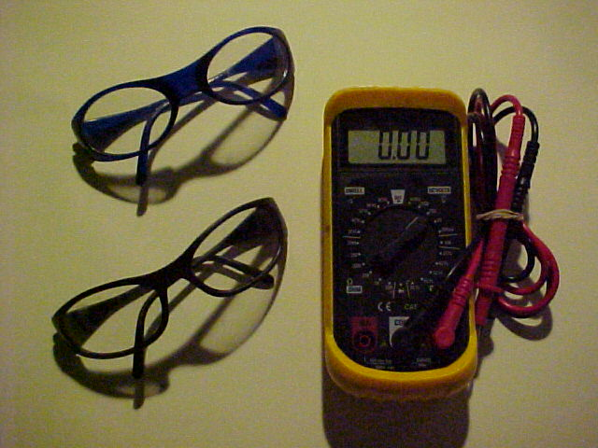

Materials Needed
EYE PROTECTION
Digital-Volt-Ohm-Meter (DVOM)
Vehicle (see instructor)

Slide 4
Procedure - Overview
Always wear EYE PROTECTION.
DO NOT open cooling system while hot!
Carefully remove radiator cap.
Set DVOM to 2 Volt DC scale (or auto-range).
Connect DVOM negative lead to negative battery terminal.
Take positive lead and place into coolant using care not to touch sides of radiator neck.
Test for voltage present under the conditions listed in the table on task sheet.

Slide 5
WEAR EYE PROTECTION!

Slide 6
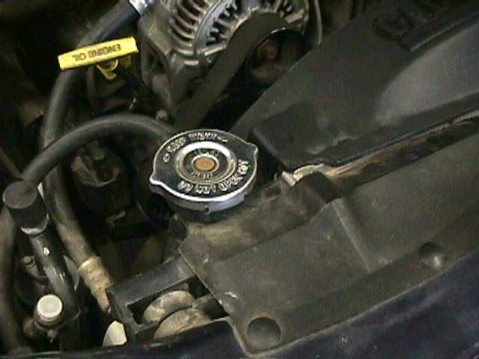
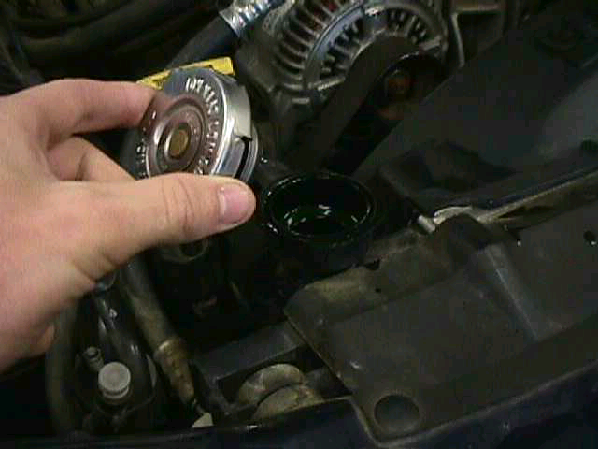
Remove Radiator Cap
DO NOT open cooling system while hot!
Carefully remove radiator cap.

Slide 7
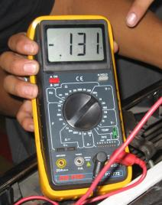
Set DVOM to 2 Volt DC Scale

Slide 8
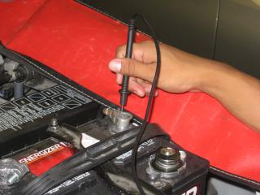
Connect DVOM negative lead to negative battery terminal

Slide 9
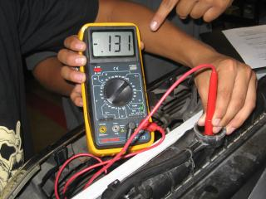
Take positive lead and place into coolant using care not to touch sides of radiator neck

Slide 10
Data Collection
Test for voltage present under the conditions listed below
0.000v-0.150v = Pass 0.150v-0.400v = Questionable 0.400v-Above = Fail | DC Volts | Pass/Questionable/Fail P/Q/F
Note: If any voltage readings indicate failure, coolant must be flushed
Conditions: | Vehicle 1 Voltages | P/Q/F | Vehicle 2 Voltages | P/Q/F
Engine Off | 0._ _ _ |  | 0._ _ _
Engine Running | 0._ _ _ |  | 0._ _ _
Engine Running w/Lights | 0._ _ _ |  | 0._ _ _
Engine Running w/Lights & A/C | 0._ _ _ |  | 0._ _ _
Engine Running w/Lights & A/C @ 2000RPM | 0._ _ _ |  | 0._ _ _

Slide 11

Your Recommendation
Does the coolant need to be flushed?
If the readings were questionable, what would you recommend to a customer?
If this was your vehicle, what would you do?
Think about why you chose your answer

Slide 12
Fill out your task sheet completely
Top up radiator coolant
Install radiator cap fully
Remove fender cover
Close hood on vehicle
Clean and put away DVOM
Have instructor review & sign task sheet

Slide 13
QUESTIONS?
Read your task sheet completely
Review this power point again
Ask three other students for help
Ask Instructor where to find answers

