Slide 1
REMOVE AND INSTALL THERMOSTAT AND TEST OPERATION
CS4
A.1 D.6 P-5/6

Slide 2
Objective
    Student Will Remove and Install Thermostat and Test Operation.

Slide 3
Materials Needed
    EYE PROTECTION
      .Hand Tools and Torque wrench
      .Coolant
      .Sealer and gasket
      .Vehicle (see instructor)

Slide 4
Procedure
    WEAR EYE PROTECTION! As outlined in video.
    WITH ENGINE COOL! Carefully remove radiator cap. Locate radiator drain and loosen drain plug and drain coolant into suitable container. Locate thermostat housing and remove bolts. Remove thermostat housing and thermostat. Inspect thermostat and test. Clean gasket material from housing and opposite surface. Place thermostat into position with the correct side up. Apply thin layer of sensor safe sealer to both sides of new gasket. Install gasket and then housing. Hand tighten bolts. Finish torquing bolts to 12-15 foot pounds. Hand tighten drain plug and put coolant back into radiator. Run engine until warm. Top off coolant and reinstall cap.
    Check and fill overflow bottle to full mark. Check for leaks.

Slide 5
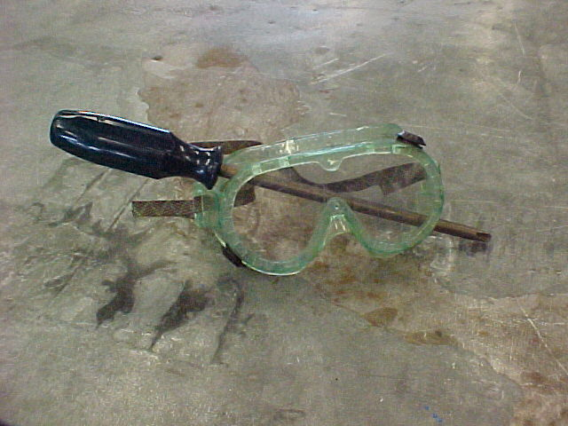
WEAR EYE PROTECTION
Or Else!

Slide 6
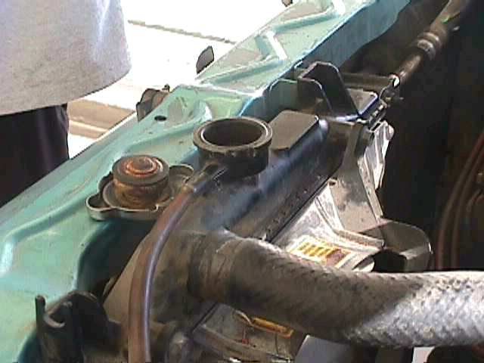
Step 1
WITH ENGINE COOL! Carefully remove radiator cap. Locate radiator drain and loosen drain plug and drain coolant into suitable container.

Slide 7
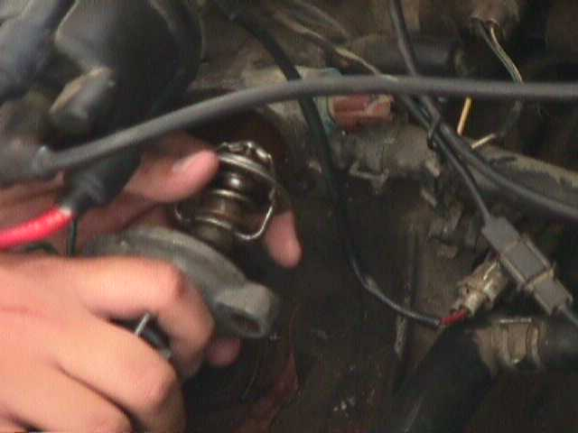
Step 2
Locate thermostat housing and remove bolts.

Slide 8
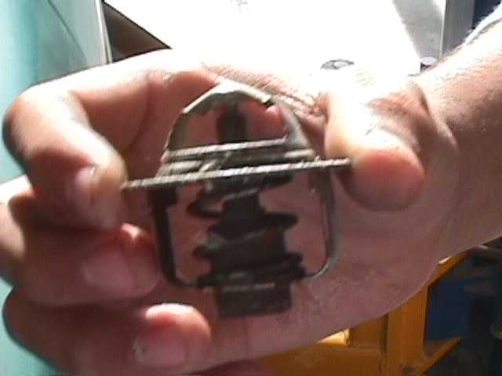
Step 3
Remove thermostat housing and thermostat.

Slide 9
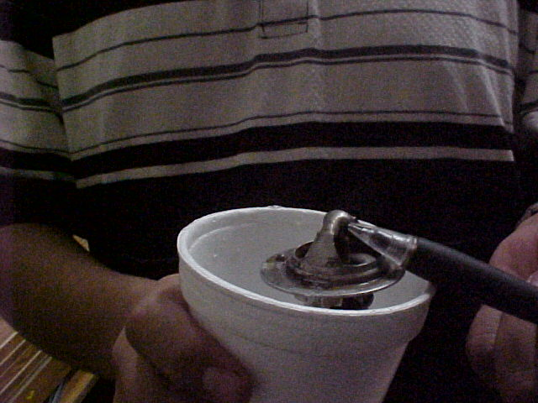
Step 4
Inspect thermostat and test. Test by putting the thermostat into boiling water for 1 minute. It should open about ½ inch. If not, replace thermostat.
Record results on skill sheet.

Slide 10
Step 5
Clean gasket material from housing and opposite surface. Leave no old gasket or housing will leak!

Slide 11
STEP 6
    Place thermostat into position with the correct side up. (Vent hole) Apply thin layer of sensor safe sealer to both sides of new gasket. Install gasket and then housing. Hand tighten bolts. Finish torquing bolts to 12-15 foot pounds. Hand tighten drain plug and put coolant back into radiator. Run engine until warm. Top off coolant and reinstall cap.
    Check and fill overflow bottle to full mark. Check for leaks.

Slide 12
Conclusion
Clean Up Your Mess
Put Away All Tools
Record Information on Skill/Task Sheet
Get Skill/Task Sheet Signed

Slide 13
Written By
ERIC ZAMBRANO AND JULIAN ESTRADA PER 5/6.

