Slide 1


Slide 2
Front Drive Axle Replacement
THIS DEMONSTRATION WAS DONE ON A 1990 SUBARU LEGACY WAGON
SOME MODELS MAY VARY SLIGHTLY FROM THIS DEMONSTRATION
by
Vance Bloom
CTE AUTOMOTIVE TECHNOLOGY
Hemet High School

Slide 3
Why Do I Want To Know This?
How Will This Information Benefit Me?

Slide 4
$$$$$$$$$$$$$$$$$$$$$$
You Can Save Yourself BIG Money!
The Average Labor Charge to Replace The Front Axle is About $150.00
It Takes About 1.5 Hour of Your Time To Replace The Front Axle
This Translates To About $100 Per Hour Savings!
(How Much Do You Make Per Hour?)

Slide 5
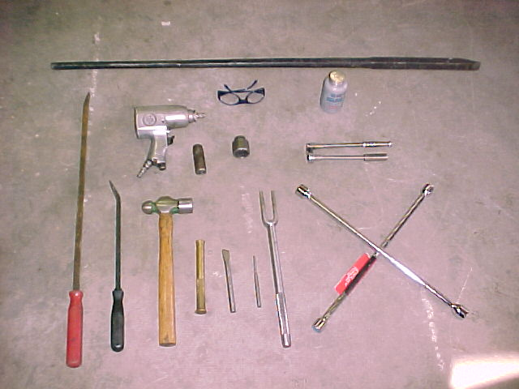
Tools Needed

Slide 6
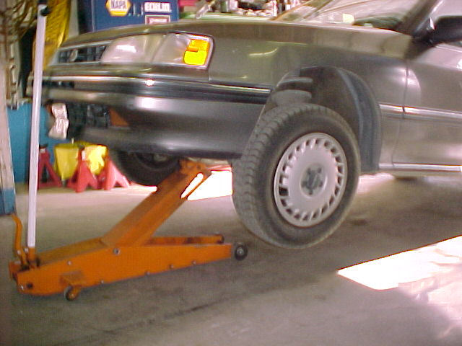
STEP 1
RAISE VEHICLE ON FLOOR JACK

Slide 7
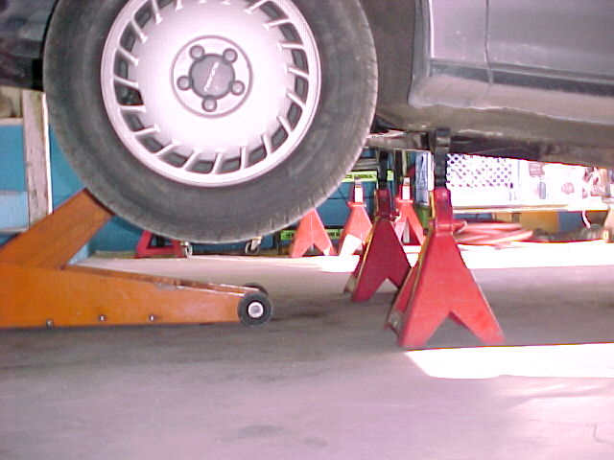
STEP 2
PLACE SAFETY STANDS UNDER VEHICLE

Slide 8
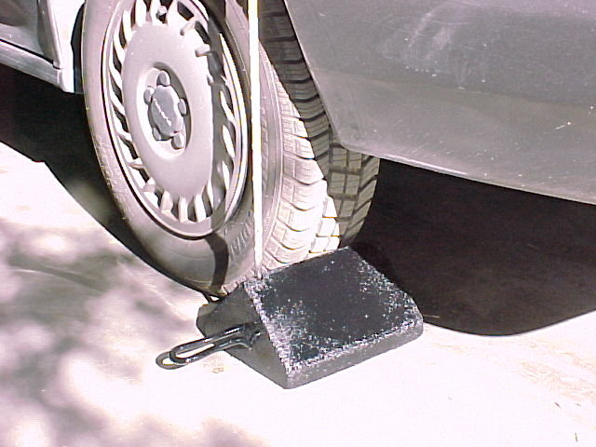
STEP 3
PLACE CHOCK BEHIND REAR WHEEL

Slide 9
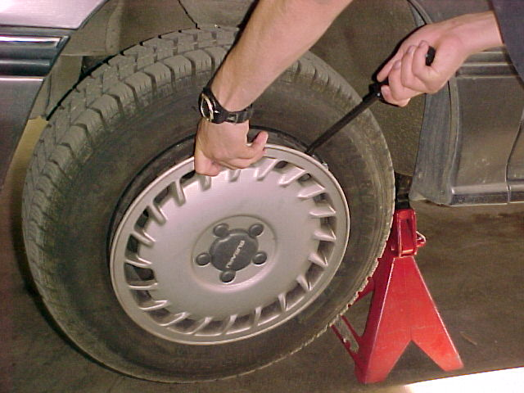
STEP 4
REMOVE HUBCAP

Slide 10
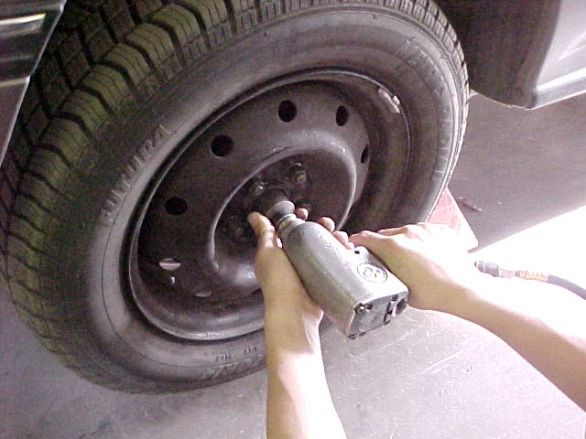
STEP 5
REMOVE HUB NUT

Slide 11
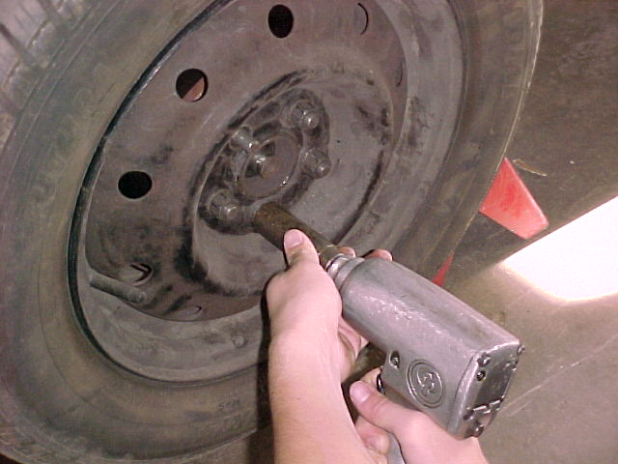
STEP 6
REMOVE LUG NUTS AND WHEEL

Slide 12
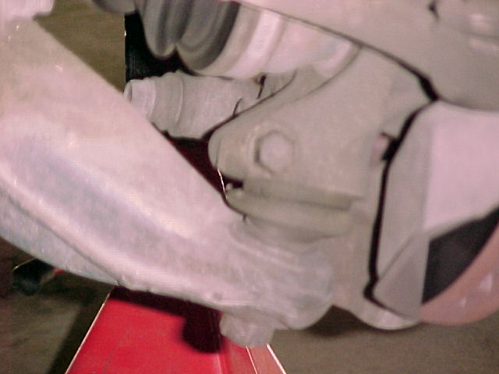
STEP 7
14mm
LOCATE BALL JOINT RETAINING BOLT

Slide 13
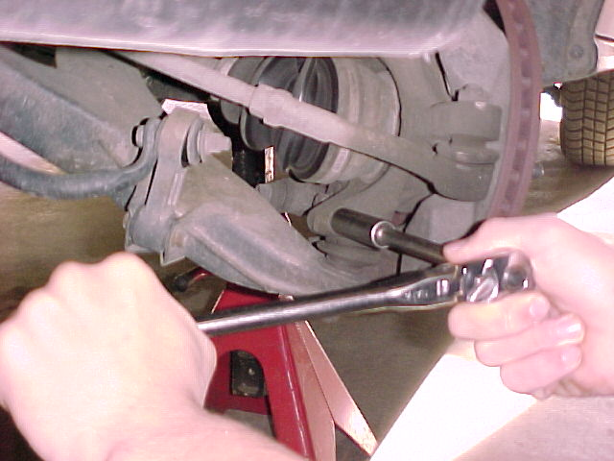
STEP 8
REMOVE BALL JOINT RETAINING BOLT

Slide 14
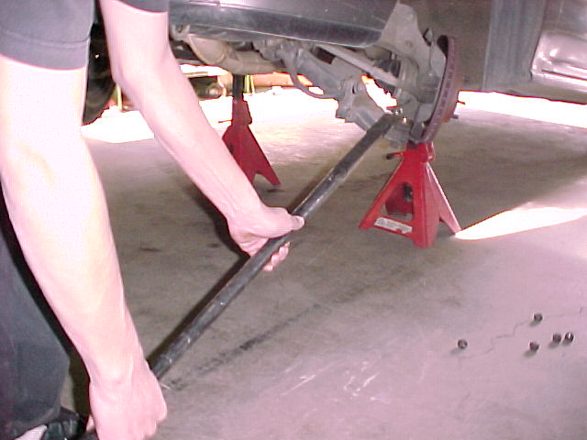
STEP 9
SEPARATE STEERING KNUCKLE FROM LOWER CONTROL ARM

Slide 15
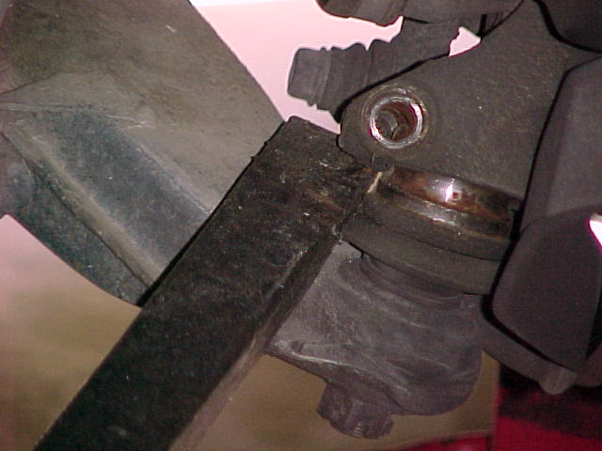
CLOSER VIEW

Slide 16
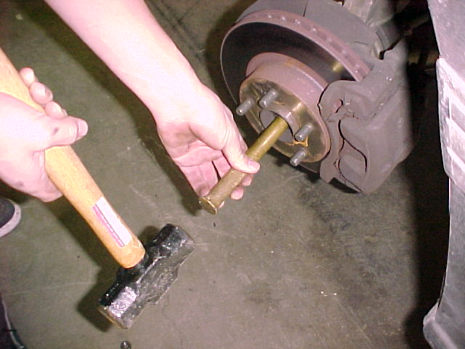
STEP 10
GENTLY DRIVE OUT AXLE FROM HUB

Slide 17
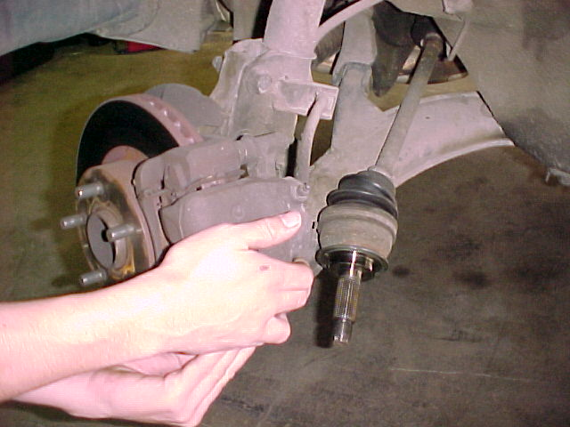
STEP 11
SEPARATE OUTER END OF AXLE FROM HUB

Slide 18
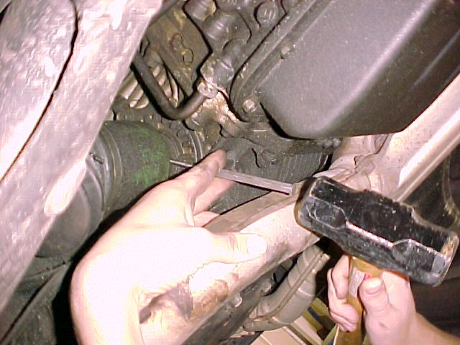
STEP 12
DRIVE OUT ROLL PIN (SOME MODELS)

Slide 19
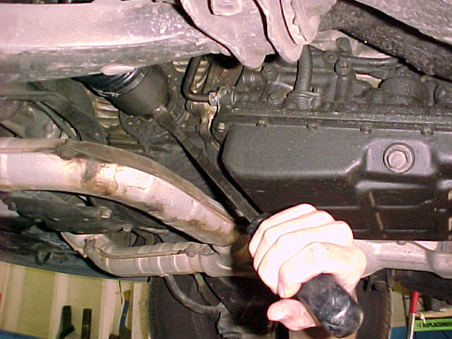
ALTERNATE STEP 12
PRY OUT AXLE FROM TRANS (SOME MODELS)

Slide 20
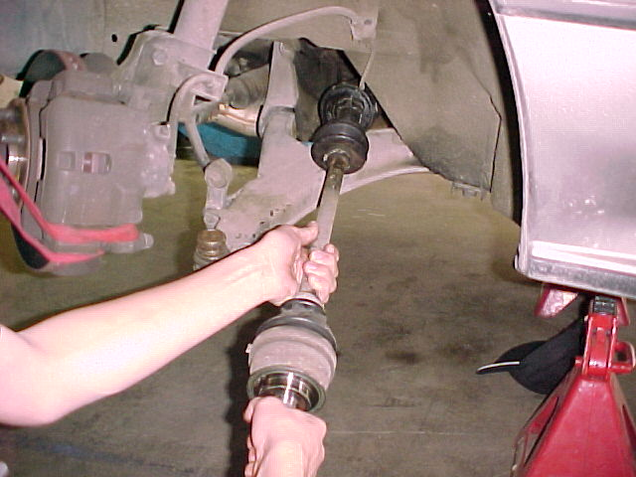
STEP 13
REMOVE AXLE

Slide 21
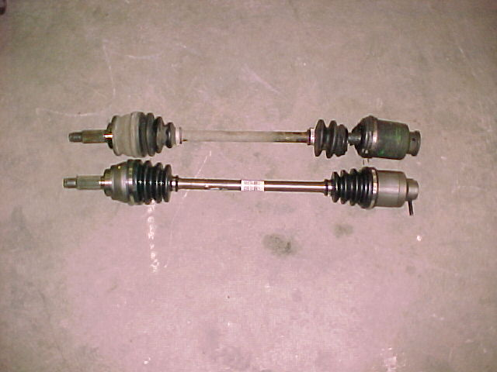
STEP 14
COMPARE THE OLD AND NEW AXLES TO BE SURE YOU HAVE THE CORRECT ONE

Slide 22
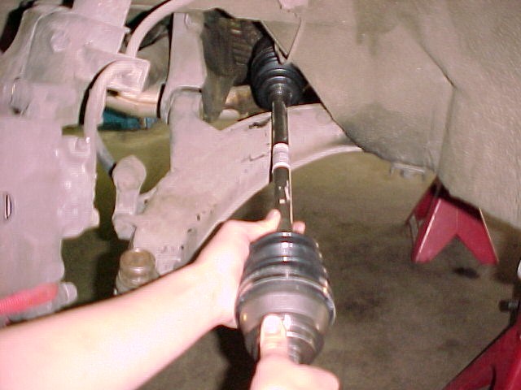
STEP 15
INSTALL NEW AXLE

Slide 23
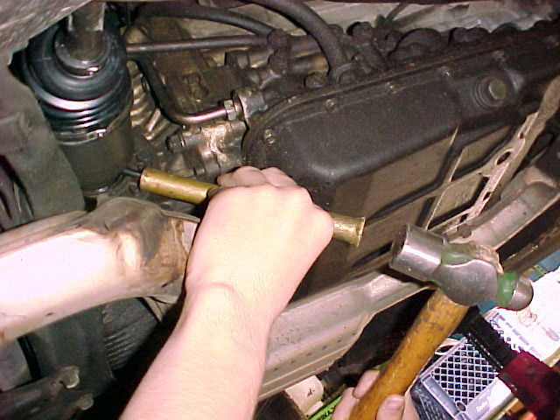
STEP 16
DRIVE IN NEW ROLL PIN (SOME MODELS)
Make sure holes are perfectly aligned!

Slide 24
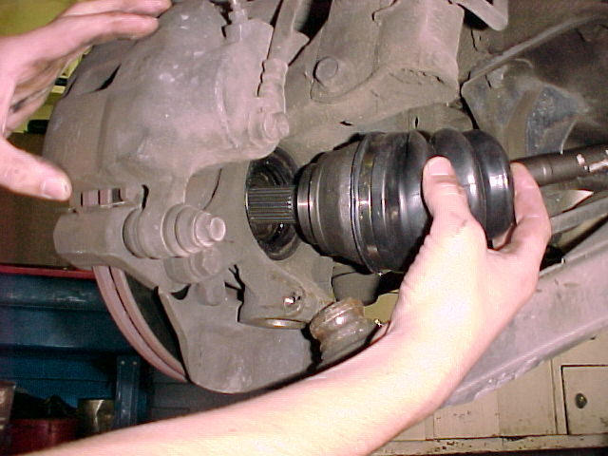
STEP 17
INSERT OUTER END OF AXLE INTO HUB

Slide 25
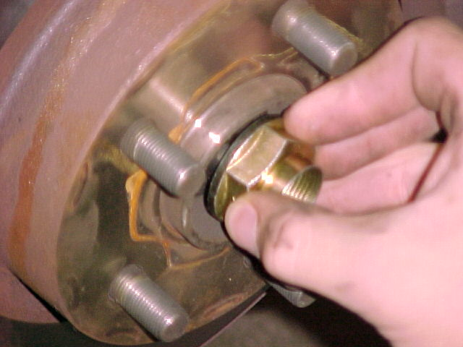
STEP 18
START HUB NUT

Slide 26
STEP 19
PUT BALL JOINT BACK INTO KNUCKLE

Slide 27
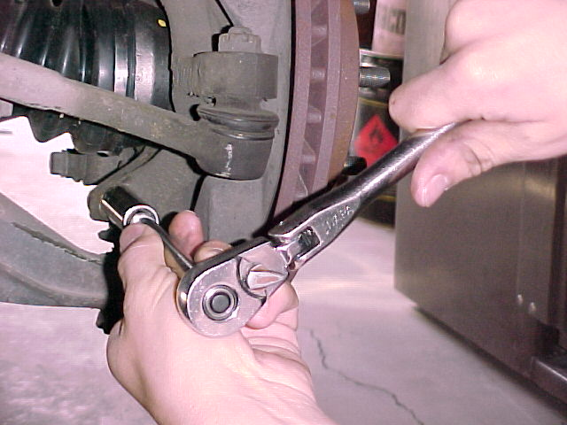
STEP 20
REINSTALL LOWER BALL JOINT RETAINING BOLT AND TORQUE TO SPECIFICATIONS

Slide 28
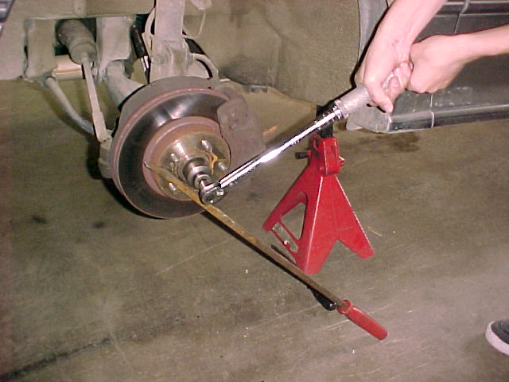
STEP 21
TORQUE HUB NUT TO SPECIFICATIONS

Slide 29
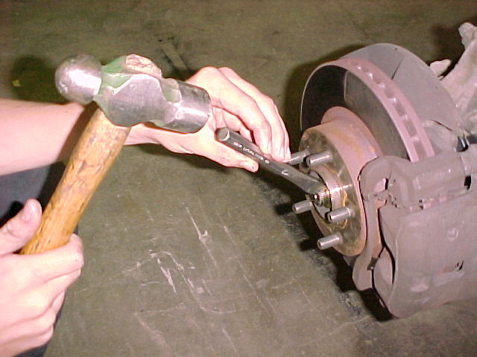
STEP 22
DENT HUB NUT COLLAR TO LOCK IN PLACE

Slide 30
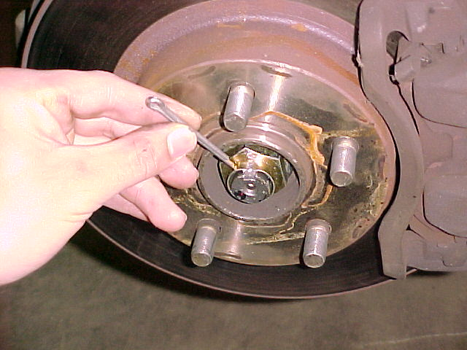
ALTERNATE STEP 22
SOME MODELS USE A COTTER PIN TO SECURE THE HUB NUT IN PLACE

Slide 31
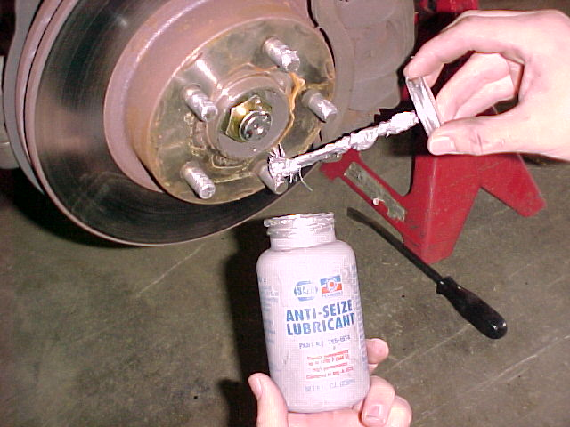
STEP 23
PUT ANTI-SEIZE LUBE ON LUG STUDS

Slide 32
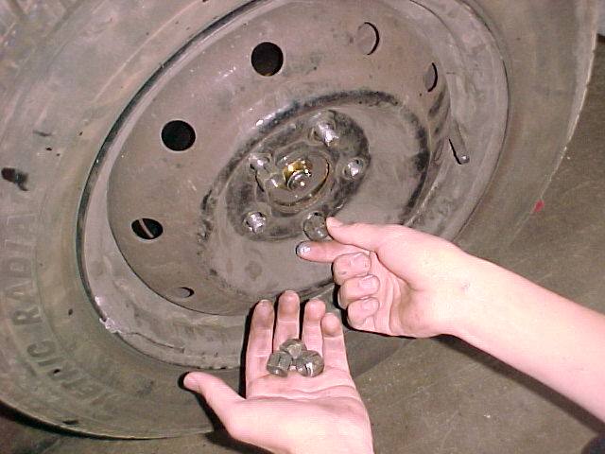
STEP 24
INSTALL WHEEL AND LUG NUTS BY HAND

Slide 33
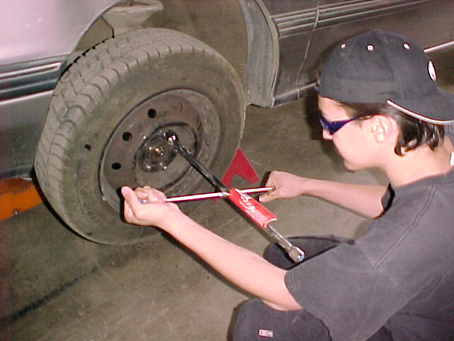
STEP 25
HAND TIGHTEN LUG NUTS

Slide 34
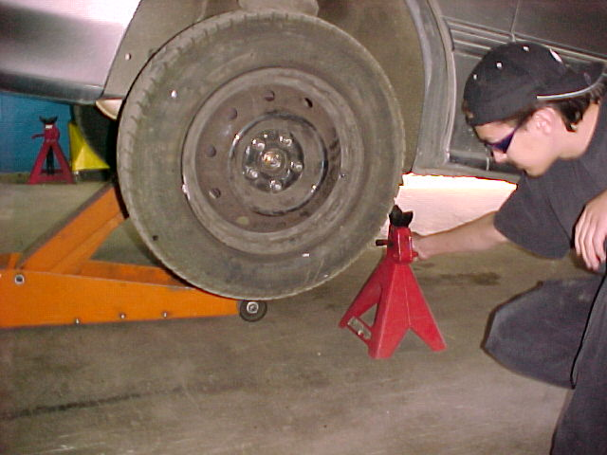
STEP 26
RAISE VEHICLE, REMOVE SAFETY STANDS, THEN LOWER VEHICLE TO GROUND

Slide 35
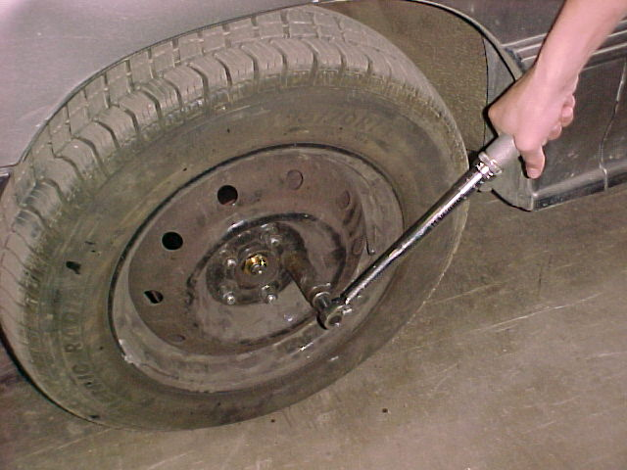
STEP 27
TORQUE LUG NUTS TO SPECIFICATIONS

Slide 36
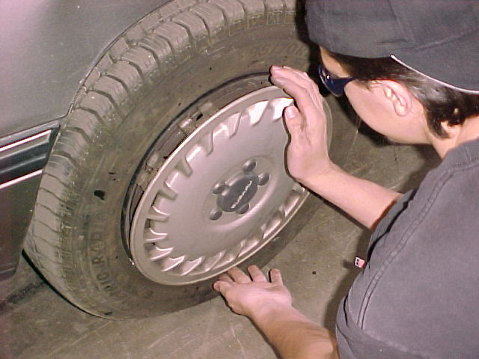
STEP 28
INSTALL HUBCAP

Slide 37

Road Test
Take vehicle out to empty parking lot and drive in tight circles two circles to the right and then two circles to the left.
SLOWLY!

Slide 38
Now Clean Up Your Mess!
Clean and put away all tools
Clean up floor under vehicle
Repack old axle in box and return for core refund
Figure out how to spend the $150 you saved!

Slide 39
QUESTIONS?
Check your repair manual first!
CONTACT
Vance Bloom
vbloom@hemetusd.k12.ca.us

Slide 40
SOME MODELS MAY VARY SLIGHTLY FROM THIS DEMONSTRATION
THIS DEMONSTRATION WAS DONE ON A 1990 SUBARU LEGACY WAGON

Slide 41
THE END

