Slide 1

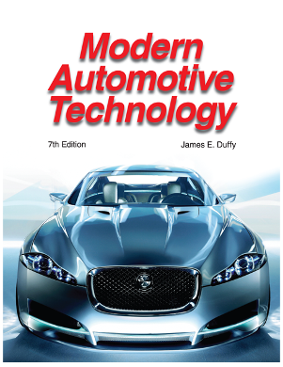

PowerPoint for
Modern Automotive
Technology
by
Russell Krick
Publisher
The Goodheart-Willcox Co., Inc.
Tinley Park, Illinois

Slide 2
Chapter 37
Sound Systems
and
Power Accessories

Slide 3
Contents
Sound systems
Power seats
Power windows
Power door locks
Power trunk release
Power steering wheel
Rear window defogger (Continued)

Slide 4
Contents
Heated windshield
Reminder system
Cruise control systems
Power mirrors
Cellular mobile telephone
Driver information center

Slide 5
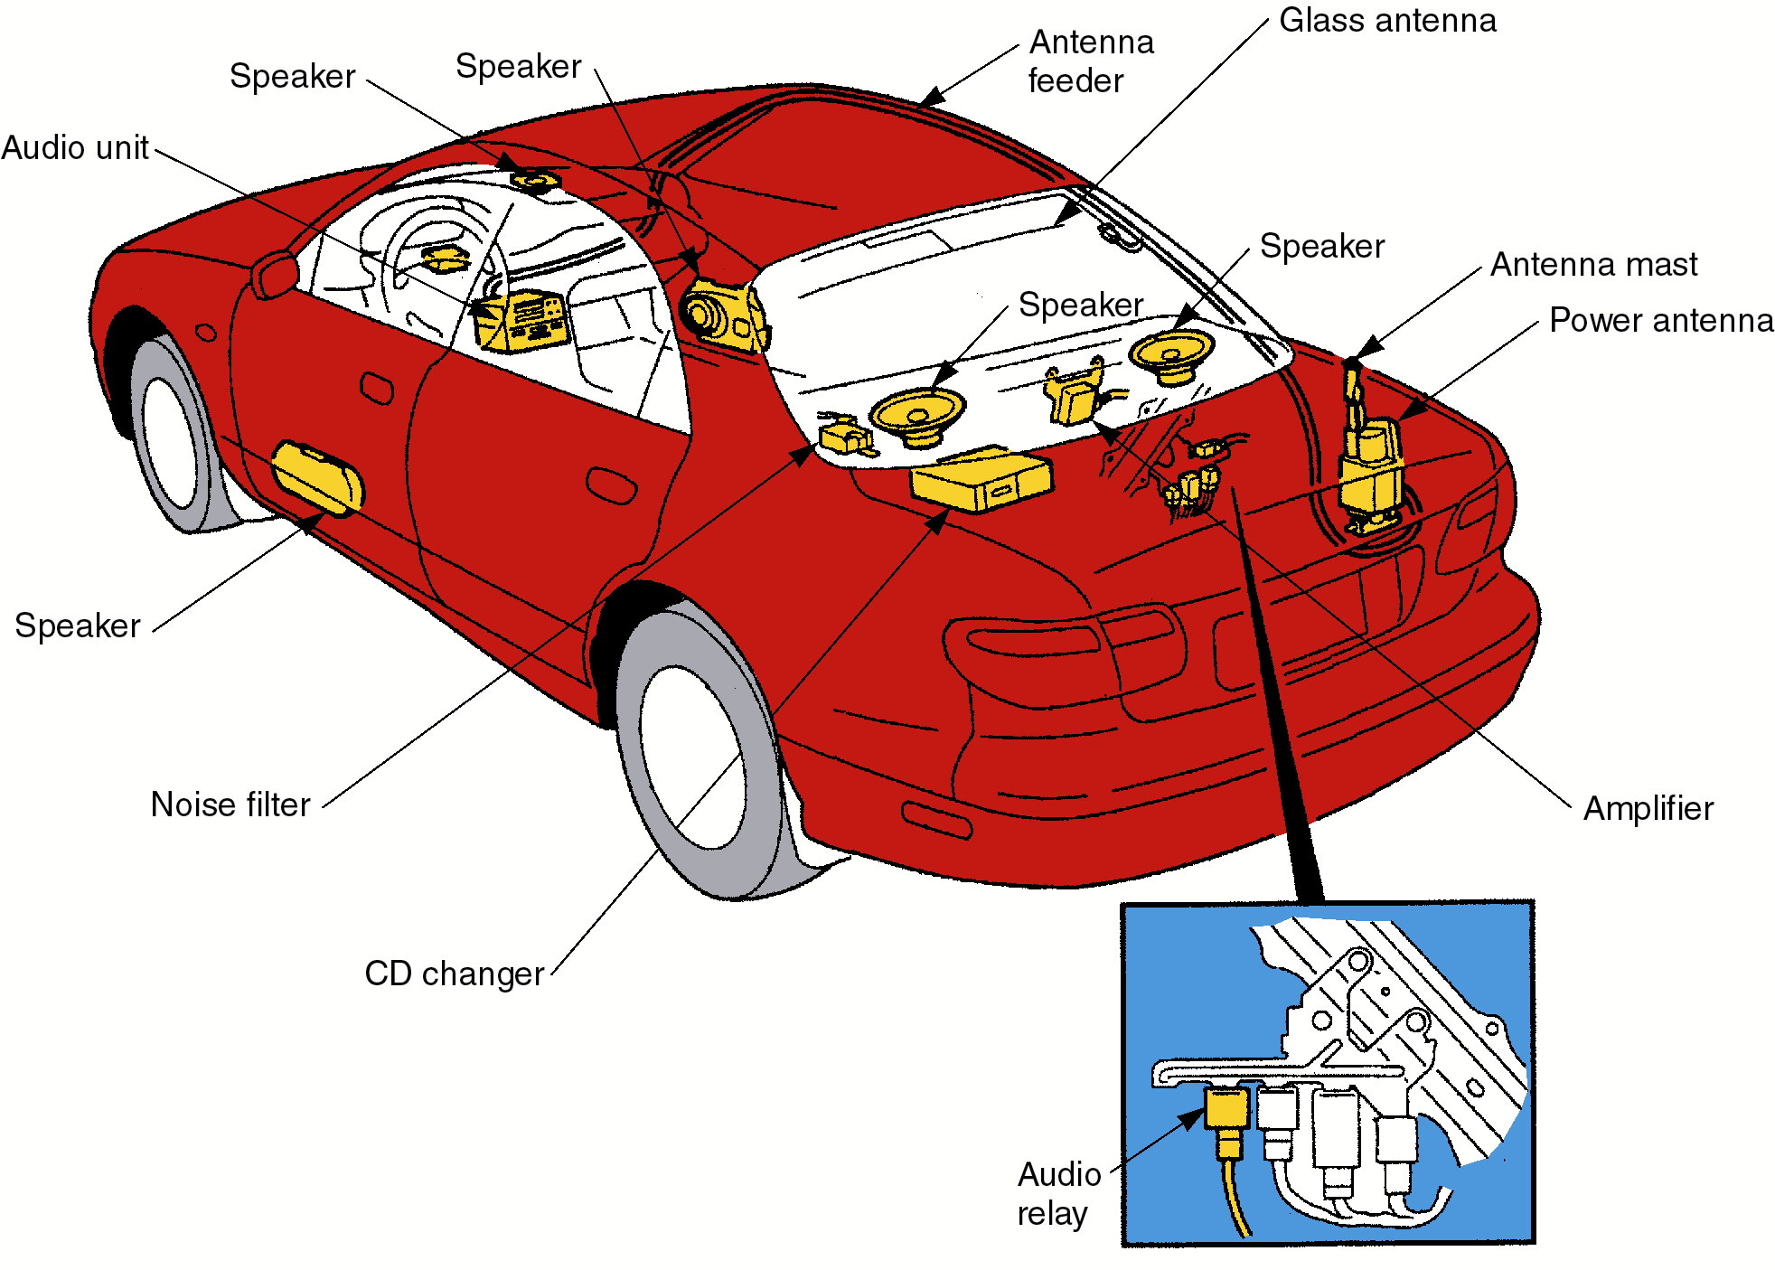
Sound Systems

Slide 6
Radio System
Components:
  antenna
  radio (receiver-amplifier)
  power supply circuit
  speakers

Slide 7
Basic Operation
The radio station broadcasts an electromagnetic signal
When the signal moves past the antenna, tiny electrical modulations (fluctuations) are induced in the antenna
The radio amplifies this signal to operate the speakers
The speaker diaphragm moves back and forth, producing air pressure waves

Slide 8
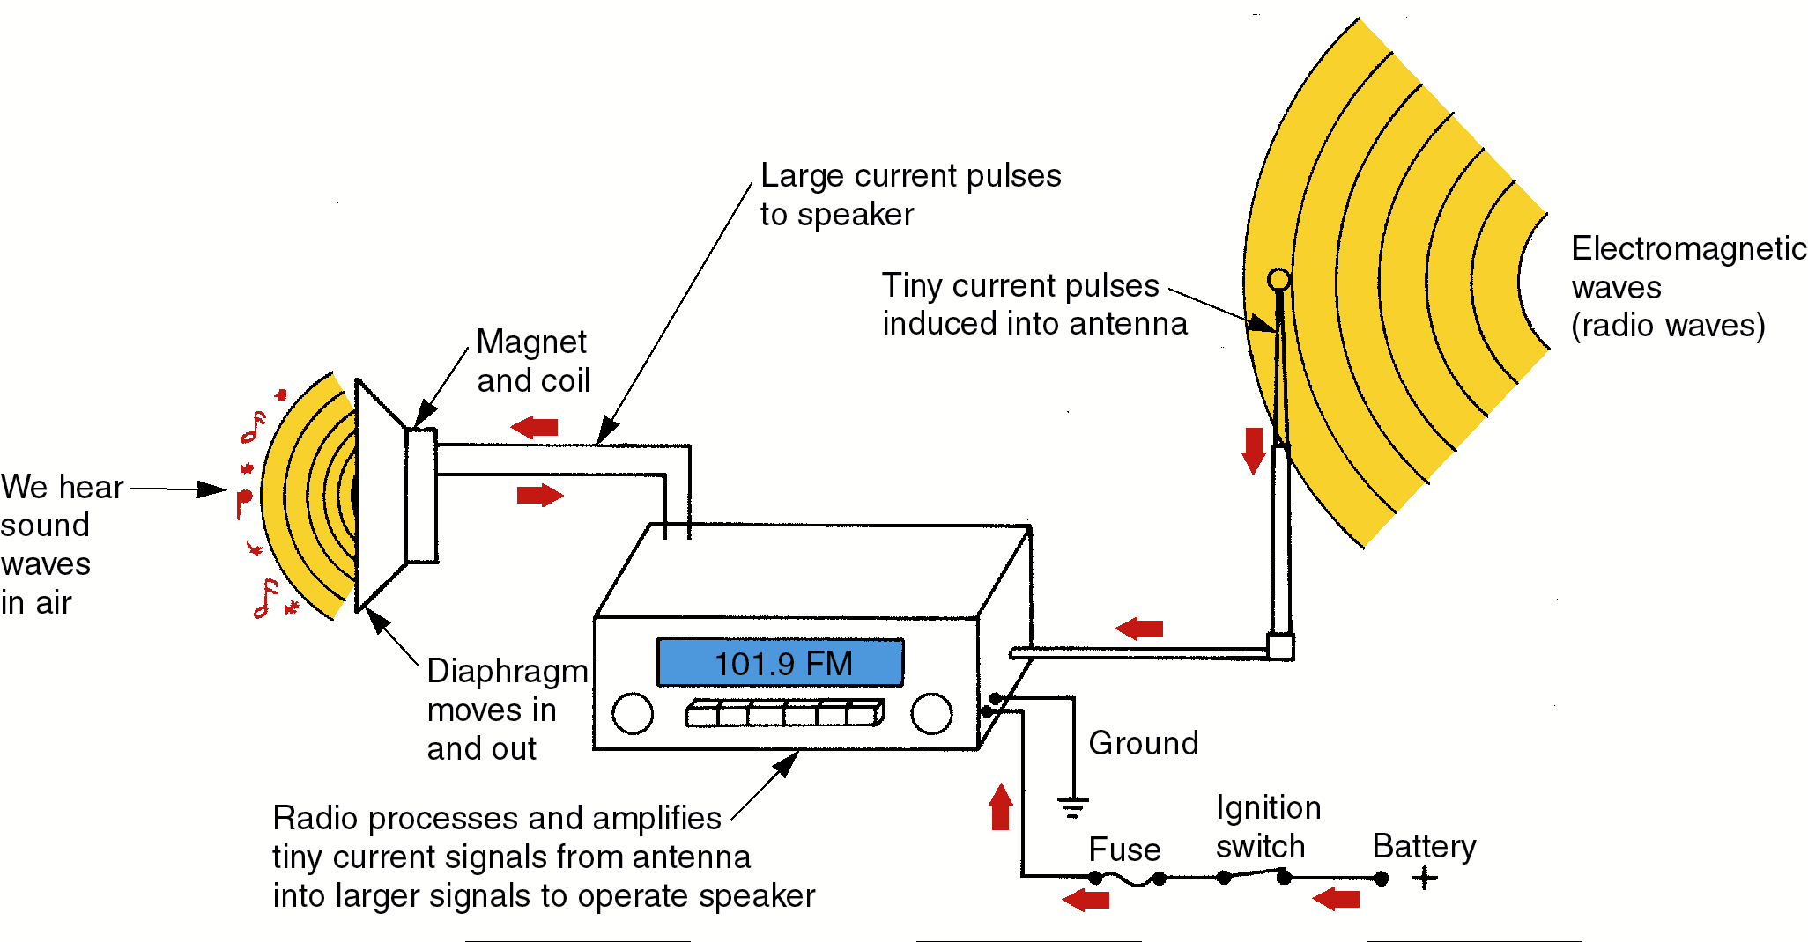
Basic Operation

Slide 9
Sound System
Components:
  AM/FM radio
  tape player
  amplifier
  sub-woofer speaker
  CD player
  power antenna

Slide 10
Radio
Electronic circuits that receive and amplify a radio signal to operate the speakers
The tuner is used to select frequencies

Slide 11
AM Radio
AM signals vary in amplitude (strength)
Frequency range: 530–1610 kilohertz (kHz)
The signal is reflected off the ionosphere, giving it long range

Slide 12
FM Radio
FM signals vary in frequency
Frequency: 88–108 megahertz (MHz)
The signal is not reflected off the ionosphere, limiting its range

Slide 13
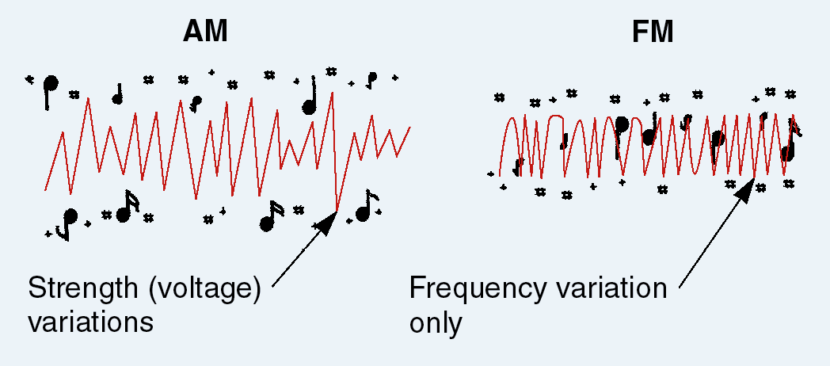
AM versus FM Signals

Slide 14
Radio Service
If a radio fails to work, check the fuse
Other external problems:
  power supply lead
  speakers and connections
Internal problems should be repaired by a radio repair technician

Slide 15
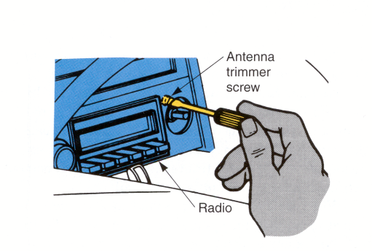
Antenna Trimmer Screw
Adjust for maximum volume and clarity

Slide 16
Antennas
Types:
  very fine piece of wire in window glass
  metal mast (rod)
A power antenna telescopes (extends) when the radio is turned on
An electric motor operates a cable or slide mechanism on the mast

Slide 17
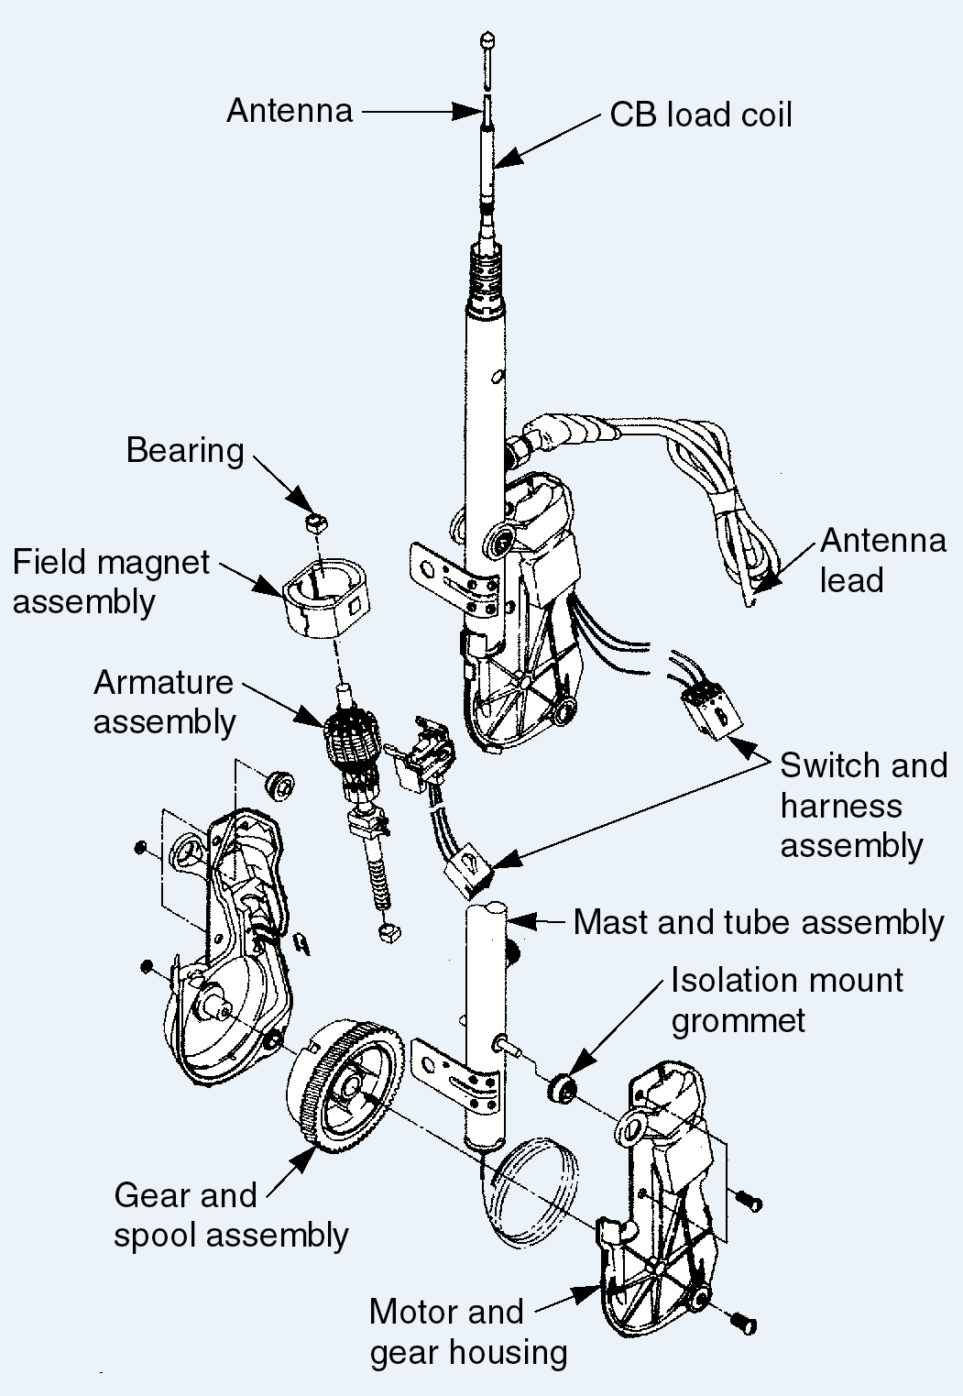
Power Antenna Components

Slide 18
Antenna Service
Connect a known good antenna
On a power antenna, check for power to the motor with a test light or voltmeter

Slide 19
Speakers
Permanent magnet and a coil of wire mounted on a flexible diaphragm that convert electricity into motion and sound
When current passes through the coil, magnetism pulls the coil and diaphragm toward the magnet
Rapid movement of the diaphragm causes pressure waves in the air (sound)

Slide 20
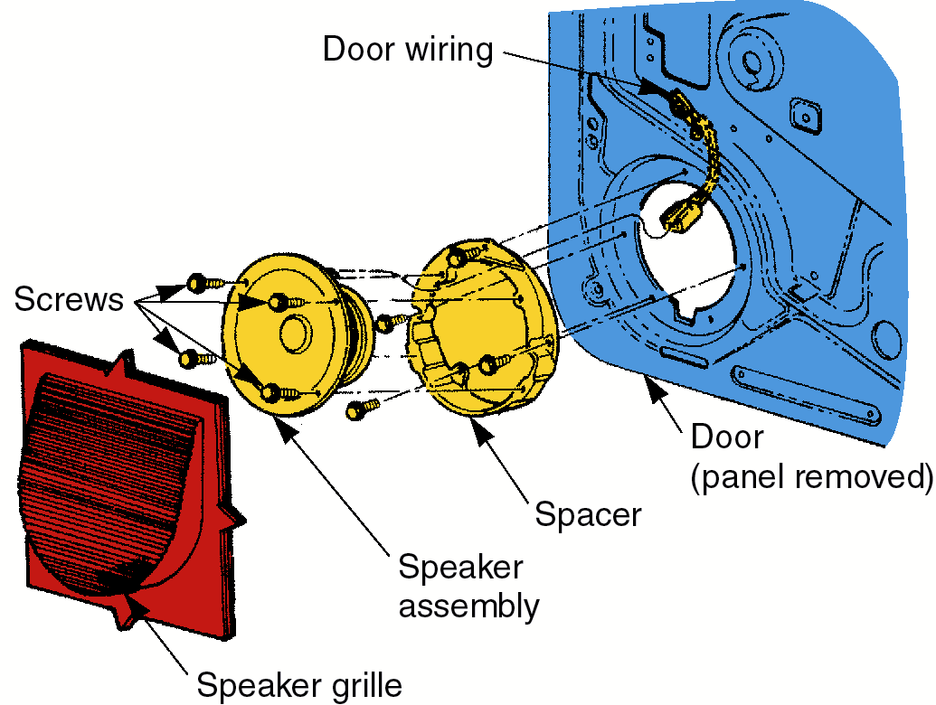
Speakers
Loose mounting screws may sound like a blown speaker

Slide 21
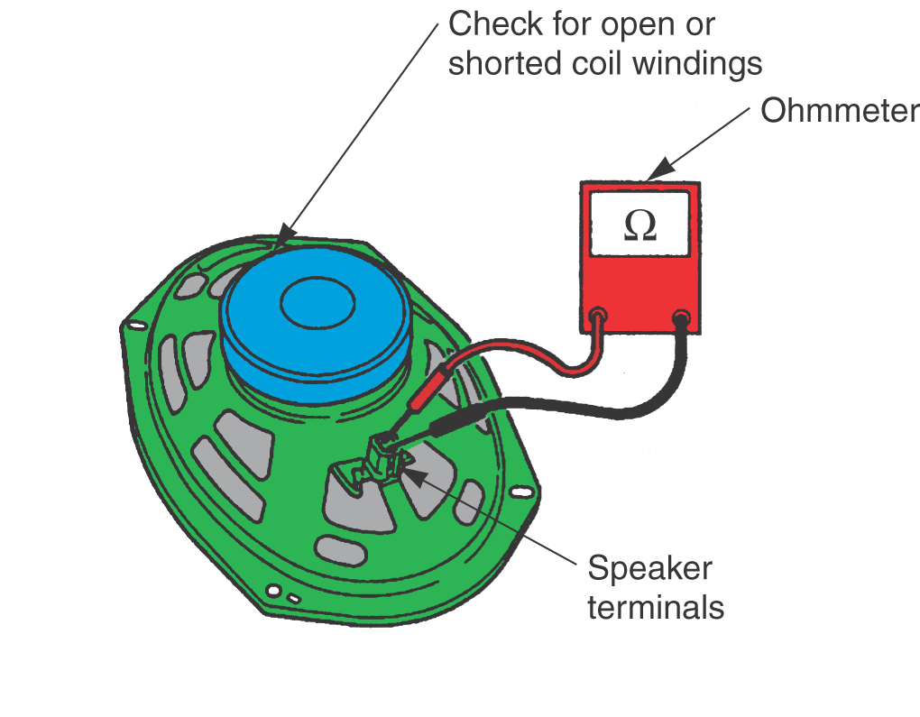
Speaker Service
Measure with an ohmmeter
4 or 8 ohms resistance

Slide 22
Tape Player
Remove any broken tapes
Clean the tape head
Check power and grounds

Slide 23
CD Players
Compact disc players
Use a plastic disc
Play music digitally
Locations:
  in dash
  in trunk

Slide 24
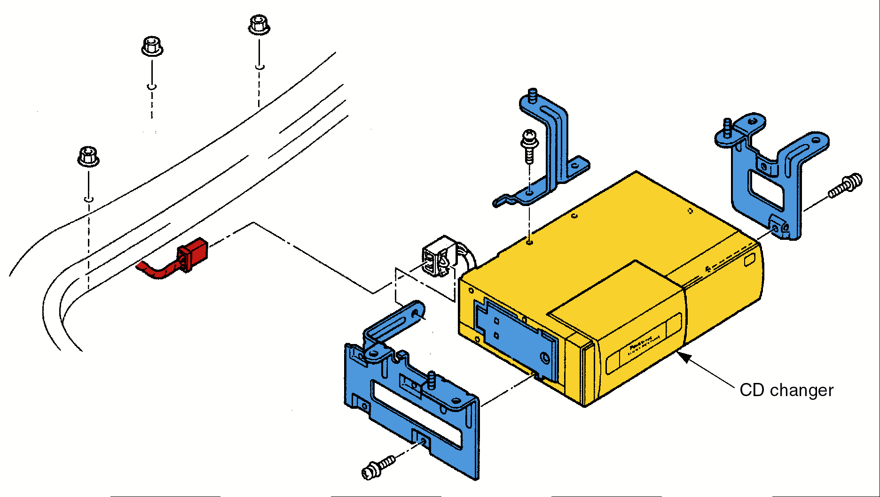
CD Player
Check for stuck CDs, dirty heads,
power, and grounds

Slide 25
Radio Noise
Interference or static (popping, clicking)
Causes:
  faulty antenna
  open or shorted noise suppressor (capacitor)
  faulty spark plug wire
  faulty radio
  distant stations

Slide 26
Radio Noise
A noise that changes with engine speed may be caused by faulty ignition or charging systems
Noise suppressors are capacitors that absorb voltage fluctuations, smoothing the current
  found at the alternator, ignition coil, distributor, or blower motor

Slide 27
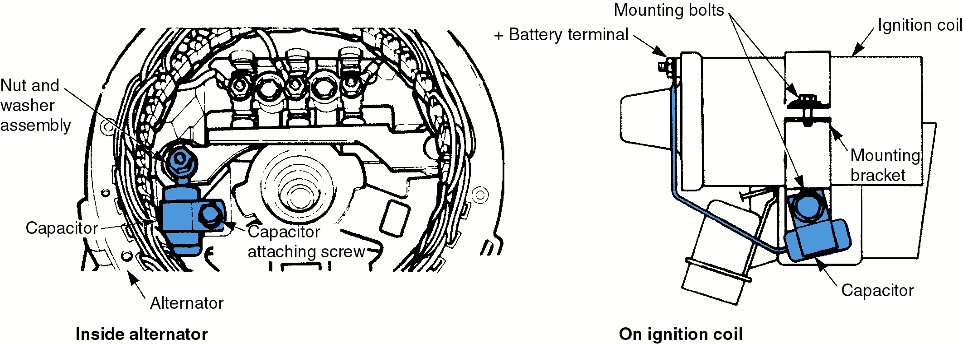
Noise Suppressors
Two common locations

Slide 28
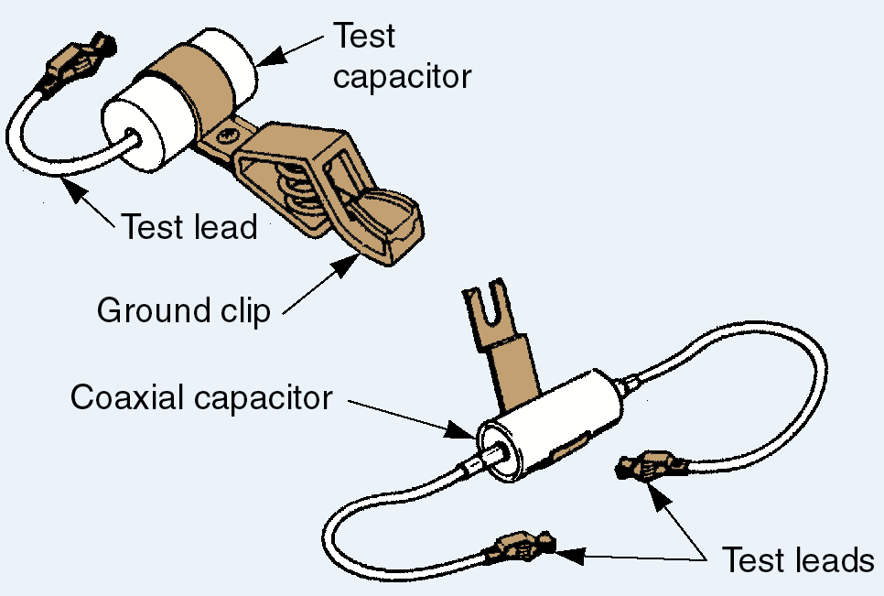
Clip-On Capacitor
If the static quiets when the test unit is connected, the old capacitor is bad

Slide 29
Power Seats
Components:
  fuses or circuit breakers
  switches
  electric motor and drive assembly
  related wiring
When activated by a switch, the reversible dc motors operate a gear mechanism, positioning the seat

Slide 30
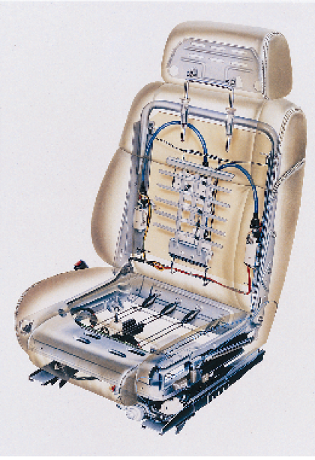
Power Seat
Headrest
Back
cushion
Rear
vertical
motor
Seat removal may be needed to service the seat motors
Lumbar
motor
Seat
cushion
Power seat switches
Seat track
Slide motor

Slide 31
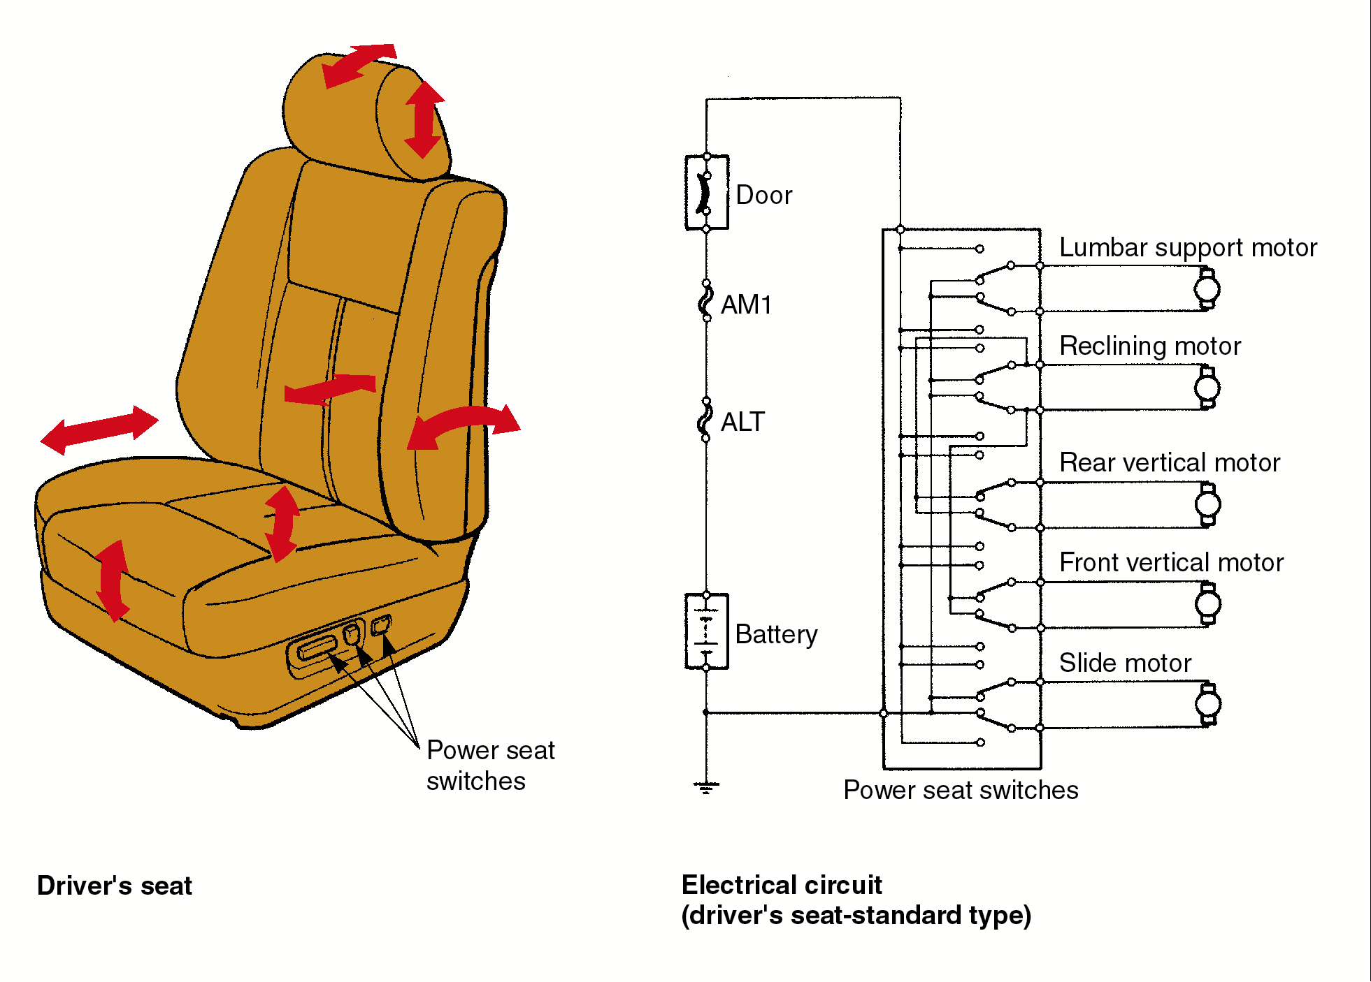
Power Seat
Each motor operates different
seat adjustments

Slide 32
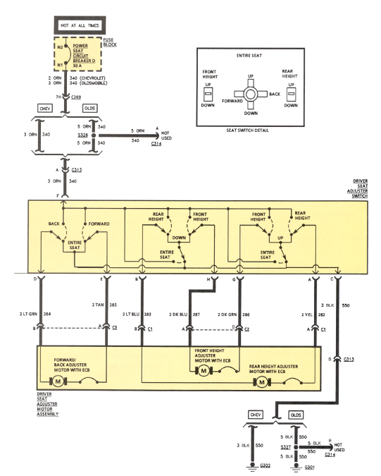
Power Seat
System

Slide 33
Memory Seats
A small computer “remembers” seat positions for several drivers
May be networked to remember seat, steering wheel, rearview mirror, and electronic suspension settings for each driver

Slide 34
Power Seat Service
Verify if one or both seats fail to function
If both seats fail, check common circuits such as fuses, circuit breakers, and connections
If only one seat fails, check the components affecting only that seat

Slide 35
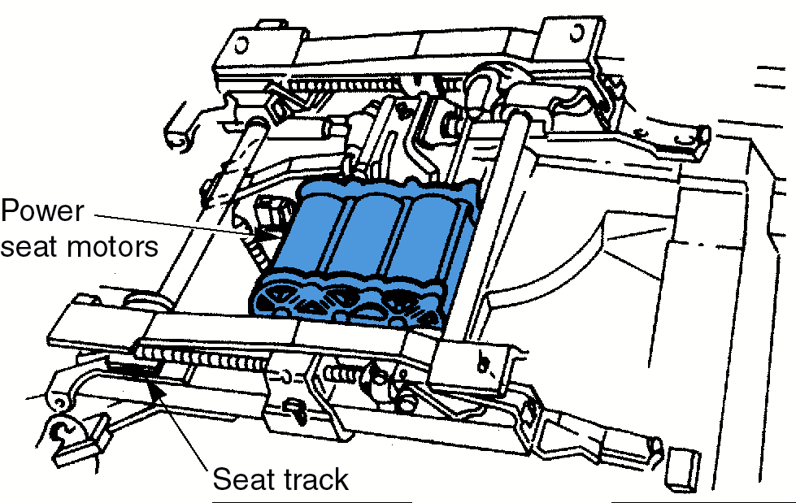
Power Seat Mechanism

Slide 36
Heated Seats
Components:
  heating element
  switch
  relay
  related wiring
Warms the seat cushions in cold weather using internal resistance wires

Slide 37
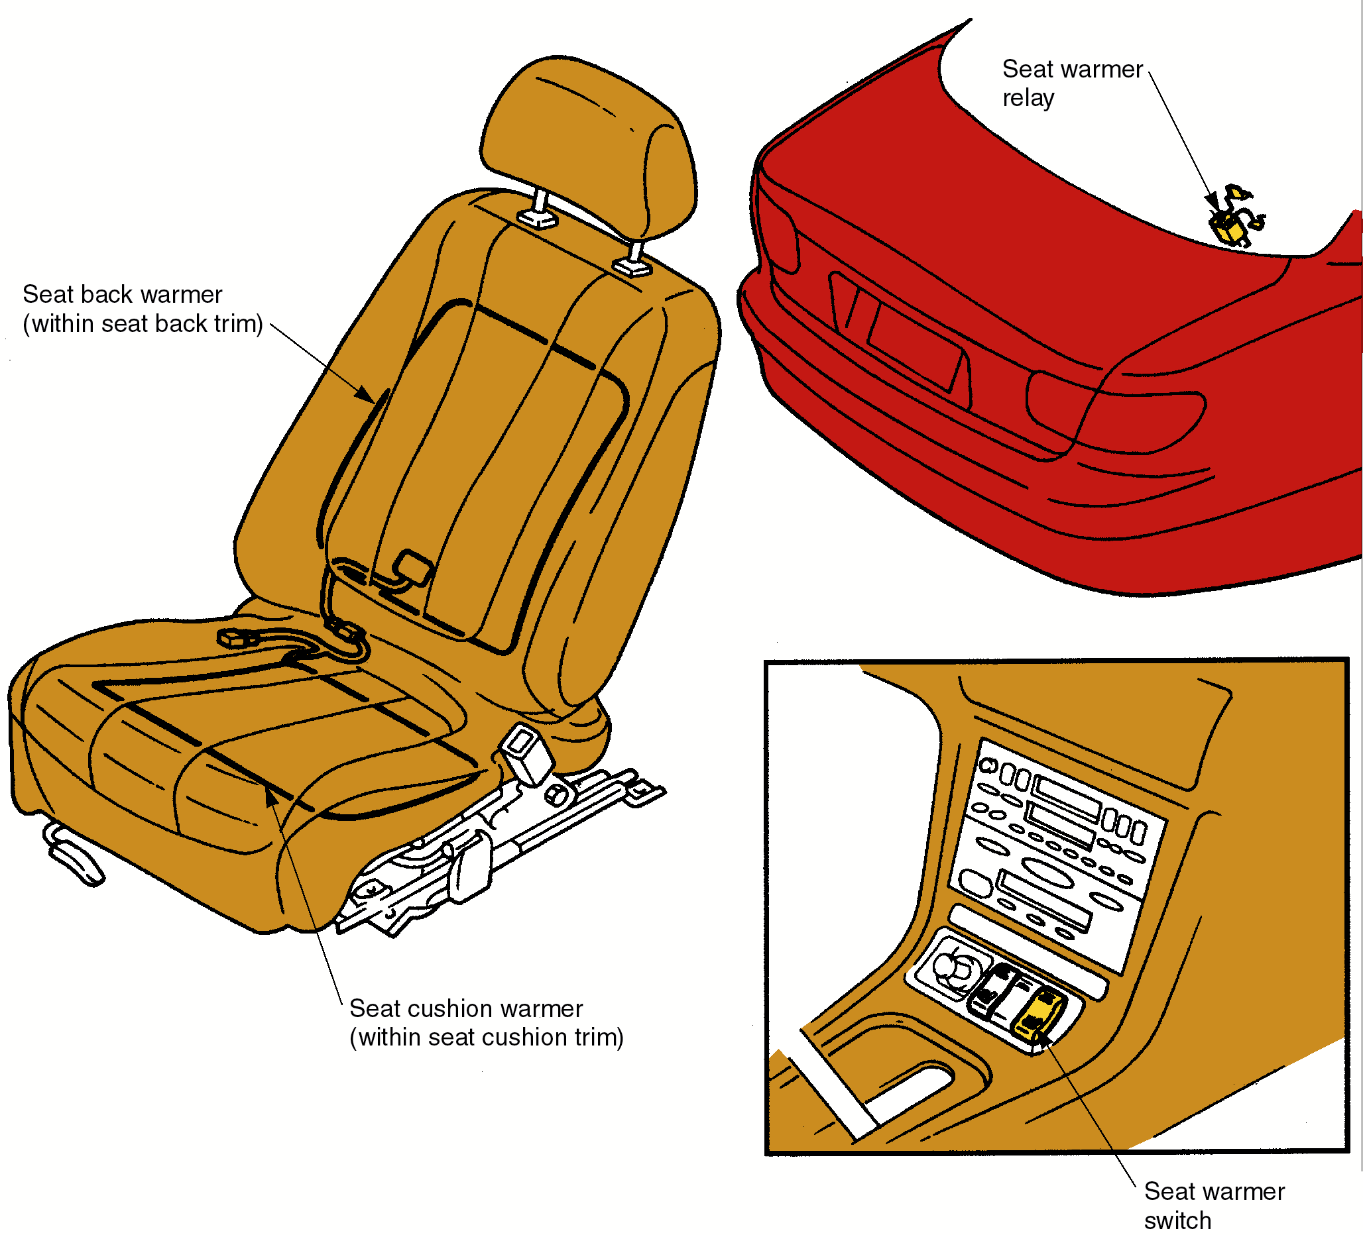
Heated Seats
Check for power to the
resistance wires
Check the resistance wires with an ohmmeter

Slide 38
Power Windows
Components:
  control switches
  reversible electric motor
  circuit breaker
  fuse
  related wiring
Operate some or all of the car’s side windows electrically

Slide 39
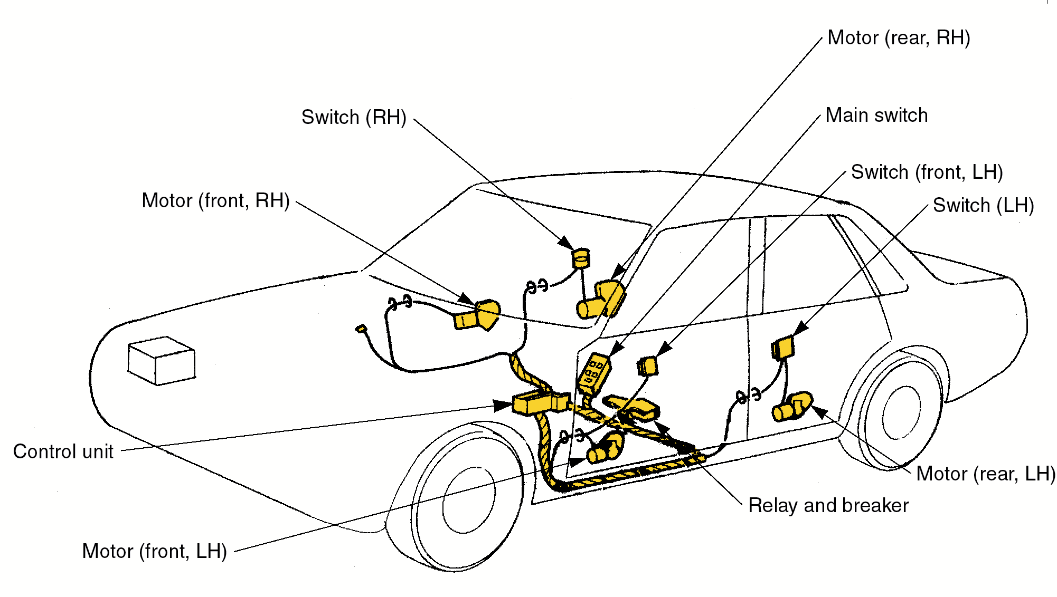
Power Window System

Slide 40
Power Windows
A motor and regulator mechanism is located in each door
A gearbox converts the motor’s rotary motion to linear motion to drive the window up and down
A circuit breaker protects the motor if the switch is held on one position too long or if window is frozen in place

Slide 41
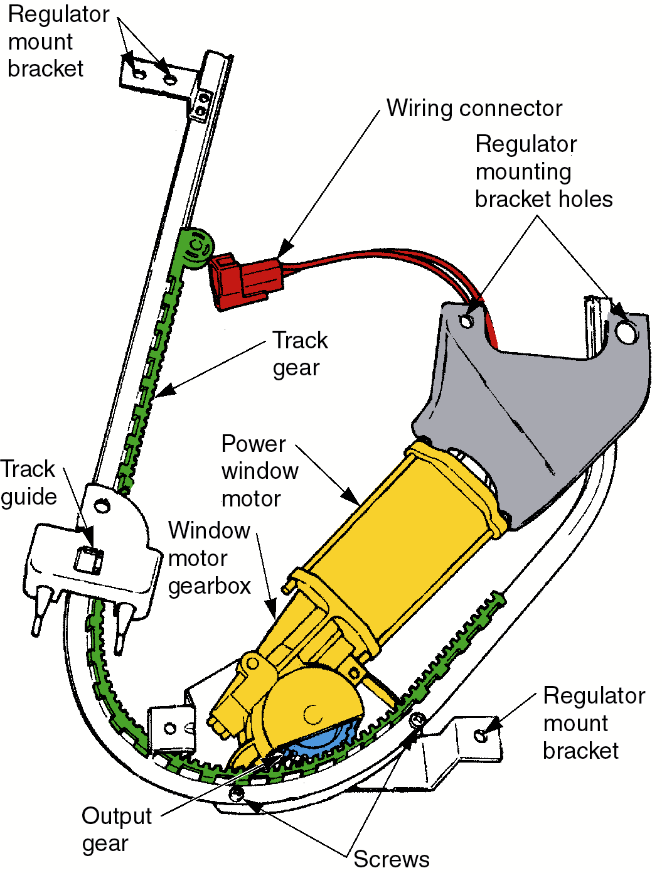
Motor and Regulator

Slide 42
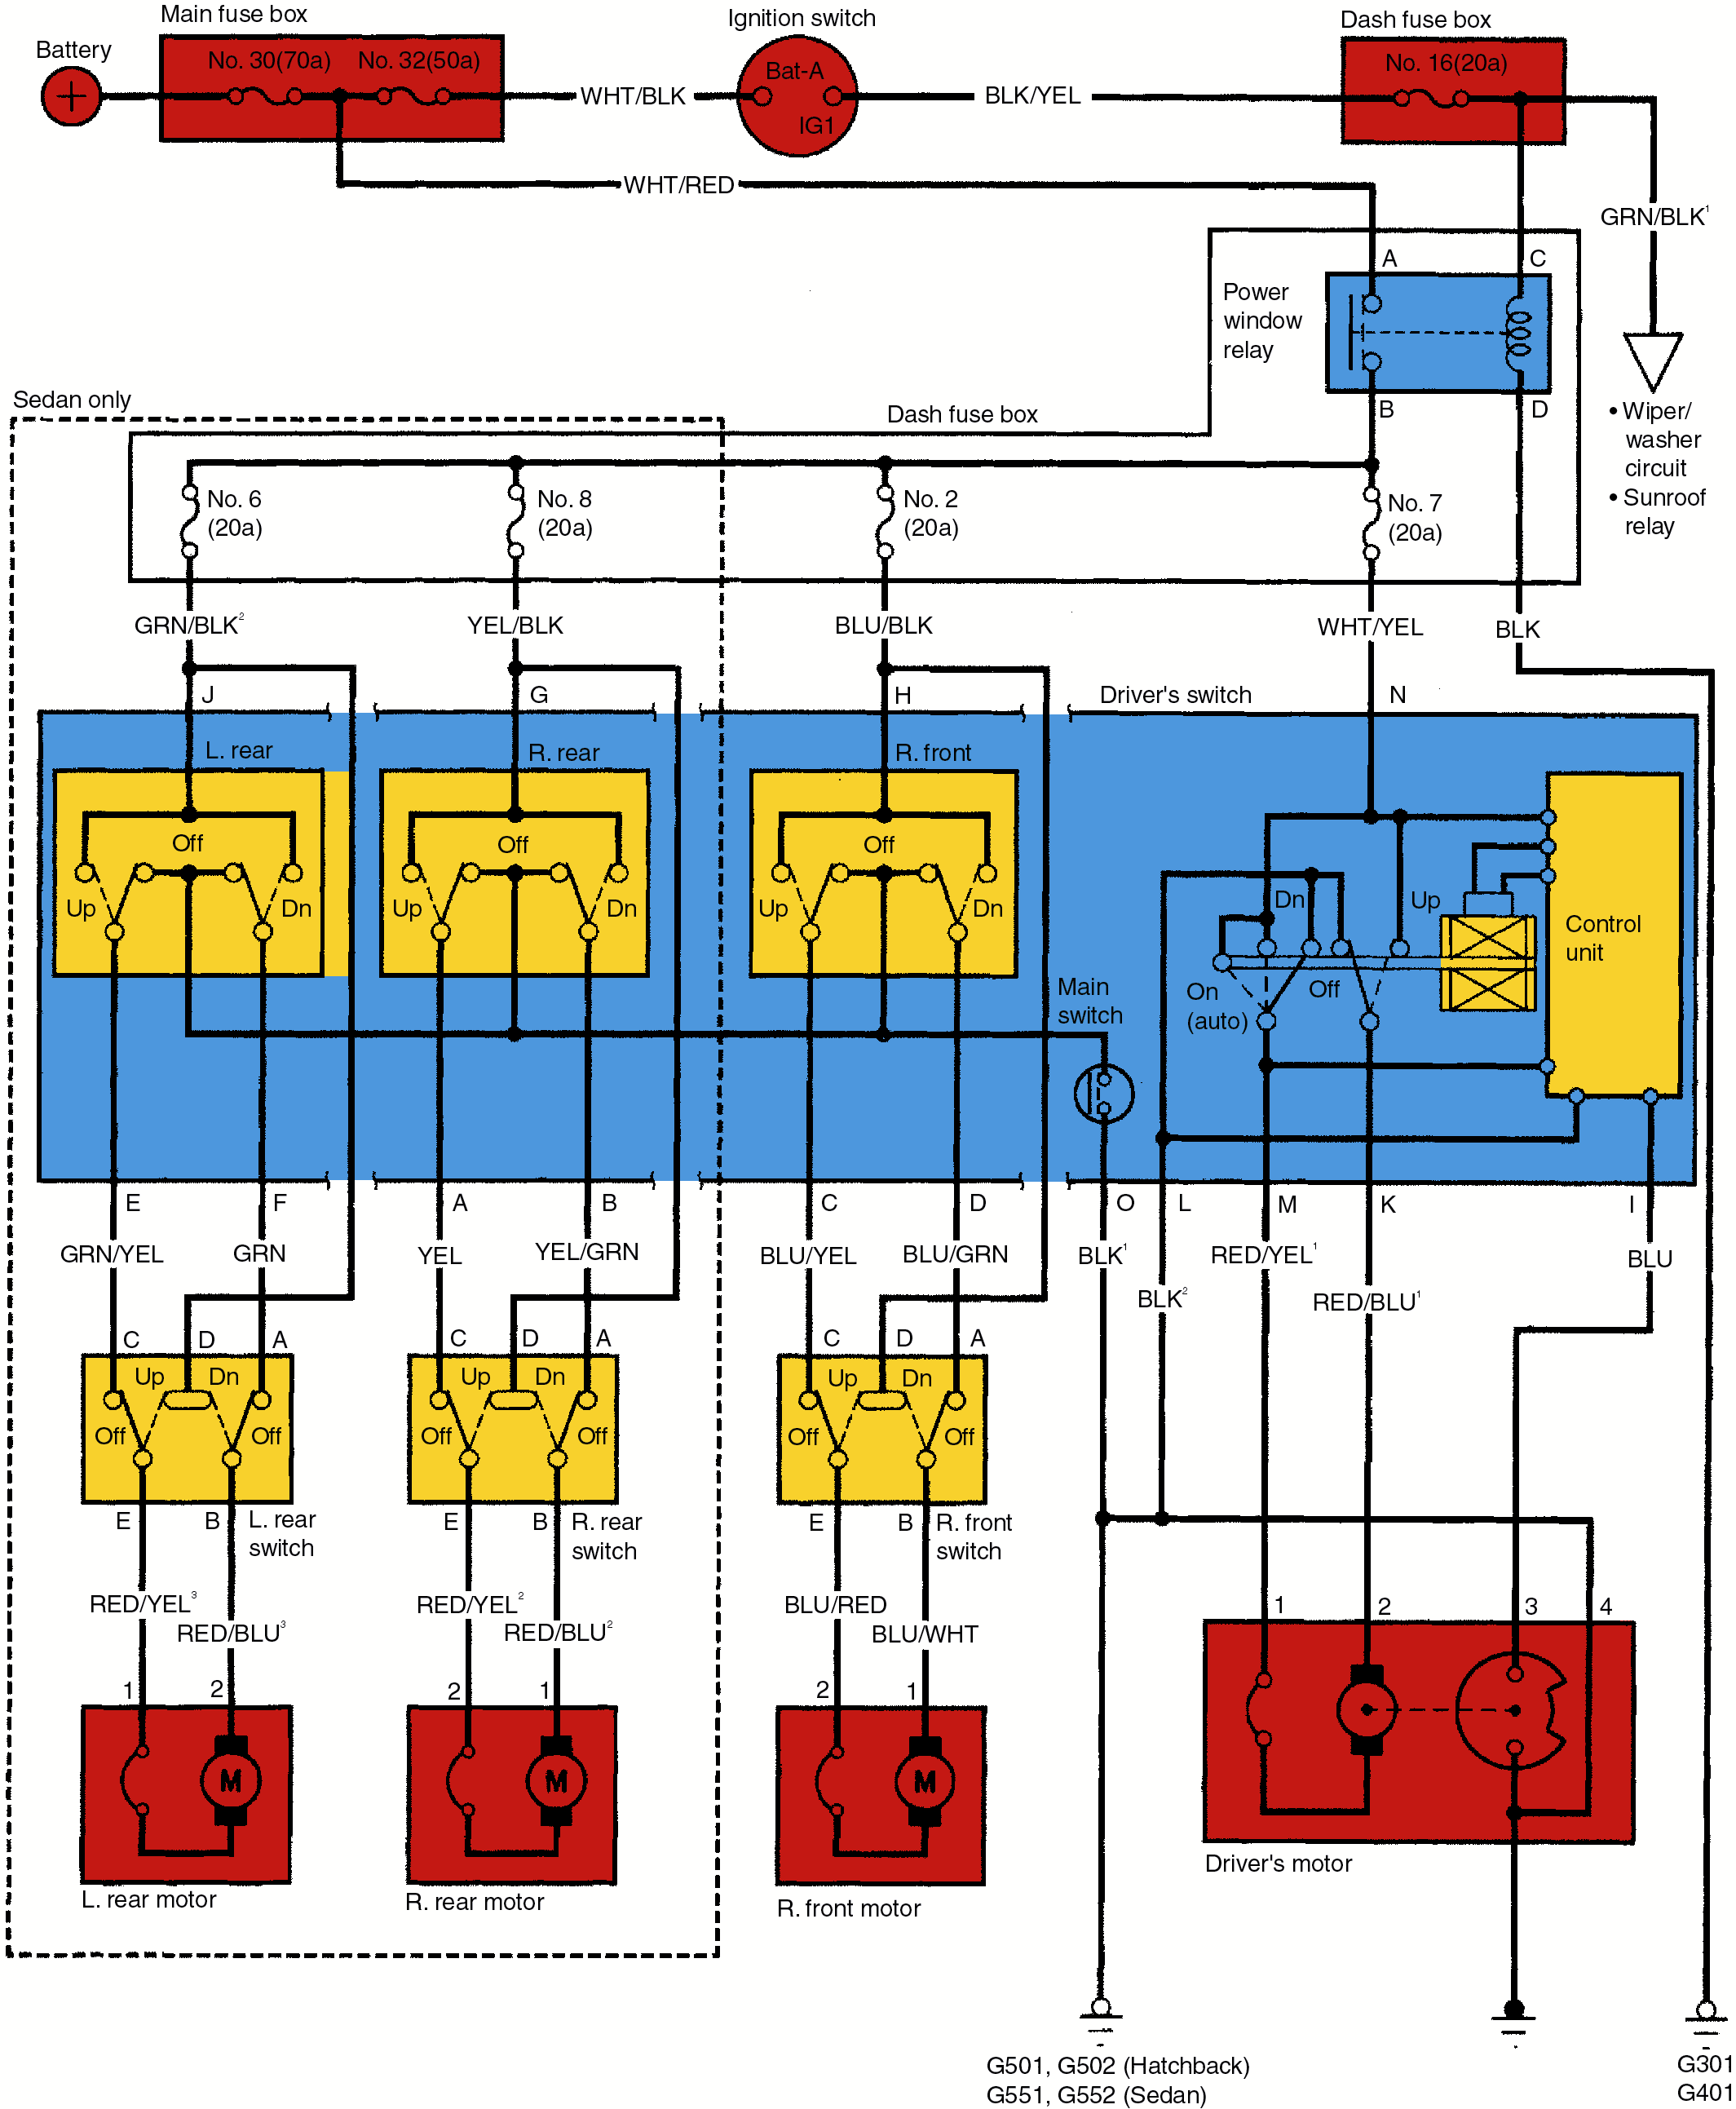
Power Window Circuit

Slide 43
Power Door Locks
Components:
  switches
  solenoids or motors
  fuse
  related wiring
Operate the door lock mechanisms

Slide 44
Power Door Locks
When the door key is turned, or the interior switch is closed, the motors or solenoids move the arms on the door latches to lock or unlock the doors
If all locks fail, check the main fuse and connections
If only one door lock fails, check its switch and solenoid or motor

Slide 45
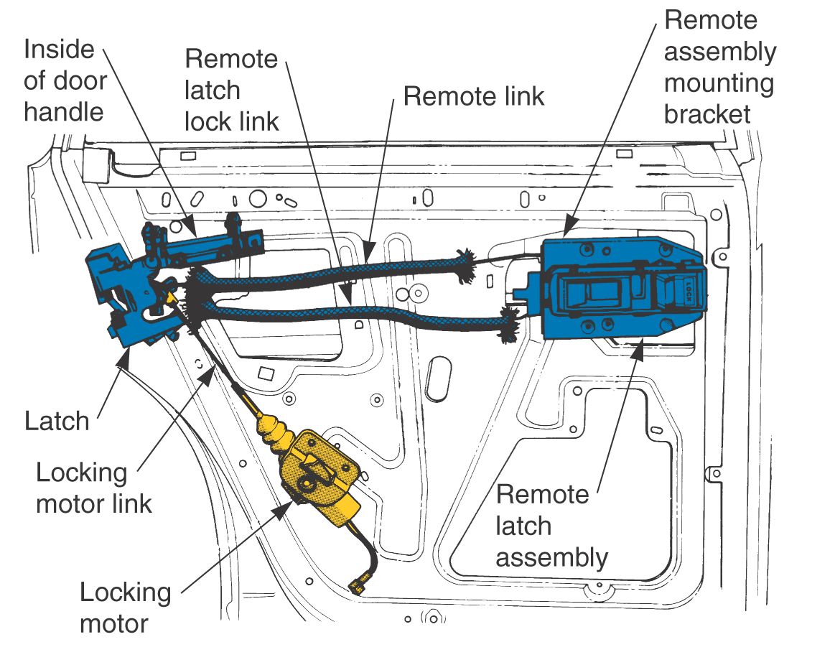
Power Door Lock System

Slide 46
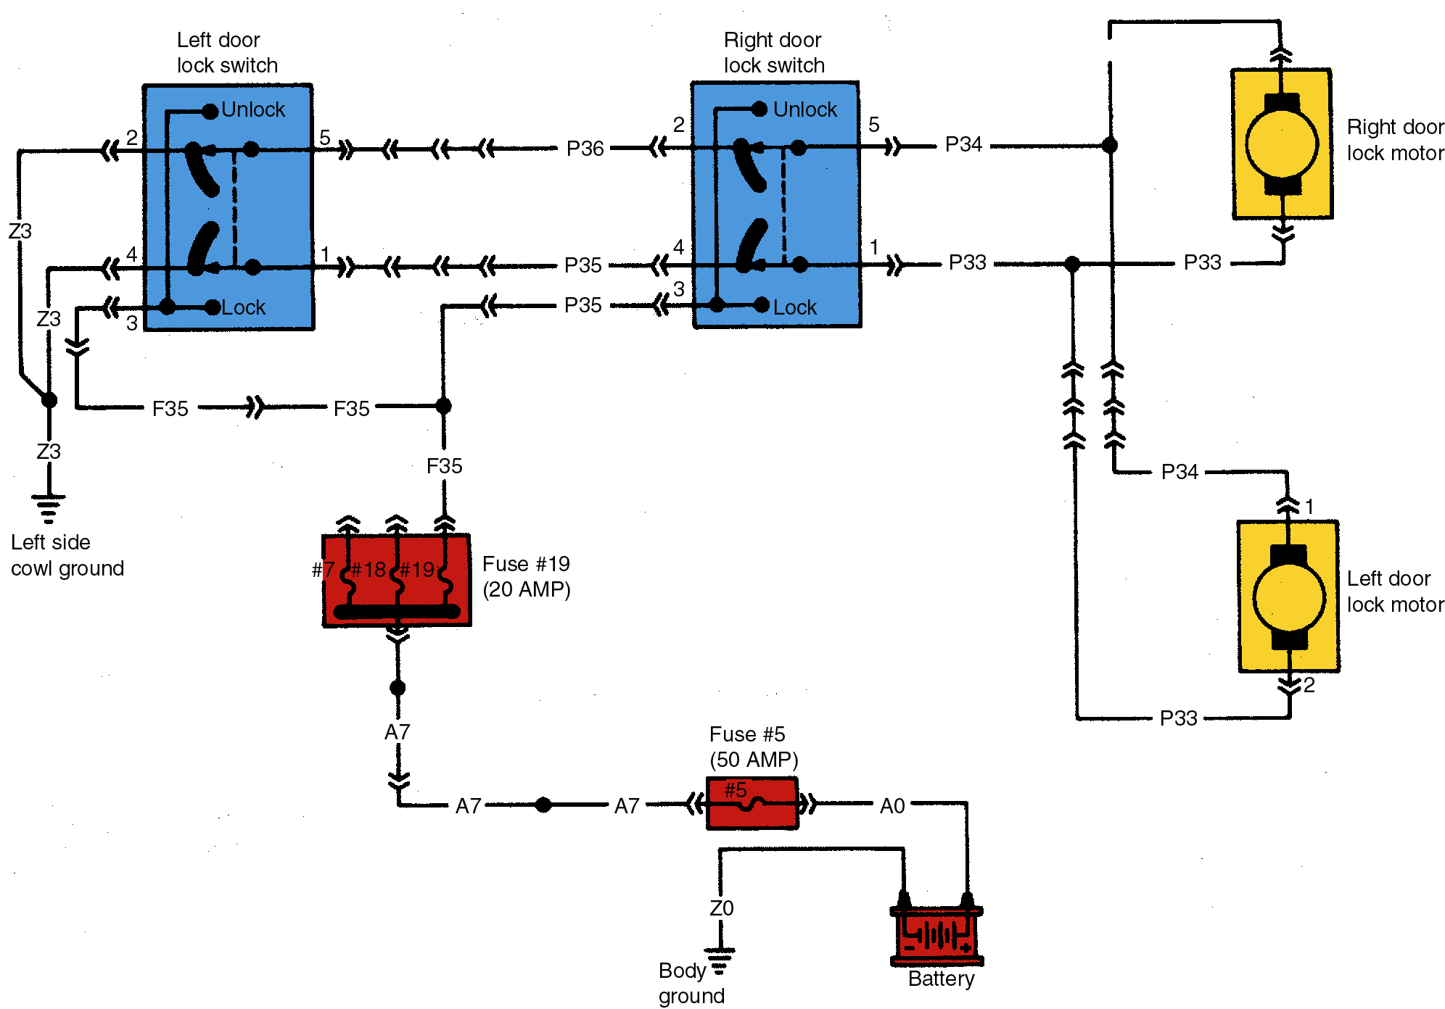
Power Door Lock Circuit

Slide 47
Power Trunk Release
Components:
  solenoid mounted on the trunk latch
  fuse
  switch
When the trunk release switch is closed, it sends power to the trunk latch
The trunk pops open
Most problems are in the switch or solenoid

Slide 48
Power Steering Wheel
Components:
  computer
  switches
  sensors
  motors
Automatically tilts and telescopes the steering wheel

Slide 49
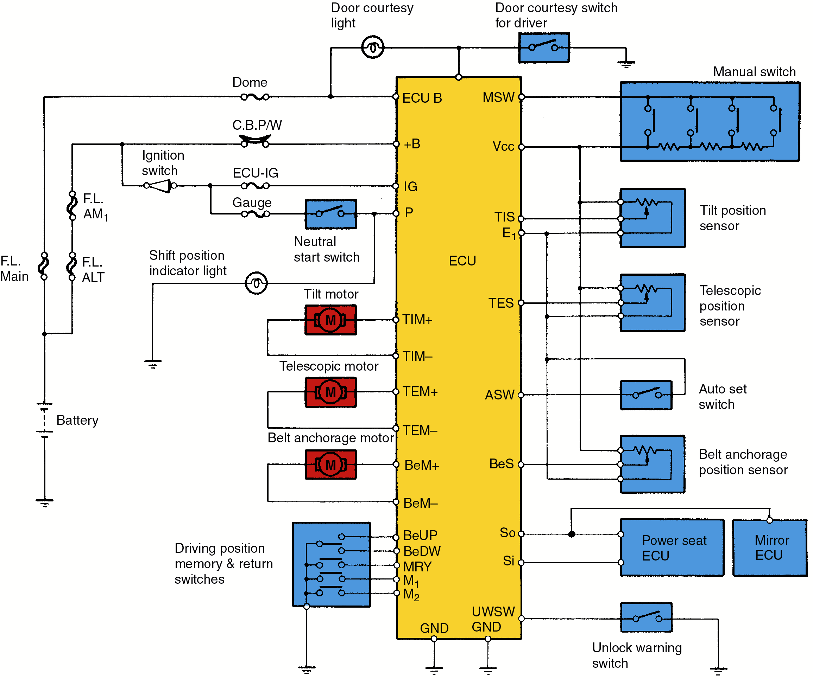
Power Steering
Wheel Circuit
Programmed to position for each driver

Slide 50
Rear Window Defogger
Components:
  switch
  relay
  indicating light
  window heating grid
When switched on, current flows to the heating grid, causing it to heat up
The grid is composed of resistance wire on or in glass

Slide 51
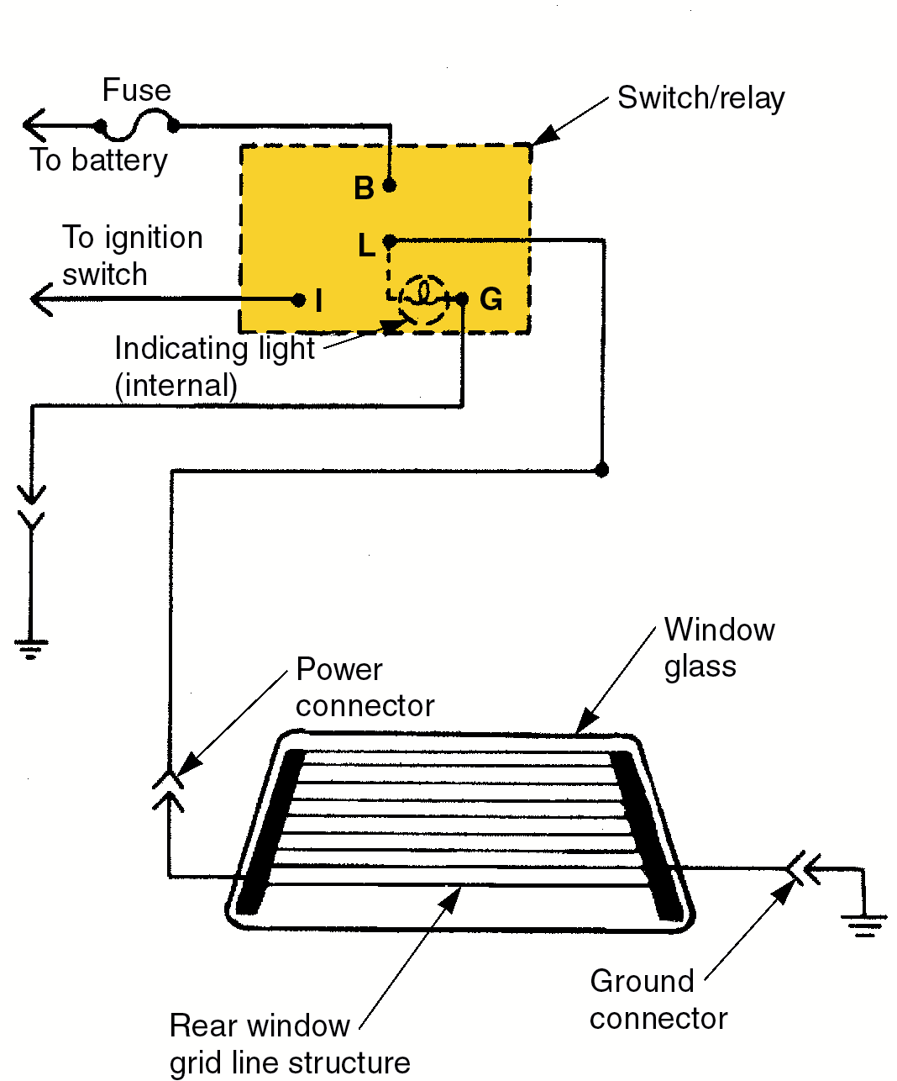
Rear Window Defogger Circuit

Slide 52
Heated Windshield
A special conductive film is sandwiched inside the windshield glass
  made of zinc and tin oxide material
When high voltage (70–90 volts) is applied to the film, the glass heats up, melting ice and snow

Slide 53
Reminder System
Warning or chime system
Warns driver of several conditions
  seat belts are not fastened, engine on
  keys in ignition, engine off
  headlamps on, engine off

Slide 54
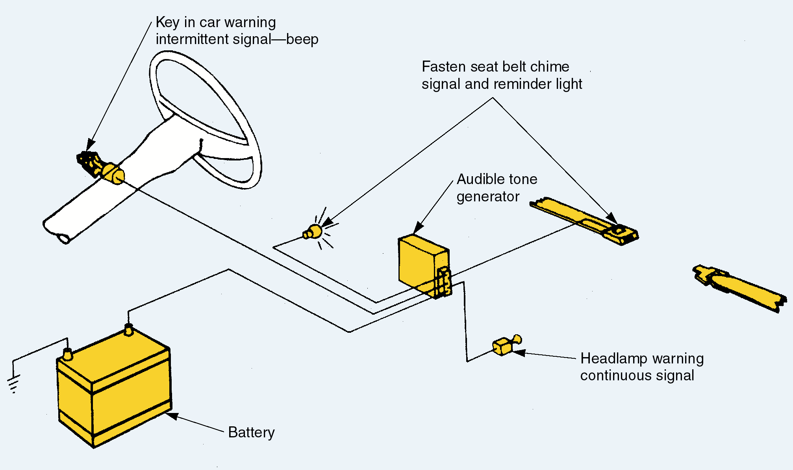
Reminder System

Slide 55
Cruise Control System
Uses a computer, sensors, and a throttle actuator to maintain vehicle speed

Slide 56
Components
Power switches
  feed current to the computer
  activate the system
Control switch
  signals the computer to maintain the present vehicle speed
Vehicle speed sensor
  feeds a pulsing signal into the computer
  the signal represents the car’s velocity

Slide 57
Components
Cruise control module
  uses input signals to control outputs to the throttle actuator
Throttle actuator (servo)
  physically moves the engine throttle lever
  controls engine power and vehicle speed
Brake light switch
  signals the computer to shut off the cruise control when the brakes are applied

Slide 58
Components
Clutch switch
  signals the computer to deactivate the cruise control when the clutch pedal is depressed
Neutral safety switch
  signals the computer to shut off the cruise control when the shift lever is moved out of drive

Slide 59
Operation
When driver activates system, power is fed to the cruise control module
The module activates the speed control servo (throttle actuator)
The servo pulls on throttle linkage to maintain vehicle speed
The speed sensor sends pulses to the cruise control module to monitor speed

Slide 60
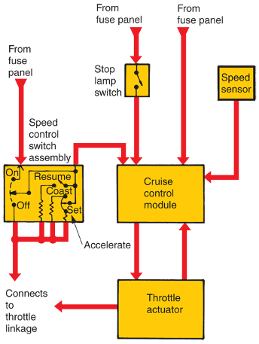
Electronic Cruise Control System

Slide 61
Cruise Control Service
Check the following:
  fuse
  power feed and grounds
  brake light switch
  on and resume switch operation
  vacuum actuator and lines if equipped
The computer is usually suspected only after these checks

Slide 62
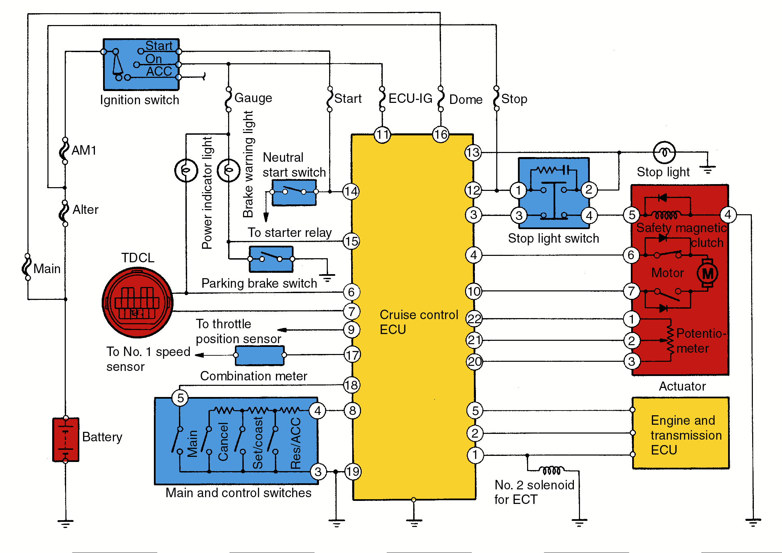
Electronic Cruise Control Circuit

Slide 63
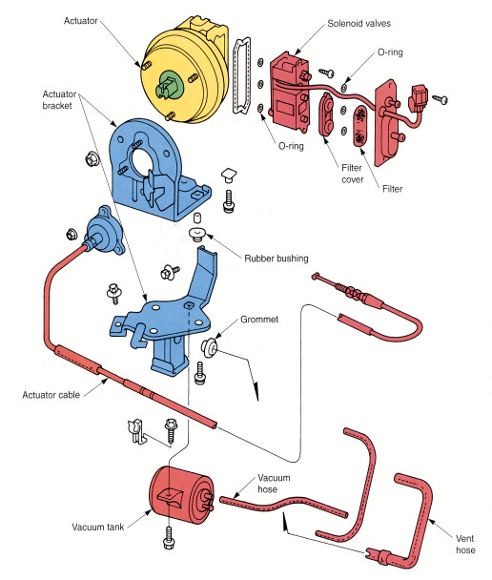
Electro-Pneumatic Actuator
Solenoids control vacuum to the diaphragm

Slide 64
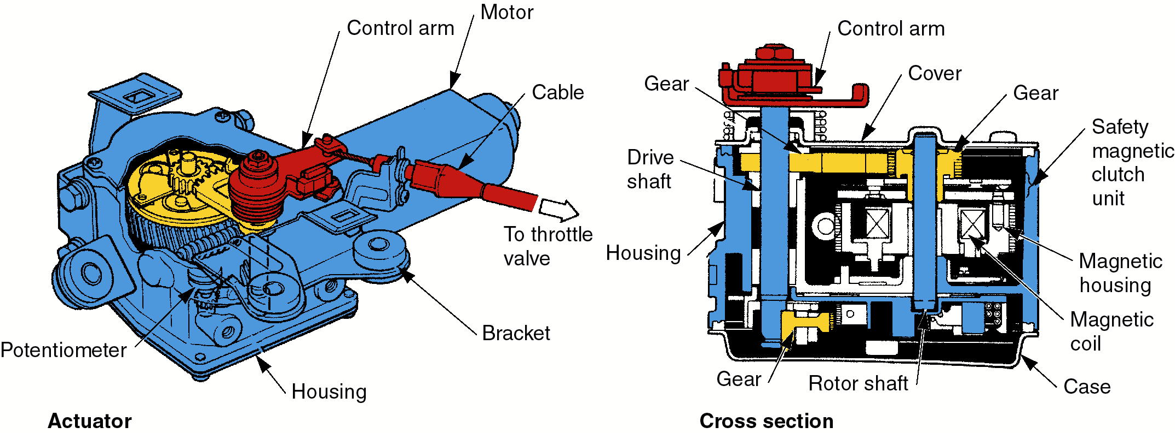
Motor-Operated Actuator
The ECU drives the motor in the
desired direction

Slide 65
Power Mirrors
Tiny reversible electric motors tilt the side view mirror into different positions
A multiposition “joy switch” energizes each motor
If neither mirror works, check the fuse and power supply circuit
If only one mirror fails, check its switch and motors

Slide 66
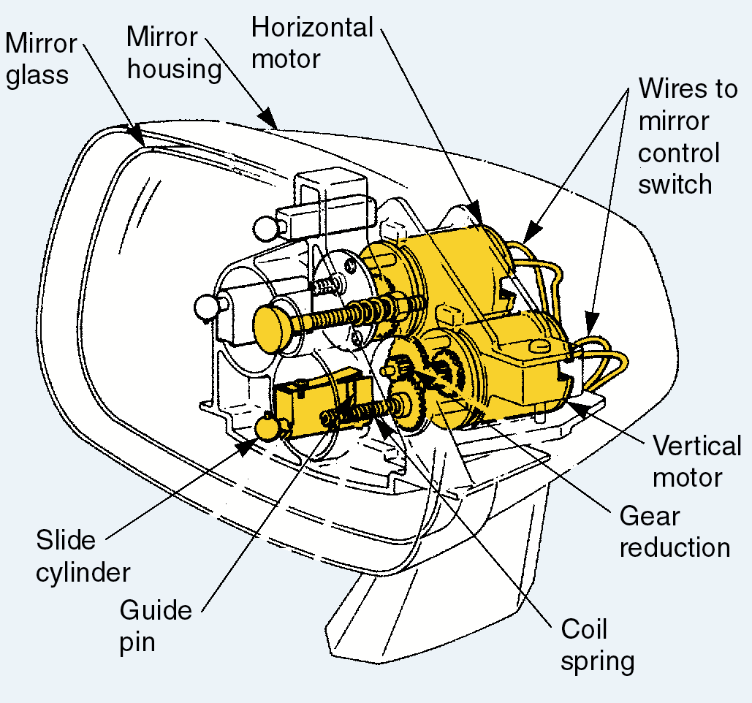
Power Mirror

Slide 67
Cellular Mobile Telephone
Uses a transceiver to communicate with other people via phone station towers
Some can be used hands-free

Slide 68
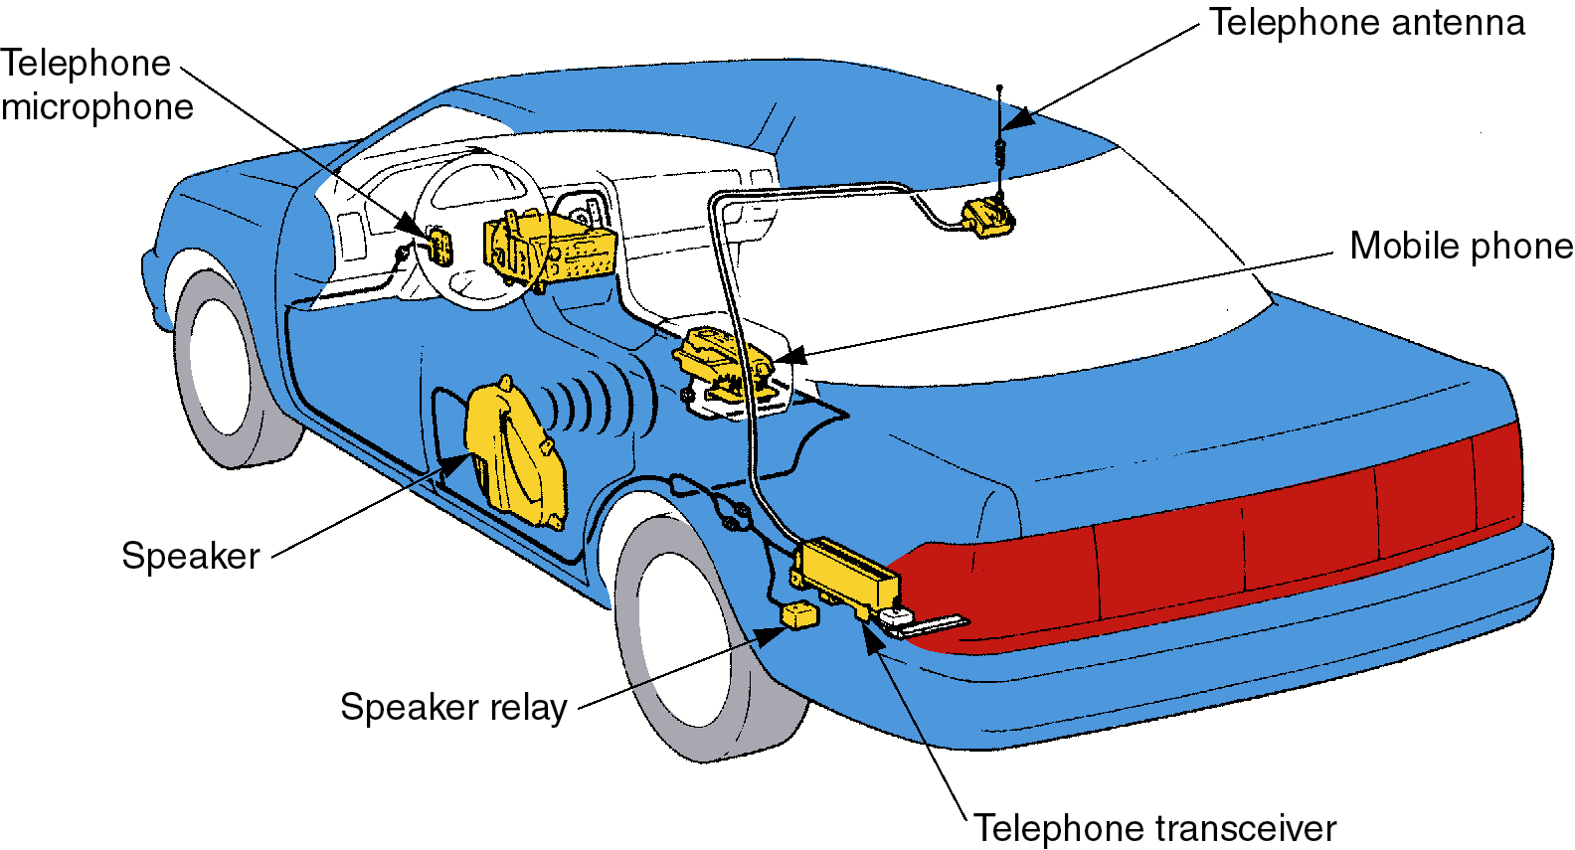
Cellular Phone System

Slide 69
Driver Information Center
Components:
  computer
  small speaker or digital display
  sensors and switches
Informs driver of various conditions
Outputs a display or spoken words
  e.g. “Your washer fluid is low”

Slide 70
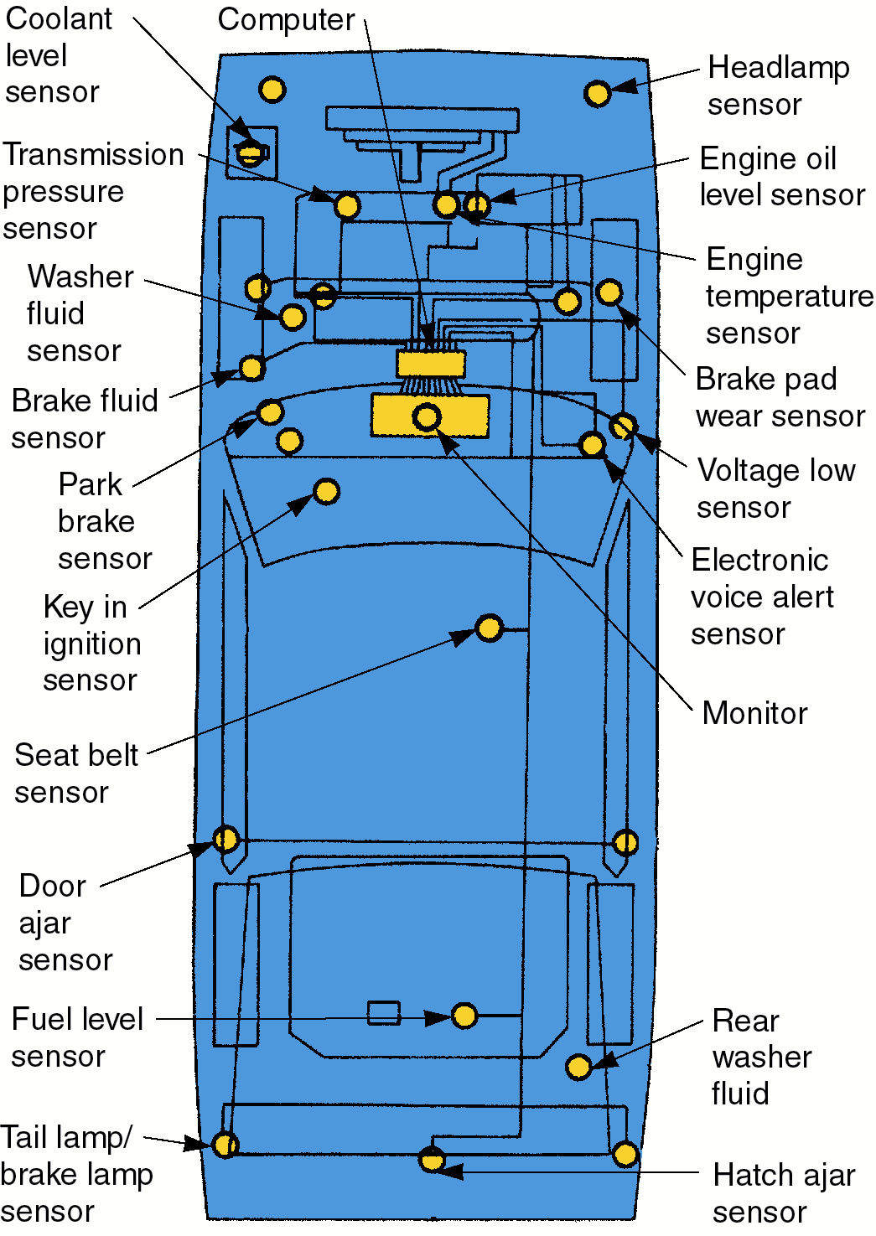
Components

Slide 71
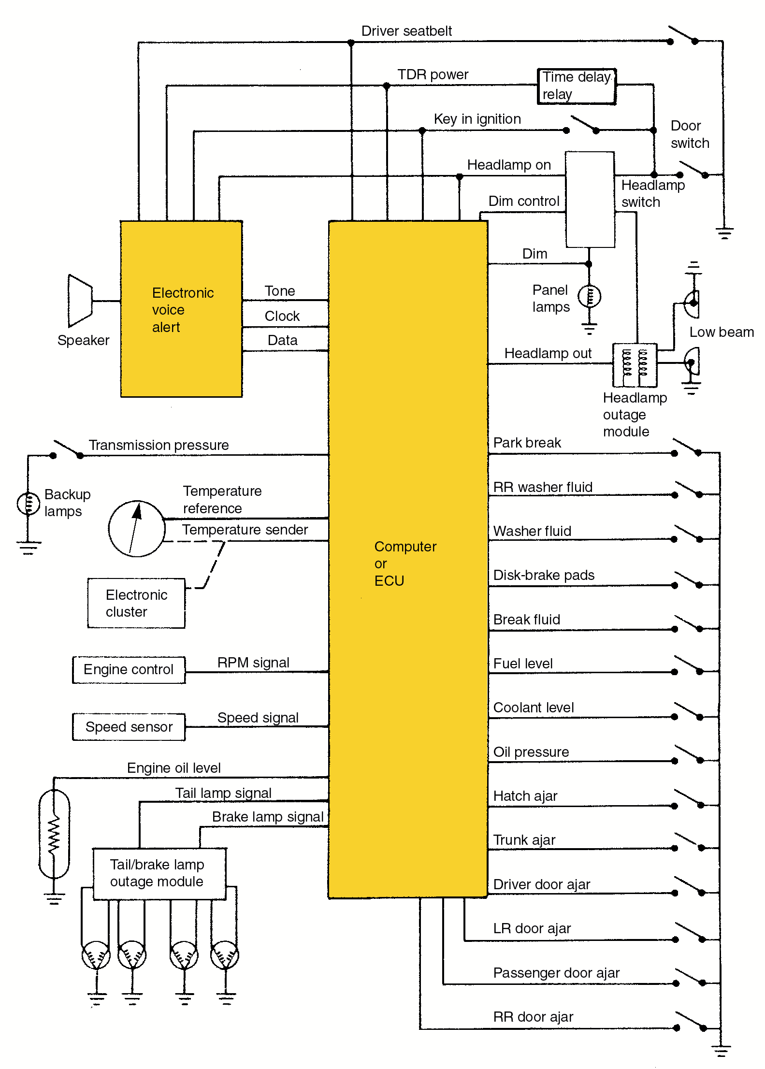
Driver Information Center Circuits

