Slide 1

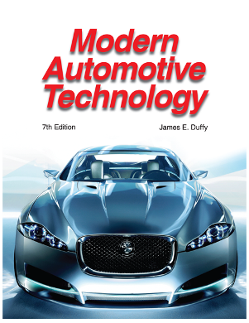

PowerPoint for
Modern Automotive
Technology
by
Russell Krick
Publisher
The Goodheart-Willcox Co., Inc.
Tinley Park, Illinois

Slide 2
Chapter 47
Engine Tune-Up

Slide 3
Contents
Engine tune-up
General tune-up rules
Tune-up safety rules
Typical tune-up procedures
Diesel engine tune-up (maintenance)
Engine tune-up (maintenance) intervals

Slide 4
Engine Tune-Up
Ensures that the engine, ignition system, fuel system, and emission control systems are within factory specifications
Recommended after a specific mileage
Refer to a service manual for the service intervals for all parts that require adjustment or replacement

Slide 5
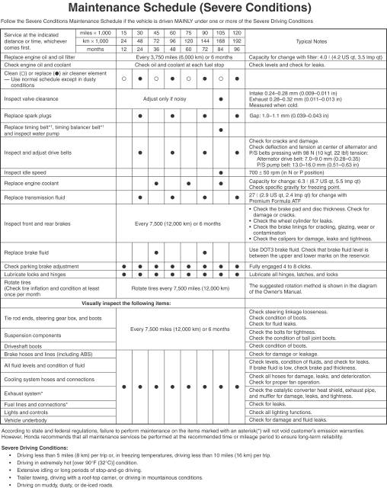
Tune-Up Intervals

Slide 6
Minor Tune-Up
Performed on low mileage vehicles 30,000–40,000 miles
(48,279–64,372 km)
Involves:
  parts inspection
  fluid replacement
  filter and spark plug replacement
  minor adjustments

Slide 7
Typical Tasks
Visual inspection
Check for diagnostic trouble codes
Replace the spark plugs
Check the ignition secondary components
Replace the air and fuel filters
Oil change and chassis lubrication
Emission control system service
Clean the throttle body

Slide 8
Major Tune-Up
More thorough than a minor tune-up
Performed after prolonged use
Involves:
  diagnostic tests
  fuel injector service
  carburetor repairs
  distributor rebuild

Slide 9
Typical Tasks
Perform a scope analysis
Test and replace the spark plug wires
Test and replace the fuel pump
Replace the drive belts and timing belt
Replace fluids
Adjust the valve train
Replace weak sensors

Slide 10
General Tune-Up Rules
Gather information about the vehicle
Warm the engine to operating temperature
Calibrate the test equipment to ensure accuracy
Refer to a service manual and the vehicle’s emission control information sticker for specifications and procedures

Slide 11
General Tune-Up Rules
Use quality parts
Keep accurate service records
Lubricate hinges and latches, inspect belts and hoses, and check tire pressure

Slide 12
Tune-Up Safety Rules
Wear eye protection
Set the parking brake and block the wheels
Place the transmission in park or neutral
Place an exhaust hose over the tailpipe
Keep clothing, hands, and tools away from moving parts

Slide 13
Tune-Up Safety Rules
Disconnect the battery’s negative cable when recommended
Do not touch hot exhaust parts
Keep a fire extinguisher handy
Relieve residual fuel pressure before opening the fuel system

Slide 14
Tune-Up Safety Rules
Disable the injection pump when removing a diesel fuel injector line
Read the operating instructions for all test equipment
Never look into a carburetor or throttle body when cranking or running the engine

Slide 15
Typical Tune-Up
Procedures

Slide 16
Preliminary Inspection
Battery—clean, no corrosion or damage
Air cleaner—filter, vacuum lines, and door condition
Belts—condition and tension
Fluid levels—oil, brake fluid, power steering fluid, and coolant
Hoses—condition
Electrical connections—condition

Slide 17
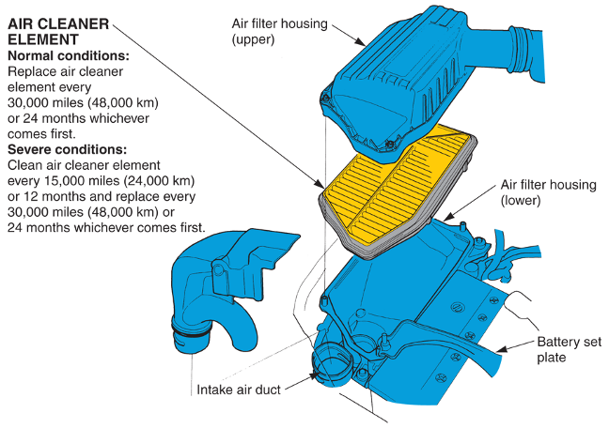
Air Cleaner Inspection

Slide 18
Spark Plug Replacement
Check the plug wire numbering and routing
Remove the wire from the plug by twisting and pulling on the boot
Blow debris away from the plug holes
Remove the spark plugs

Slide 19
Spark Plug Replacement
Read the spark plugs
  normal brown to grayish-tan color
Replace the plugs (select the proper heat range and reach) and reconnect wires

Slide 20
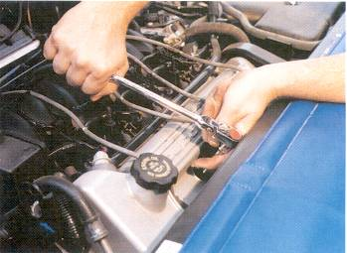
Spark Plug Replacement
Use a spark plug socket

Slide 21
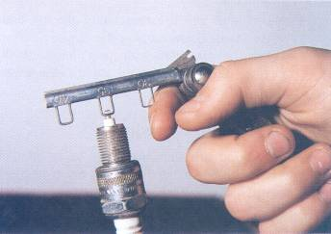
Spark Plug Replacement
Use a wire feeler gauge to gap the new plugs

Slide 22
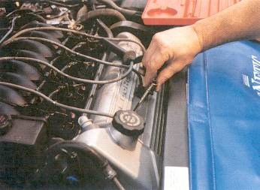
Spark Plug Replacement
Start the plugs by hand to prevent
cross threading

Slide 23
Oxygen Sensor Replacement
The sensors should be replaced at periodic intervals
The sensors become coated or fouled with exhaust by-products
Fuel economy and emissions are affected

Slide 24
Oxygen Sensor Replacement
Disconnect the negative battery cable
Unplug the connector
Use a ratchet and sensor socket for removal
Inspect the sensor’s condition
Coat the threads of the new sensor with antiseize compound
Start the sensor by hand and finish with a wrench

Slide 25
Compression Testing
Checks the mechanical condition of the engine
It is impossible to tune an engine that is not in good mechanical condition

Slide 26
Adjustments
Valve adjustment
  mechanical (solid) lifters require adjustment
  incorrect valve adjustment will upset the amount of air-fuel mixture pulled into the cylinder
  the adjustment affects valve lift and duration

Slide 27
Adjustments
Pickup coil air gap adjustment
  use a nonmagnetic feeler gauge to set the gap between the trigger (reluctor wheel) and the pickup
Idle speed adjustment
  turn off all accessories
  turn the idle speed adjusting screw on the throttle body or carburetor until the specified rpm is reached

Slide 28
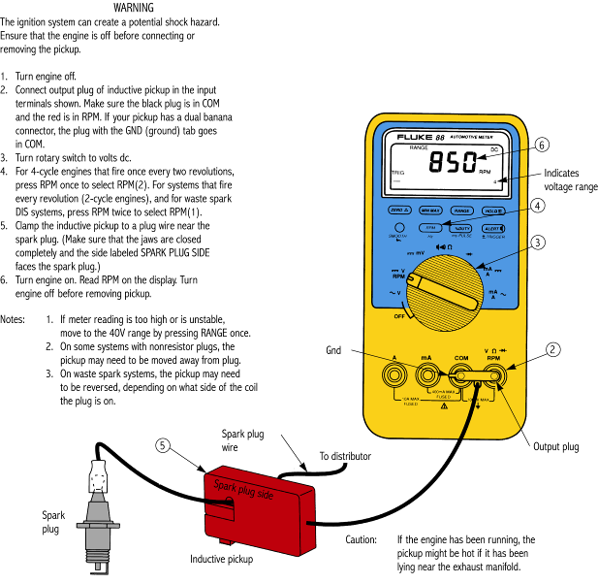
Idle Speed Adjustment

Slide 29
Adjustments
Ignition timing adjustment
  disconnect the distributor’s vacuum hose where applicable
  set the computer to base timing mode
  aim the timing light at the timing marks with engine idling
  rotate the distributor to change timing
  refer to a service manual for procedures and specifications

Slide 30
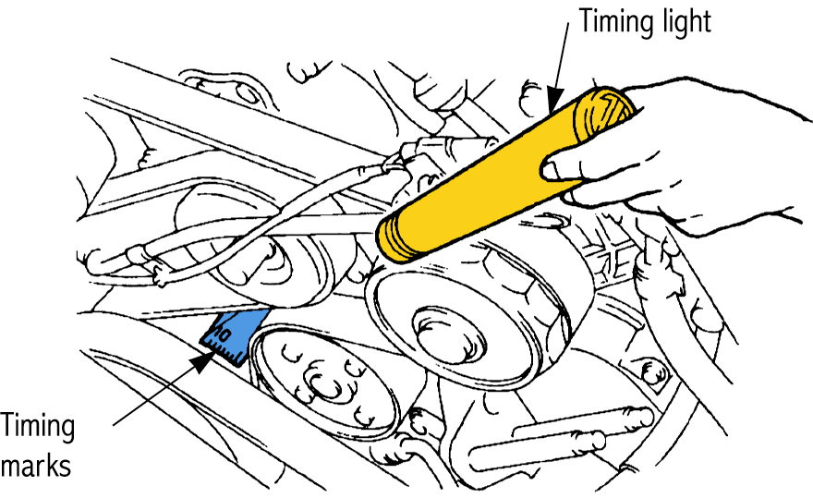
Ignition Timing Adjustment

Slide 31
Diesel Engine Tune-Up
(Maintenance)

Slide 32
Typical Tasks
Replace the air filter element
Clean, drain, or replace the fuel filters
Adjust the idle speed
Adjust the accelerator and governor linkage
Inspect the engine and related systems
Adjust the valve and injector timing
Change the engine oil and filter
Service the emission control systems

Slide 33
Engine Tune-Up
(Maintenance) Intervals
Specific periods (in miles or months) for component service
Given in the vehicle’s service manual

