Slide 1
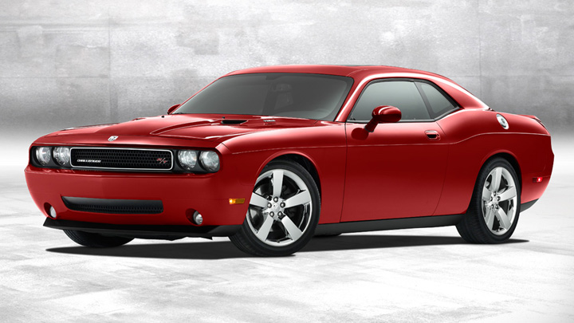
CHAPTER 1
The Automobile

Slide 2
Parts, Assemblies, and Systems
What is an auto part?
(n) auto part, car part (a component of an automobile)
What is an assembly?
a group of machined parts that fit together to form a self-contained unit
What is a system?
A set of fitted parts designed to complete a function

Slide 3
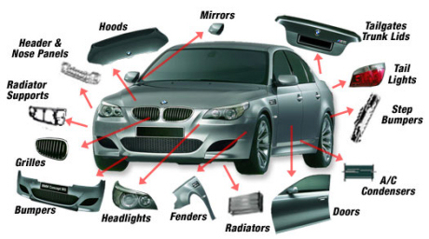
Today's Automobiles have 10,000+ Parts

Slide 4
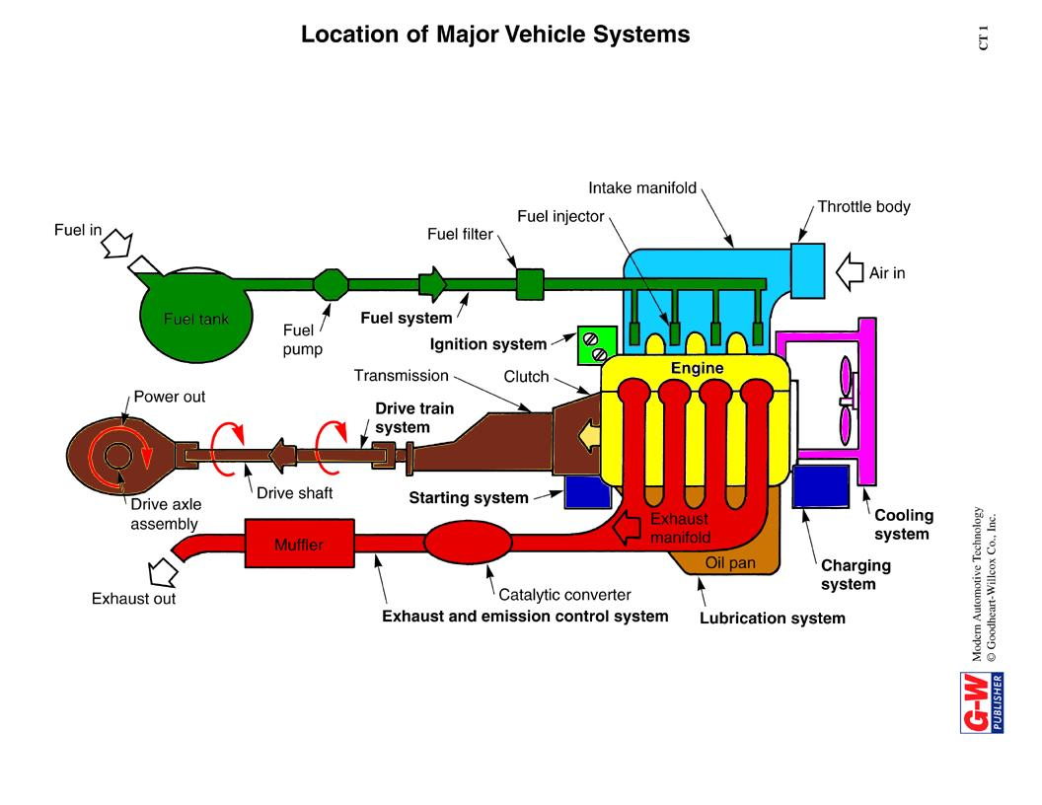
Major Automotive Systems
Fuel
Exhaust
Drive-train
Cooling
Engine
Electrical
Lubrication
Induction (Intake)
Ignition

Slide 5
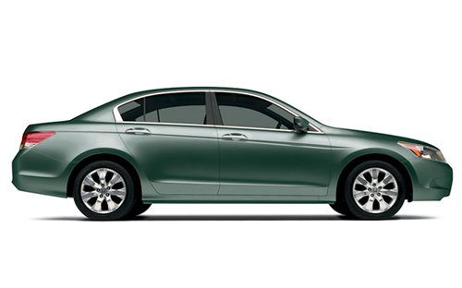
Common Automotive Body Types
Sedan
  A car seating four or more with a fixed roof that is full-height up to the rear window. They have a trunk in the back.

Slide 6
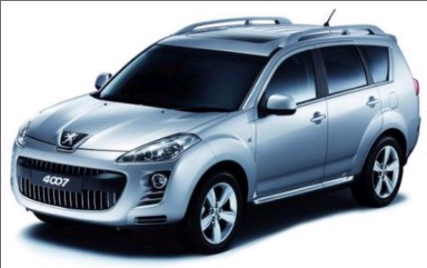
Common Automotive Body Types
Sport utility vehicle (SUV)
  Derivative of a pickup truck or 4-wheel-drive vehicle, but with fully-enclosed passenger cabin interior and carlike levels of interior equipment.

Slide 7
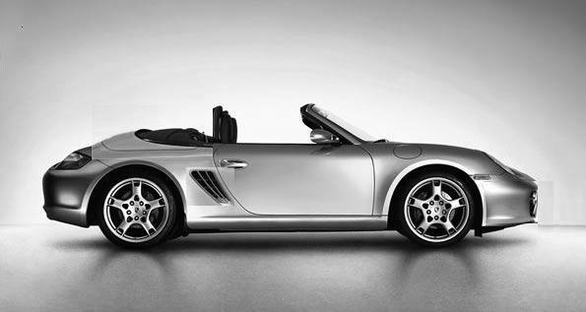
Common Automotive Body Types
Convertible
  A body style with a flexible textile folding roof or rigid retracting roof — of highly variable design detail — to allow driving in open or enclosed modes.

Slide 8
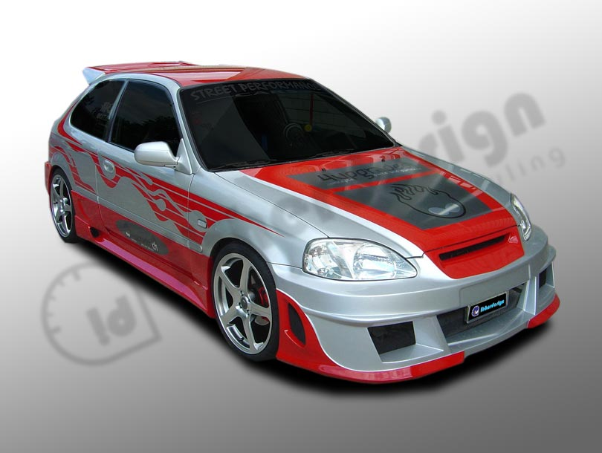
Common Automotive Body Types
Hatchback
  Identified by a rear door including the back window that opens vertically to access a storage area not separated from the rest of the passenger compartment.

Slide 9
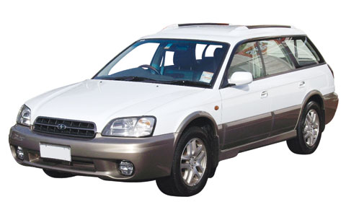
Common Automotive Body Types
Station wagon
  A car with a full-height body all the way to the rear; the load-carrying space created is accessed via a rear door or doors.

Slide 10
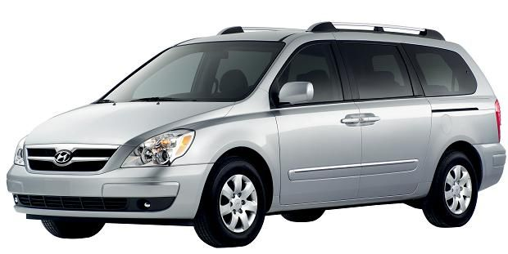
Common Automotive Body Types
Minivan
  North American term for a boxy wagon-type of car usually containing three or four rows of seats, with a capacity of six or more passengers.

Slide 11
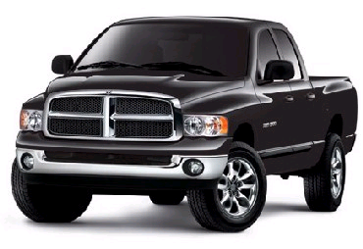
Common Automotive Body Types
Pickup truck
a.k.a pickup
  A small, medium, or large-sized truck, though smaller in every case than a truck. The passenger cabin is wholly separated from the cargo bed.

Slide 12
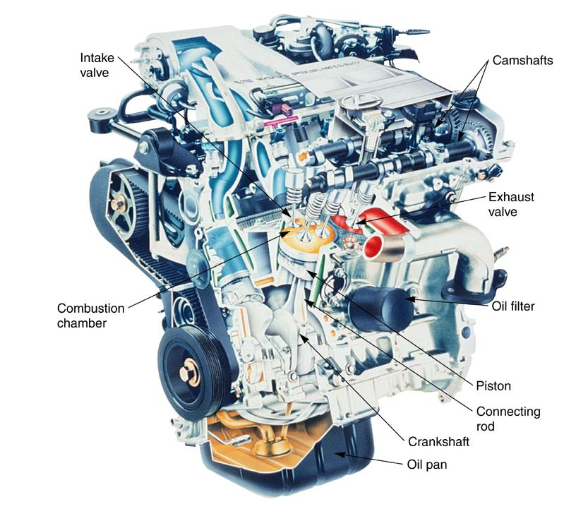
Engines

Slide 13
Engine Parts of the Cylinder Head
(Top End)
Cylinder Head: covers and seals top of cylinder, contains parts below
Valve: A device that admits fuel and air into the cylinder of an internal combustion engine, or one that allows combustion gases to exit
Camshaft: A machined shaft with lobes that open and close engine-cylinder intake and exhaust valves
Valve Springs: A coil spring used to keep valves closed
Rocker Arms: Transfer camshaft action to the valves
Lifters: Ride on the camshaft and transfer motion to the rocker arms
Combustion Chamber: The area in the cylinder where the air/fuel mixture actually ignites and burns. Located between the top of the piston and the cylinder head.

Slide 14
Engine Parts of the Block
(Bottom End)
Block: The large part of the engine that houses the cylinders and water jacket; a metallic casing with a bore for each piston
Cylinder: A round chamber for the piston to travel through
Crankshaft: Changes the reciprocating motion of the piston and rod into useful rotary motion
Connecting Rod: connecting link between crankshaft and the pistons
Piston: A round cup that transfers energy of combustion to the crankshaft
Rings: . Keeps combustion pressure and oil from leaking between the piston and cylinder wall crankcase
Water Jackets: The area around the engine cylinders that is left hollow so that coolant may be admitted
Oil Pump: forces oil under pressure to the oil galleries for distribution throughout the engine
Flywheel: A large heavy wheel that forms the base for the starter ring gear and provides a mounting surface for the torque converter or clutch assembly

Slide 15
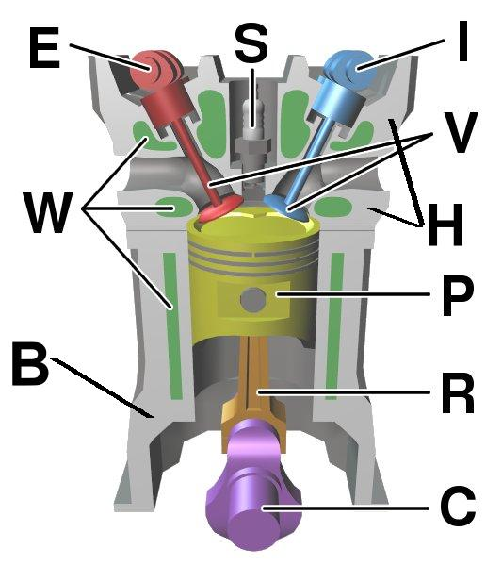
The Basic 4-Stroke Engine
I – Intake Camshaft
V – Valves
H – Cylinder Head
P – Piston
R – Connecting Rod
C – Crankshaft
B - Block
W – Water Jackets
E – Exhaust Camshaft
S – Spark Plug

Slide 16
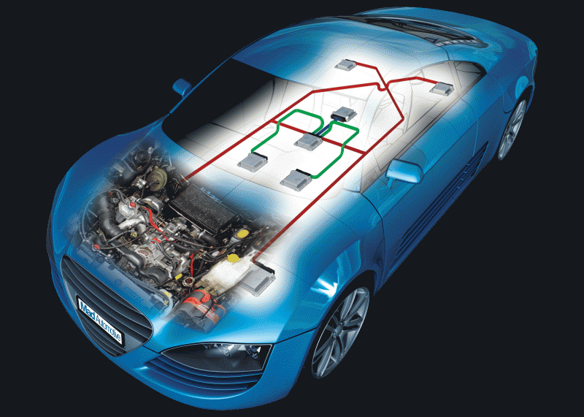
Automotive Computer Systems

Slide 17
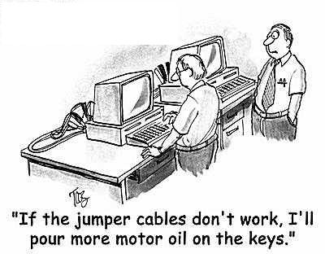
The Automotive Computer System

Slide 18
The Automotive Computer System
The automobiles’ computer systems use input and output devices to monitor and control various systems in the vehicle, including: fuel, ignition, brakes, traction control, security, climate control, transmission control, and other systems.

Slide 19
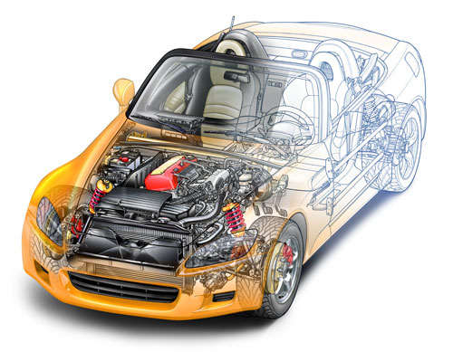
Automotive Computer Systems
(Common Systems)
Fuel
Security
Climate Control
Automatic Ride Control
GPS/Navigation
Audio/Sound
Tire Pressure Monitoring
Transmission Control
Traction Control
Anti-Lock Braking

Slide 20
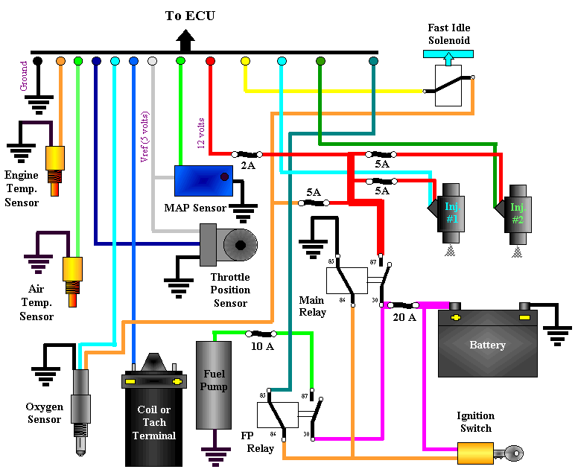
The Automotive Computer System
(Fuel Control)

Slide 21
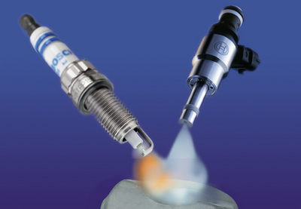
The Automotive Computer System
(Fuel Control)
The purpose of the automotive fuel control system is to maintain the correct mixture of air and fuel under all operating conditions, including cold startup, rapid acceleration, and hot starting situations.
This is done with a combination of three primary parts: sensors, actuators, and an Electronic Control Module (ECM) working in conjunction with each other.

Slide 22
The Automotive Computer System
Sensors (Input Devices)
Automotive Sensor: Any device designed to measure engine operating conditions or ambient pressures and temperatures. Most sensors are electronic in nature and designed to send a variable voltage signal to an on-board computer; some sensors may operate as a simple on/off switches or they may provide a variable or modulated voltage signal (like a potentiometer) as conditions or measured parameters change.
When comparing an automotive sensor or input device to a home computer, the mouse, keyboard, microphone, and CD-ROM would be considered input devices.

Slide 23
The Automotive Computer System
Input Devices (Sensors)
Common Automotive Sensors
Oxygen Sensor: A device that detects the amount of oxygen in the exhaust stream and sends that information the ECM for proper fuel control
Coolant Temperature Sensor: Measure the cooling system temperature and sends a variable voltage signal to the ECM
Throttle Position Sensor: Sends a signal to the ECM telling it the position of the throttle valve or gas pedal
Air Intake Temperature Sensor: Tells the ECM the outside air temperature
MAP Sensor: A manifold absolute pressure sensor (MAP) tells the ECM air pressure measured inside the intake manifold
RPM Sensor: Tells the ECM the engine speed
Crankshaft/Camshaft Sensors: Small magnetic sensors that send the ECM pulsing signals that vary with crank and cam movement indicating their precise positions.

Slide 24
The Automotive Computer System
Output Devices
Solenoid Valve: An electrical valve the uses a Magnetic force to open and close the valve (injectors)
Actuator: A device that converts an electronic signal into a mechanical motion (Idle speed controller)
Motor: type of engine capable of transforming the electricity it receives into mechanical energy
Coil: an induction coil that converts current from a battery into the high-voltage current required by spark plugs
When comparing an automotive output device to a home computer, the monitor, speakers, and CD-Burners would be output devices.

Slide 25
The Automotive Computer System
Output Devices
Common Output Devices
Idle Speed Controller: Controls the engine idle speed
Fuel Injectors: Spray precise quantities of fuel into the engine
Fuel Evaporative Solenoid: Opens to let fuel tank vapors into the engine to be burned during driving
Ignition Coil(s): Creates the spark to fire the spark plugs
Starter Relay: Closes to allow the engine to start
Radiator Fan: Turns on to cool the engine coolant
Check Engine Lamp: Turns on to let the driver be aware that there is a malfunction somewhere within the system

Slide 26
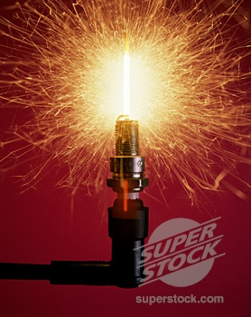
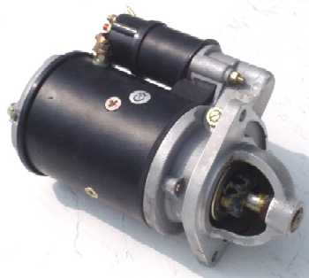
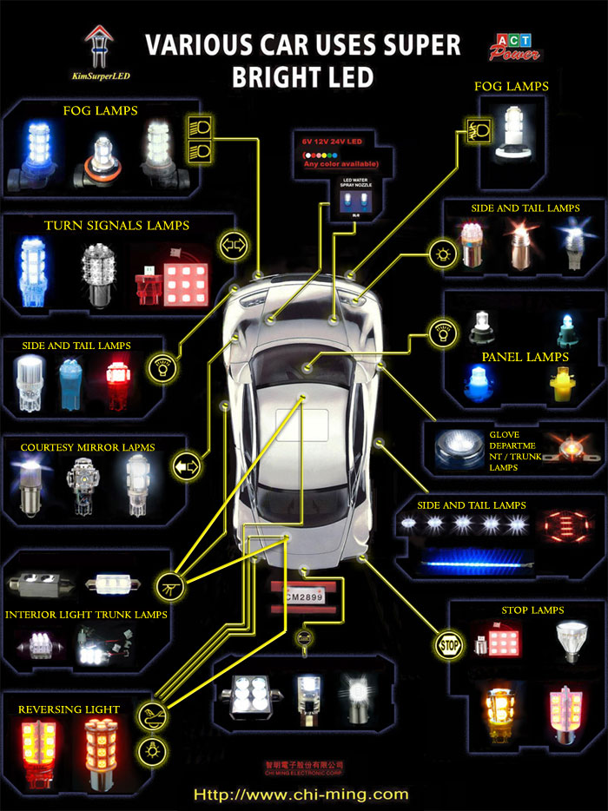
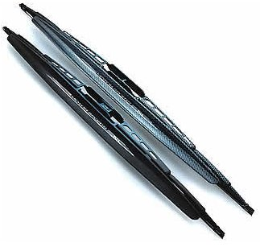
Electrical System
Ignition System: Provides electrical energy to create sparks to ignite the air-fuel mixture at the exact right moment for best performance
Starting System: Converts battery power to mechanical energy by using a large electrical motor to turn over and start the engine.
Lighting System: Provides light to see and be seen at night.
Accessories System : Includes wipers, horn, and radio to provide better safety and driver comfort.

Slide 27
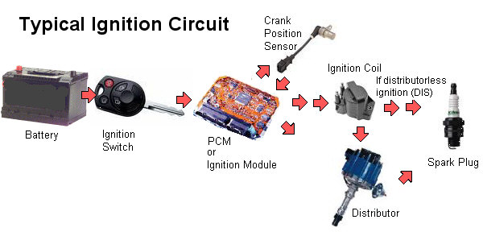
Typical Ignition System
The ignition system supplies high-voltage current to the spark plugs to ignite fuel vapor in the cylinders. There are many variations, but all gasoline-engine ignition systems draw electric current from the battery, significantly increase the current’s voltage, then deliver it to spark plugs that project into the combustion chambers. An electric arc between two electrodes at the bottom of the spark plug ignites the fuel vapor.

Slide 28
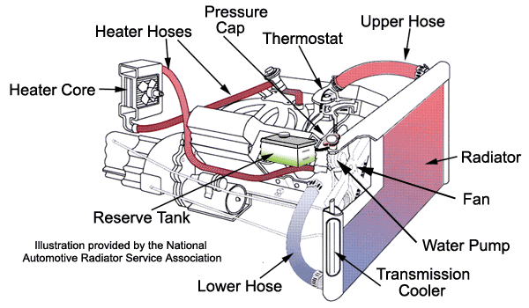
Cooling System
The engine's combustion chamber reaches up to a temperature of four thousand five hundred degrees Fahrenheit. About thirty percent of the fuel is converted into actual power, and about seventy percent is spent into heat. A cooling system protects an engine from damage by transferring heat to the atmosphere by using the radiator. A correct operating temperature is critical for the proper function of the engine. The thermostat maintains a constant engine temperature by controlling the flow of coolant into the radiator and back into the engine. A fan draws cool air through the radiator.

Slide 29
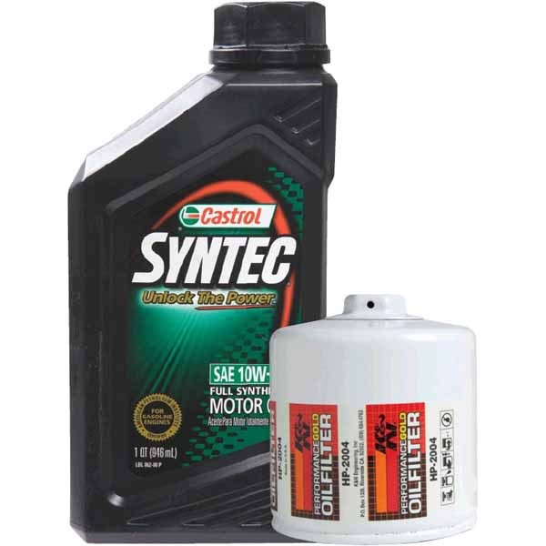
Automotive Lubrication System
The function of an automotive
lubrication system is to circulate filtered oil to high friction points in the engine. The lubrication system also helps cool the engine by carrying heat away from the engine.
The oil pump pulls oil out of the pan forces it throughout the engine to lubricate and cool various moving parts within the engine.

Slide 30
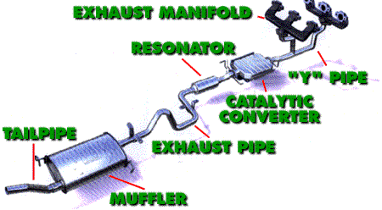
Exhaust System
The exhaust system in your car does three jobs. First, it transfers poisonous exhaust gases from the engine to the rear of the car. Next, it quiets down the engine sound while running. Finally, it converts unspent fuel into spent fuel with the help of a catalytic converter.

Slide 31
Drive Train Systems
Automatic Transmission - Uses an internal hydraulic system electronic controls to shift gears
Clutch - Allows the driver to engage or disengage the engine and the manual transmission
Differential - A set of gears and shafts that transmit power from the drive shafts to the axles
Drive Shaft - . Transfers power from the transmission to the rear axle assembly
Drive Train - . Transfers turning force from the engine crankshaft to the drive wheels

Slide 32
Drive Train Systems (Continued)
Manual Transmission - Lets the driver change gear ratios to accommodate driving conditions
Rear Drive Axle - Contains a differential and two axles
Transaxle - A transmission and differential in one assembly
Transmission - Uses various gear combinations, or ratios, multiply engine speed and torque to accommodate driving conditions

Slide 33
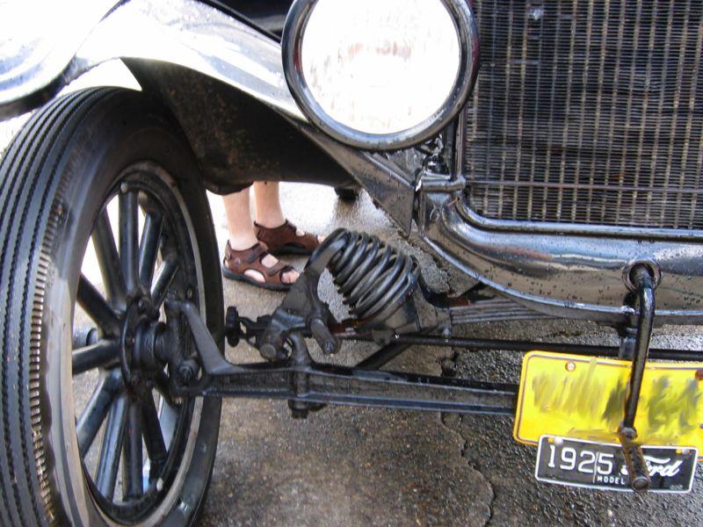
Suspension System
Suspension is the term given to the system of springs, shock absorbers, and linkages that connects a vehicle to its wheels. The Suspension System allows the vehicle’s wheels and tires to move up and down with very little effect on body movement. This makes the vehicle ride smooth and safe. The suspension system also prevents excessive body roll (leaning) when turning corners.
The suspension components of a Ford Model T

Slide 34
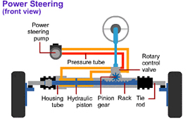
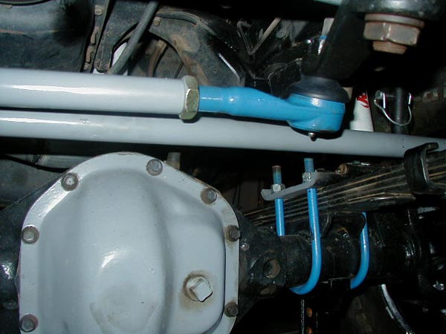
Steering System
The steering system allows the driver to control the direction of the vehicle by turning the wheels from left to right. There are basically two styles of vehicle steering systems, rack and pinion and worm gear box (. Rack and pinion steering is one of the oldest types of steering systems and is still used today. Inside the rack body a flat rack gear moves in a linear direction driven by a circular gear called a pinion. The steering wheel is connected to the pinion gear (shaft).

Slide 35
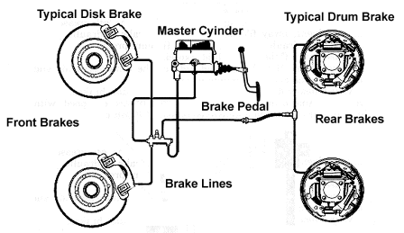
Brake System
Brake systems are designed to slow the vehicles wheel movement through friction. There are primarily two brake systems, ABS and non ABS (anti brake skid). Both systems work on basic hydraulics and utilize a brake master cylinder (connected to the brake peddle in the car) that supplies brake fluid pressure to the front brake calipers and rear wheel cylinder or brake calipers if so equipped.

Slide 36
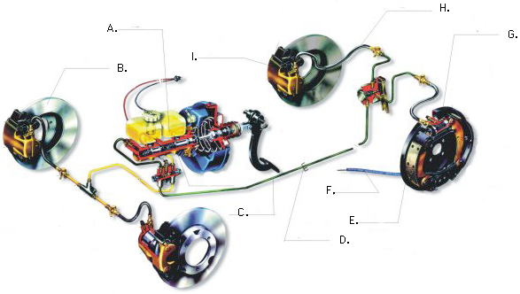
Brake System
A-Brake Fluid Reservoir
B-Brake Rotor or Disk
C-Brake Line
D-Retaining Clip
E-Brake Shoe
F-Parking Brake Cable
G-Rear Wheel Cylinder
H-Brake Sensor
I-Brake Caliper

Slide 37
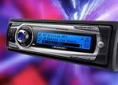
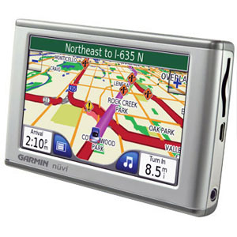
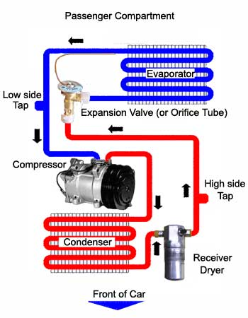
Accessory Systems
Audio/Sound: For your listening enjoyment
Navigation/GPS Systems: So you won’t get lost
Air-Conditioning/Heating: Keeps you cool! (and warm)

Slide 38
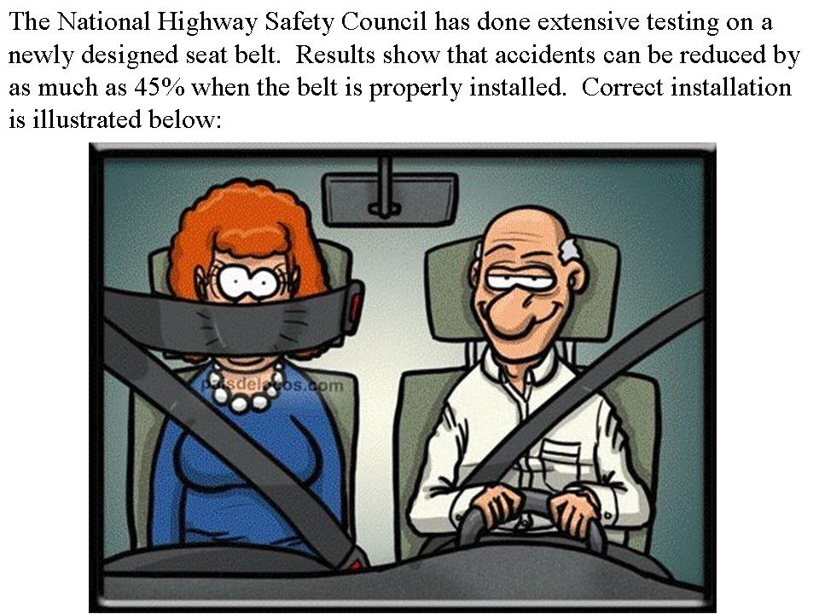
Safety Systems

Slide 39

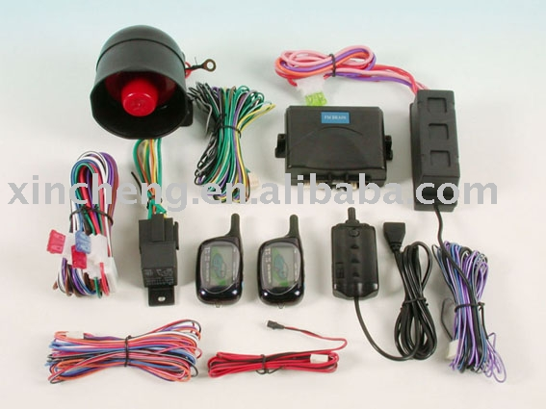
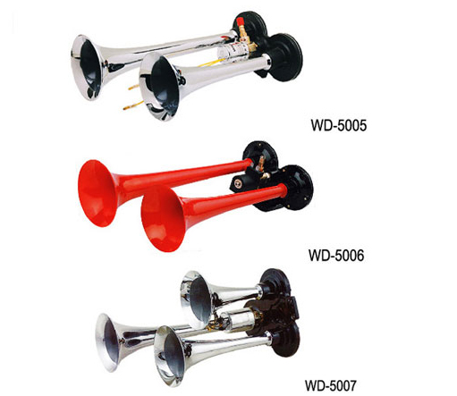
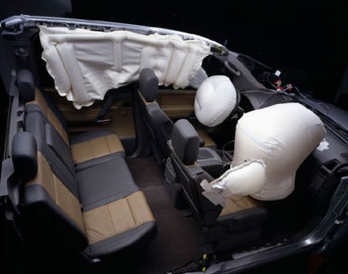
Safety Systems
Seat Belts
Air Bags
Security System
Wipers
Horns
Lights

Slide 40
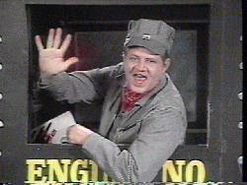
That’s All Folks

