Slide 1


Slide 2
Front Disc Brake Inspection
By
Vance Bloom
ROP Automotive Technology
Murrieta Valley High School

Slide 3
Why Do I Care?

Slide 4
Many Shops Charge $$ for Brake Inspections
Some Shops Are Not Honest
About What You Really Need!
If You Do it Yourself
You Can Be Sure it’s Done Right!

Slide 5
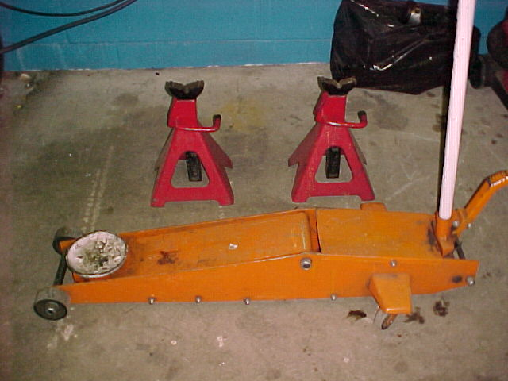
Tools Needed
Safety Stands
Floor Jack

Slide 6
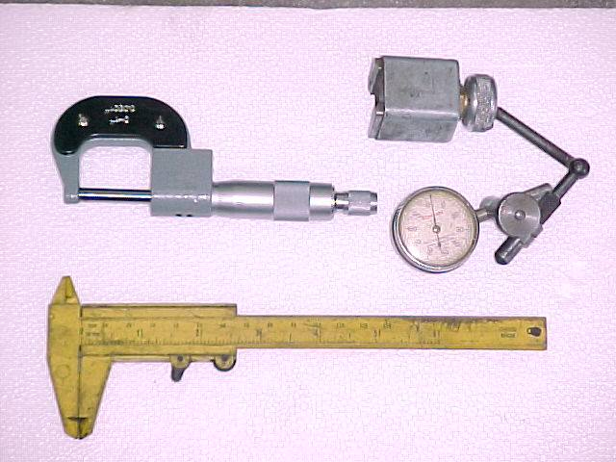
Dial Indicator
Micrometer
Vernier Caliper

Slide 7
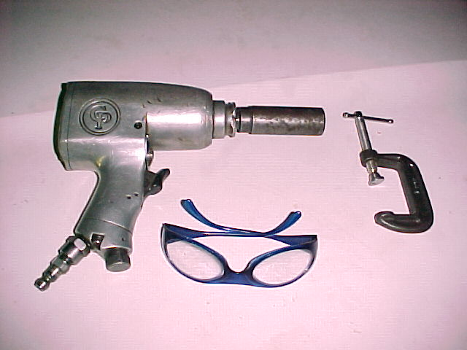
1/2” Drive Impact Gun
“C” Clamp
Safety Glasses

Slide 8
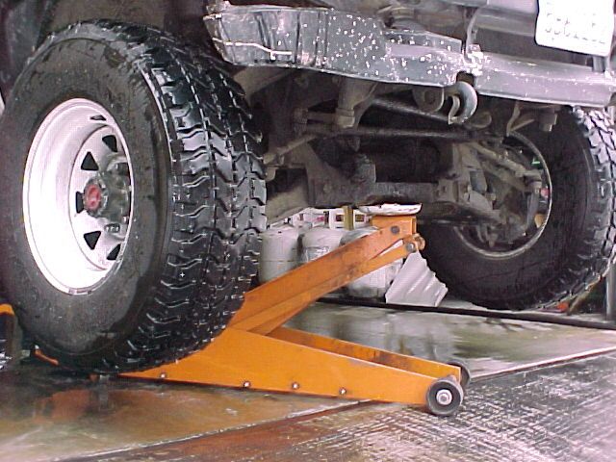
Raise Vehicle on Jack

Slide 9
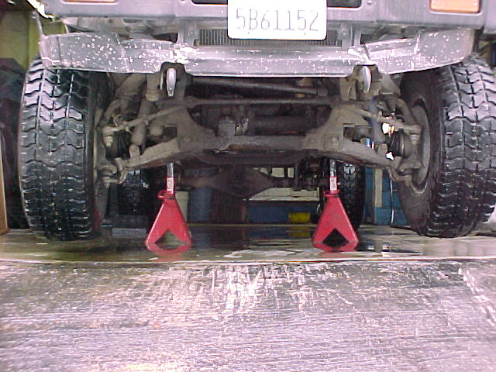
Place Safety Stands Under Vehicle

Slide 10
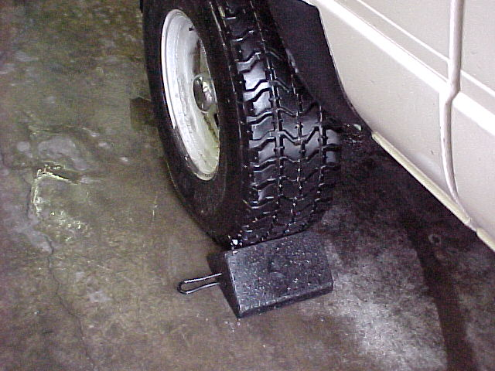
Place Chock In Front Of Wheel

Slide 11
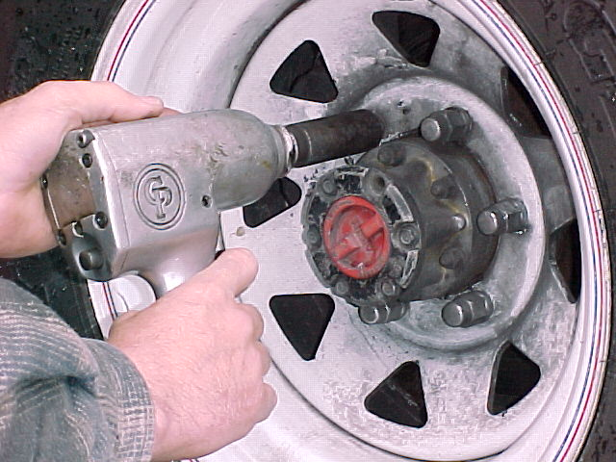
Remove Lug Nuts and Wheel

Slide 12
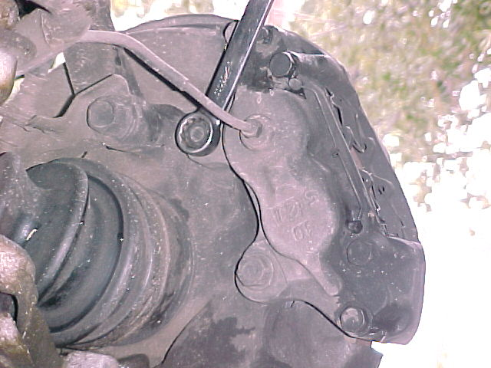
Remove Caliper Retaining Bolts

Slide 13
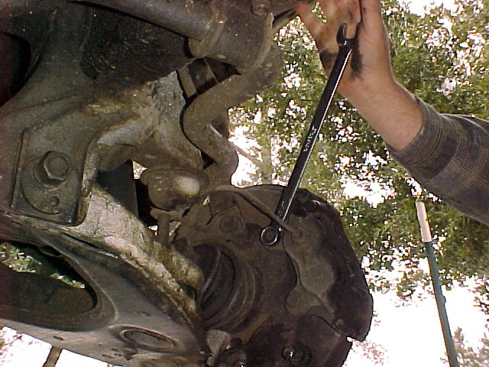

Be Careful Not To Bust
Your Knuckles, Always
Push With Open Palm

Slide 14
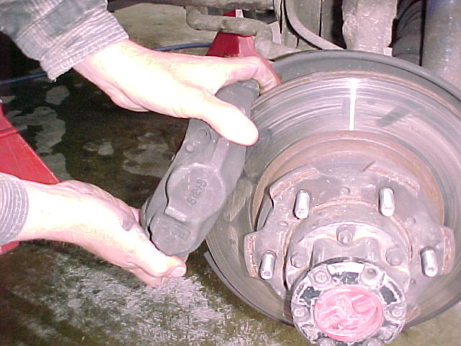
Remove Caliper

Slide 15
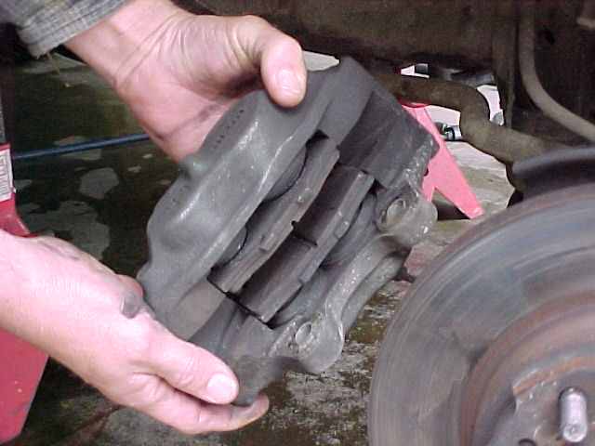
Inspect Caliper For Fluid Leaks

Slide 16
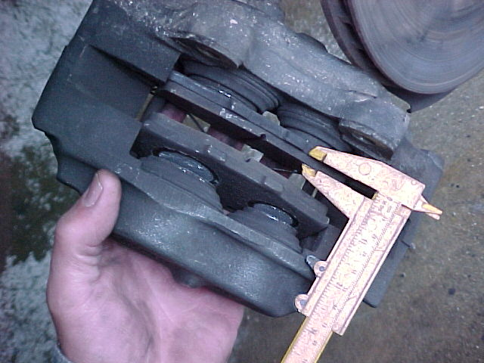
Measure Brake Pad Lining Thickness With Vernier Caliper

Slide 17
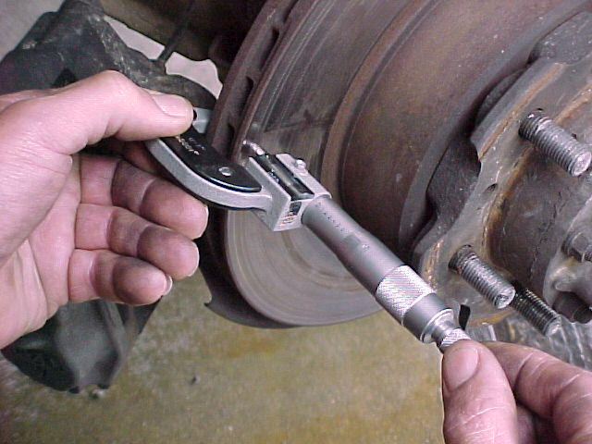
Measure Thickness Of Brake Rotors & Compare To Specifications

Slide 18
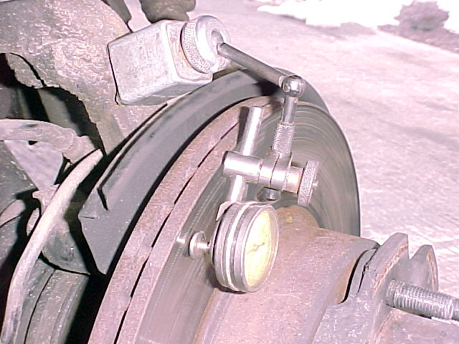
Measure Lateral Runout With Dial Indicator

Slide 19
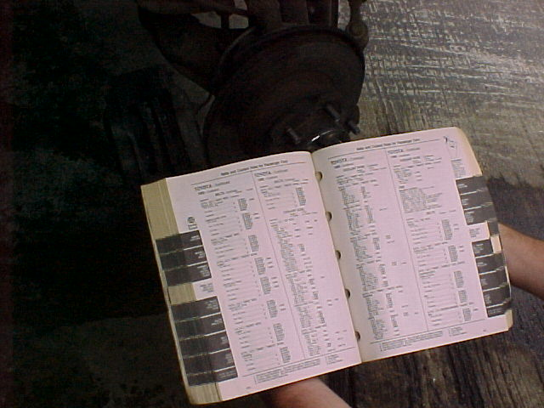
Compare Lateral Runout, Brake Pad & Rotor Thickness, to Factory Specifications

Slide 20
Document All Findings on Repair Order
Document Brake Fluid Condition, Level & Leaks Found
Document Brake Pad Thickness & Minimum Specifications
Document Brake Rotor Thickness & Minimum Specifications
Document Brake Rotor Runout & Maximum Specifications

Slide 21
Determine needed repairs and Document on Repair Order
Example: Rotor Machining or Replacement Brake Pad Replacement Brake Caliper Rebuild or Replacement No Service Required

Slide 22
Complete Brake Repairs As Necessary, If Proper Authorization Is Obtained
Put Vehicle Back Together Without Repairs, If Authorization Is Not Obtained

Slide 23
Pump Brake Pedal To Test For Proper Operation
Check Brake Fluid Level & Condition
Now Clean Up Your Mess
Clean & Put Away All Tools

Slide 24
Questions?
Contact
Vance Bloom
1-909-696-1081
vbloom@murrieta.k12.ca.us

Slide 25
The End

