Slide 1
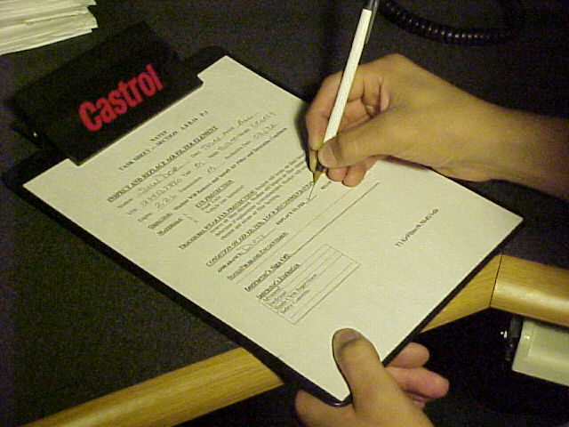
How to fill out a Task Sheet
Filling out the top portion of your task sheet
By Jonathan Rollins
Edited by Vance Bloom

Slide 2

Before you start your task, you need to fill out the top of your task sheet

Slide 3
First
Put your name, date, and
period on your paper
What day is this?
What period am I in?

Slide 4

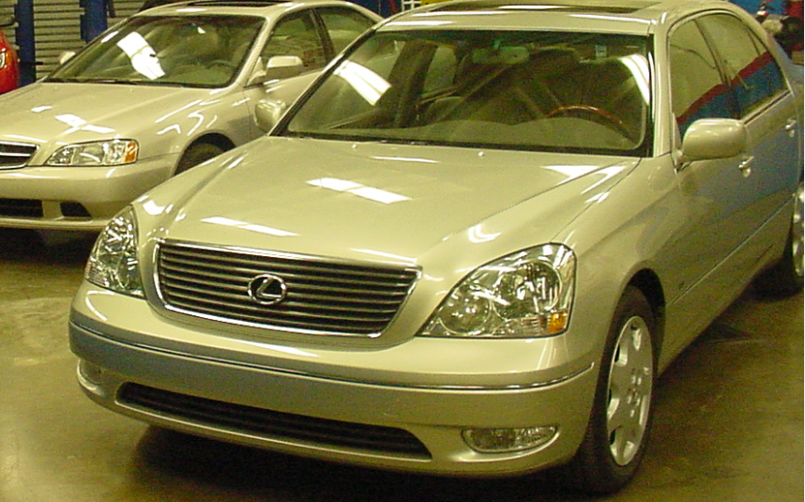
VIN
You need the 17 digit VIN number off the car dashboard, seen through the driver side windshield

Slide 5
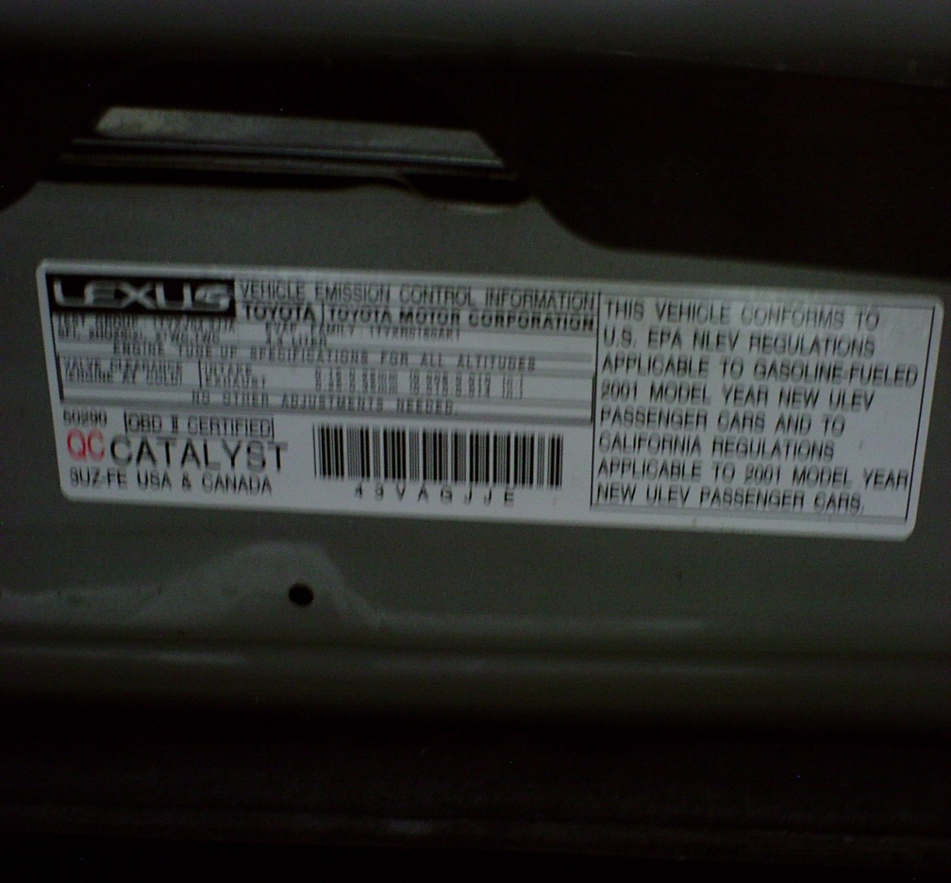
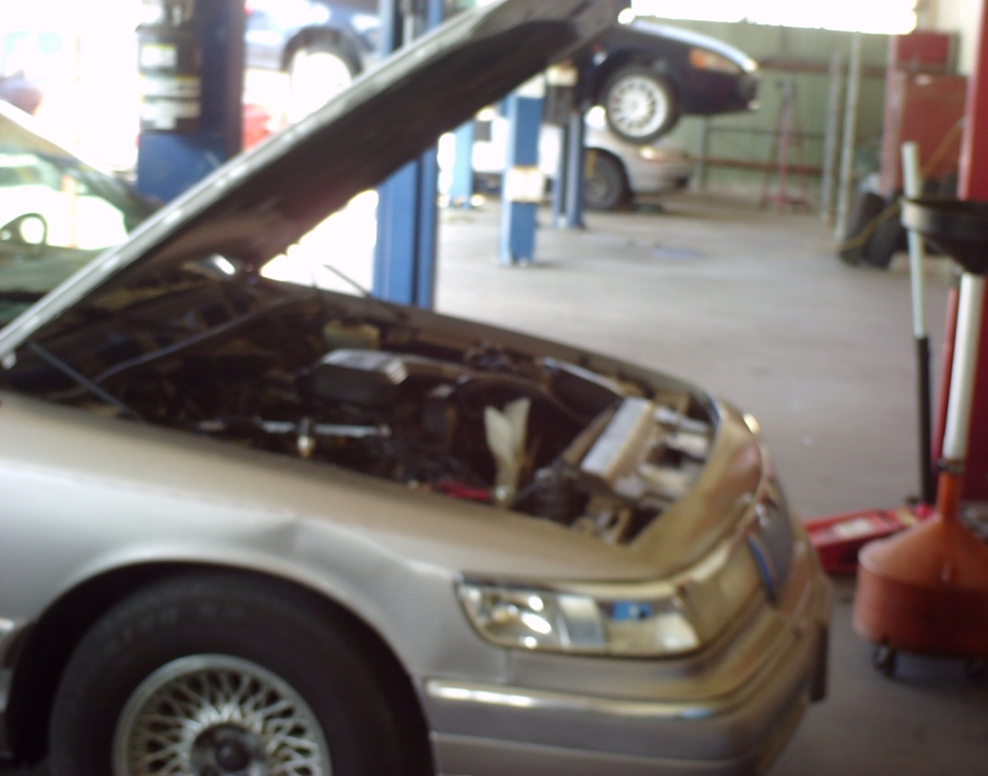
Year
Model Year (Year)
Found on the under hood
“Vehicle Emission Control System Information”
Label
Usually Here
Sometimes Here

Slide 6
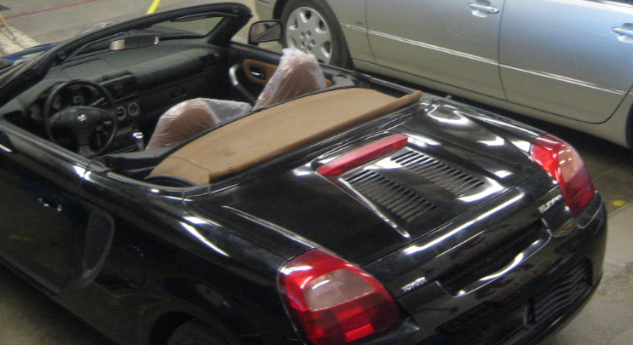

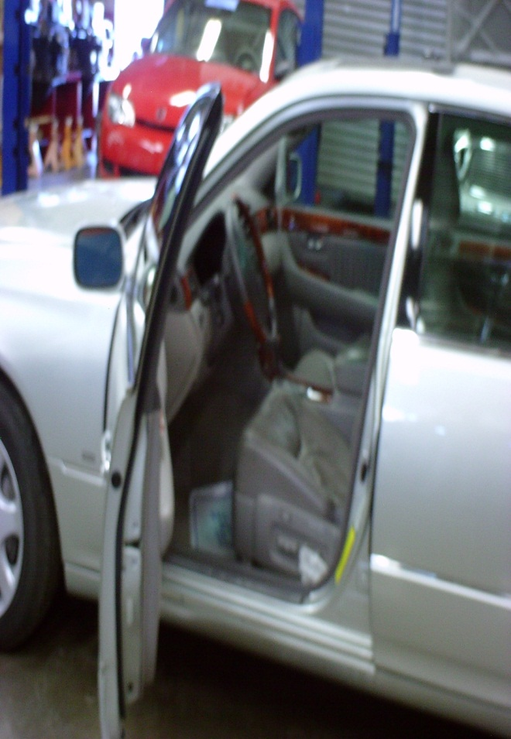
Make and Model
Found on the trunk of the car,
or under hood, or door jamb

Slide 7
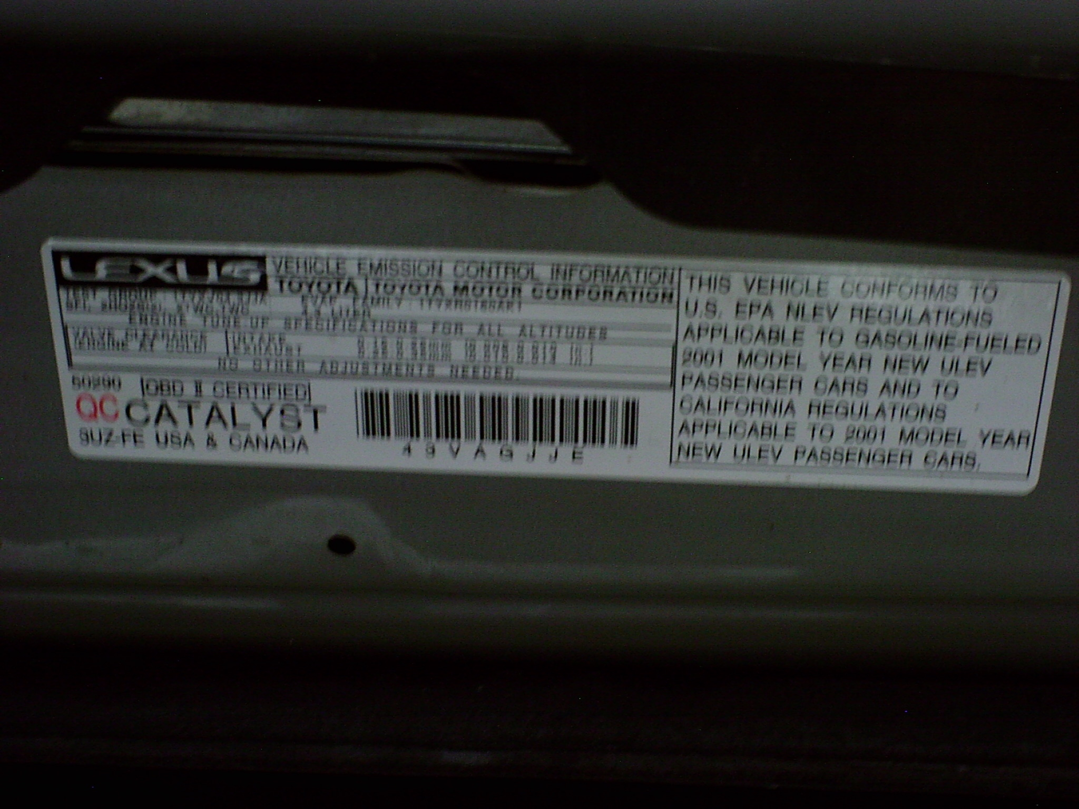

Engine Size (Usually in liters)
Found on the informational sticker under hood

Slide 8
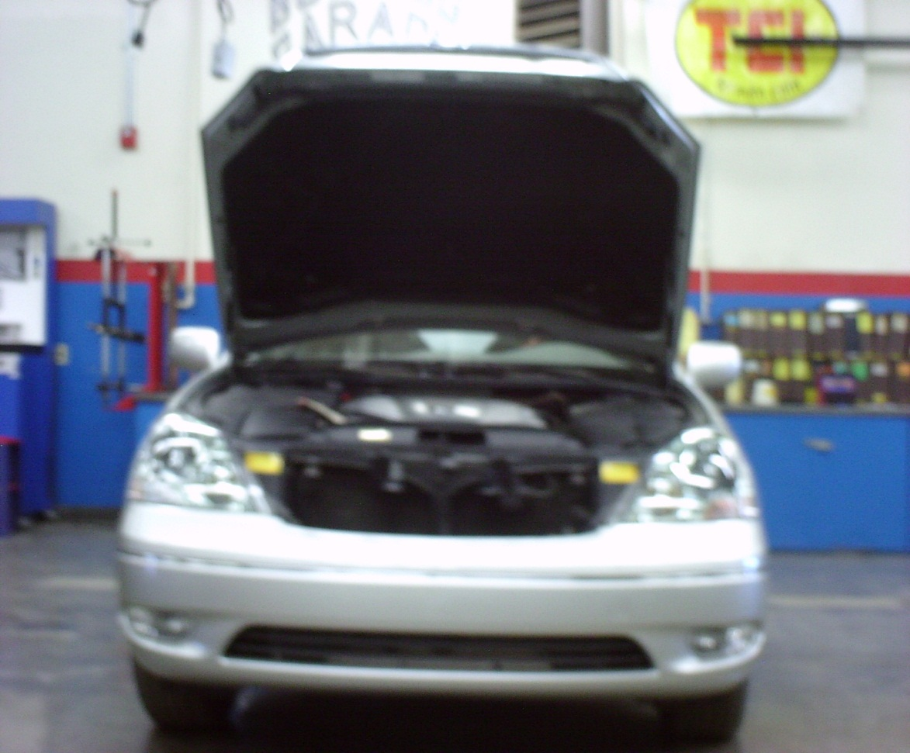

Transmission
Determine transmission of the car you are to work on A=Automatic M=Manual (Stick)

Slide 9


Production Date
Found on the informational sticker on the
driver side door jamb (get month and year)

Slide 10
Questions?
First, Watch this PowerPoint again
Then, Ask three other students
Finally, Ask the instructor

