Slide 1
PROPER USE OF FLOOR JACK AND SAFETY STANDS
NATEF TASK SHEET
SECTION SAFETY

Slide 2
OBJECTIVE
Student will safely raise a vehicle with a hydraulic floor jack and set it up on safety stands. Student will then check to be sure the vehicle is securely set and put chocks behind the tires still on the ground (downhill side).

Slide 3
Materials Needed
1. Hydraulic floor jack
2. Safety stands
3. Wheel chocks
4. Vehicle (see instructor)
5. EYE PROTECTION

Slide 4
Procedure

Slide 5

Step 1
WEAR EYE PROTECTION!

Slide 6
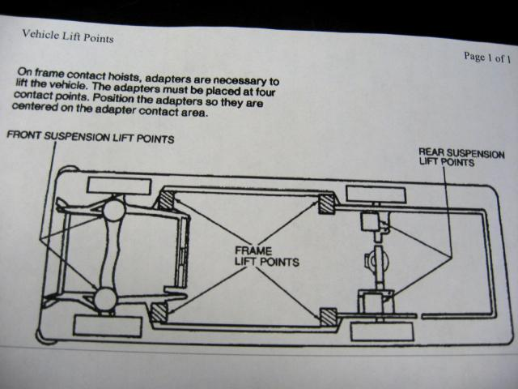
Step 2
Look up lift points for vehicle being lifted in All-Data, Mitchell-on-Demand, or in Owner’s manual.

Slide 7
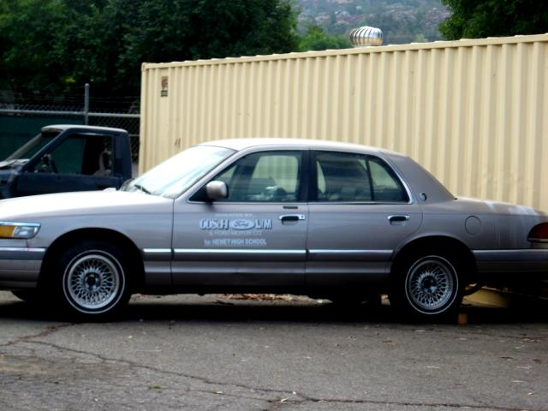
Step 3
Park vehicle on level surface.

Slide 8
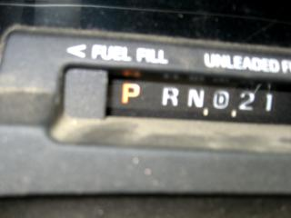
Step 4
. Place shifter in park (automatic) or neutral (manual).

Slide 9
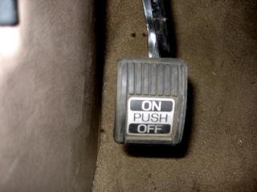
Step 5
Set parking brake.

Slide 10
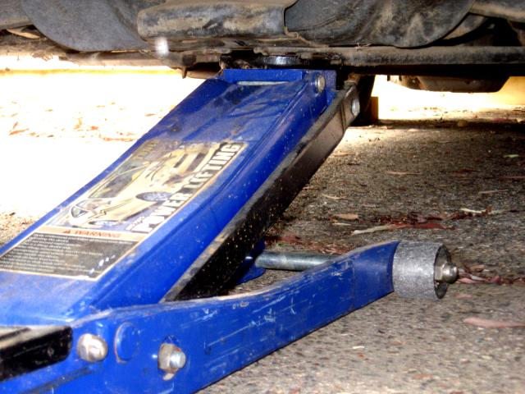
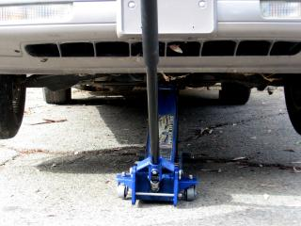
Step 6
Place jack under correct lifting point.
Raise vehicle slightly higher than you intend it to end up.

Slide 11
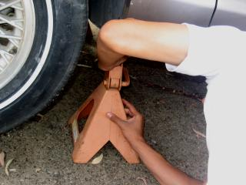
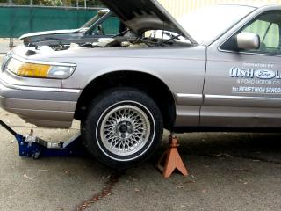
Step 7
Place the pair of safety stands under vehicle frame or lift points, one on each side.

Slide 12
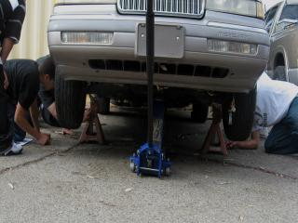
Step 7 Continued…
Make sure both jack stands are set to the same height!

Slide 13
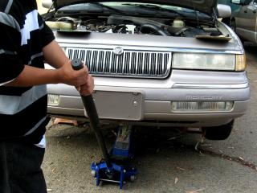
Step 8
Slowly lower vehicle onto stands.

Slide 14
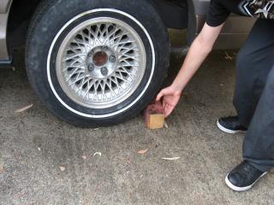
Step 9
Place chocks behind tires of wheels still on ground (downhill side).

Slide 15
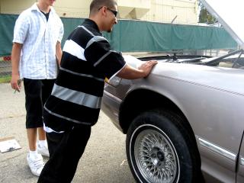
Step 10
Verify vehicle is stable by pushing firmly on side of vehicle.
Have instructor inspect vehicle.

Slide 16

Finishing Up
Completely fill out task sheet
Have instructor verify task completion
Put away all equipment used
Have instructor sign task sheet

Slide 17
Questions?
Always ask if there is any question about the lift points on the vehicle being lifted.
BEFORE YOU LIFT THE VEHICLE!
Have another student check your work
Think and work safely!
A MISTAKE CAN BE DISASTROUS!

