Slide 1

WELCOME TO Hemet High School’s
AUTOMOTIVE TECHNOLOGY PROGRAM
A Riverside CTE and Hemet Unified School District Sponsored Program
Instructors:
Adrian Lallman &
Joshua Thomson

Slide 2
Program Orientation
Course Overview
For Students,
Parents, & Counselors

Slide 3
AUTOMOTIVE TECHNOLOGY
BASIC AUTO MECHANICS
An Introduction to the Automotive Trades
Basic Automotive Maintenance & Repair
Essential for all those who:
Plan on owning a vehicle
Are interested in an automotive career
Want to avoid being ripped off by a repair shop

Slide 4
OBJECTIVES
Students will develop “critical thinking skills” – A way of thinking about any problem or subject in which the student evaluates the information and uses such conclusions to guide future actions.
Students will learn to “collaborate” within work groups - to work jointly with others or together especially in an intellectual endeavor
Students will develop “effective oral and written communication skills” – learning to convey ideas to others successfully
Students will learn to “access and analyze information” systems

Slide 5
Opportunities
Students will learn basic automotive theory, service, and repair techniques.
Students will receive practical experience in the shop.
Students will have the opportunity to advance their skills in CC/CVE/AYES Internship programs.

Slide 6
Automotive Career Possibilities
Lot Porter
Lube Technician
Service Technician
Service Advisor
Service Manager
Parts Technician
Salesperson
Shop owner
Dealership Owner
And more…

Slide 7
INTRO COURSE OUTLINE
General Automotive Information
Systems Overview
Wheels & Tires / Suspension
Starting-Charging Systems
Cooling System Service & Repair
Tune-up / Emission Controls
Vehicle Maintenance
Electronic Computer Control Systems

Slide 8


ASE/NATEF/AYES
Automotive Service Excellence National Automotive Technicians Education Foundation Automotive Youth Educational Systems
Our automotive program is NATEF/AYES Certified.
NATEF Follows guidelines that the industry has determined are necessary for standardized automotive technical training.
Students will use a NATEF based training curriculum.
The NATEF curriculum is a professional level training and requires student commitment.
See the automotive curriculum page on our web site for more specific information.
AYES is the organization that gives us nice cars!

Slide 9

NATEF CURRICULUM
Suspension-Steering
Brakes
Electrical
Engine Performance

Slide 10
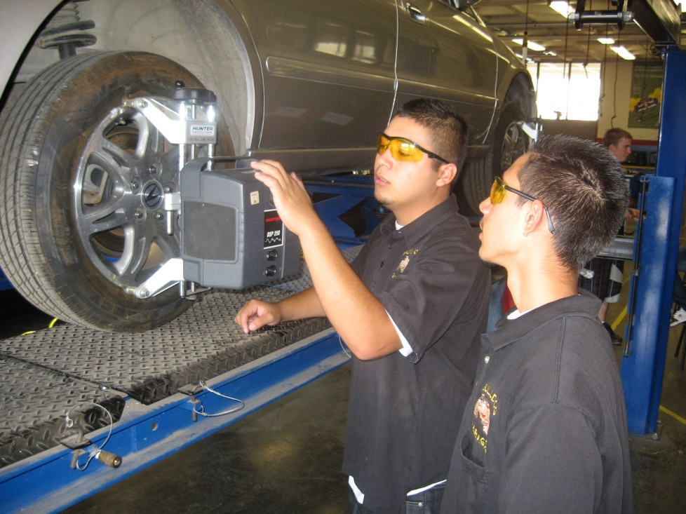
Suspension-Steering
Steering
Suspension Systems
Wheel Alignment
Wheels and Tires

Slide 11
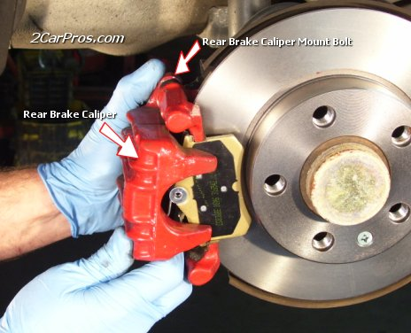
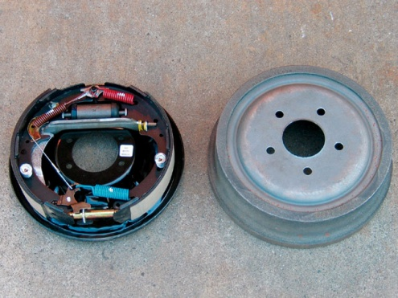
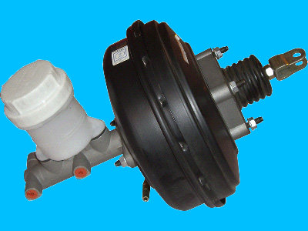
BRAKES
General Brake Systems Diagnosis
Hydraulic System Diagnosis and Repair
Drum Brake Diagnosis and Repair
Disc Brake Diagnosis and Repair
Power Assist Units Diagnosis and Repair
Miscellaneous (Wheel Bearings, Parking Brakes, Electrical, Etc.) Diagnosis and Repair
Electronic Brake, Traction and Stability Control Systems Diagnosis and Repair

Slide 12
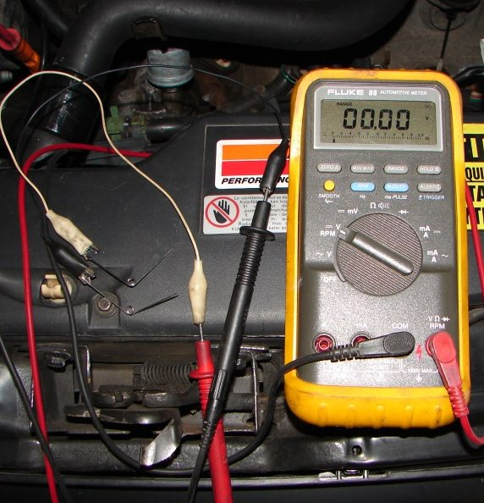
ELECTRICAL
General Electrical System Diagnosis
Battery Diagnosis and Service
Starting System Diagnosis and Repair
Charging System Diagnosis and Repair
Lighting Systems Diagnosis and Repair
Gauges, Warning Devices, and Driver Information Systems Diagnosis and Repair
Horn and Wiper/Washer Diagnosis and Repair
Accessories Diagnosis and Repair

Slide 13
TOOLS
Hemet High has a fully equipped tool room
We supply Safety Glasses (1st pair only, upon completion of safety module)
You Supply:
Close toed shoes (Mandatory)
Coveralls (Optional )
Your brain (Mandatory)
Safety glasses (after the first pair)

Slide 14
BE PROMPT TO CLASS
This means being in your seat by the tardy bell!
Tardy Policies will be enforced!
Students that are never tardy or absent, will be given a certificate and enough extra credit to raise their grade one full level (Mr. Bloom’s Class only)

Slide 15
ATTENDANCE
If you are absent more than 10 times, you will be dropped by the instructor
Students must remain in class until the bell signals the end of class. Students leaving even 1 second early, will receive a call home and 2 lunch detentions minimum!
You must have an excused absence to be allowed to make up work missed
Students who are truant or suspended will not be allowed to make up missed assignments

Slide 16
GRADING POLICY
“A” Means excellent. Excellent students do not have truancies or excess tardies. Good work habits will help keep you employed! Students will demonstrate effective work habits and possess the ability to self-manage*
Students with excess tardies (>5) or one or more truancies will receive a B+ maximum!
Class work is required to be finished before related hands-on skills can be done
Late work may be turned in for partial credit. After 2 weeks - NO CREDIT!
* R.E.A.L. Goals

Slide 17
GRADING SCALE
101% and UP=A+*
93% to 100%=A
90% to 92% =A-
87% to 89% =B+
83% to 86% =B
80% to 82% =B-
77% to 79% =C+
70% to 76% =C
65% to 69% =C-
60% to 64% =D
55% to 60% =D-
54% & under = F
* There are many opportunities for extra credit assignments

Slide 18
RULES AND EXPECTATIONS
Student will report to class on time and be in assigned seat before the bell.
Student will act in a safe manner at all times.
Student will respect others at all times.
Student must wear eye protection while in shop.
Student will use computers in an appropriate manner (and not sit on desks).
Student will use appropriate language at all times.
Student will ask Instructor BEFORE working on any car!
Student must have a valid driver’s license to start or move vehicle!
Student will leave food or drink outside of class room and shop.
Student will not leave class early!
Student will not enter shop without instructor’s explicit permission.
Student will not talk while instructor is talking.
Student will NOT SIT IN OR ON SHOP CARS.
Student will use tools and equipment appropriately!
Student will not engage in horseplay in the classroom or shop.
Theft or vandalism is cause for permanent removal from class, an “F” grade for the semester, and possible legal action.

Slide 19

REQUIRED TEXT
Modern Automotive Technology
by James E. Duffy
Available in class (To remain in class)
Copies are available for check-out in the Library for make-up work at home.
Cost: Approx. $85.00

Slide 20
Homework
It is our policy to give very little homework!
Class work missed or not finished during class may be done at home.
Complete the whole assignment to receive full credit!
Late work may be turned in for partial credit
After 2 weeks - NO CREDIT!

Slide 21
AUTOMOTIVE TECHNOLOGY
There are three reasons for being here:
1. You would like a career in automotive
2. You would like to save money working on your own vehicle
3. You do not want to get ripped off when you have your vehicle repaired

Slide 22
QUESTIONS?
Watch this power-point again!
Ask another student who watched it!

Slide 23
Still have QUESTIONS?
Contact
Mr. Lallman
Mr.Thomson
alallman@hemetusd..org
jthomson@hemetusd.org

