Slide 1
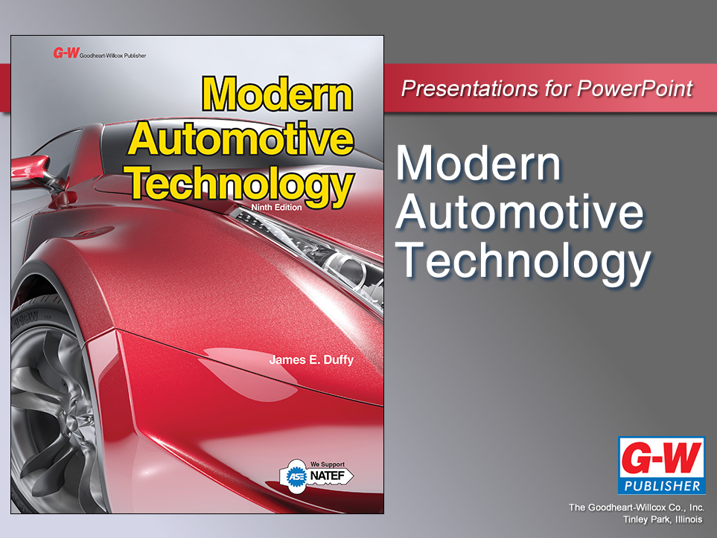

Slide 2
4
Chapter
Power Tools
and Equipment

Slide 3
Objectives
After studying this chapter, you will be able to:
List the most commonly used power tools and equipment.
Describe the uses for power tools and equipment.
Explain the advantages of one type of tool over another.
Explain safety rules that pertain to power tools and equipment.
Correctly answer ASE certification test questions that require a knowledge of power tools and equipment.

Slide 4
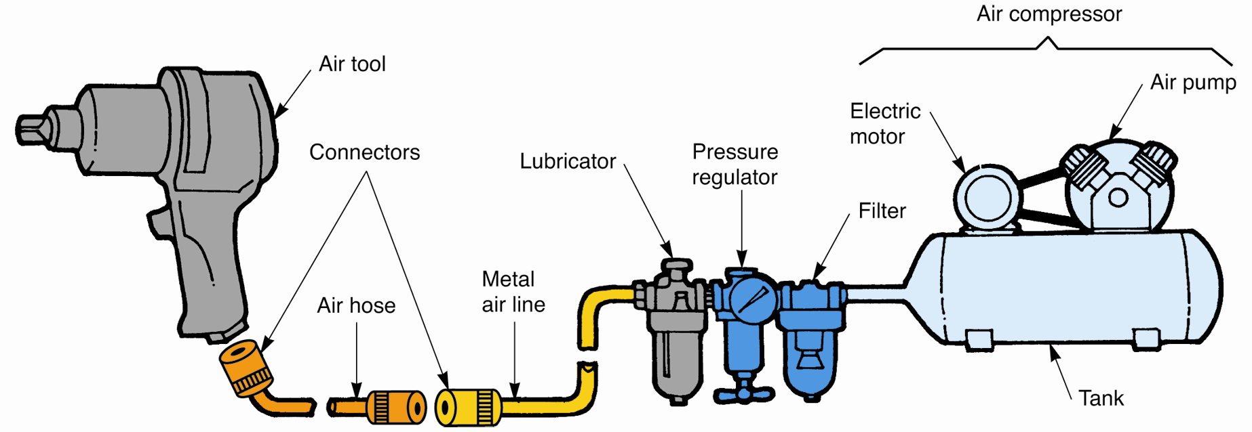
Compressed-Air System
Air compressor
Air lines
Air hoses
Pressure regulator
Quick-disconnect couplings
Filter
Lubricator
(Florida Dept. of Voc. Ed.)

Slide 5
Air Tools
Also known as pneumatic tools
Use stored energy of compressed air for operation
Impact wrenches
Heavy-duty air wrenches with great deal of torque
Air ratchet
Special air wrench designed to quickly remove fasteners
Impact sockets and extensions
Case-hardened steel to withstand extra force

Slide 6
Air Tools (Cont.)
Air hammer or air chisel
Use for driving and cutting operations
Blowgun
Use to dry and clean parts washed in solvent
Air drill
Can drill holes, grind, polish, and clean parts
Rotary brush
Abrasive pad
Rotary file

Slide 7
Electric Tools
Fixed
Drill press
Bench grinder
Portable
Portable electric drill
Rechargeable drill
Electric impact drill

Slide 8
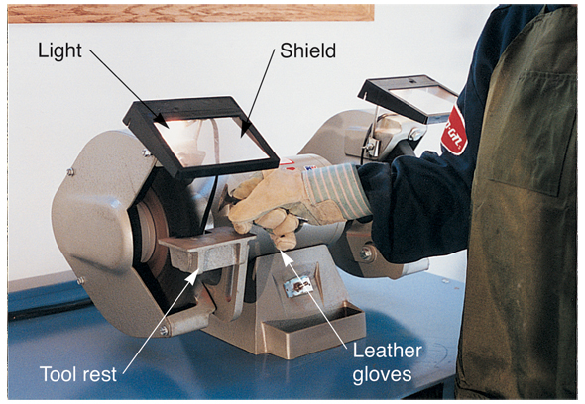
Bench Grinder
Grinding, cleaning, or polishing
Safety
Wear eye
protection
Use shields
Adjust tool rest
Do not use
wire wheel
on soft metal
parts
(Snap-on Tool Corp.)

Slide 9
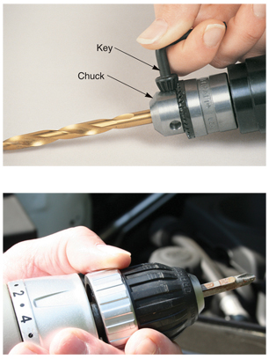
Drills
Create holes in metal
and plastic parts
Use drill bits or twist
drills
Bits mount in drill
chuck
Keyed or keyless
Portable electric drills
Handheld drills
Cordless

Slide 10
Drill Press
Large floor- or bench-mounted drill
Large holes
Deep holes
Many holes in several parts
(a_v_d/Shutterstock.com)

Slide 11
Drill Press Safety
Remove key from chuck before turning on press
Secure part to be drilled with C-clamps or other holding fixtures
Use center punch
Release pressure before bit breaks through part
Oil bit as needed

Slide 12
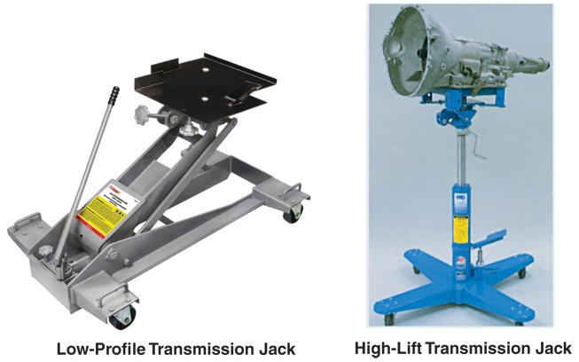
Hydraulic Tools
Powered by pressurized liquid
Various types
Floor jack
Transmission
jack
Engine crane
Hydraulic
press
(OTC/SPX Corp.)

Slide 13
Shop Equipment
Tire changer
Remove and replace tires on wheels
Jack stands
Support vehicle during repairs
Engine stand
Hold engine assembly after removal

Slide 14
Shop Equipment (Cont.)
Cold-solvent tank
Remove grease and oil from parts
High-pressure washer and steam cleaner
Remove heavy deposits from outside of large assemblies
Pressure blaster
Enclosed cabinet
Clean rusty or corroded parts

Slide 15
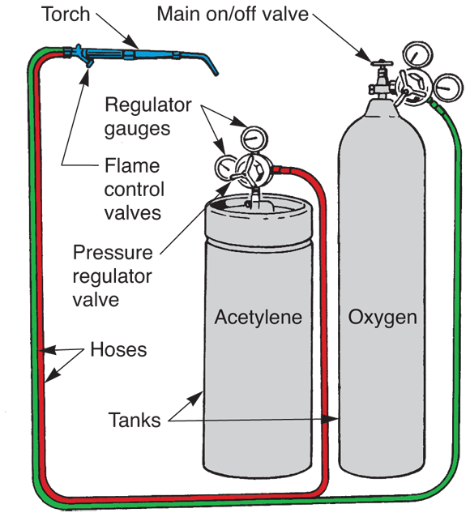
Oxyacetylene Torch
Heat, cut, weld, or braze metal parts
Use also to remove old, rusted exhaust systems
Parts
Oxygen tank
Acetylene tank
Pressure regulators
Hoses
Handheld torch
(Sun)

Slide 16
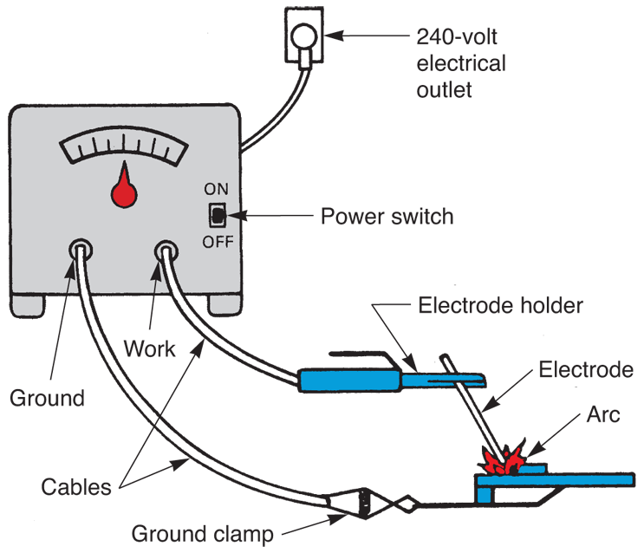
Welder
Uses high electric current
Creates high-power arc to melt and fuse metal
Complete proper training before use
(Sun)

Slide 17
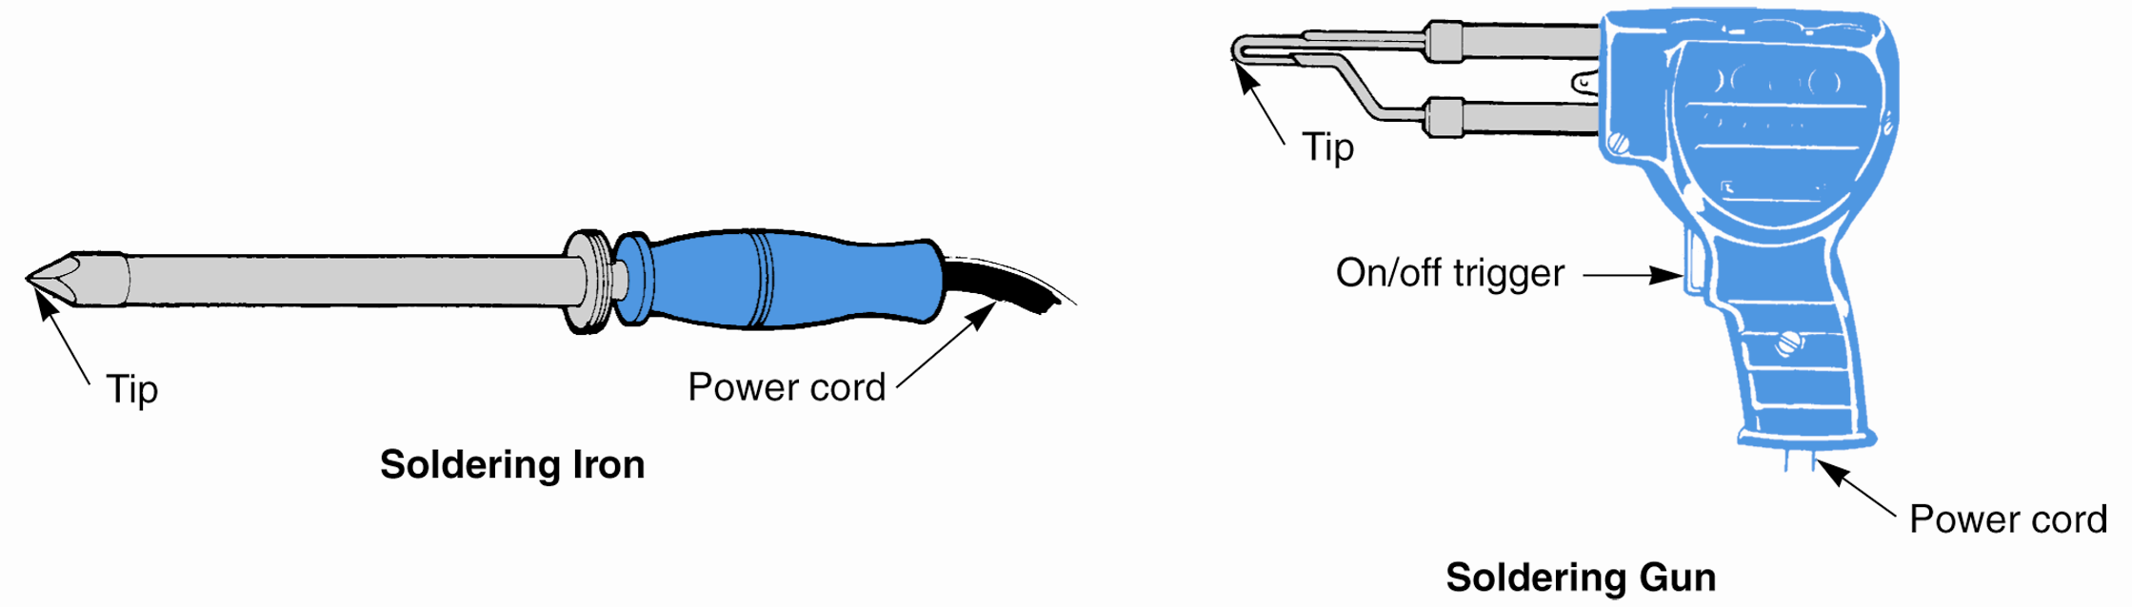
Soldering Gun or Soldering Iron
Join electrical wires
Electric current heats tip and wires
Solder, a lead-tin alloy, applied and melts
Cools to form strong, solid connection
(Florida Dept. of Voc. Ed.)

Slide 18
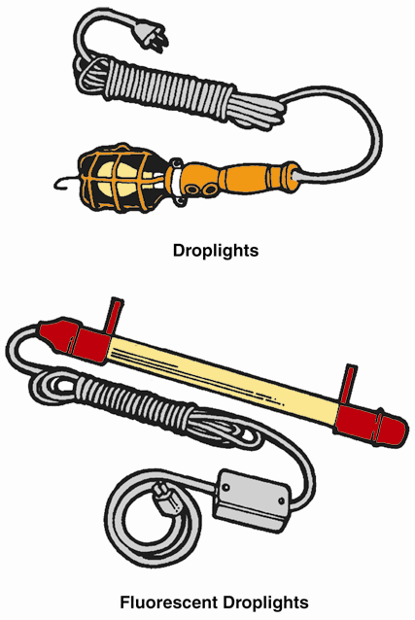
Other Shop Equipment
Battery charger
Re-energizes “dead” or discharged battery
Droplight
Provides portable source of light
Anywhere additional light needed for repairs
(Florida Dept. of Voc. Ed.)

Slide 19
Pullers
Specialized tool
Removes
Seals
Gears
Pulleys
Steering wheels
Axles
Other press-on parts

Slide 20
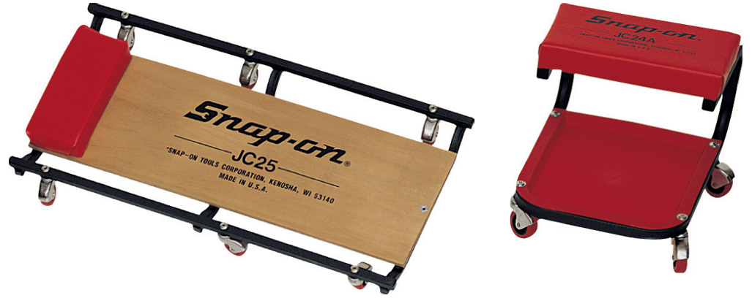
Creepers
Allows technician to roll around and under vehicle
Stool creeper
Allows technician to sit while working on parts near ground
(Snap-on Tool Corp.)

Slide 21
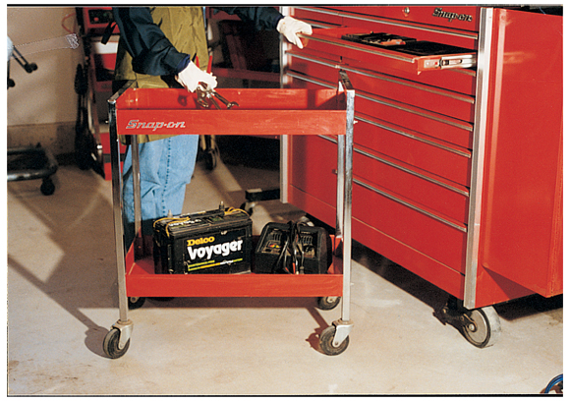
Roll-Around Cart
Carries various tools/equipment to job area
Allows needed tools to be within reach
Saves time and effort
(Snap-on Tool Corp.)

Slide 22
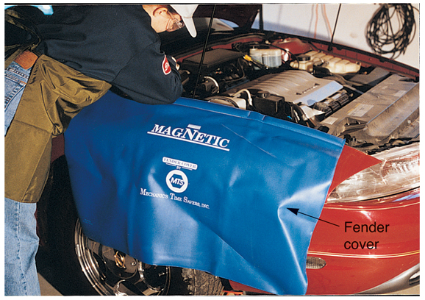
Covers
Fender covers
Prevent vehicle damage
Seat covers
Protect from
dirt, oil, and
grease

Slide 23
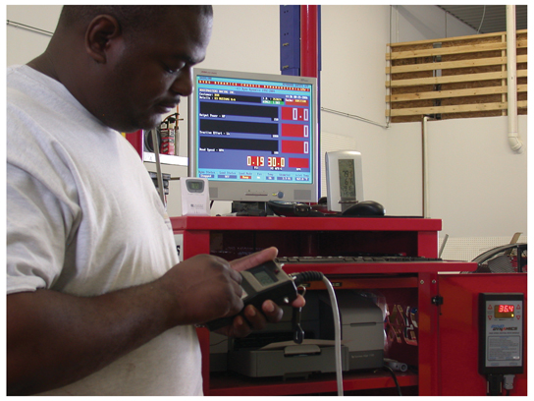
Personal Computer
Laptops
Help with many tasks
Problem
diagnosis
Preprogramming
of computer chips
Bookkeeping
Reference to
service literature

