Slide 1


Slide 2
6
Chapter
Automotive Measurement and Math

Slide 3
Objectives
After studying this chapter, you will be able to:
Use both customary and metric measuring systems.
Identify and use basic measuring tools.
Use decimal and metric conversion charts.
Use basic math skills.
Understand percentages and ratios.
Correctly answer ASE certification test questions that require a basic understanding of measurement and math.

Slide 4
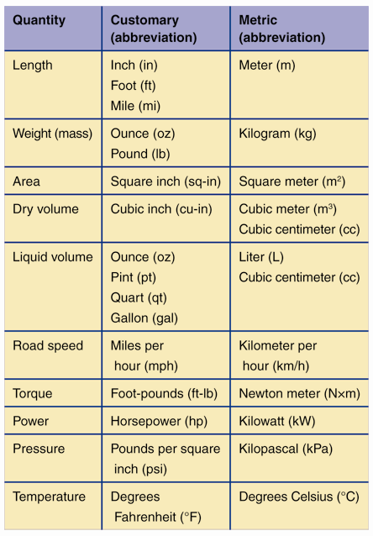
Measuring Systems
Two are commonly used in auto shop
Customary or US customary
Inches, pounds, etc.
Metric (SI)
Millimeters, grams, etc.

Slide 5
Measuring Systems (Cont.)
Customary
Originated with sizes taken from parts of human body
Metric (SI)
Power of 10 for all basic units
Conversion chart
Change measurement from one system to another
Decimal conversion chart
Find equivalent values for fractions, decimals, and millimeters

Slide 6
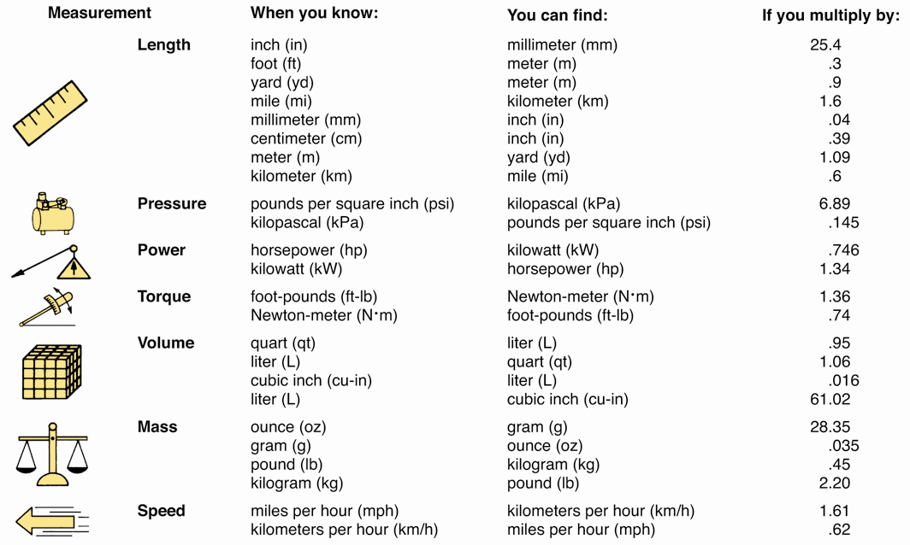
Conversion Chart

Slide 7
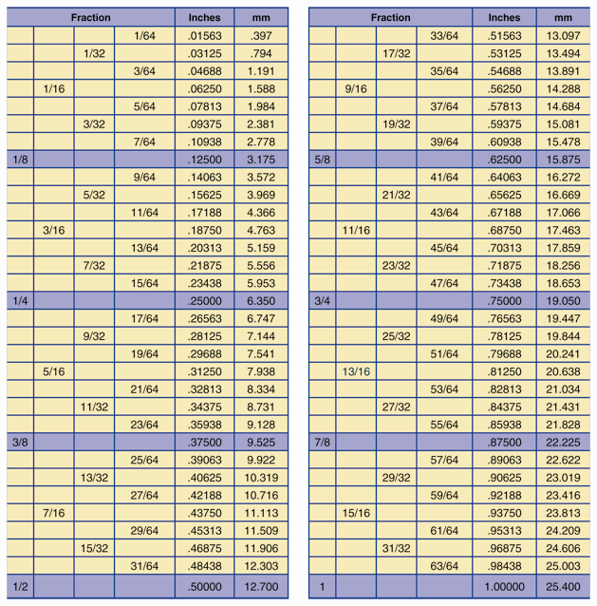
Decimal Conversion Chart
(Parker Hannifin Corp.)

Slide 8
Measuring Tools
Steel rule or scale
Use to make low-precision linear measurements
Customary rule
Uses numbered lines to represent inches
Uses unnumbered lines to represent fractions of inch
Metric rule
Uses unnumbered lines to represent millimeters
Uses numbered lines to represent centimeters (10mm = 1cm)

Slide 9
Measuring Tools (Cont.)
Pocket rule
Typically 6″ long and fits in pocket
Combination square
Sliding square mounted on steel rule
Tape measure
Extends to several feet or meters in length
Yardstick or meterstick
Use for large linear measurements up to one yard or one meter

Slide 10
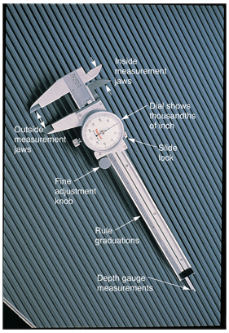
Calipers
Vernier caliper
Use to make inside, outside, and depth measurements
(Starrett)

Slide 11
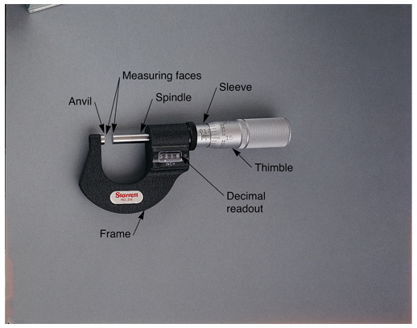
Micrometers
Use to make very accurate measurements
One ten-thousandth
of inch
0.0001″
0.001 mm
Outside micrometer
External dimensions
Diameters
Thicknesses
(Starrett)

Slide 12
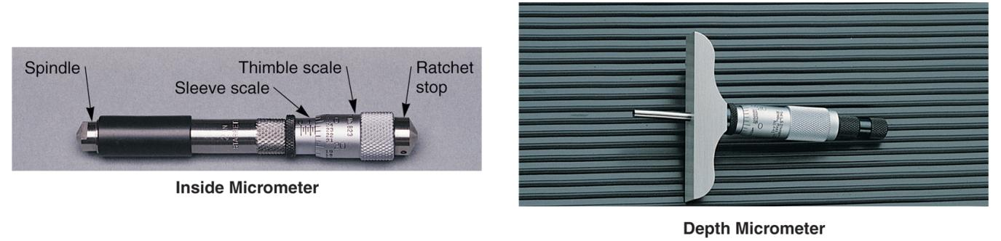
Micrometers (Cont.)
Inside micrometer
Large holes
Cylinders
Part openings
Depth micrometer
Use to measure depth of opening
(Starrett and Snap-on Tool Corp.)

Slide 13
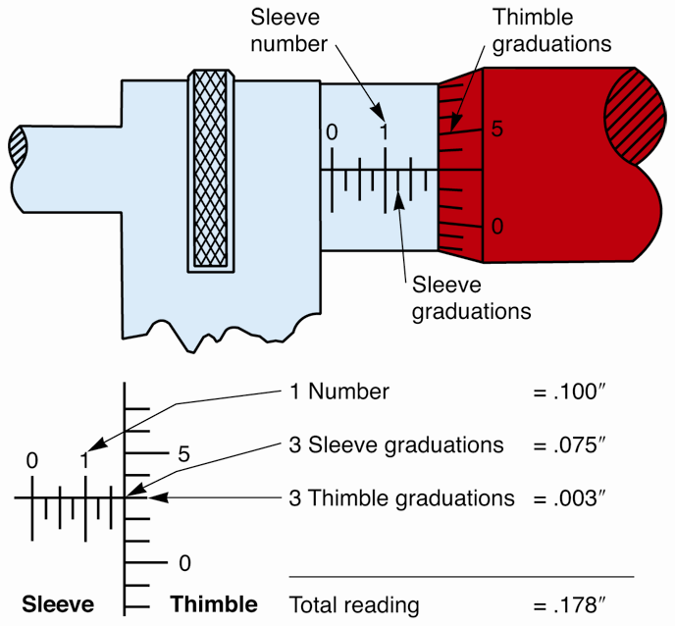
Reading a Micrometer
Note largest number visible on sleeve
Count sleeve graduation lines to the right
Note thimble graduation (round off)
Add all decimal values
Add any full inches
Metric micrometers
Read same way
(Starrett)

Slide 14
Measuring Tool Rules
Never drop or overtighten micrometer or caliper
Store measuring tools where they cannot be damaged
Grasp micrometer frame in palm and turn thimble with thumb and finger
Hold micrometer squarely with work

Slide 15
Measuring Tool Rules (Cont.)
Rock or swivel micrometer as it is touched on round parts
Place thin film of oil on micrometer and caliper surfaces during storage
Always check for accuracy using standardized gauge block after dropping or prolonged use

Slide 16
Feeler Gauges
Use to measure small clearances or gaps between parts
Flat feeler gauge
Precision-ground steel blades, various thicknesses
Size written on each blade in thousandths of an inch or hundredths of a millimeter
Wire feeler gauge
Precise-sized wires labeled by diameter of thickness
Use to measure slightly larger gaps and spaces

Slide 17
Dial Indicator
Measures part movement in thousandths of an inch
Hundredths of a millimeter
Use to check
Gear teeth backlash (clearance)
Shaft end play
Cam lobe lift

Slide 18
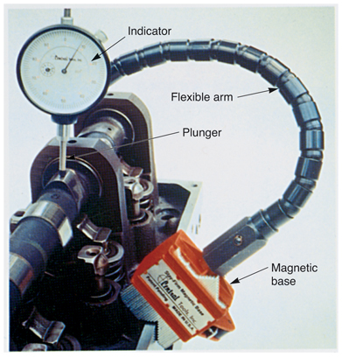
Using a Dial Indicator
Mount indicator securely
Position dial plunger
Partially compress indicator plunger
Lock in place
Move or rotate part
Read indicator
Subtract lowest reading from highest
(Central Tool Co.)

Slide 19
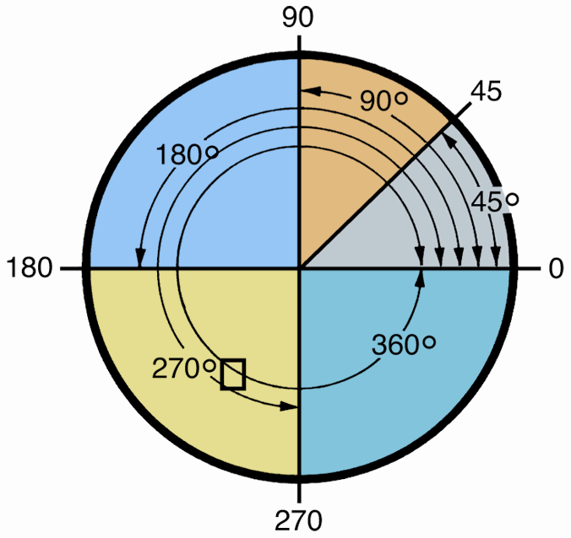
Angle Measurement
Circle divided into 360 equal parts called degrees
Abbreviated using “deg.” or (°)
One-quarter of circle equals 90°

Slide 20
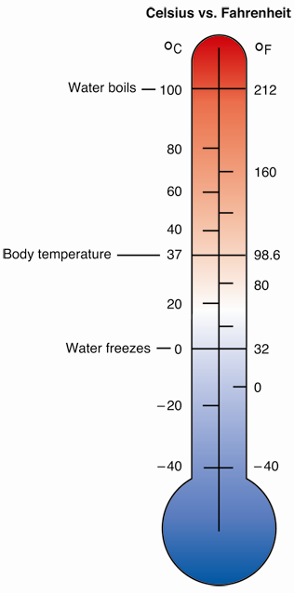
Temperature Measurement
Measure using temperature gauges or thermometers
Available in either Fahrenheit (F°) or metric Celsius (C°)

Slide 21
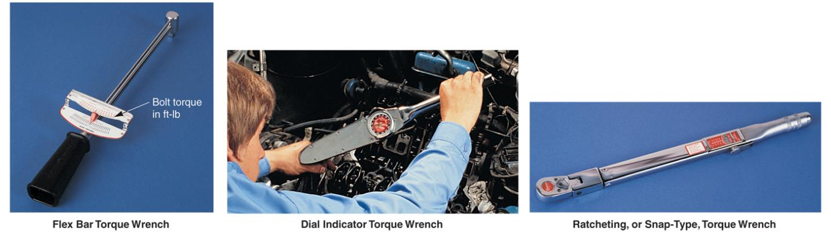
Torque Wrenches
Use to apply specific amount of turning force to fastener
Read
Foot pounds (ft-lb)
Newton-meters (N • m)

Slide 22
Other Measurements and Measuring Tools
Pressure gauge
Use to measure air or fluid pressure
Pounds per square inch (psi)
Kilograms per square centimeter (kg/ cm²)
Kilopascals (kPa)
Vacuum gauge
Use to measure negative pressure or vacuum
Inches of mercury (in/ Hg)
Metric kilograms per square centimeter (kg/ cm²)

Slide 23
Other Measurements and Measuring Tools (Cont.)
Telescoping gauge
Measures internal part bores or openings
Hole gauge
Measures very small holes in parts

Slide 24
Review of Shop Math
Auto technicians work with whole numbers, fractions, and decimals every day
Calculate
Measurements
Clearances
Part prices
Labor charges
Tax percentages
Total charges

Slide 25
Addition
Combining two or more numbers to find total quantity
Result called sum
Write large numbers, or long series of numbers, in column
Use for adding up costs of parts and labor

Slide 26
Subtraction
Taking away certain quantity from another
Amount left after subtracting called remainder
Use to determine customers’ bills after deposit
Useful for checking paychecks for tax deductions

Slide 27
Division
Finds out how many times a number is contained in another number
Number being divided is dividend
Number that dividend is divided by is divisor
Answer is quotient
Use to determine unit costs
If 10 fuel pumps cost $100.00, then 1 fuel pump costs?

Slide 28
Multiplication
Shortcut for adding same number over and over
Number by which another number is multiplied is multiplier
Result of multiplication is product

Slide 29
Fractions
Represent portion of whole number
Written as two numbers, one over the other or one beside the number
Number below line or slash called denominator
How many parts the whole is divided into
Number above line or slash called numerator
How many parts are present in the fraction

Slide 30
Decimal Fractions
Also have numerator and denominator
Denominator always a multiple of 10 that is never written
Use decimal point, a dot or period, instead
For example, 9/10 is written 0.9
Number of digits to right of decimal point tells what multiple of 10
Tenths, hundredths, thousandths, etc.

Slide 31
Decimal Fractions (Cont.)
Zero placed
Between number and decimal point changes value of number (.45 is not the same as .045)
To right of decimal number does not change value of number (.45 is the same as .450)
To left of decimal point does not change value of number (0.45 is the same as .45)

Slide 32
Addition and Subtraction of Decimals
Line up decimal points in column
Decimal point in answer must be in same position as decimal point in column

Slide 33
Multiplication of Decimals
Decimal points do not need to be aligned
Multiply numbers ignoring decimal points
Count total number of decimal points to right of both numbers
Starting from right digit, count to left the same number of digits in answer
Place decimal point to left of last digit counted

Slide 34
Division of Decimals
When neither dividend nor divisor contain decimal points, but division does not come out even
Place decimal point to right of last number of dividend
Add one or more zeros after decimal and continue dividing to number of spaces necessary

Slide 35
Division of Decimals (Cont.)
When dividend has decimal and divisor does not
Divide as usual
Place decimal point in answer directly above decimal point in dividend

Slide 36
Division of Decimals (Cont.)
When divisor has decimal point
If dividend does not have decimal point, add one to far right
If dividend has decimal point, move it one place to the right for each decimal place in divisor
Use zeros as placeholders if needed
Divide as usual
Place decimal point in answer directly above relocated decimal point in dividend

Slide 37
Percentages
Quantities expressed as part of 100
10% equal to 10 out of every 100
Commonly used to calculate tax on parts
To find percentage of any number
Convert percentage to decimal
Drop percentage sign and move decimal left two places
Multiply decimal by number

Slide 38
Ratios
Mathematic expression comparing two numbers
Represent how many of one number there is compared to another
Ratio of 2 to 1 can be written 2:1 or 2/1
Ratios are commonly used when expressing relationships between gears
If two gears have 3:1 gear ratio, one gear would turn three revolutions to only one revolution of other gear

