Slide 1


Slide 2
8
Chapter
Fasteners, Gaskets, Seals, and Sealants

Slide 3
Objectives
After studying this chapter, you will be able to:
Identify commonly used automotive fasteners.
Select and use fasteners properly.
Remove, select, and install gaskets, seals, and sealants correctly.
Summarize safety rules relating to fasteners, gaskets, seals, and sealants.
Correctly answer ASE certification test questions that require a knowledge of fasteners, gaskets, seals, and sealants.

Slide 4
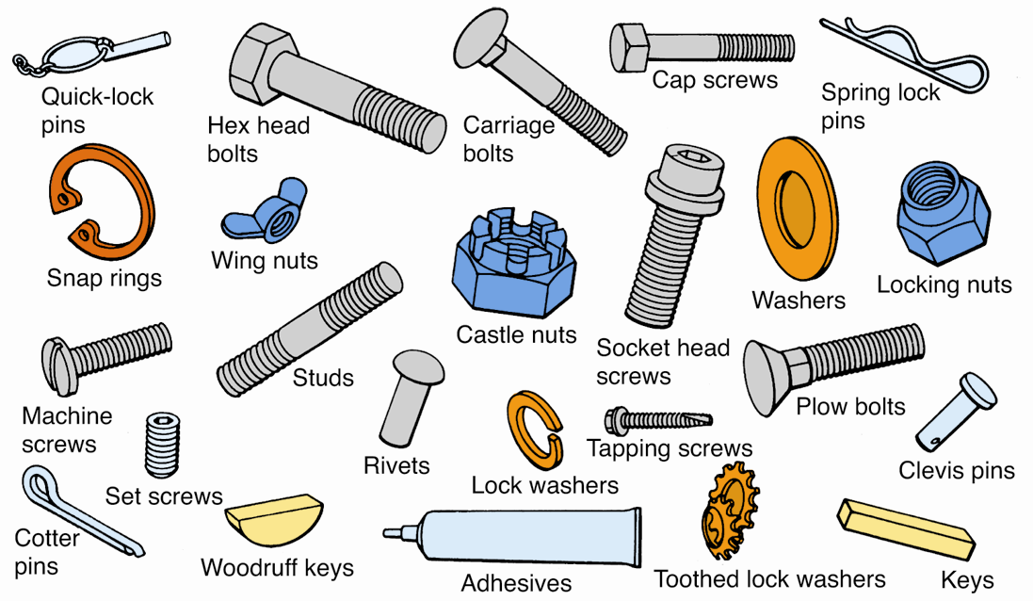
Fasteners
(Deere & Co.)

Slide 5
Bolts and Nuts
Bolt size
Outside diameter of bolt threads
Bolt head size
Distance across outer sides of bolt head
Bolt length
Measured from bottom of bolt head to threaded end of bolt
Thread pitch or thread coarseness
Number of threads per inch

Slide 6
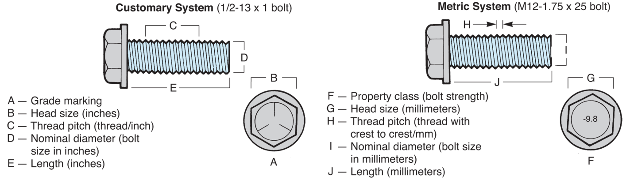
Bolts and Nuts (Cont.)
(Ford)

Slide 7
Bolts and Nuts (Cont.)
Thread types
Coarse (UNC)
Fine (UNF)
Metric (SI)
Bolt grade
Indicates bolt’s tensile strength
Bolt description
Series of numbers and letters describing bolt

Slide 8
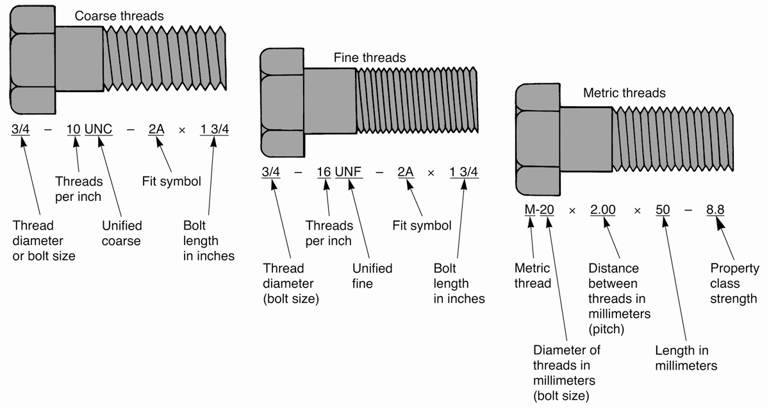
Bolt Description Numbers

Slide 9
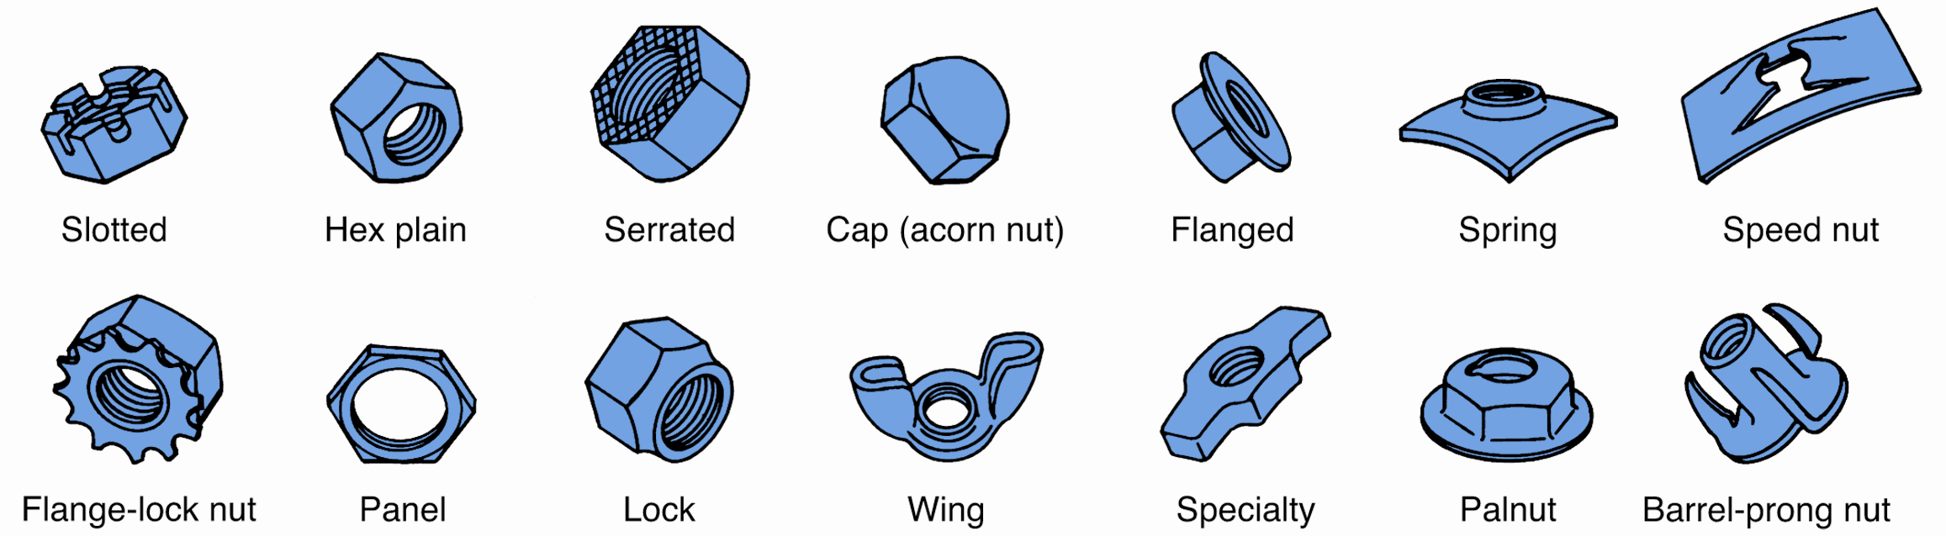
Nut Types
(Deere & Co.)

Slide 10
Washers
Use under bolt heads and nuts
Flat washer
Increases clamping surface under washer
Lock washer
Prevents bolt or nut from coming loose under stress or vibration
Lock tabs or lock plates
Perform function of both flat washers and lock washers

Slide 11
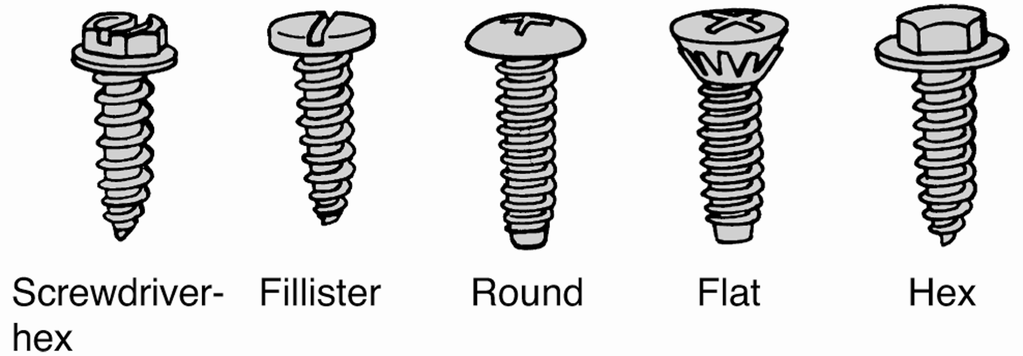
Screw Types
Machine screws
Similar to bolts but normally have screw-type heads
Sheet metal screws or tapping screws
Used on plastic and sheet metal
Wide range of head configurations and sizes
(Deere & Co.)

Slide 12
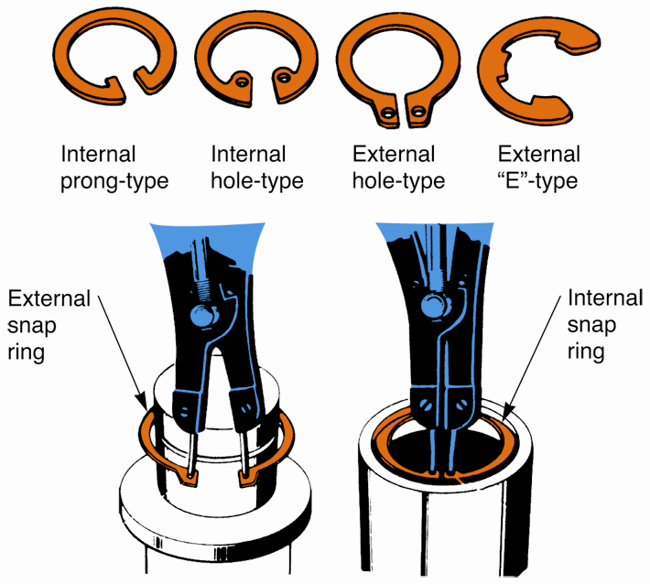
Snap Rings
Fit into groove in part
Commonly hold shafts, bearings, gears, pins, and components in place
Require snap ring pliers to remove and install

Slide 13
Keys and Set Screws
Keys
Fit into keyseat or slot cut into shaft and keyway cut into mating part
Set screws
Lock part onto shaft
Used with or without key
Hex (Allen) or screwdriver

Slide 14
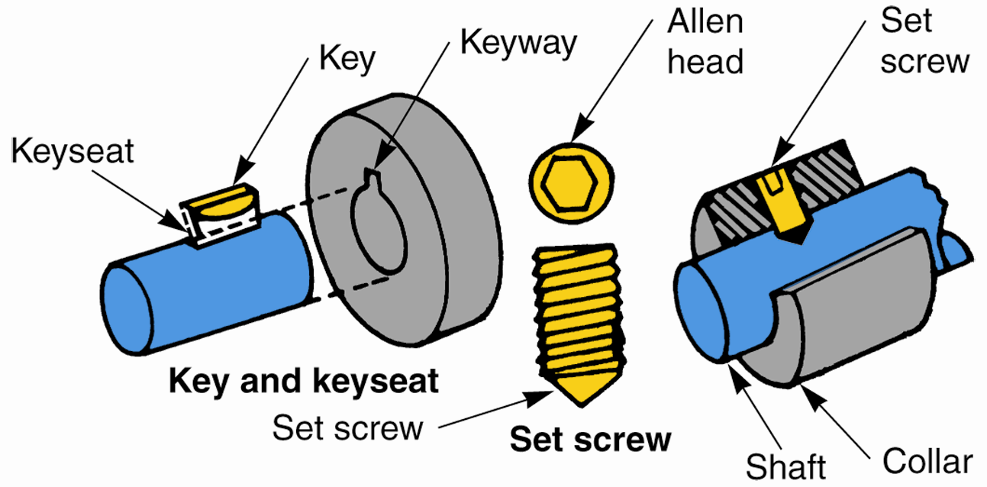
Keys and Screw Sets (Cont.)
(Florida Dept. of Voc. Ed.)

Slide 15
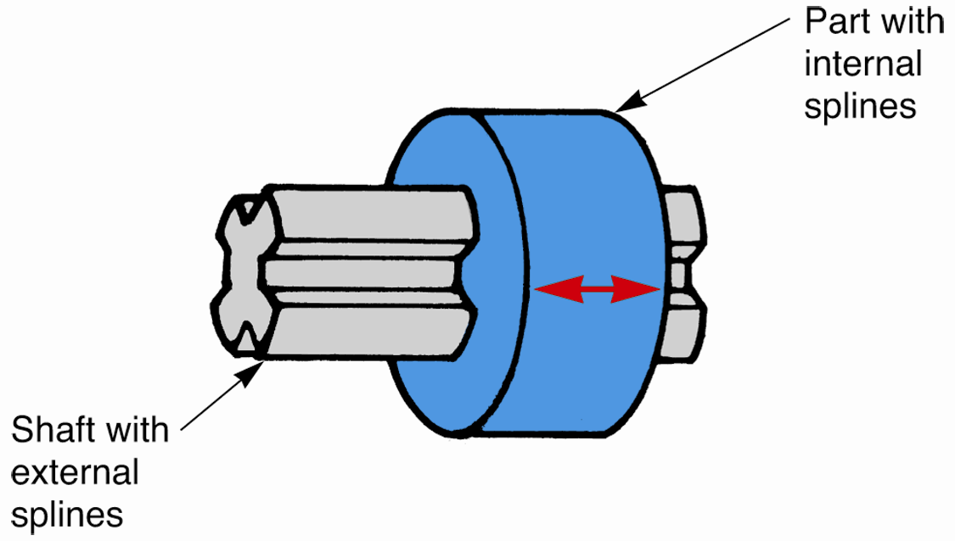
Splines
Series of slots cut into shaft and mating part
Allow gears or collars to slide but not rotate
Manual transmissions
Clutches
Drive shaft yokes

Slide 16
Adhesives
Special glues widely used in vehicles
Body moldings
Rubber weather stripping
Body emblems
Some stay soft and pliable while others dry hard
Some take hours to dry while others dry in seconds

Slide 17
Torquing Bolts and Nuts
Torque specifications
Tightening specifications given by manufacturer
Torque-to-yield
Tightening method where bolt is tightened to specific torque and then additional number of degrees

Slide 18
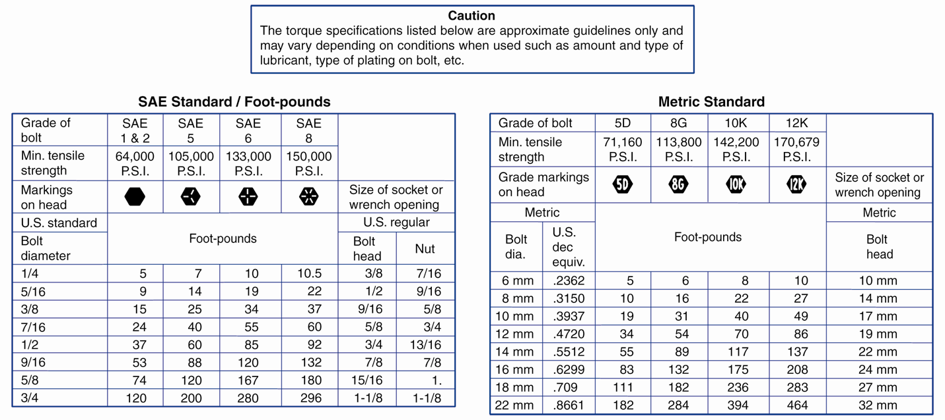
Torquing Bolts and Nuts (Cont.)

Slide 19
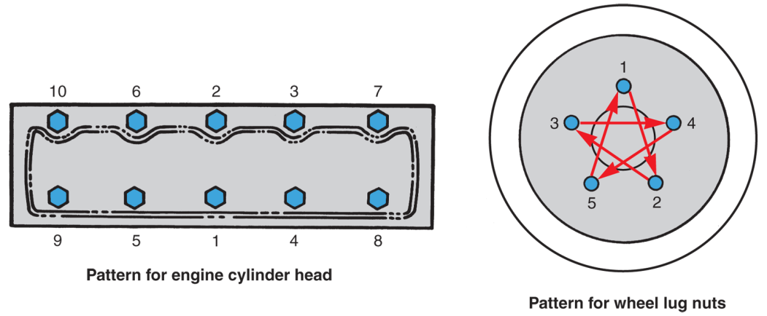
Bolt Tightening Sequence
Also called torque pattern
Used to make sure parts are fastened evenly
Uses crisscross pattern
Uneven tightening
Breaks
Leaks
Warping

Slide 20
Using a Torque Wrench
Pull steadily on wrench
Clean fastener threads
Avoid using swivel joints
Look straight down at scale
Only use torque value chart when no manufacturer's specifications are available
If torque pattern is not available, use general crisscross pattern

Slide 21
Using a Torque Wrench (Cont.)
Pull only on handle of torque wrench
Do not allow beam of beam-type wrench to touch anything
Tighten bolts in four steps
Retorque when required

Slide 22
Thread Repairs
Minor
Cleaned up with thread chaser
Major
Must be repaired with either a tap or a die
Tap is threaded tool for cutting internal threads
Die cuts external threads

Slide 23
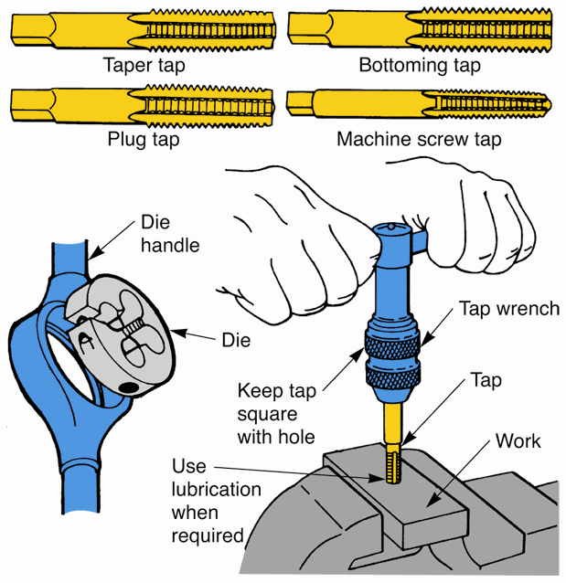
Tap and Die Rules
Never force tap handle
Keep tap and die well oiled
Always use right size tap in correct size hole
Use coarse threads when tapping soft metal

Slide 24
Thread Repairs (Cont.)
Tapping oversize
When thread chaser or tap cannot be used to clean up damaged threads, hole can be tapped and threaded oversize
Use drill and tap size chart

Slide 25
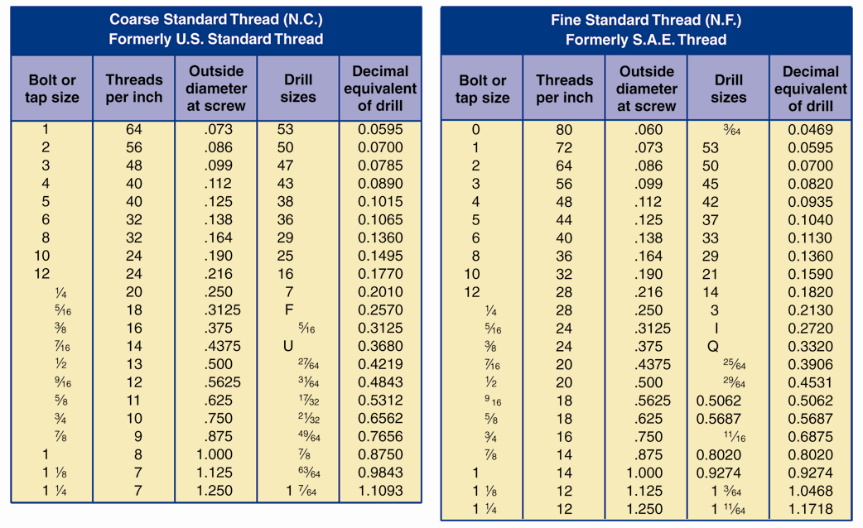
Thread Repairs (Cont.)

Slide 26
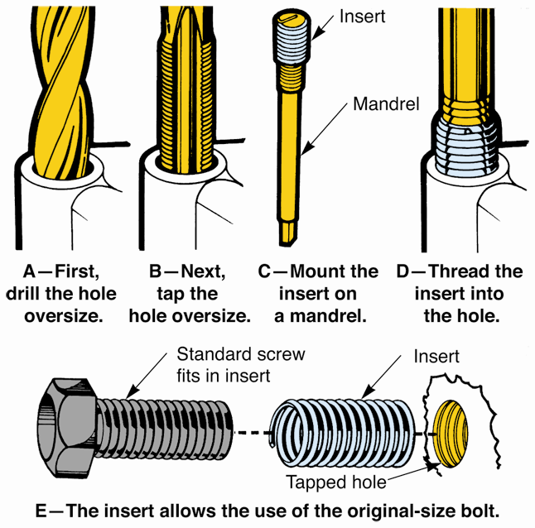
Thread Repairs (Cont.)
Thread repair insert
Use when oversize hole and fastener is not acceptable
Insert replaces damaged internal threads
Allows use of original size bolt
(Chrysler and The Eastwood Company)

Slide 27
Removing Damaged Fasteners
Locking pliers
Remove broken bolts, screws, and fasteners
Stud puller
Removes studs and bolts broken off above surface of part
If fastener is too short to grasp
Cut slot with hacksaw
Weld on new head

Slide 28
Removing Damaged Fasteners (Cont.)
If fastener is broken flush
Use hammer and punch
Screw extractor or “easy out”
Removes bolts broken flush or below surface
Try drilling hole almost as large as bolt, then use tap or punch to remove excess
Rust penetrant dissolves rust or corrosion
Use to aid removal

Slide 29
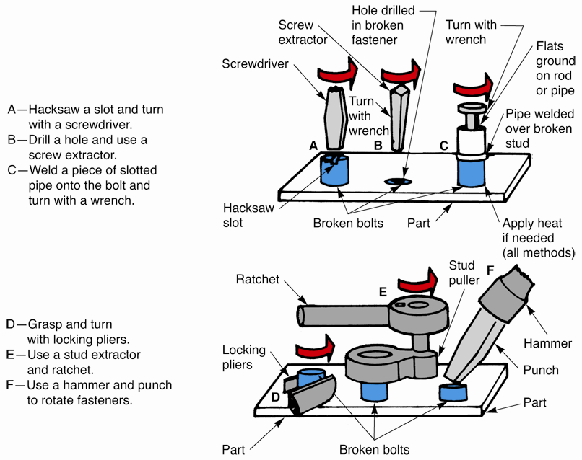
Removing Damaged Fasteners (Cont.)

Slide 30
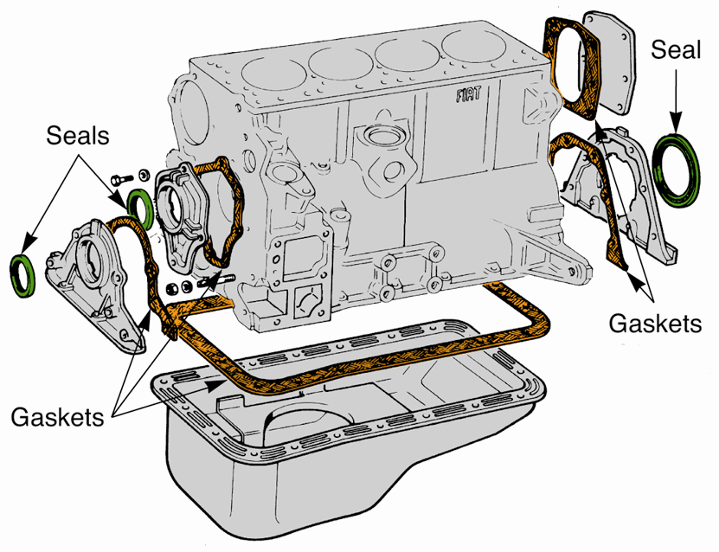
Gaskets and Seals
Gasket
Soft, flexible material placed between parts to prevent leakage
Fiber
Rubber
Neoprene
Cork
Treated paper
Thin steel
(Fiat)

Slide 31
Using Gaskets
Inspect for leaks prior to disassembly
Clean off old gaskets carefully
Use scraper or wire brush
Be extra careful with aluminum and brass
Wash and dry parts thoroughly using solvents
Dry with compressed air
Compare new gasket to shape of mating surface
Must match perfectly

Slide 32
Using Gaskets (Cont.)
Use sealer if needed
Screw in all bolts by hand
Use crisscross pattern and tighten in steps
Torque one step at a time if required

Slide 33
Sealers
Coat gasket to prevent leakage
Hold gaskets in place during assembly
Hardening sealers
Use on permanent assemblies
Fills uneven surfaces
Resistant to heat and chemicals
Shellac
Sticky, nonhardening sealer
Use on fiber gaskets

Slide 34
Sealers (Cont.)
Form-in-place gaskets
Special sealers used in place of fiber or rubber gaskets
Room temperature vulcanizing (RTV)
Anaerobic sealer

Slide 35
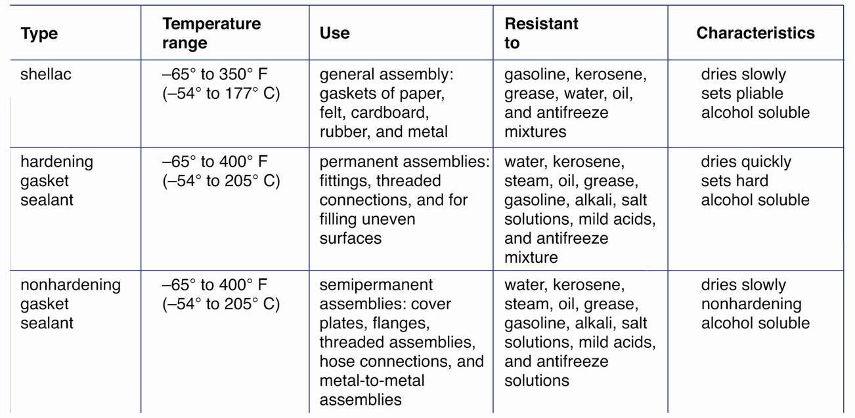
Sealers (Cont.)
(Fel-Pro Gaskets)

Slide 36
Seals
Prevent leakage between stationary part and moving part
Found in almost any part containing fluid and moving parts
Allow shafts to spin or slide without fluid leakage
Normally made of synthetic rubber molded onto metal bodies

Slide 37
Seal Rules
Inspect for leakage prior to disassembly
Look for bent shafts, misaligned housing, or damaged parts
Remove old seal carefully
May require special puller
Inspect shaft for wear or burrs
File off burrs
Polish, repair, or replace worn shafts

Slide 38
Seal Rules (Cont.)
Compare old seal to new one
Both inside and outside diameter should match
Slip seal over shaft and verify snugness
Install new seal
Coat outside of seal housing with sealer
Coat inner lip with system fluid
Backward installation will cause heavy leakage
Verify it is squarely and firmly seated

Slide 39
O-Ring Seals
Stationary seal that fits into groove between two parts
Form leakproof joints by applying pressure to multiple surfaces
Coat with system fluid before installation

Slide 40
Other Information
Special gaskets and seals
Installation techniques
These special situations are discussed in later chapters of this textbook

