Slide 1
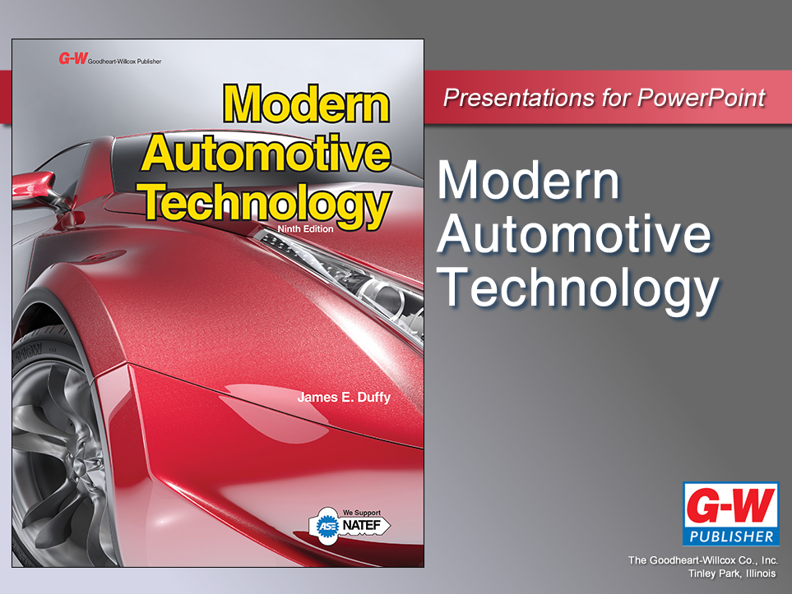

Slide 2
9
Chapter
Vehicle Maintenance, Fluid Service, and Recycling

Slide 3
Objectives
After studying this chapter, you will be able to:
Check a car’s fluid levels.
Explain the importance of vehicle maintenance.
Locate fluid leaks.
Replace engine oil and filter.
Change automatic transmission fluid and filter.

Slide 4
Objectives
Perform a grease job.
Inspect for general problems with hoses, belts, and other components.
Demonstrate safe practices while working with vehicle fluids.
Recycle or properly dispose of auto shop wastes.
Correctly answer ASE certification test questions on fluid service and vehicle maintenance.

Slide 5
Vehicle Fluids
Engine oil
Coolant
Brake fluid
Transmission fluid
Power steering fluid
Other liquids

Slide 6
Lubrication Service
Checking fluid levels and conditions
Changing engine oil and filter
Changing automatic transmission fluid
Lubricating (greasing) chassis parts constructed with grease fittings
Locating liquid leaks and other obvious problems
Following state regulations for recycling and disposal of waste fluids

Slide 7
Vehicle Maintenance
Includes any operation that will keep vehicle in good operating condition
No proper care
Automobile life may be reduced

Slide 8
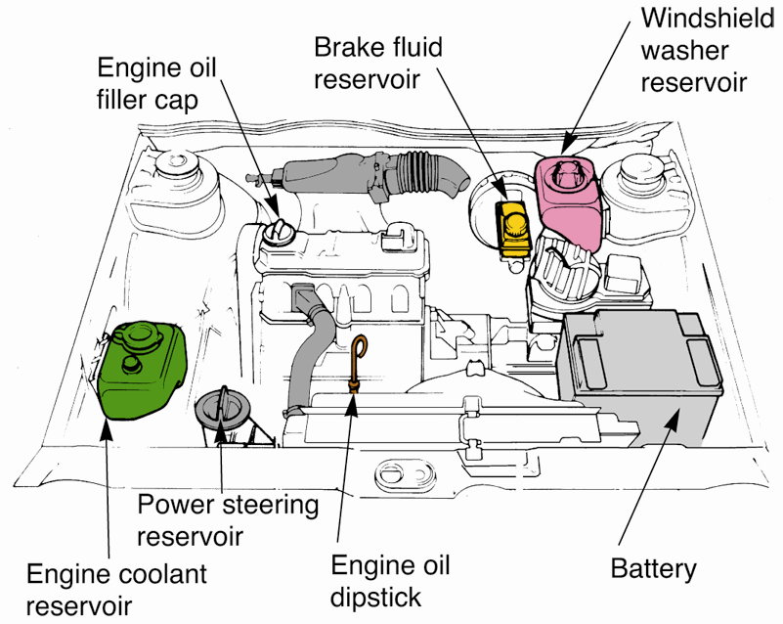
Fluid Service
Check service manual
Location of all fluid checkpoints and fill points
Interval between fluid checks and changes
Correct type and quantity of fluids
(VW)

Slide 9
Checking Engine Oil
Warm engine
Locate and remove dipstick
Wipe off and replace it
Pull dipstick back out and hold over shop rag
Oil level
Between ADD (LOW) and FULL marks on dipstick

Slide 10
Checking Engine Oil (Cont.)
Inspect condition of oil
Not too thick or thin
Not too dirty
Does not smell like gasoline
Overfilling can cause oil foaming
Oil absorbs air bubbles
Reduces lubricating ability

Slide 11
Adding Engine Oil
Obtain correct oil
Look for lubrication sticker in engine compartment
Use same oil as last oil change if possible
Remove oil cap
Usually located on valve cover
Install funnel
Pour slowly

Slide 12
Changing Engine Oil and Filter
Warm up engine
Put on eye or face protection and gloves
Raise vehicle
Keep level
Place catch pan under oil drain plug
Unscrew drain plug
Allow oil to drain completely
Reinstall drain plug

Slide 13
Changing Engine Oil and Filter (Cont.)
Position catch pan under filter
Unscrew filter using filter wrench
Obtain correct replacement filter
Wipe small amount of oil on O-ring
Tighten by hand
Never use filter wrench during install

Slide 14
Changing Engine Oil and Filter (Cont.)
Lower vehicle
Add correct amount of fresh oil
Start engine and check oil pressure light
Let engine run and check for leaks
Shut off engine and check oil level again

Slide 15
Automatic Transmission/Transaxle Fluid and Filter Service
Should be checked at specified intervals
Transmission fluid contamination
Metal
Dirt
Moisture
Friction material

Slide 16
Checking Automatic Transmission/Transaxle Fluid
Warm up engine
Move gear selector through all positions
Apply parking brake
Place transmission in park and block wheels
With engine running, locate and remove transmission dipstick
Some are sealed and don’t have a dipstick

Slide 17
Checking Automatic Transmission/Transaxle Fluid (Cont.)
Wipe off dipstick and replace it
Pull dipstick back out and hold over shop rag
Fluid level
Between ADD (LOW) and FULL marks on dipstick

Slide 18
Checking Automatic Transmission/Transaxle Fluid (Cont.)
Inspect fluid for discoloration and odor
Smells burned or looks dirty, replace it
Easy to overfill transmission fluid
Usually requires fraction of quart

Slide 19
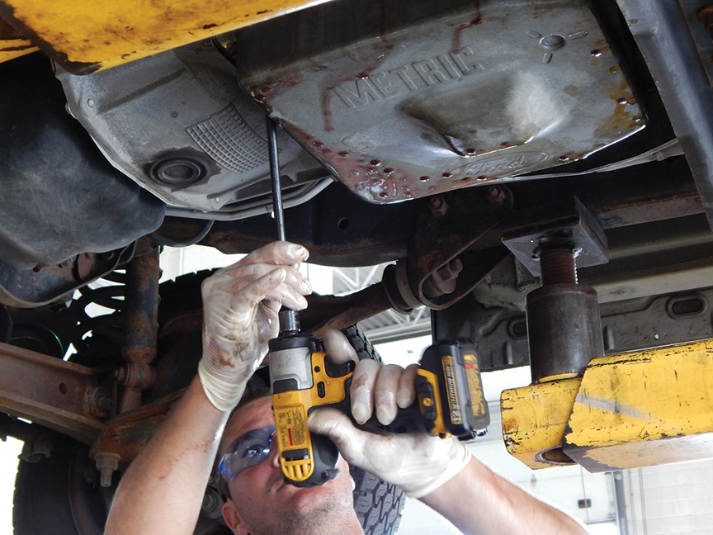
Changing Automatic Transmission/Transaxle Fluid and Filter
Warm up engine
Raise vehicle
Remove all but one of pan bolts
Loosen last pan bolt while holding pan
Allow pan to drop and catch fluid in catch pan
(Subaru)

Slide 20
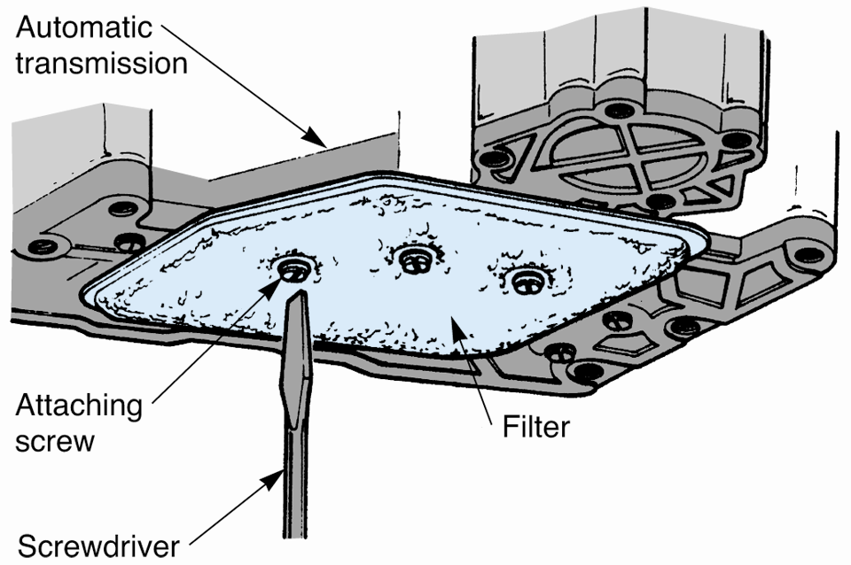
Changing Automatic Transmission/Transaxle Fluid and Filter (Cont.)
Replace filter
Replace and seal pan gasket
Reinstall transmission pan
Drain torque converter (if recommended)
Refill transmission fluid
Shift through gears
Check for leaks

Slide 21
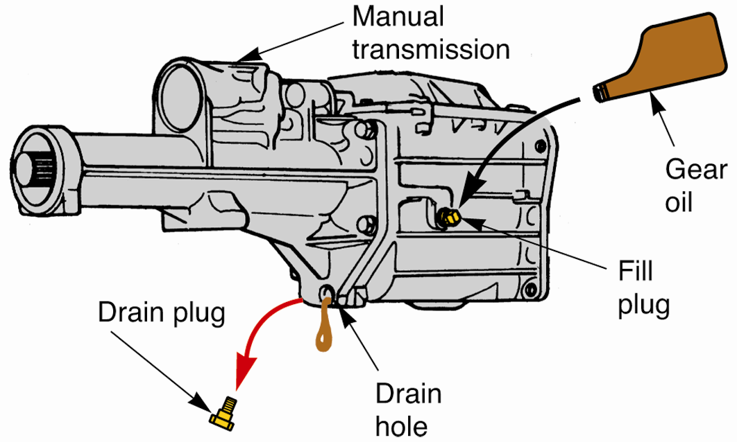
Manual Transmission Fluid Service
To check fluid
Locate and remove transmission fill plug
Fluid
Warm
Even with fill hole
Cold
Just below fill hole
(Chrysler)

Slide 22
Manual Transmission Fluid Service (Cont.)
Some manufacturers suggest periodic change of manual transmission, others do not
If fluid change needed
Remove drain plug
Drain fluid into catch pan
Replace drain plug
Fill with correct fluid
Lubricate gear shift mechanism and clutch release

Slide 23
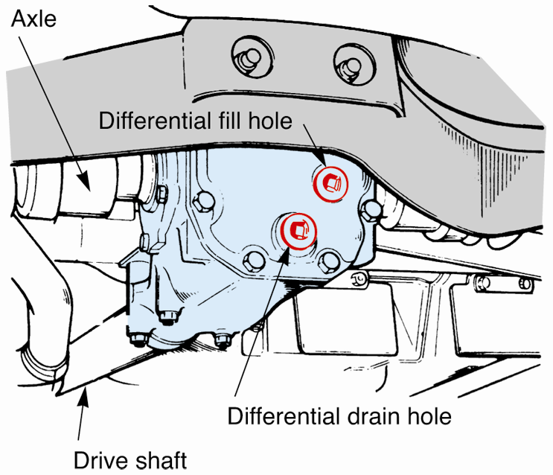
Differential Fluid Service
To measure fluid
Locate and remove differential fill plug
Fluid
Hot
Even with fill hole
Cold
Just below fill hole
To change fluid
Remove drain plug on bottom of differential
Use special siphon gun to draw out old fluid
(Subaru)

Slide 24
Checking Engine Coolant
Engine coolant
Mixture of antifreeze and water
Must be periodically changed
Becomes corrosive and filled with rust over time
Damages water pump, thermostat, and radiator
To check coolant level
Look at side of overflow tank
Between hot and cold marks
Some older cars, remove radiator cap
1″ down in radiator

Slide 25
Checking Power Steering Fluid
Engine off
Located in clear, plastic reservoir
Check level to side markings
Some vehicles require removal of dipstick from power steering pump
Check dipstick
If fluid is low, check for leaks
Replace as needed with correct fluid
Smells like burned rubber
Flush and replace fluid

Slide 26
Checking Brake Fluid
Inspect twice yearly
Locate master cylinder
Located in clear, plastic reservoir
Check level to side markings
Some vehicles require removal of reservoir cover
1/4″ down from top
Replace as needed with correct fluid

Slide 27
Checking Fluids
Hydraulic clutch fluid
Clutch master cylinder similar to brake master cylinder
If low, add brake fluid
Manual steering fluid
Check by removing fill plug or bolt from box or rack top
Almost even with top
If low, add recommended fluid

Slide 28
Checking Fluids (Cont.)
Windshield washer solution
Normally visible through storage tank
Aids in cleaning and prevents ice formation
Replace as needed with correct solution

Slide 29
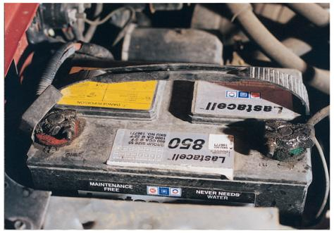
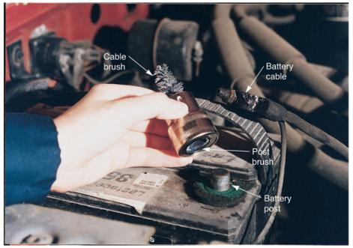
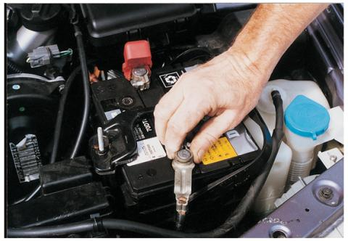
Checking Battery
New cars use maintenance-free batteries
Check electrolytes if needed
Clean top and terminals
Baking soda and water

Slide 30
Filter service
Various filters may need replacing during lubrication service
Air filters
Fuel filters
Cabin filters

Slide 31
Chassis Lubrication
Involves greasing high-friction points on vehicle
May include lubricating locks, hinges, latches, and other body parts
Grease job
Lubrication of high-friction pivot points on suspension, steering, and drive train systems using grease gun

Slide 32
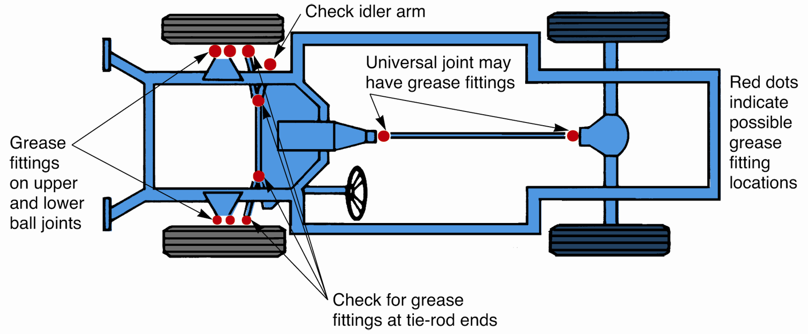
Grease Job

Slide 33
Body Lubrication
Engine oil
Hard-to-reach high-friction points
Graphite
Excellent for door and trunk locks
Dry stick (wax) lubricant
For door latches and strikers

Slide 34
Body Lubrication (Cont.)
Chassis grease
Good all-around lubricant
Silicone lubricant
Weather stripping and windows
Canned, sprays on dry

Slide 35
Checking Tires
Inspect tire treads
Grooves at least 1/8″ deep
Check tire pressure
Remove cap and check pressure with tire gauge
Compare pressure to tire specs
Add air if needed
Recheck until correct

Slide 36
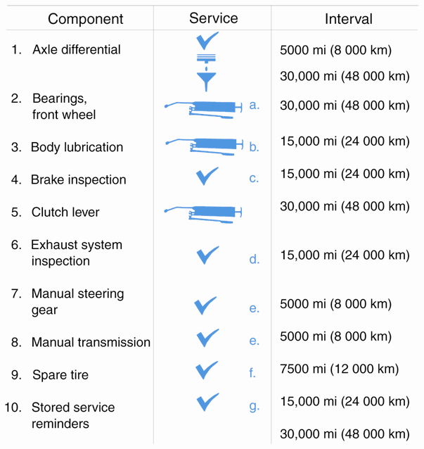
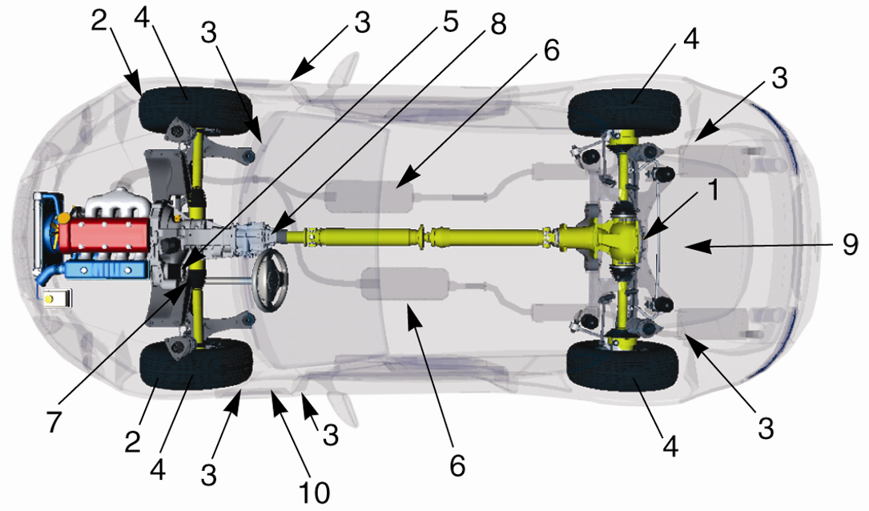
Service Intervals

Slide 37
General Inspection and Problem Location
Hose
Drive belt
Wiring
Tire
Steering system
Exhaust system
Brakes

Slide 38
Fluid Leaks
Bad gaskets, seals, or hoses
Cracks in parts
Become familiar with different fluids
Color
Smell
Feel

Slide 39
Fluid Leaks (Cont.)
Tend to flow downward and toward rear of vehicle
Fix leaks located highest and farthest forward first
Badly soiled
Clean area to better find source of leak
Most frequent cause of leakage is broken gaskets and worn seals

Slide 40
Noise Detection and Location
Abnormal noises and unwanted sounds
Knocks
Clunks
Rattles
Clicks
Hisses
Indicate part wear or mechanical problems

Slide 41
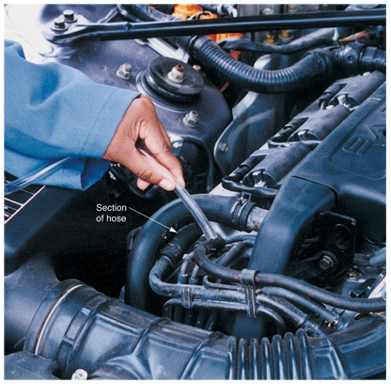
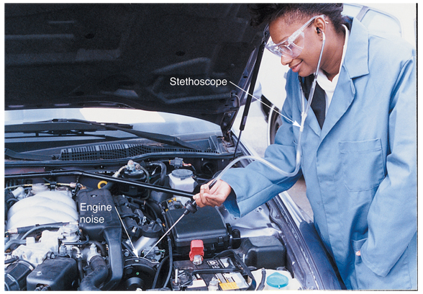
Noise Detection and Location (Cont.)
To pinpoint noises
Listen
Use stethoscope
Use long screwdriver
Section of vacuum hose

Slide 42
Auto Shop Wastes
Used motor oil
Other discarded lubricants
Transmission and differential fluids
Used parts
Cleaners and degreasers

Slide 43
Auto Shop Wastes (Cont.)
Carburetor and injection system cleaners
Rust removers
Paint thinners
Worn out batteries
Tires and catalytic converters

Slide 44
Auto Shop Wastes (Cont.)
Facilities that generate over 220 lb. of hazardous waste monthly
File Uniform Hazardous Waste Manifest before removing waste
No manifest needed for recycled materials

Slide 45
Recycling
Some recycling materials considered hazardous waste unless destined to be recycled
Motor oil
Coolants
Never mix together
Refrigerants
Never vent into atmosphere

Slide 46
Other Recyclables
Catalytic converters
Contain platinum
Worn tires
Retreading
Shredded for road resurfacing
Batteries
Make new batteries
Brake shoes
Make reconditioned brake shoes

Slide 47
Other Recyclables (Cont.)
Small assemblies (alternators, starters, master cylinders, etc.)
Rebuilt
Plastic bumpers and body parts
Various recycling options

