Slide 1


Slide 2
10
Chapter
Career Success

Slide 3
Objectives
After studying this chapter, you will be able to:
List the traits employers look for in their employees.
Summarize the different systems used to pay technicians.
Explain the types of repair facilities.
Explain how to find job openings in the automotive field.

Slide 4
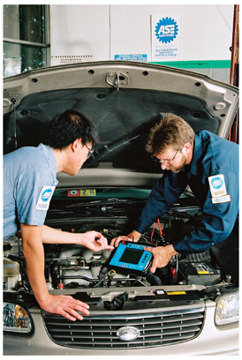
Traits of Desirable Employees
Dependability
  Capability to be relied on in workplace
Cooperativeness
  Ability to work with others to achieve goals
Leadership
Ability to guide and motivate others
(ASE)

Slide 5
Traits of Desirable Employees (Cont.)
Curiosity
  Desire to learn
Efficiency
  Ability of technician to produce high quality work quickly
Professionalism
  Presenting yourself in an appropriate manner in workplace

Slide 6
Honesty
Ethical behavior
Conforming to accepted standards of fairness and good conduct
Based on person’s sense of what is right to do
Integrity, confidentiality, and honesty are crucial
Most shops have set workplace polices that employees are expected to follow

Slide 7
Strong Communication Skills
Communicating with others is important for success as an automotive technician
Two primary forms of communication
Verbal
Speaking, listening, and writing
Nonverbal
Sending and receiving messages without use of words
Communication tools have advanced with development of new technologies

Slide 8
Earnings
Three basic methods to pay technicians
  Hourly rate
  Commission
  Commission plus parts

Slide 9
Types of Shops
Dealerships
  Pay well
  Have high work volume
  Required to perform warranty work
    Pays less
Independent shops
  Good pay
  No warranty work
  Shop owner controls work atmosphere and conditions

Slide 10
Types of Shops (Cont.)
Service station
  Good place for beginners to learn
  Mostly quick service repairs
Specialty shops
  Does one type of work
  May be franchise
  Lack of variety

Slide 11
Getting a Job as an Automobile Technician
Preparing a résumé
  Document summarizes your qualifications
    Help assess your qualifications
    Review your skills
    Prepare for an interview
    Job Application Forms
    Highlights information employer needs to know about you
    Education
    Prior work experience

Slide 12
Sample Résumé
Contact information
Objective
  Identifies type of job sought
Summary
  Education, skills, work experience
Two or three references
Internet and public libraries
  Sources to aid in creation

Slide 13
Finding Job Openings
Help-wanted ads in local newspaper
Ask automotive instructors
Search Internet and social media sites
  Helpful if relocating
Employment agencies
Local telephone directory
Walk into local shops and garages

Slide 14
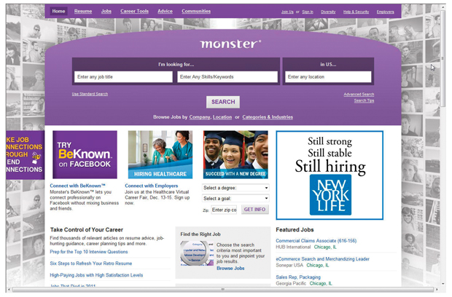
Internet Job Site

Slide 15
Interviewing
Arrive early
Dress neatly
Sit upright
Talk slowly and plainly
Maintain eye contact
Answer all questions thoroughly and honestly

Slide 16
Interviewing (Cont.)
Ask questions
Emphasize your qualifications and certifications
Do not brag or act like you know everything
Thank interviewer
Send follow-up letter

Slide 17
Accepting an Offer of Employment
Know and understand all terms of employment before accepting
You may be required to supply own tools
Ask about starting date
Be comfortable with all terms and conditions
Formally accept offer

