Slide 1


Slide 2
12
Chapter
Engine Design Classifications

Slide 3
Objectives
After studying this chapter, you will be able to:
Describe basic automotive engine classifications.
Compare gasoline and diesel engines.
Contrast combustion chamber designs.
Discuss alternative engine types.
Compare two- and four-stroke cycle engines.
Correctly answer ASE certification test questions that require a knowledge of engine classifications and design differences.

Slide 4
Engine Classifications
Cylinder arrangement
Number of cylinders
Cooling system type
Valve location
Camshaft location
Combustion chamber design

Slide 5
Engine Classifications (Cont.)
Type of fuel burned
Type of ignition
Number of strokes per cycle
Number of valves per cylinder
Type of aspiration

Slide 6
Cylinder Arrangements
Refers to cylinders’ position in relation to crankshaft
  Five basic cylinder arrangements
    Inline
    V-type
    Slant
    W-type
    Opposed

Slide 7
Number of Cylinders
Car and truck engines have 4, 6, or 8 cylinders
  Some have 3, 5, 10, 12, or 16
  More cylinders increase engine smoothness and power
  Cylinder numbers normally stamped on connecting rods
    Cast into intake manifold

Slide 8
Cooling System Types
Liquid cooling systems
  Surround cylinder with coolant
Air cooling systems
  Circulate air over cooling fins on cylinders

Slide 9
Fuel Types
Gasoline
Diesel fuel
Liquefied petroleum gas
Gasohol
Pure alcohol

Slide 10
Ignition Types
Spark ignition
  Uses electric arc at spark plug
Compression ignition
  Squeezes air in combustion chamber until it is hot enough to ignite fuel
    No spark plugs used

Slide 11
Valve Locations
L-head engine or flat head engine
  Both intake and exhaust valves in block
I-head engine or overhead valve engine
  Both valves in cylinder head

Slide 12
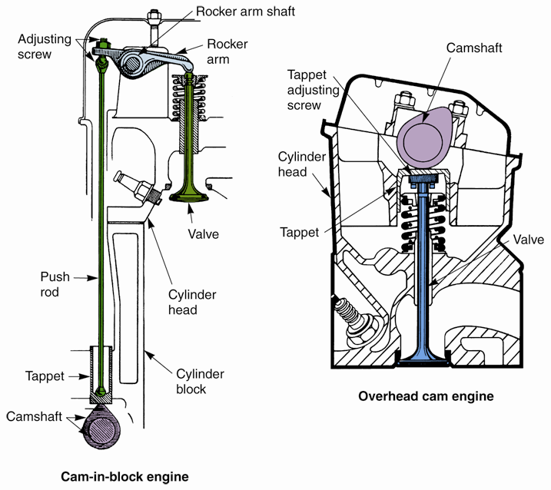
Valve Locations (Cont.)
(Black & Decker and Chrysler)

Slide 13
Camshaft Locations
Cam-in-block
  Uses push rods to transfer motion to rocker arms and valves
    Overhead valve
Overhead cam engine
  Camshaft located in top of cylinder head
  Push rods not needed
    Single or dual overhead valve engines

Slide 14
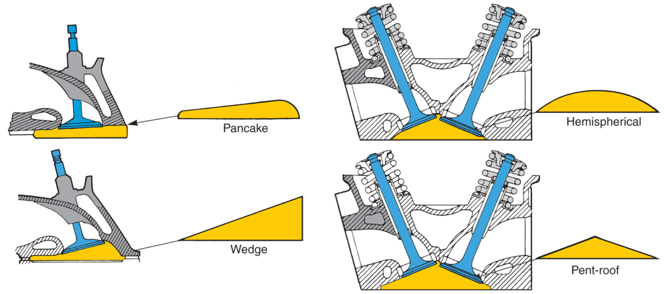
Combustion Chamber Shapes
Gasoline engines
  Pancake or bath tub
  Wedge or wedge head
  Hemispherical (hemi)
  Pent-roof
(Chrysler)

Slide 15
Combustion Chamber Types
Swirl
Four-valve
Three-valve
Stratified charge
Air jet
Precombustion
  Also called diesel prechamber

Slide 16
Alternative Engines
Variable displacement engine
  Deactivates cylinders
    Conserves fuel and reduces emissions
Variable valve timing engine
  Alters valve opening and closing independent of crankshaft rotation

Slide 17
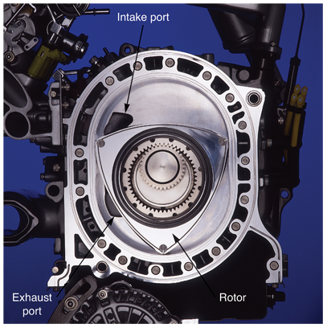
Alternative Engines (Cont.)
Rotary engine or Wankel engine
  Uses spinning triangular rotor instead of conventional pistons

Slide 18
Alternative Engines (Cont.)
Two-stroke-cycle engine
  Requires only one revolution of crankshaft for complete power producing cycle
    Generally not used in vehicles
  Uses either reed valve or rotary valve to control flow of fuel and oil into crankcase

Slide 19
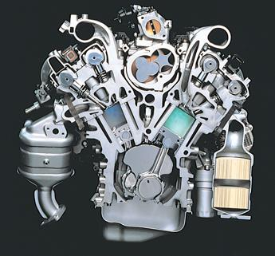
Alternative Engines (Cont.)
Miller-cycle engine
  Uses modified four-stroke cycle
  Shorter compression stroke and longer power stroke
    Increase efficiency
(Mazda)

Slide 20
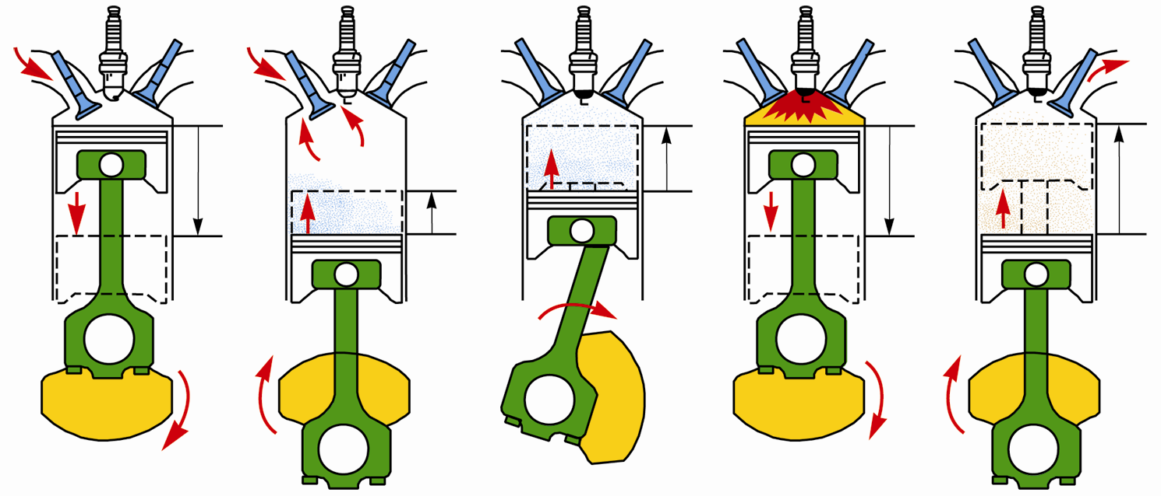
Miller-Cycle Engine
Illustrated Operation

