Slide 1
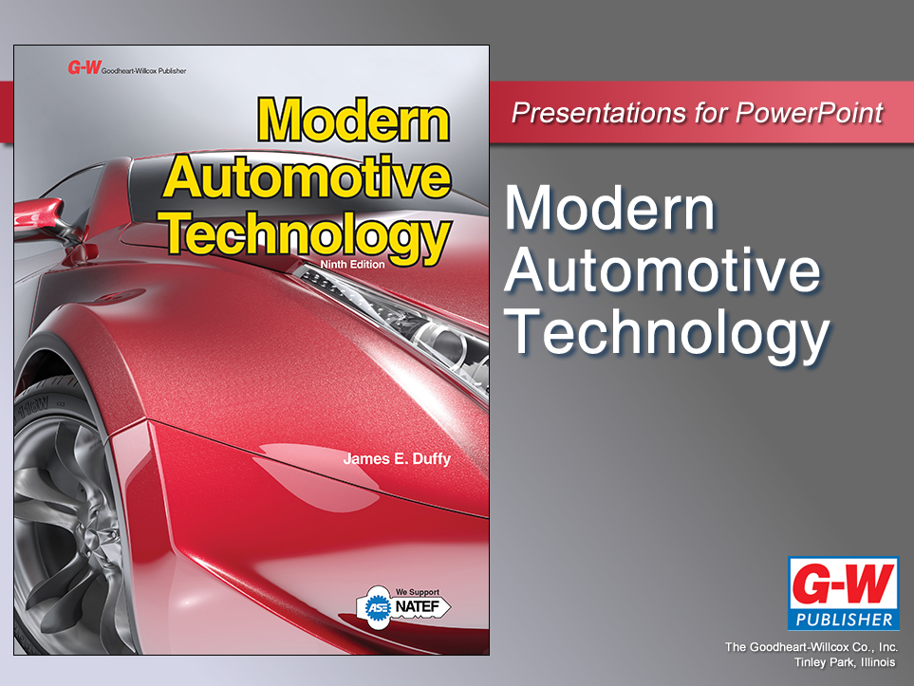

Slide 2
17
Chapter
Electrical Principles

Slide 3
Objectives
After studying this chapter, you will be able to:
Describe the parts of the atom.
Explain the principles of electricity.
Describe the principles of magnetism and magnetic fields.
Describe the action of electric circuits.

Slide 4
Objectives
Compare voltage, current, and resistance.
Compare dc and ac electricity.
Correctly answer ASE certification test questions that require a basic understanding of electricity and electronics.

Slide 5
Atomic Structure
Matter
Anything in the universe that occupies space and has mass
Solid, liquid, or gas
Atom
Microscopic particle unable to break into smaller pieces without losing its properties
Not visible without highly specialized electron microscope

Slide 6
Atomic Structure (Cont.)
Element
Group of one type of atom
Molecule
Group of two or more atoms joined together
Compound
Substance composed of molecules containing two or more elements

Slide 7
Parts of an Atom
Electrons
Negatively charged particles in specific orbits around atom’s nucleus
Protons
Positively charged particles located in nucleus
Neutrons
Particles with no positive or negative charge
Have mass and occupy space in nucleus

Slide 8
Free Electrons
Normally, number of electrons circling atom’s center equals number of nucleus’s protons
Extra electrons, or free electrons, in outer orbits
Free electrons
Easily dislodge from one atom and jump to neighboring atom

Slide 9
Electricity
Movement of free electrons from one atom to another
Electrical discharge results from negative and positive charges interacting

Slide 10
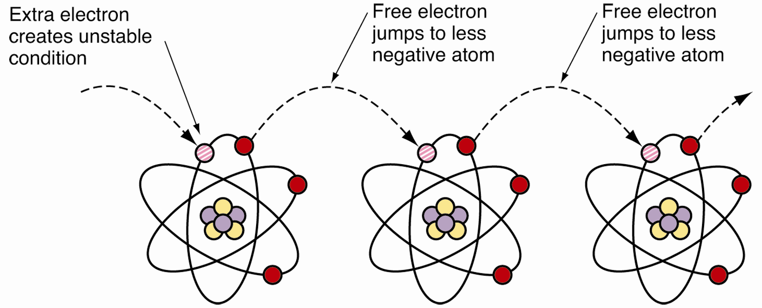
Electricity (Cont.)

Slide 11
Conductors and Insulators
Conductor
Substance that allows flow of free electrons
Metal wires make good conductors
Metals have unstable atoms
Gold conducts best of all elements
Insulator
Substance that stops flow of electrons
Air, glass, plastic, rubber, and porcelain

Slide 12
Functions of Electricity
Produce
Light
Heat
Motion

Slide 13
Mechanical vs. Electrical
Electrical devices have replaced many mechanical devices
Electrical devices perform more quickly and efficiently
Lighter vehicles
Ride smoother
Stop faster
Provide more comfort
Repair quickly and easily

Slide 14
Electrical vs. Electronic
Electrical device
Conventional component that uses electricity to do work
Electric motor, mechanical switch, relay, solenoid, or lightbulb
Electronic device
Solid state component that does not use moving parts
Diodes, transistors, sensors, and computers

Slide 15
Magnetism
Atomic force attracts or repels ferrous substances through space, air, or solid matter
Plays important role in producing and using electrical energy

Slide 16
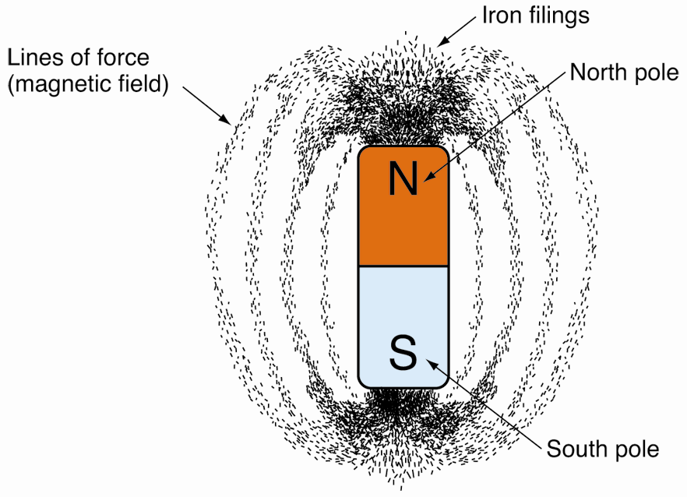
Magnetic Field or Flux
Exists between poles of magnet
Caused by movement of electrons
Can act on ferrous (iron) substances

Slide 17
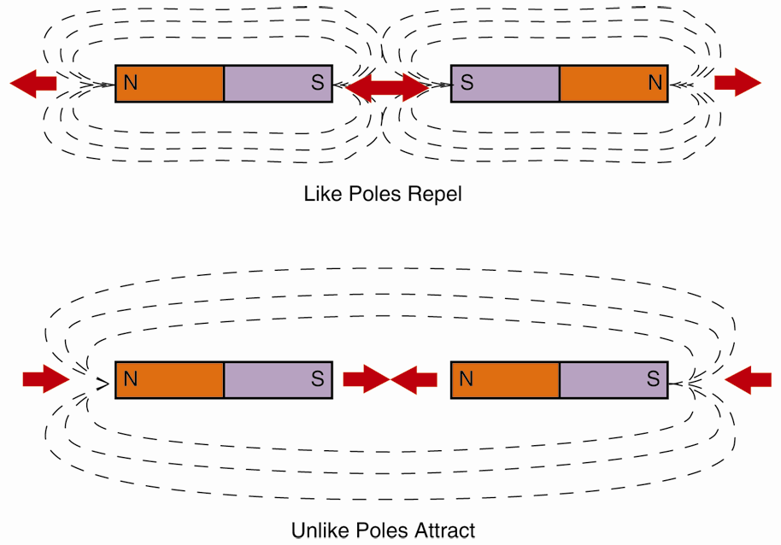
Like and Unlike Charges
Interaction of magnetic substances follows two rules
Like charges repel each other
Unlike charges attract each other

Slide 18
Electromagnetism
Branch of physics dealing with interaction of electricity and magnetism
Electricity produces magnetism, and magnetic fields produce electricity
Electromagnet
Electrically energized magnet

Slide 19
Induction
Process of creating electricity in wire by passing through a magnetic field
Used in alternators, inductive meters, and other electrical-electronic components

Slide 20
Components of an Electric Circuit
Power supply
Source of electrical energy
Battery or generator
Load
Device that uses electrical energy
Lightbulb or electric motor
Conductor
Substance that carries electrical current through circuit
Wires, metal frame of vehicle, engine block

Slide 21
Voltage
Electrical force, or pressure, that pushes free electrons and causes current
Also known as electromotive force (EMF) or potential difference
Measured in volts
Represented by letters V or E

Slide 22
Current
Rate of electron flow in circuit
Commonly refers to electron flow in circuit
Measured in electrical units called amperes or amps
Represented by letter I

Slide 23
Resistance
Opposition to free electron flow
Used to limit or control current
Measured in ohms (Ω)
Represented by letter R

Slide 24
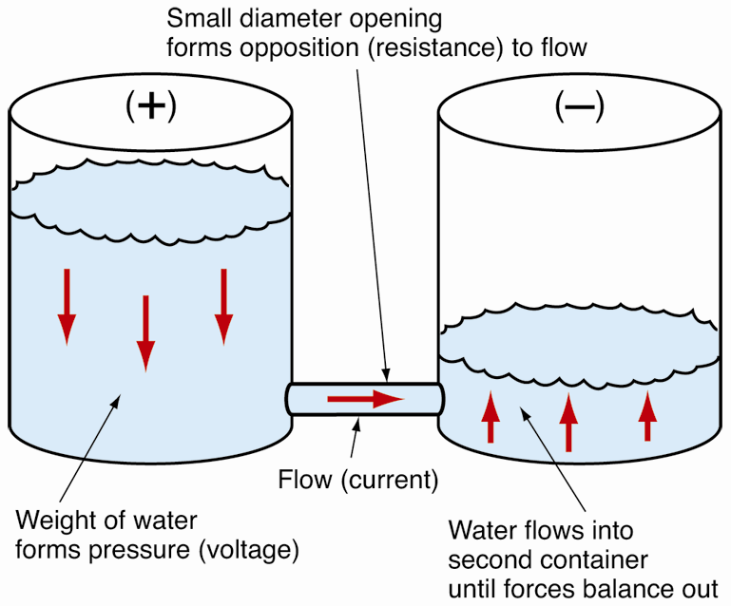
Relationship of Voltage, Current, and Resistance
Voltage
Difference between weight of water in two containers
Current
Flow through tube
Resistance
Diameter of tubing

Slide 25
Conventional and Electron Theories
Conventional current theory
Electrons flow through circuit from positive (+) to negative (-)
Electron flow theory
Electrons leave negative (-) terminal, flow through circuit, and re-enter positive (+) terminal
Opposite of conventional current theory

Slide 26
Direct and Alternating Current
Direct current (dc)
Electron flow in one direction only
Most automotive circuits operate on direct current
Alternating current (ac)
Electron flow in alternating directions
Polarity (positive or negative state) of ac cycles back and forth in circuit

Slide 27
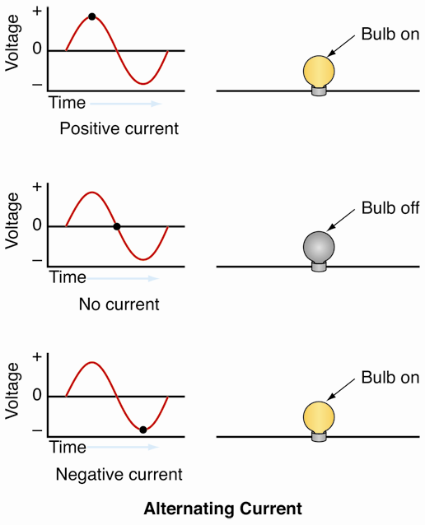
Alternating Current
Voltage in ac circuit changes over time
Cycle
One complete positive curve and negative curve
Sine wave
Curve representing alternating current in basic circuit

