Slide 1
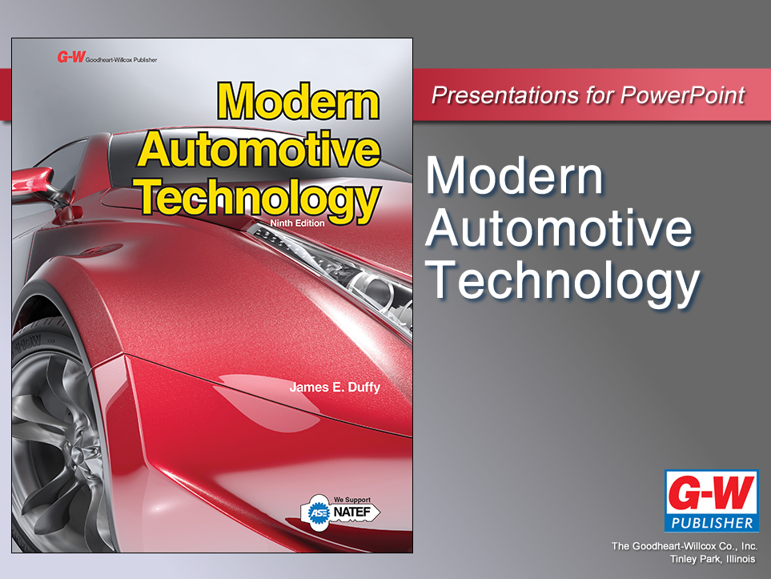

Slide 2
18
Chapter
Circuit Types and Ohm’s Law

Slide 3
Objectives
After studying this chapter, you will be able to:
Compare the operating characteristics of series, parallel, and series-parallel circuits.
Explain the operation of a frame-ground circuit.
Recall the three Ohm’s law formulas that express the relationships among voltage, current, and resistance.

Slide 4
Objectives
Explain how changes in voltage and resistance affect current.
Use Ohm’s law and circuit-type formulas to calculate unknown circuit values.
Use the formula for calculating electric power or wattage.
Interpret electrical prefixes.

Slide 5
Circuit Types
Circuit
Closed electrical path for current
Three main types of circuits
Series
Parallel
Series-parallel circuits
Automotive systems also use frame-ground circuits

Slide 6
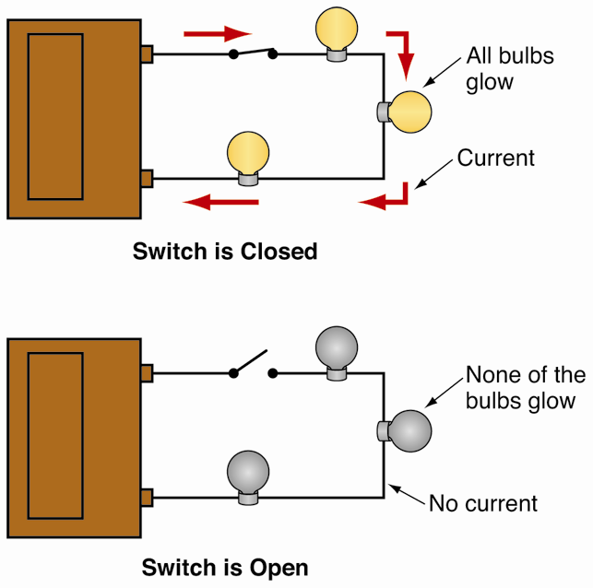
Series Circuit
Only one path for current
One or more loads wired into this single path
If one bulb burns out, all other lights go out

Slide 7
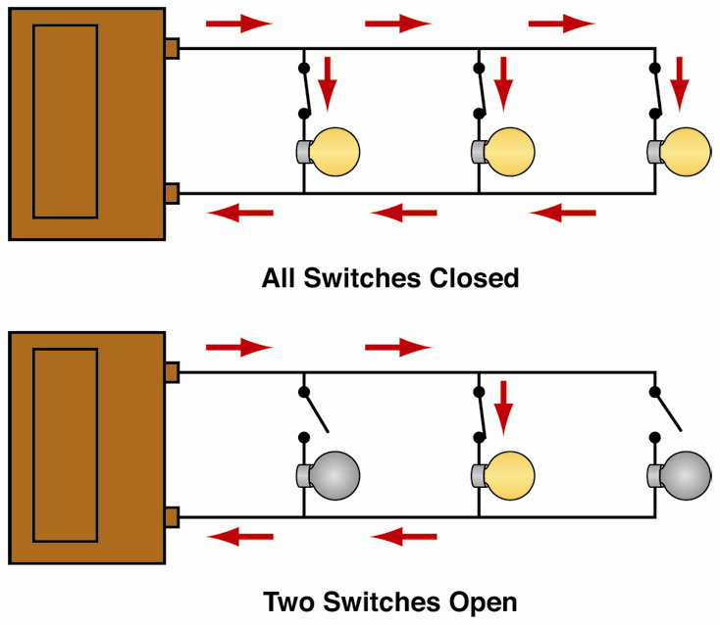
Parallel Circuit
Has more than one path for current
Two or more loads placed on separate paths
One burned-out light does not affect other bulbs

Slide 8
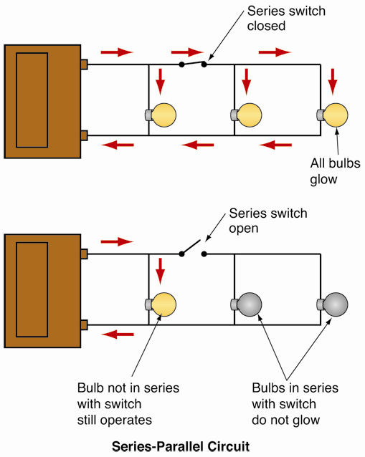
Series-Parallel Circuit
Combination of series circuit and parallel circuit
Some components wired in series, others wired in parallel

Slide 9
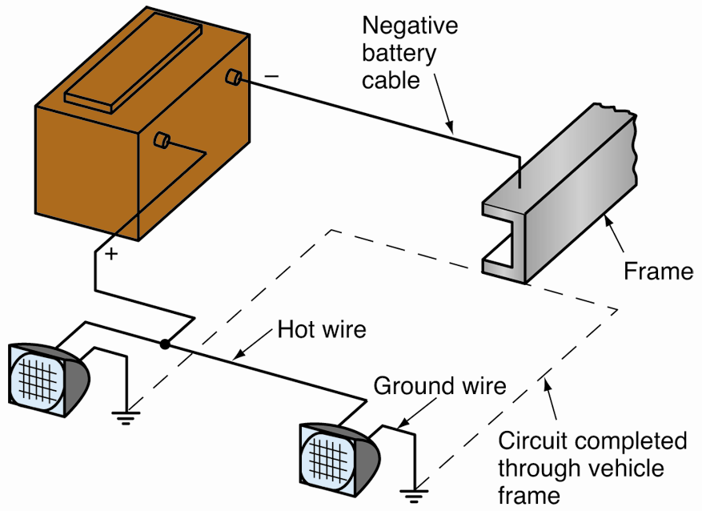
Frame-Ground Circuit
Also called one-wire circuit
Uses vehicle’s metal structure to return electricity to power source
Eliminates need to run wires back from components

Slide 10
Ohm’s Law
Formula set expressing relationships between voltage, current, and resistance in electric circuit
Ohm’s law stated as three different formulas
If any two of three electrical values in circuit are known, third value can be calculated

Slide 11
Ohm’s Law (Cont.)
E = I × R
Voltage equals current multiplied by resistance
Volts = amps × ohms
I = E ÷ R
Current equals voltage divided by resistance
Amps = volts ÷ ohms
R = E ÷ I
Resistance equals voltage divided by current
Ohms = volts ÷ amps

Slide 12
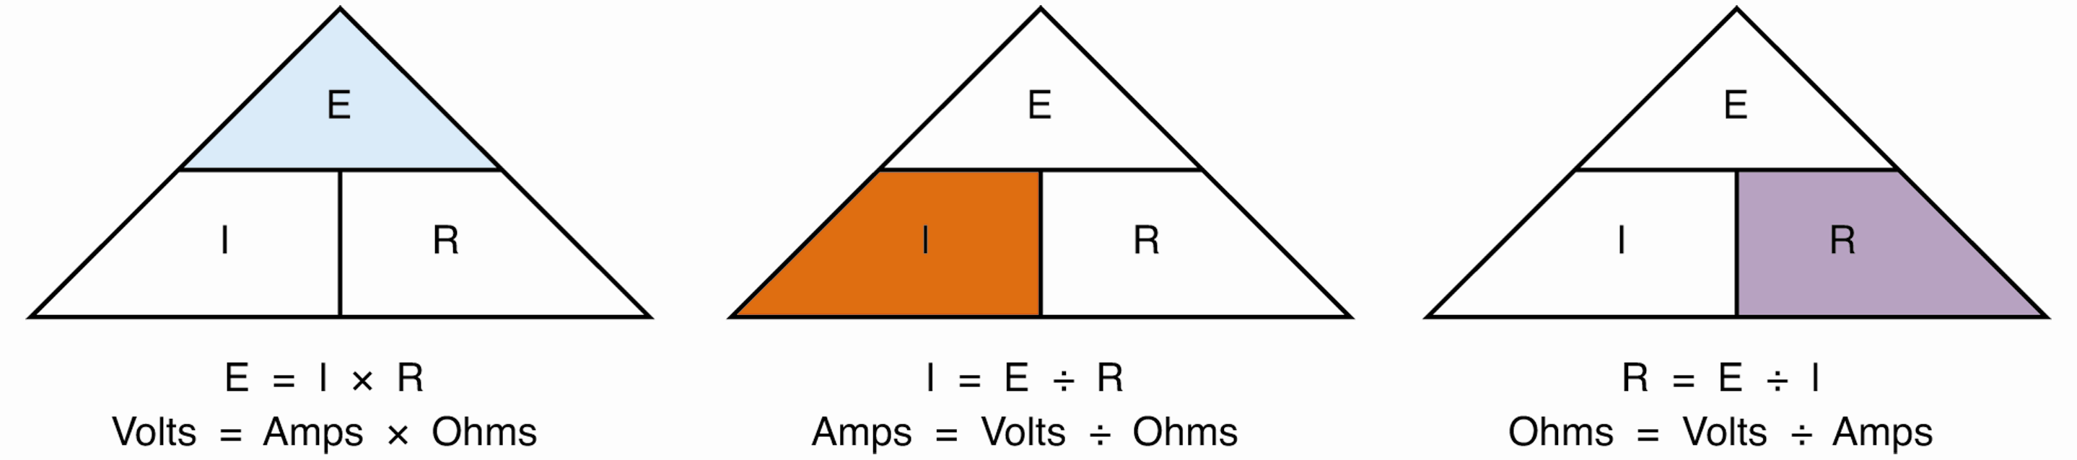
Ohm’s Law (Cont.)

Slide 13
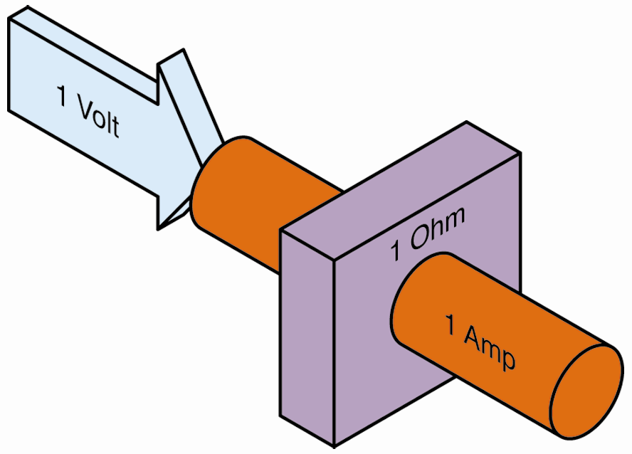
Ohm’s Law (Cont.)
1 volt needed to push 1 amp of current through 1 ohm of resistance
If any one value changes, it affects others

Slide 14
Change in Resistance
Alters amount of current in circuit
If resistance is low, current will be high
If resistance is high, current will be low
Most electrical problems caused by changes in circuit resistance

Slide 15
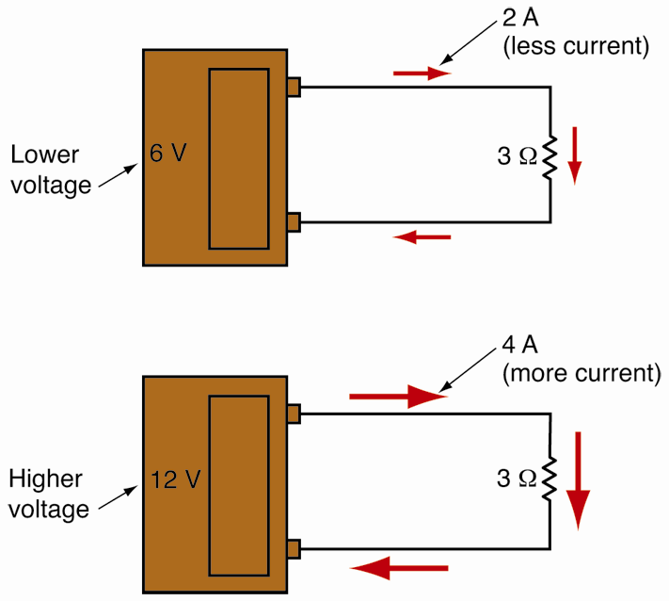
Change in Voltage
Affects amount of current in circuit
Rise in voltage increases current
Drop in voltage decreases current

Slide 16
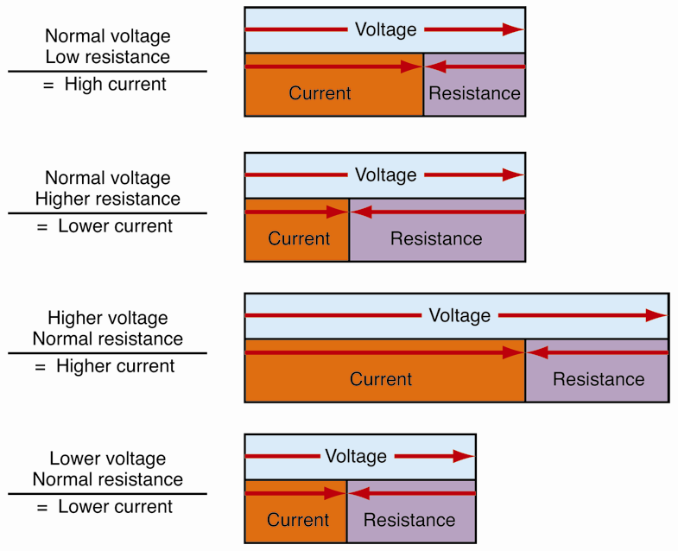
Change in Current
Result of increased or decreased voltage or resistance
Without sufficient current, load will not function properly

Slide 17
Series Circuit Calculations
Three rules apply to series circuits
Current is same everywhere
Total resistance (R_{t}) is sum of all resistances
Voltage drop across each resistance equals voltage applied
Voltage used by all resistance elements equals total voltage

Slide 18
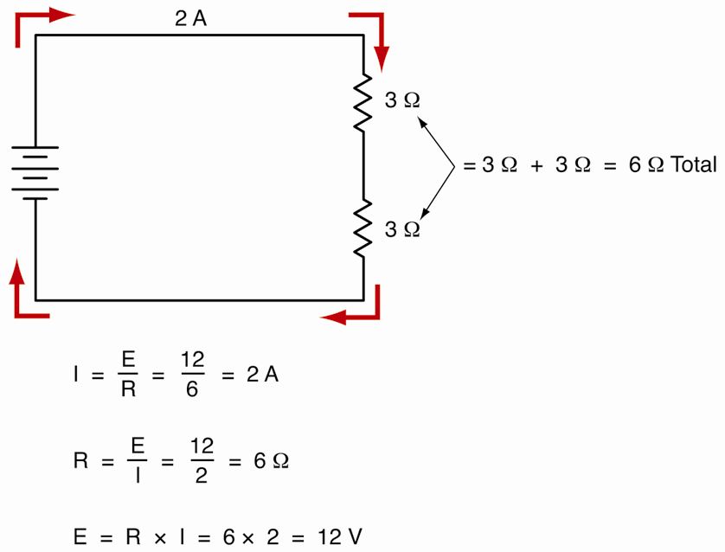
Series Circuit Calculations (Cont.)

Slide 19
Parallel Circuit Calculations
Parallel circuits also have three rules
Total current (I_{t}) is sum of all branch currents
Total circuit resistance is less than resistance in any one branch
Total voltage equals supply voltage, and voltage is the same throughout circuit

Slide 20
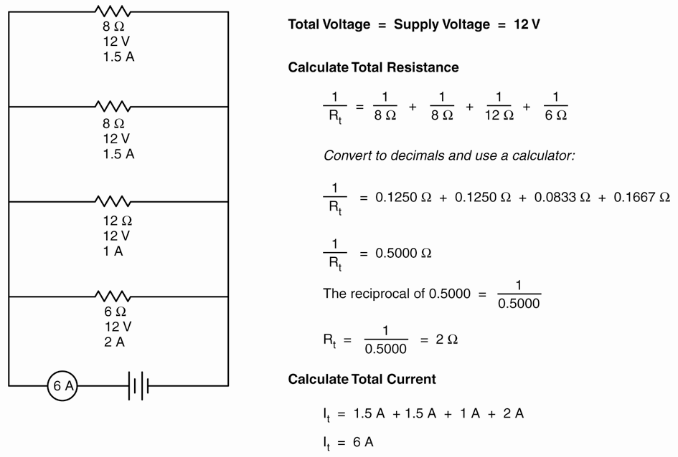
Parallel Circuit Calculations (Cont.)

Slide 21
Series-Parallel Circuit Calculations
Equivalent resistance
Total resistance found by calculating resistance of each parallel section and then adding series resistances

Slide 22
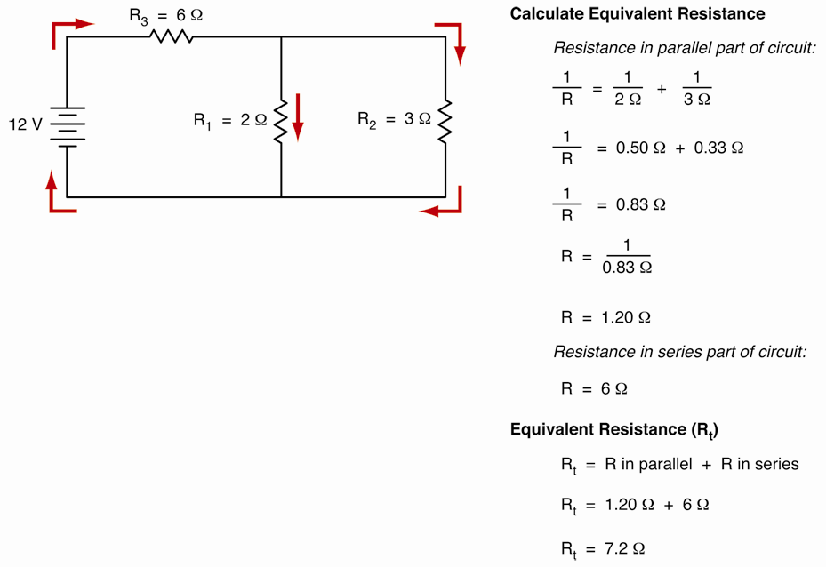
Series-Parallel Circuit Calculations (Cont.)

Slide 23
Complex Series-Parallel Circuits
When working with complex series-parallel circuits
Start by working with parallel sections
Arrive at R for each section
Add any series resistance to find total resistance

Slide 24
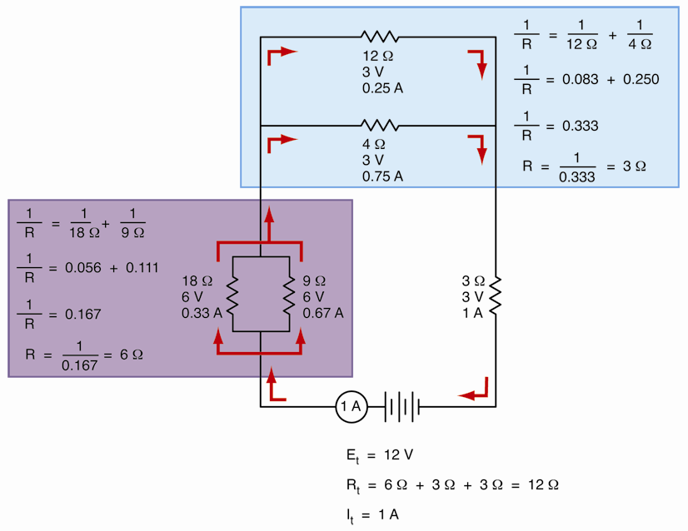
Complex Series-Parallel Circuits (Cont.)

Slide 25
Electric Power Calculations
Electric power
Work done by electric current
Unit of measurement is watt
Calculate circuit’s electric power with its current and either voltage or resistance
P (in watts) = E × I or P = I² × R

Slide 26
Prefixes for Electrical Units
Electrical values may be very large or very small
Prefixes indicate multiplier or exponent
Examples include
MΩ (megohms) = 5,000,000 Ω
10 kΩ (kilohms) = 10,000 Ω
32 mA (milliamperes) = 0.032 A
12 μF (microfarads) = 0.000 012 farad

Slide 27
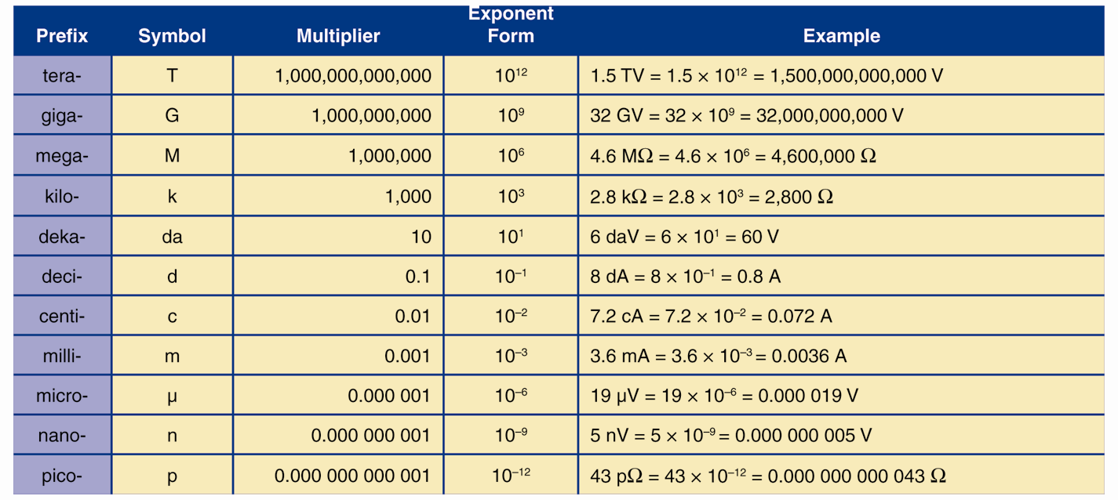
Prefixes for Electrical Units (Cont.)

