Slide 1
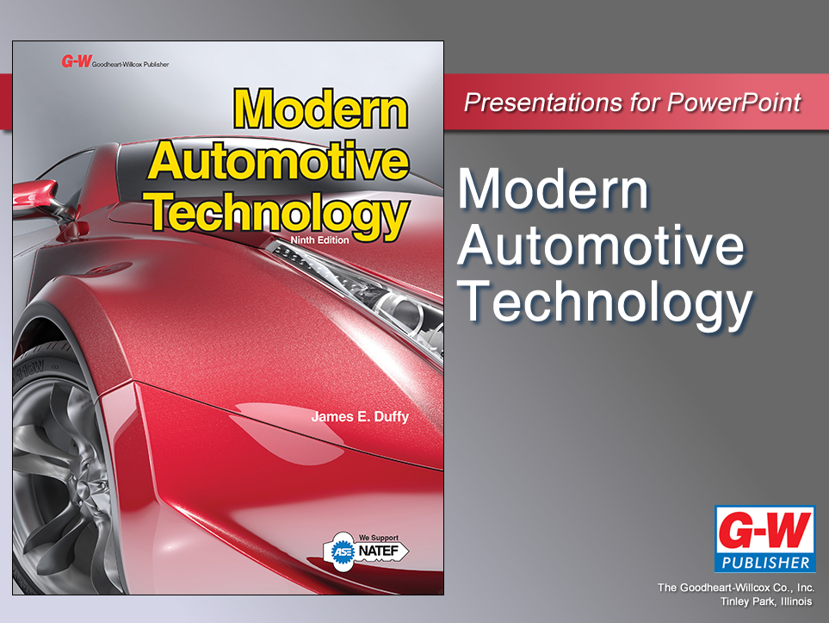

Slide 2
19
Chapter
Electric and Electronic Components

Slide 3
Objectives
After studying this chapter, you will be able to:
Identify electric components.
Explain the function and operation of electric and electronic components.
Interpret electric and electronic component ratings and values.

Slide 4
Objectives
Recognize the symbols and letter designations for electric and electronic components.
Recall the properties of semiconductor materials.
Recall the common types of transistors.
Give examples of photonic devices.

Slide 5
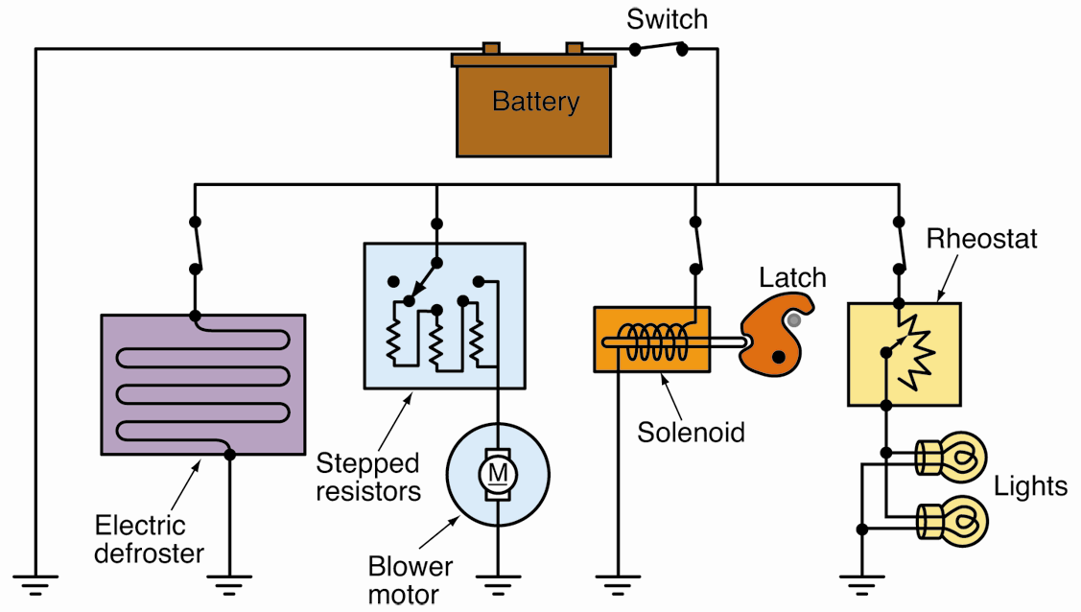
Electric Components

Slide 6
Resistors
Limits and controls current flow in circuit
Various shapes and sizes, depending on function
Fixed resistors have set ohms value that does not change

Slide 7
Variable Resistors
Has adjustable range of internal resistance
Two types of variable resistors
Rheostats
Potentiometers

Slide 8
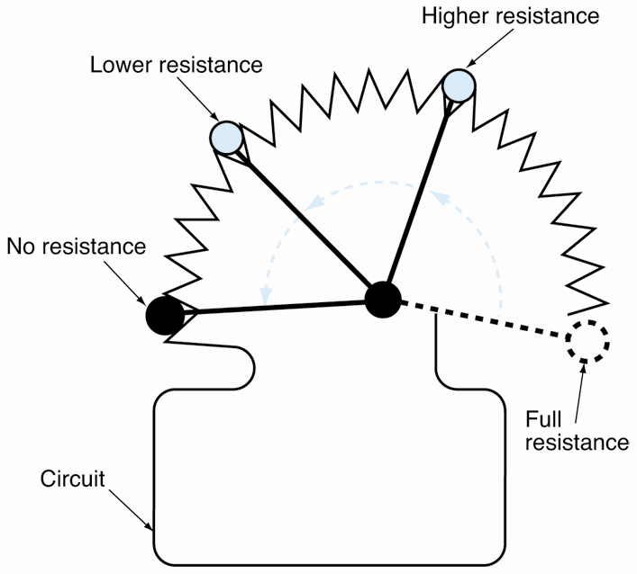
Rheostats
One terminal wires to one end of resistance unit
Other terminal connects to sliding contact
Turning control knob moves contact and alters resistance

Slide 9
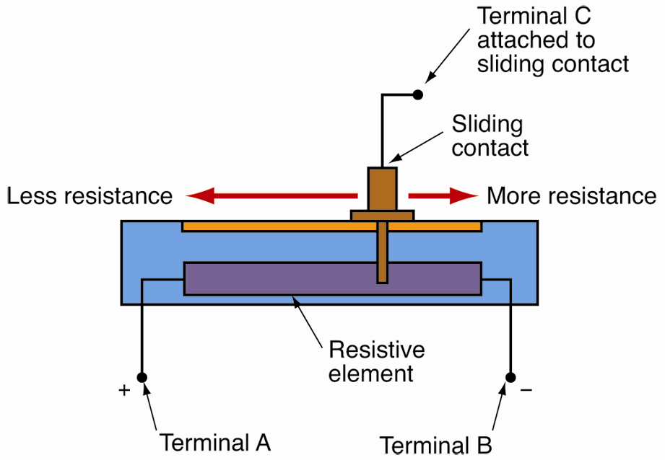
Potentiometer
Variable resistor with three electrical connections
One at each end of resistance unit
One for sliding contact

Slide 10
Switches
Connects or disconnects power supply in circuit
Push-button
Spring-loaded button that makes or breaks electrical connection
Push-pull
Stays in each position until moved

Slide 11
Switches (Cont.)
Thermal
Opens and closes with changes in temperature
Pressure
Reacts to changes in internal pressure
Mercury
Uses liquid mercury to open and close its switch contacts
Dozens of switches found in modern vehicles

Slide 12
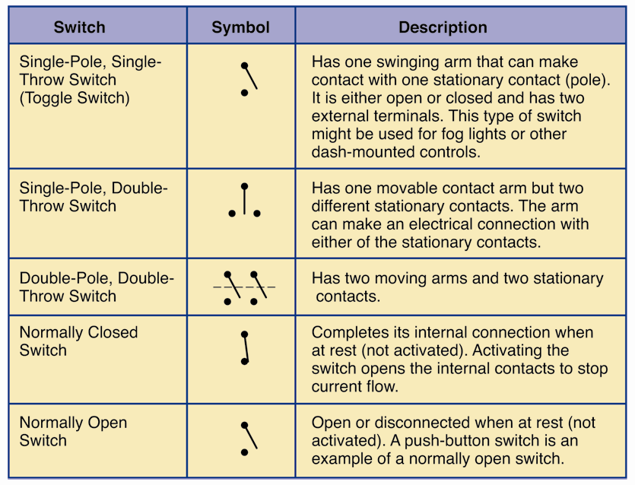
Switches (Cont.)

Slide 13
Capacitors
Storage device for electrons or electrical energy
How capacitors work
When dc applies to capacitor, electrons build up on conductor strip
Capacitor becomes charged
When charge equals dc voltage, electrons can no longer flow

Slide 14
Capacitors (Cont.)
Small capacitors
Can be used to stop dc voltage
Larger capacitors
Can be used to even out voltage fluctuations
Alternating current
Can pass through capacitor
Charges while current is in one direction
Discharges back into circuit when current changes direction

Slide 15
Capacitors (Cont.)
In vehicles
Used as noise suppressor
Found in computer circuits, sound systems, navigation systems, and printed circuits
Capacitor’s size or storage ability rated in farads (F)
Most small capacitors rated in microfarads (μF) or picofarads (pF)

Slide 16
Fuses
Protects circuit from damage caused by excess current
Short circuit
Results when hot wire touches any ground
Fuse ratings
Amount of current fuse can handle before its element melts

Slide 17
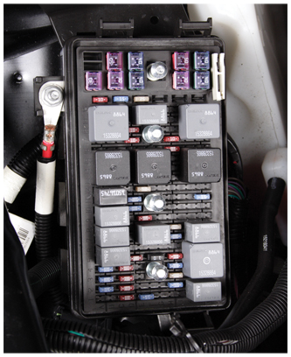
Fuse Panels
Plastic housing with metal terminals
Holds fuses and other electric components
Most mount under vehicle’s dash

Slide 18
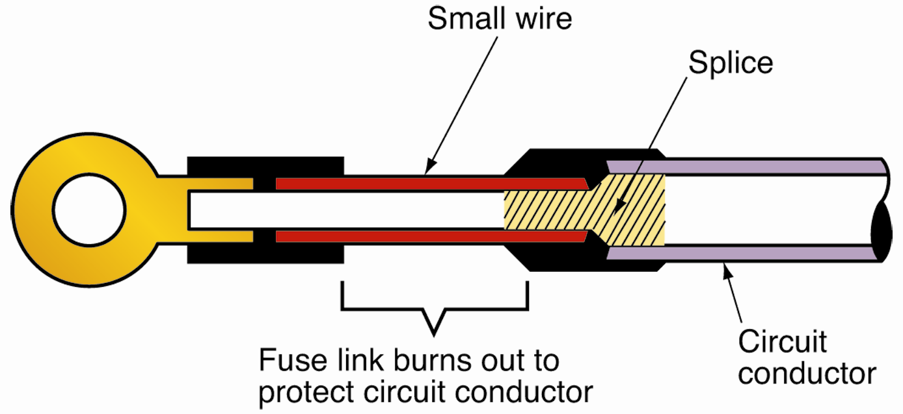
Fuse Links
Section of smaller gauge wire connected in series with larger gauge circuit wiring
Designed to serve as very large fuse
Usually wired between12-volt battery and fuse panel

Slide 19
Circuit Breakers
Protects circuit from damage from excess current
Not ruined when activated or “tripped”

Slide 20
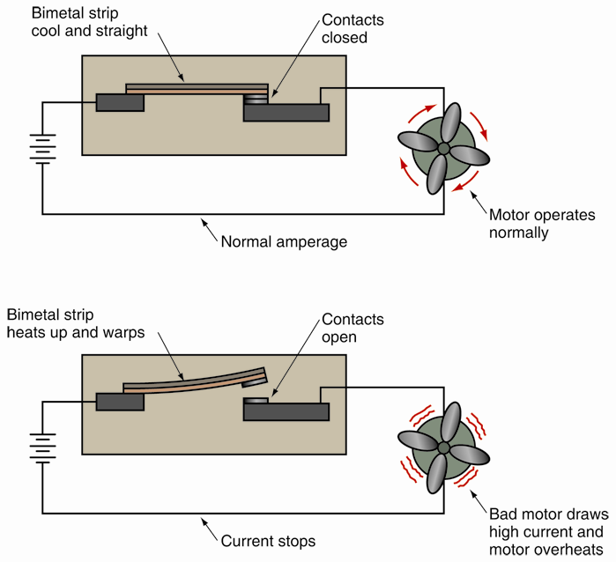
Self-Resetting Circuit Breaker
Can sense high-current conditions and disconnect circuit
Automatically reconnects circuit after it cools

Slide 21
Coils
Also called choke or inductor
Insulated wire loops placed close together to create electromagnetic field
Wrapped around iron core to strengthen electromagnetic properties
Used in electrical circuits to resist current and voltage fluctuation
Transformers, solenoids, motors, relays, and other components

Slide 22
Transformers
Uses two sets of coils to change levels of voltage and current
Impedance
Resistance to alternating current at given frequency
Turns ratio
Represents relationship between number of wire windings, wraps, in each coil

Slide 23
Transformers (Cont.)
Isolation
Has turns ratio of one to one (1:1)
Induced voltage in second coil is the same as first coil’s voltage
Isolates one circuit from another

Slide 24
Transformers (Cont.)
Step-up
Second coil has more windings than first coil
If turns ratio is 1:2, application of 12 volts to first coil produces 24 volts in second coil

Slide 25
Transformers (Cont.)
Step-down
Second coil has fewer windings than first coil
Reduces output voltage compared to input voltage
If turns ratio is 2:1, 12 volts in first coil produces output of only 6 volts in second coil

Slide 26
Transformers (Cont.)
Voltage and current in transformer are inversely proportional
When transformer increases voltage, current decreases
If transformer reduces voltage, current increases
Current sacrificed to gain voltage
Voltage sacrificed to gain current

Slide 27
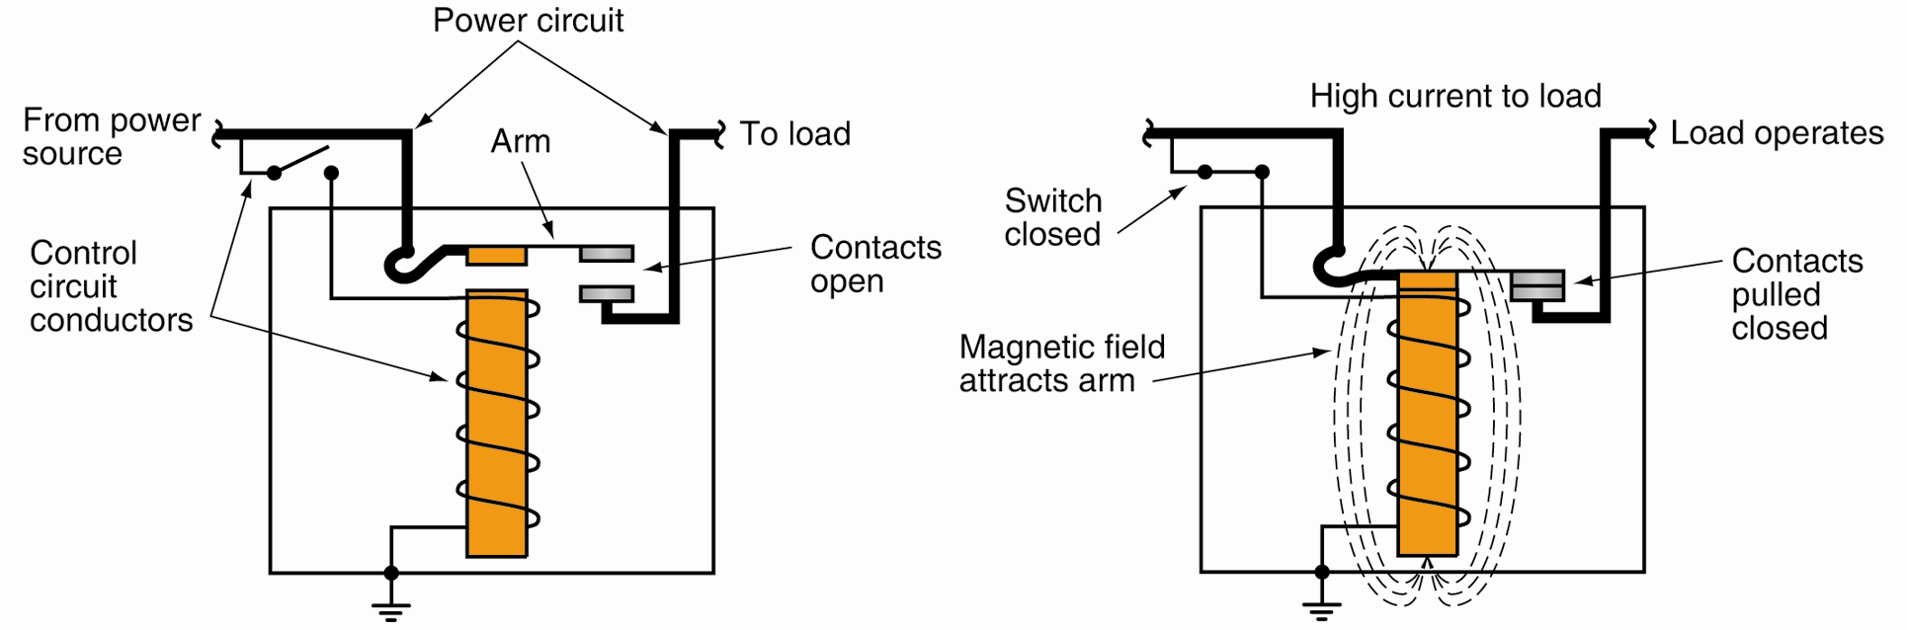
Relays
Use small input current to control larger current in circuit
Allows wires to be much smaller than otherwise needed

Slide 28
Solenoids
Electromagnets that move metal core, or plunger
When current breaks, spring action pushes core back out
Uses
Close large electrical contacts
Move parts into engagement

Slide 29
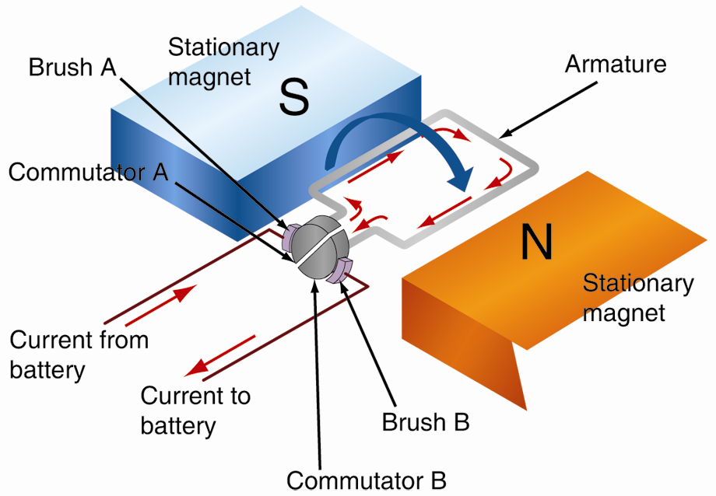
Electric Motors
Use magnetic fields to produce powerful rotating action
Parts of motor
Armature
Commutators
Brushes
Magnets

Slide 30
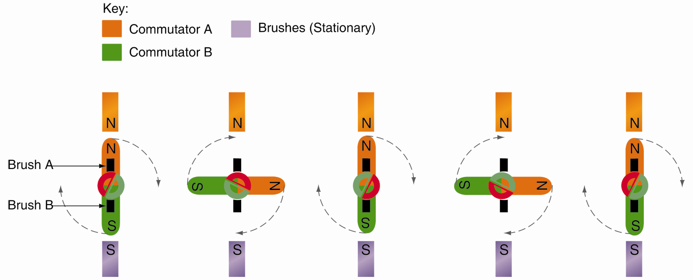
Electric Motors (Cont.)

Slide 31
Electronic Components
Also called solid state components
Composed of semiconductor material
Allows device to control electricity
Less energy consumption

Slide 32
Semiconductors
Crystal material that can conduct or insulate
P-type semiconductor
Doped so that it has excess protons
P stands for positive
N-type semiconductor
Doped so that it has excess electrons
N stands for negative

Slide 33
Diodes
Made by joining N-type semiconductor with P-type semiconductor
Blocks direct current in one direction and passes it in other
PN junction
Common edge of P-type and N-type semiconductors

Slide 34
Diodes (Cont.)
Forward bias
Connected so that it acts as conductor
Reverse bias
Connected so that it acts as insulator
Depletion area
Area surrounding PN junction

Slide 35
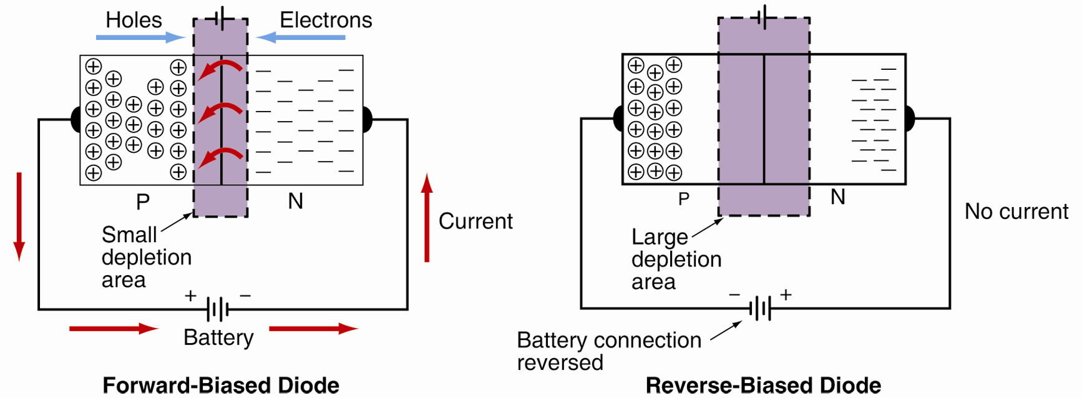
Diodes (Cont.)

Slide 36
Diodes (Cont.)
Reverse bias voltage
Rating of maximum voltage diode can block without damage
Rectification
Conversion of alternating current to direct current

Slide 37
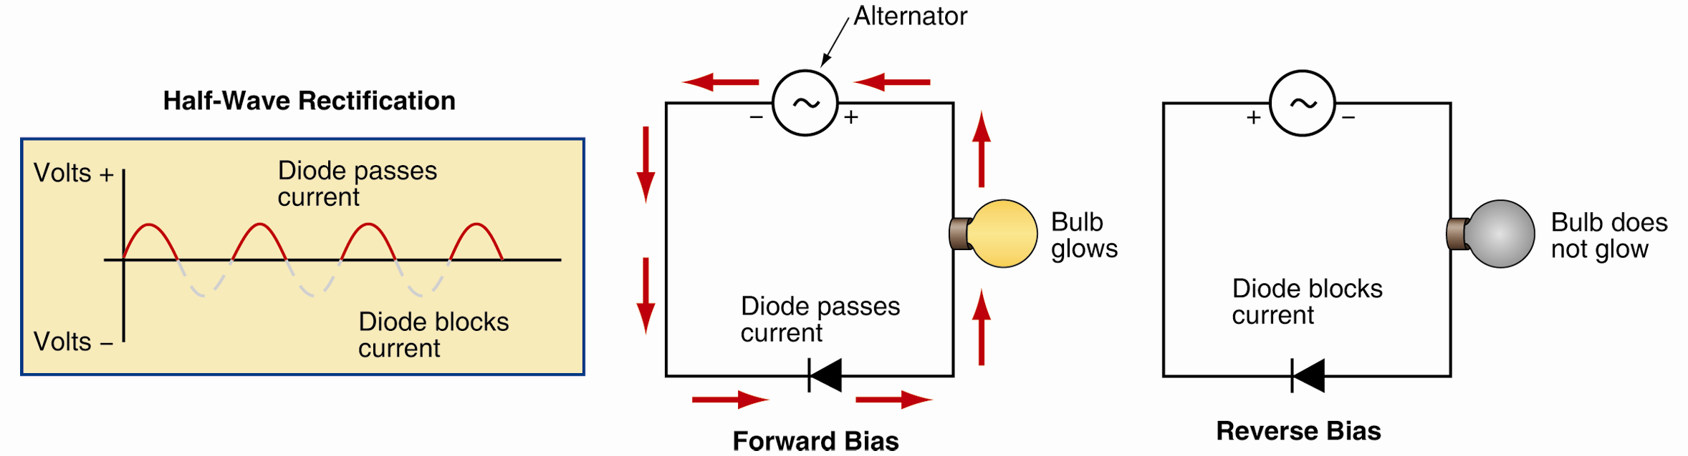
Half-Wave Rectification
Produced by single diode in series with ac source
Only half of each ac wave allowed through

Slide 38
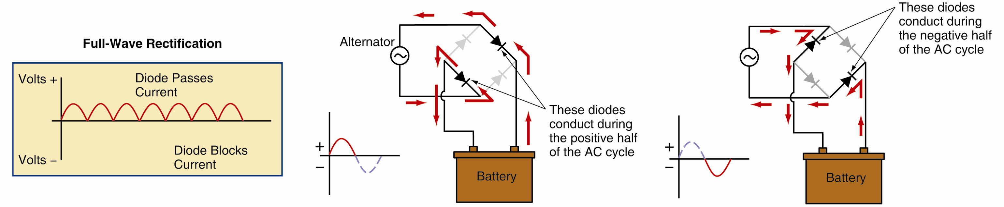
Full-Wave Rectification
Allows both halves of each ac wave through
Both halves flow in the same direction
Diodes commonly used inside charging system alternators

Slide 39
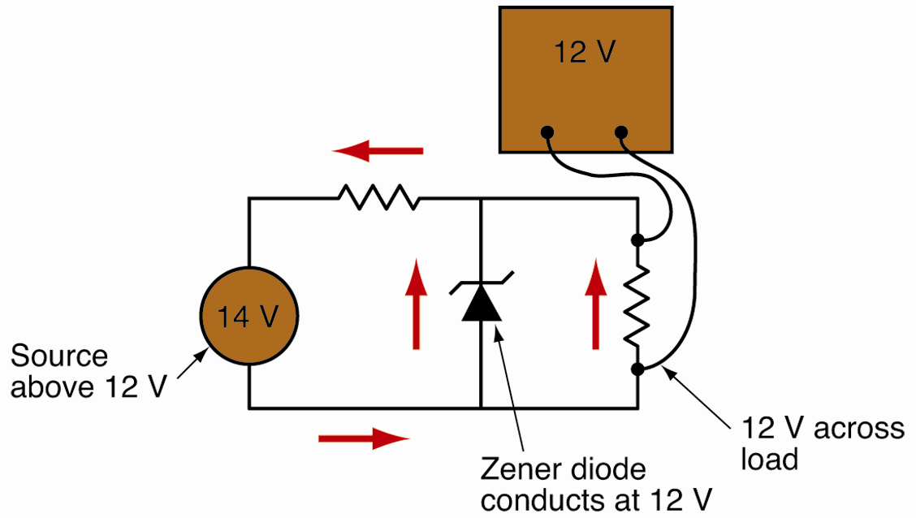
Zener Diodes
Serves as voltage regulator
Conducts current when forward biased
Blocks current when reverse biased
When specific reverse-bias voltage is reached, it conducts current

Slide 40
Transistors
Semiconductor that regulates current or voltage
Transfers or changes with electric stimulation
Can act as switch for electronic signals or current amplifier
Bipolar junction transistor (BJT)
Made by joining three semiconductor materials

Slide 41
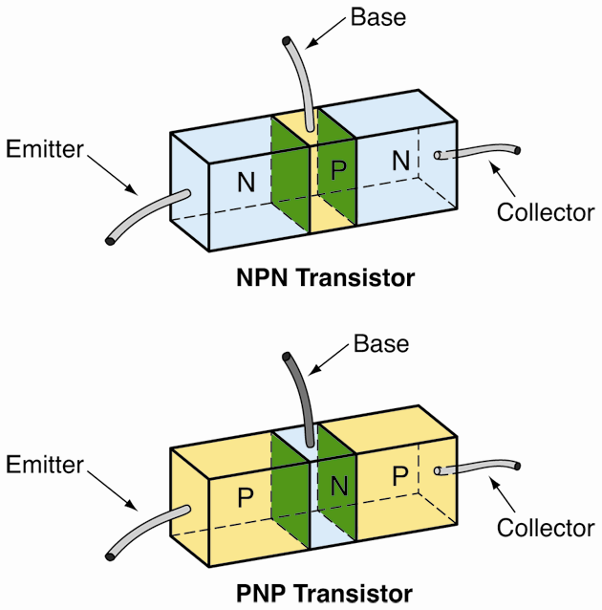
Transistors (Cont.)
NPN transistor
Two N-type semiconductors and one P-type semiconductor bonded together
PNP transistor
Two P-type semiconductors and one N-type semiconductor bonded together

Slide 42
Transistors (Cont.)
Transistor and relay can perform same function
Transistor vs. relay
Smaller
No moving parts

Slide 43
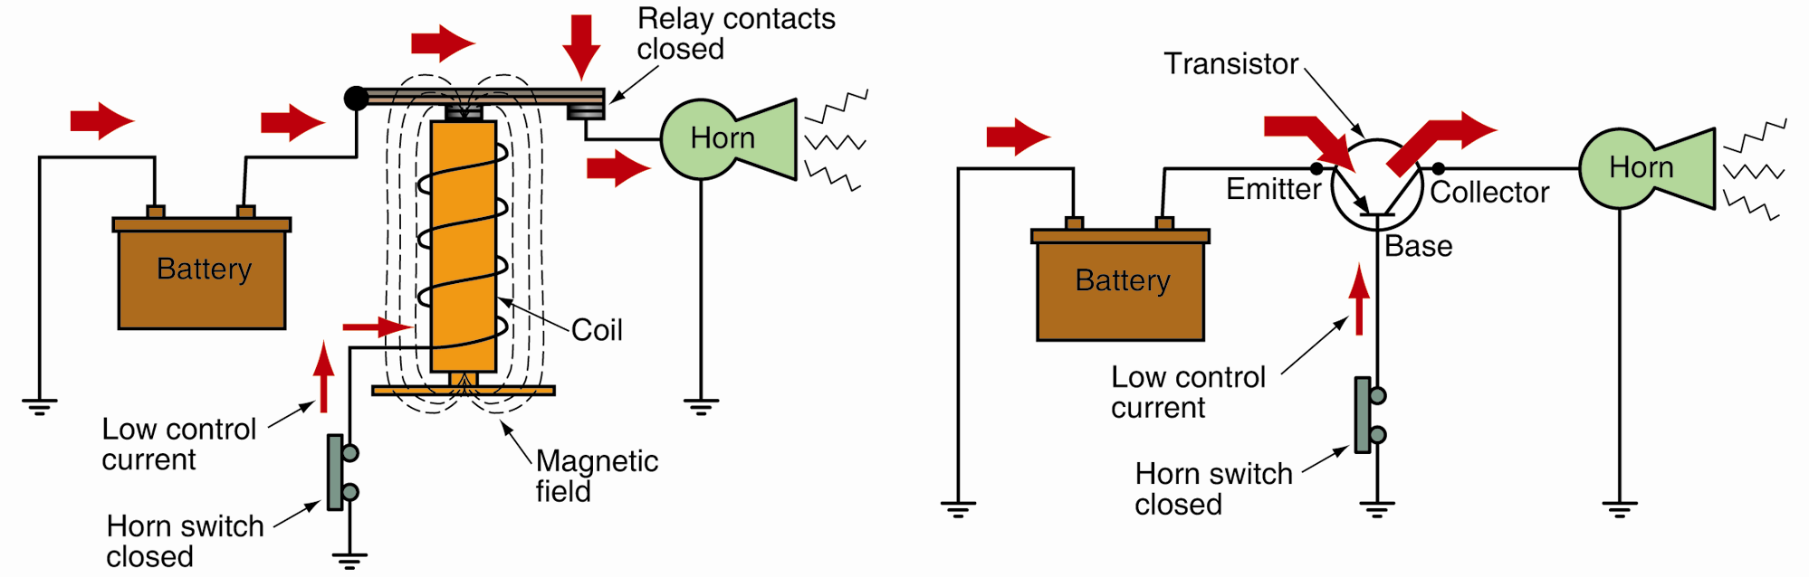
Transistors (Cont.)
(Echlin)

Slide 44
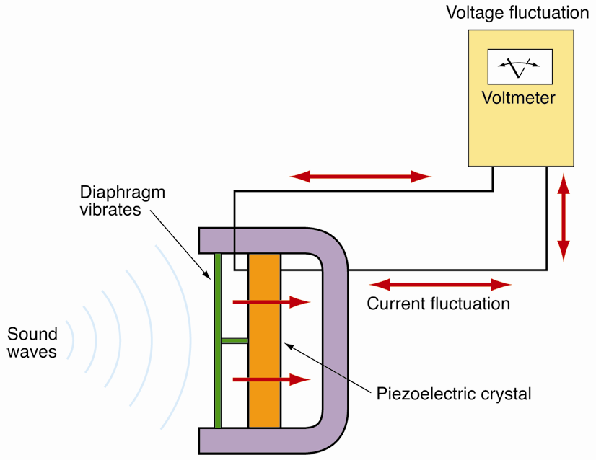
Piezoelectric Crystal
Produces low current output when physical pressure is applied
Makes a microphone when linked to diaphragm

Slide 45
Photonic Devices
Any device that can emit or detect light
Photon
Particle of electromagnetic light energy
Photonics is a fast-growing field of electronics
Photonic semiconductors are now being found in automotive electronics

Slide 46
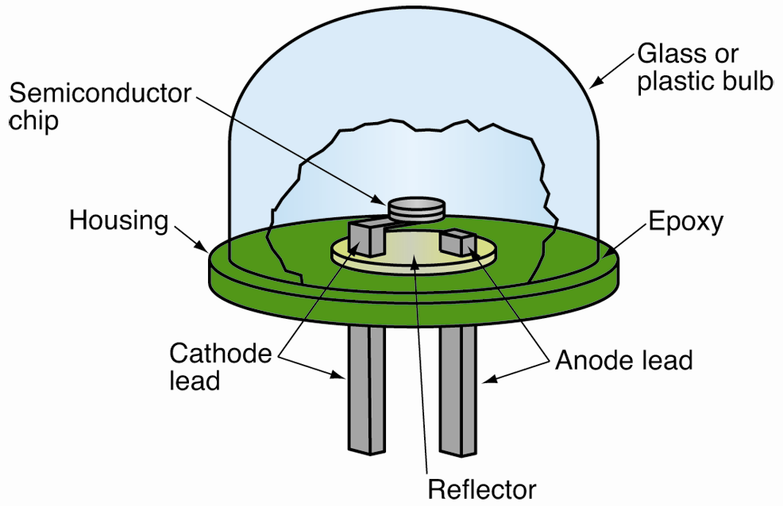
Light Emitting Diodes
LED
Semiconductor that emits light when electrically energized
More efficient than other light sources

Slide 47
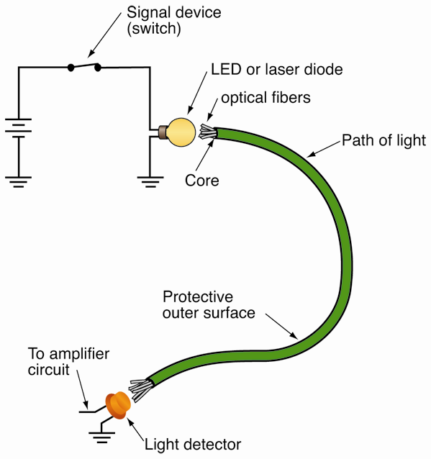
Fiber Optics
Field of electronics which uses light to carry data through small strands of plastic or glass fiber

Slide 48
Photovoltaic Cells, Photoresistors, and Photodiodes
Photovoltaic or solar cell
Converts light directly into current
Photoresistor
Acts as resistor in dark but changes to conductor in light
Photodiode
Can produce low voltage when excited by light
Control current by allowing current flow

Slide 49
Liquid Crystal Displays
Liquid crystal display (LCD)
Fluid crystal material sealed between two glass plates
Polarizes light to display numbers, letters, or other images

