Slide 1
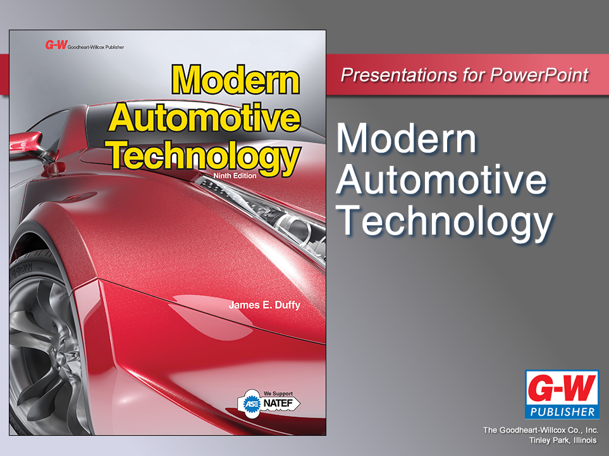

Slide 2
20
Chapter
Electrical Tools and Test Equipment

Slide 3
Objectives
After studying this chapter, you will be able to:
Identify tools that are commonly used during electrical repairs.
Summarize the use of test equipment for various vehicle systems.
Summarize the use of multi-system test equipment such as scan tools and engine analyzers.
Select the proper tool or tester for the job.

Slide 4
Soldering Tools
Solder
Alloy with relatively low melting point compared to other metals
Soldering
Process of using heat and molten solder to join wires, terminals, and other components
Best method for making electrical connections
Low resistance, resist corrosion, and vibration failure

Slide 5
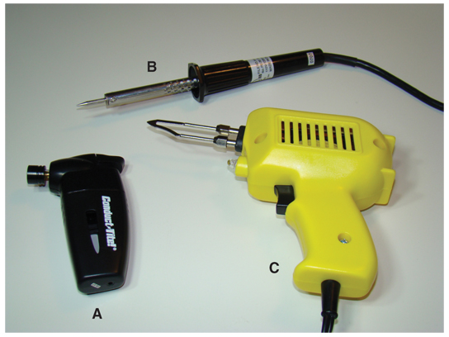
Soldering Tools (Cont.)
Soldering torch (A)
Burns butane gas to instantly generate heat
Soldering iron (B)
Tip is smaller and better suited to delicate work on circuit boards
Soldering gun (C)
High power rating and trigger-operated

Slide 6
Soldering Tools (Cont.)
Flux brush
Used to apply paste-type flux to joint
Flux
Chemically cleans metal surfaces
Molten solder bonds with base metals properly
Soldering picks
Used to scrape corrosion from components before applying solder

Slide 7
Soldering Tools (Cont.)
Heat sink
Spring-loaded, clamp-on aluminum device
Helps prevent overheating of electronic components
Desoldering bulb
Tool for removing molten solder during repairs

Slide 8
Soldering Tools (Cont.)
Soldering sponge
Soaked in water and used to clean tip of soldering gun or iron
Holding devices
Free technician’s hands to use soldering gun and solder

Slide 9
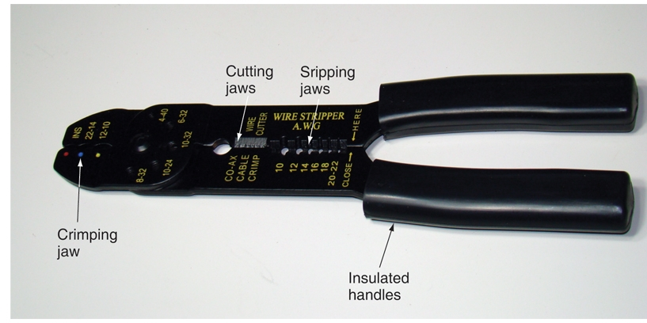
Wire Stripping Tools

Slide 10
Crimp Connecting Tools
Crimp connectors
Easy way of joining wires or installing terminal
Crimping pliers
Crushes metal part of connector around wire conductor

Slide 11
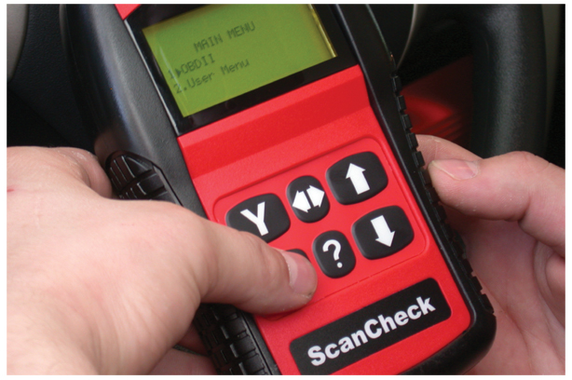
Scan Tools
Check operation
Vehicle sensors
Actuators
Wiring
Computer
(Snap-on Tool Corp)

Slide 12
Test Lights
Check circuits for power or continuity (complete circuit path)
Energized by circuit voltage
Noid lights
Check for power in wiring harness going to electronic fuel injectors

Slide 13
Multimeters
Also called volt-ohm meter or VOM
Measures exact electrical values in vehicle circuits
Combines voltmeter, ohmmeter, and ammeter into one unit
Analog multimeter
Needle or pointer shows electrical readings
Digital multimeter
Liquid crystal display shows digital readout

Slide 14
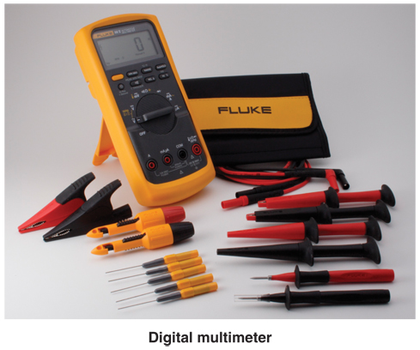
Multimeters (Cont.)

Slide 15
Multimeters (Cont.)
Digital-analog meter
Digital meter with alphanumeric display and bar graph to show fluctuating electrical values
Inductive pickup
Does not have to touch metal components in circuit

Slide 16
Inductive Wire Tracers
Finds internal breaks in wires and disconnected wires or terminals
Pulse generator connects to circuit
Inductive probe moves along wire
Tracer makes audible beeping sound if wire has continuity and carries pulsing signal

Slide 17
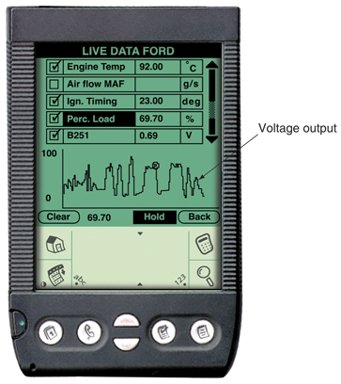
Oscilloscopes
Also called scope
Displays line pattern, or trace
Represents circuit voltages in relation to time
Handheld version has oscilloscope and multimeter
(OTC/SPX Corp.)

Slide 18
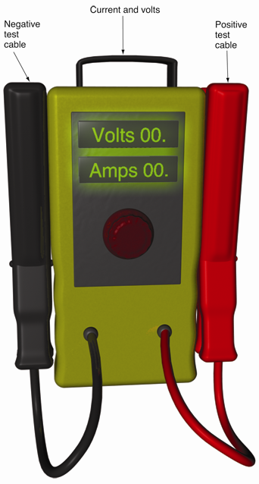
Load Testers
Tests condition
12-volt batteries
Charging systems
Starting systems

Slide 19
Charging System Analyzers
Quickly measures charging system voltage to determine alternator operation

Slide 20
System-Specific Test Equipment
Keyless entry tester
Checks condition of key chain sending unit and signal sensor of keyless entry system
Park assist tester
Troubleshoots output from laser at rear of vehicle in park assist system
Tire pressure monitor calibration tool
Used to calibrate and test tire pressure sensors

Slide 21
Diesel Test Equipment
Glow plug analyzer
Tests diesel glow plugs and engine’s operating condition

