Slide 1
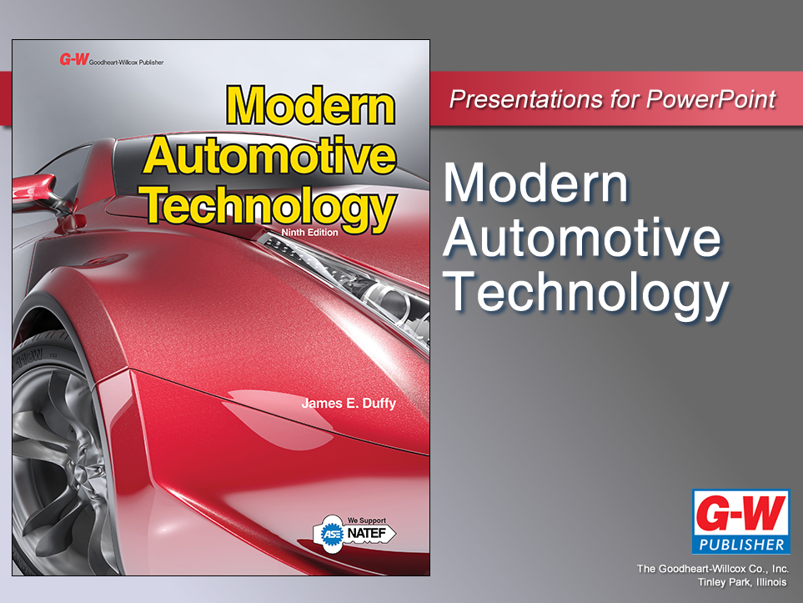

Slide 2
23
Chapter
Computer System Fundamentals

Slide 3
Objectives
After studying this chapter, you will be able to:
Compare computer systems to the human body’s nervous system.
Describe the input, processing, and output sections of a basic computer system.
Summarize computer system signal classifications.
Sketch a block diagram for a computer system.
Explain input sensor and output device classifications and operation.

Slide 4
Objectives
Summarize where computers, sensors, and actuators are typically located.
Explain how a computer uses sensor inputs to determine correct outputs.
Correctly answer ASE certification test questions that require a knowledge of automotive computer system fundamentals.

Slide 5
Computer System Fundamentals Introduction
Automotive computer
Complex set of electronic circuits
Produces programmed control currents for actuators after receiving input signals from sensors
Computers now monitor and control all major systems in modern vehicles

Slide 6
Cybernetics
Study of how electrical-mechanical devices duplicate actions of human bodies
Compares human body to computer system

Slide 7
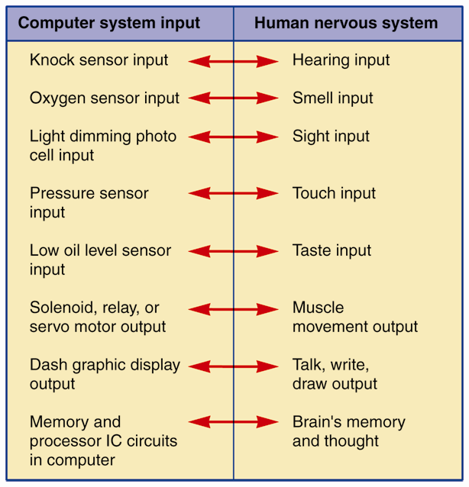
Cybernetics (Cont.)
Nervous system
Computer input
Brain
Computer processing
Reflex action
Computer output

Slide 8
Computer Circuit Advantages
Compensate for mechanical wear
Does not have as many mechanical parts
Can “think” very quickly
Reduce fuel consumption
Lower emissions
Increase engine power

Slide 9
Computer Circuit Advantages (Cont.)
Reduce vehicle weight
Have on-board diagnostics
Increase driver convenience
Improve passenger safety
Compensate for component wear and failure

Slide 10
Digital Electronics
Studies how computer uses on-off signals to produce “artificial intelligence”
Computers analyze input signals from sensors
Make logical choices by comparing input signals from sensors to known signals

Slide 11
Binary Numbering System
Uses only two numbers, zero and one
Key to how computers operate
Numbers zero (0) and one (1) arranged in different sequences can represent other numbers, letters, words, computer input, computer output, or conditions

Slide 12
Gating Circuits and Truth Tables
Gate
Electronic circuit producing specific output voltage for given input voltages
Truth table
Shows what gate’s output will be with different inputs
Graphically shows how gate functions
Called logic devices because they make logical decisions

Slide 13
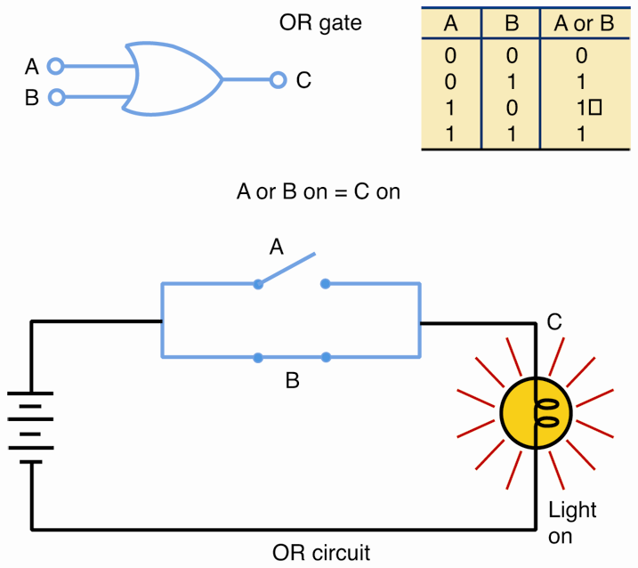
Truth Tables
Two switches wired in parallel
Either A or B (OR gate) will turn light on (output 1)
Output will be on (1) with A or B or both energized
Only when neither input is on will output be off (0)

Slide 14
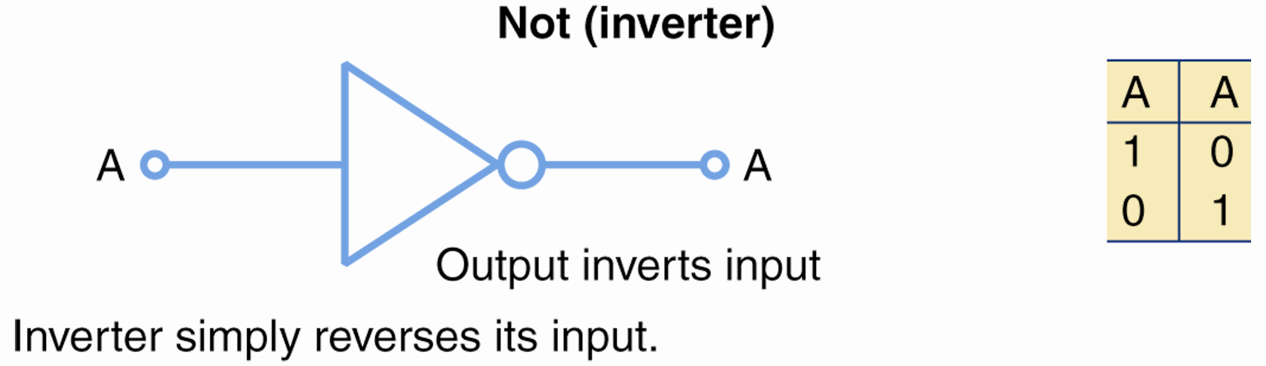
Gating Circuits
NOT gate or inverter gate
Will reverse its input
If input has voltage applied, output terminals will not have voltage or vice versa
NOT gate can be used to make other gates

Slide 15
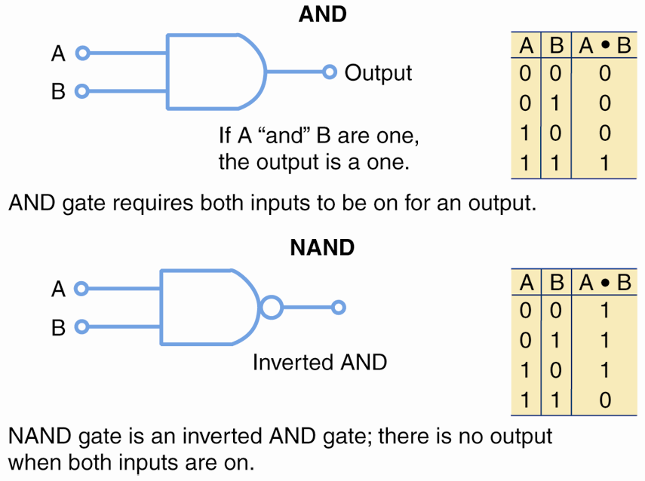
Gating Circuits (Cont.)
AND gate
Requires voltage at both inputs to produce voltage
A NAND gate
Inverted AND gate
Output will be opposite that of AND gate

Slide 16
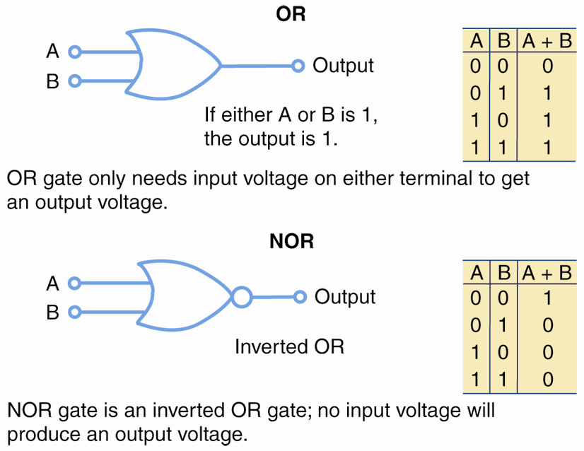
Gating Circuits (Cont.)
OR gate
Will produce output if either input is energized
NOR gate
Inverted OR gate
Output is inverted to produce output opposite that of OR gate

Slide 17
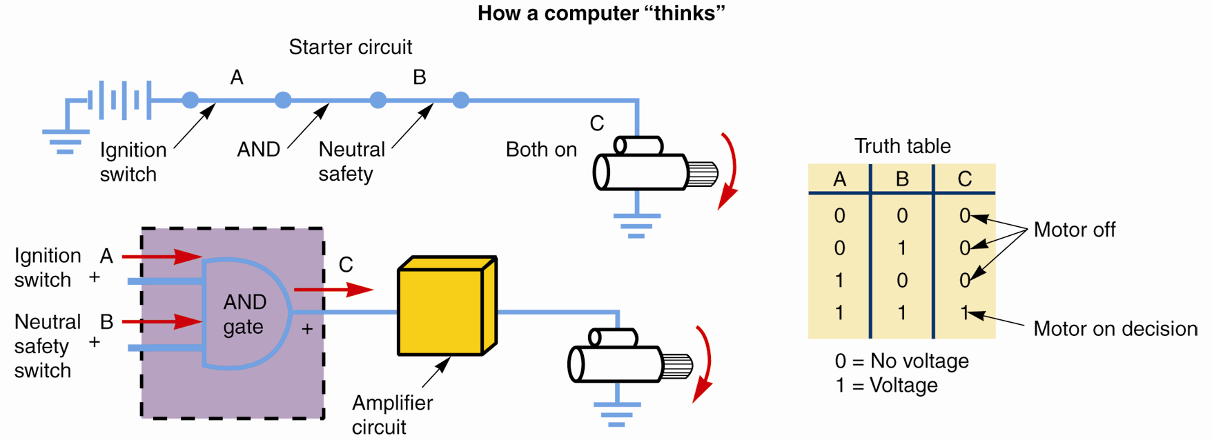
Gating Circuits and Truth Tables (Cont.)

Slide 18
Integrated Circuits
Integrated circuit (IC)
Circuit etched on surface of tiny semiconductor chip
Wire leads allow for connections to and from IC chip
Technicians often reprogram integrated circuits in vehicle computers to rectify problems

Slide 19
Computer Signals
Voltage variation over short periods of time
Specific, arranged pulses or waves carrying electronic data, or information
Computer signals can be
Digital
Square or on/off scope waveform
Analog
Smooth, gradual change in current and voltage

Slide 20
Computer Signals (Cont.)
Oscilloscope, or scan tool with scope function, measures computer signals
When connected to a sensor generating signal voltage, scope displays signal trace or waveform

Slide 21
Electrical Waveforms
AC sine wave
Curving signal that smoothly fluctuates above and below zero volts
DC sine wave
Curving, fluctuating signal that stays at or above zero volts
DC square wave
Digital, on-off signal stays at or above zero volts

Slide 22
Electrical Waveforms (Cont.)
DC ramp wave
Moves steadily up from zero and then switches off instantly
Pulse wave
Rises progressively from zero and then instantly returns to zero
Complex sine wave
Moves up and down erratically but gradually

Slide 23
Electrical Waveforms (Cont.)
Voice wave
Irregular wave that corresponds to frequency of human voice airwaves
DC noise wave
Straight line (dc) with some voltage fluctuations (noise)

Slide 24
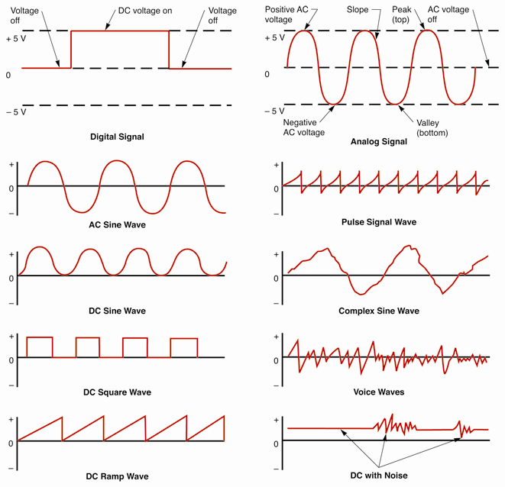
Electrical Waveforms (Cont.)

Slide 25
Computer Signal Terminology
Pulse width or signal frequency
Refers to how fast voltage signal changes over time
Signal amplitude
Refers to how much voltage is present in wave
Duty cycle
Percentage of on time compared to total cycle time

Slide 26
Computer System Operation
Input
Vehicle sensors convert condition into electrical signal used by computers
Processing and storage
Computer compares inputs to data and operating parameters to determine what action to take
Output
Electrical signals used to control physical actions and alter component operations

Slide 27
Computer System Block Diagram
Simple service manual drawing
Shows how sensors, actuators, and computers interact
Uses basic squares or rectangles to represent components and lines to represent wires

Slide 28
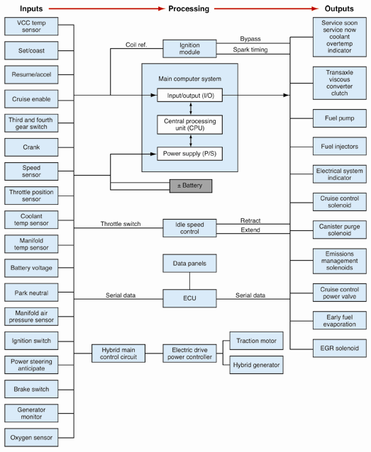
Computer System Block Diagram (Cont.)

Slide 29
Sensors
Vehicle sensors or transducers
Change physical condition into electrical signal
Transduce
Means to change from one form to another
Sensors can be found almost anywhere on vehicle

Slide 30
Sensor Classifications
Active sensor
Produces its own voltage signal internally
Shielded wire
Flexible metal tube around conductor to block induced voltage and interference
Often used with active sensors
Passive sensor
Variable resistance sensor

Slide 31
Sensor Classifications (Cont.)
Variable resistor sensor
Switching sensor
Magnetic sensor
Hall-effect sensor
Optical sensor
Knock sensor
Solar sensor
Direction sensor

Slide 32
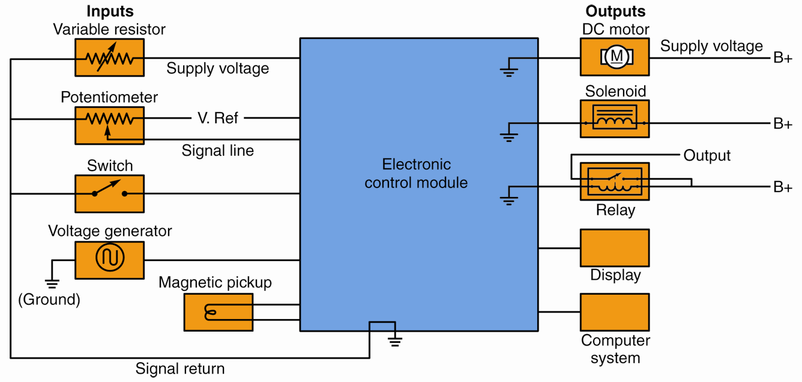
Sensor Classifications (Cont.)

Slide 33
Reference Voltage
Reference voltage (Vref)
Base voltage used to carry computer signal
Typically around 5 volts
Computer sends reference voltage to sensor
Signal fed back for processing
Interpreted by computer as change in condition

Slide 34
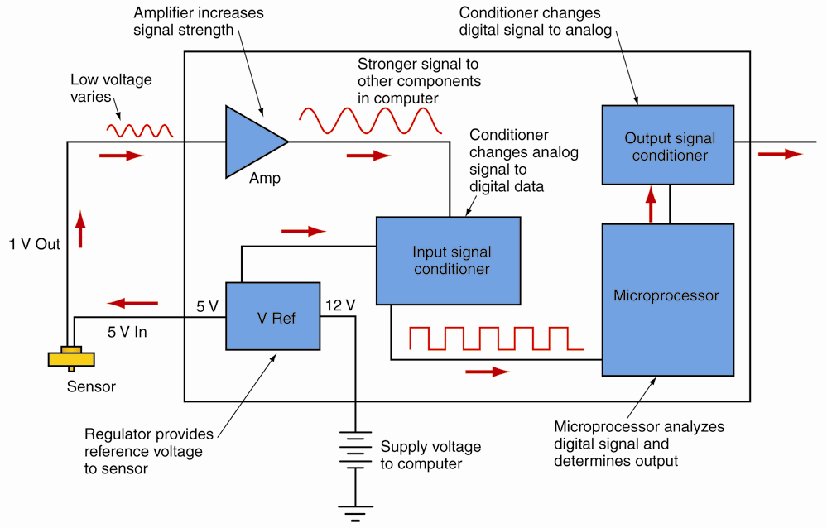
Reference Voltage (Cont.)

Slide 35
Sensor Types
Intake air temperature (IAT)
Engine coolant temperature (ECT)
Oxygen (O2) sensors
Manifold absolute pressure (MAP)
Barometric pressure (BARO)
Throttle position sensor (TPS)
Fuel pressure sensor (FPS)
Engine speed sensor (ESS)
Crankshaft position sensor
Camshaft sensor (CS)

Slide 36
Sensor Types (Cont.)
Mass airflow (MAF)
Knock sensor (KS)
Transaxle/transmission sensor
Brake switch
Wheel speed sensors
Oil level sensor
EGR sensor
Impact sensors

Slide 37
Sensor Types (Cont.)
Vehicle speed sensor
Fuel tank pressure sensor (FTPS)
Battery temperature sensor
Computer-mounted sensors
Hybrid drive circuit sensors

Slide 38
Circuit Sensing
Computer uses itself to monitor component and circuit operation
Circuits’ windings and wires serve as sensors

Slide 39
Computers
Manufacturers give their computers many names
Central processing unit (CPU)
Electronic control unit (ECU)
Electronic control module (ECM)
Engine control module (ECM)
Electronic control assembly (ECA)

Slide 40
Computers (Cont.)
Powertrain control module (PCM)
Vehicle control module (VCM)
Microprocessor
Logic module
This textbook uses ‘control module’ to refer to automotive computers in general

Slide 41
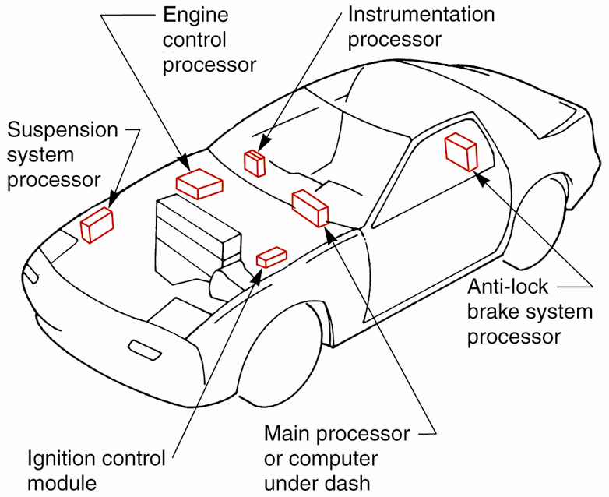
Computer Locations

Slide 42
Computer Types
Vehicle control module
Powertrain control module
Engine control module
Anti-lock brake module
Instrumentation module
Ignition module
Suspension system module
Climate control module
Air bag module
HV power control module
Hybrid control module
Body module

Slide 43
Parts of a Computer
Computer housing
Metal or plastic enclosure protecting electronic components
Circuit board
Plastic or fiberboard insulator
Has flat metal conductors printed on surface to connect and hold components

Slide 44
Parts of a Computer (Cont.)
Harness connector
Multi-pin terminal attached to vehicle’s wiring harness
Computer’s clock
Integrated circuit with constant pulse rate to coordinate signals

Slide 45
Parts of a Computer (Cont.)
Microprocessor
Usually largest integrated circuit in computer
Analyzes data from sensors
Compares data to known good operating values in memory
Memory chips
Store digital data

Slide 46
Parts of a Computer (Cont.)
Voltage regulator
Converts battery and generator voltage into lower, cleaner dc voltage usable by ECM circuits, dash displays, and sensors
Conditioners
Also called converters or interfaces
Alter signals for use by other chips and circuits
Protect computer from shorted or grounded circuits

Slide 47
Parts of a Computer (Cont.)
Buffer
Can serve as temporary storage area for data
Microprocessor
Means small (micro) computer (processor)
Integrated circuit capable of analyzing data and calculating appropriate outputs

Slide 48
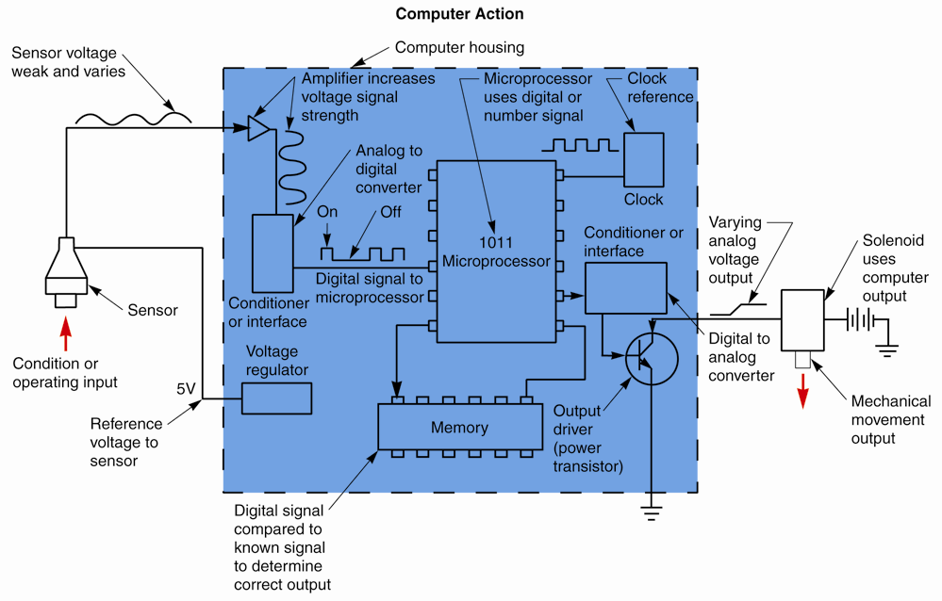
Simplified Computer System

Slide 49
Computer Memory Operation
Computer memory uses gates capable of storing data as voltage charges
Random access memory (RAM)
Read only memory (ROM)
Programmable read only memory (PROM)
Erasable programmable read only memory (EPROM)
Electrically erasable programmable read only memory (EEPROM)
Flash erasable programmable read only memory (FEPROM)

Slide 50
KAM
Keep alive memory (KAM)
Allows computer to use adaptive strategy
Adaptive strategy
Needed as parts wear and components deteriorate
Allows computer to maintain normal vehicle performance with abnormal inputs from sensors

Slide 51
Output Drivers
Sometimes referred to as quad drivers or power transistors
Control current flow through actuators
When energized, drivers ground actuator circuits
Actuators can then produce movement

Slide 52
Actuators
Hands and arms of computer system
Can be found almost anywhere on vehicle
Categories
Solenoid
Relay
Servo motor
Display devices
Control module

Slide 53
Actuator Operation
When computer turns on actuator
It provides device with ground circuit
Current then flows through actuator and frame ground to operate it

Slide 54
Specific Actuators
Fuel injectors
Fuel pump
Idle air solenoid
Idle speed motor
EGR solenoids
Canister purge solenoids
Door lock motors or solenoids
Electric seat motors
Ignition coil
Ignition module

Slide 55
Computer Networks
Series of computers that control different systems but work together to improve overall vehicle efficiency
Also called integrated computer system
Allows all on-board computers to use feedback data from several systems
Multiplexing
Term used to describe this computer interaction in vehicles

Slide 56
Computer Networks (Cont.)
Networked computers share common parts
Wires
Input signals
Output signals
They exchange data from sensors to prevent duplication of parts and to reduce wiring
Data bus
Wiring used for the network

Slide 57
Serial/Parallel Network Communication
Serial communication
Uses only one wire to exchange digital data
Data transfers one bit at a time
Parallel communication
Involves use of several wires
Exchanges multiple bits of data simultaneously

Slide 58
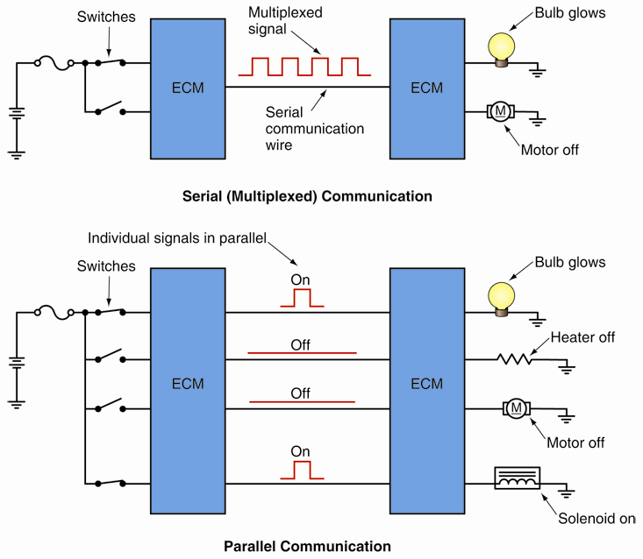
Serial/Parallel Network Communication (Cont.)

Slide 59
ECM Information Flow
Star configuration
One main processing ECM and several less complex ECMs work as a network
Smaller ECMs cannot communicate with each other unless data is first sent through main processing ECM
Bus configuration
Several ECMs wired to single conductor, or bus
No main processing ECM is used

Slide 60
ECM Information Flow (Cont.)
Ring configuration
Each ECM wired in series, or loop
Signal-transmitting ECM’s data flows through each ECM and then back to source ECM
Again, no main processing ECM needed

Slide 61
Network Wiring
Single-wire conductor
Conventional insulated wire that carries data signals between computers
Twisted-pair conductors
Carry computer data faster than single-wire conductors
Shielded twisted-pair conductor
Encased in metal shield to further reduce electromagnetic interference

Slide 62
Network Wiring (Cont.)
Differential voltage signal
Consists of two digital signals with opposing polarities
Synchronized to strengthen low-voltage communication signals between computers

Slide 63
Controller Area Network
Controller area network (CAN)
Specific type of high-speed computer data bus
Several computers and sensors use CAN bus wiring
Each computer is able to send and receive signals
Each signal carries markers that denote its origin

Slide 64
Local Interconnect Network
Local interconnect network (LIN)
Data bus system designed to work with CAN
Suited for sensor and actuator networking applications
Used in one section such as inside a door
Special CAN-LIN bridge must be used to connect LIN to CAN system

