Slide 1


Slide 2
24
Chapter
On-Board Diagnostics and Scan Tools

Slide 3
Objectives
After studying this chapter, you will be able to:
Discuss the purpose and operation of onboard diagnostic systems.
Explain the use of scan tools to simplify reading of trouble codes.
Locate the data link connector on most makes and models of cars.

Slide 4
Objectives
Activate on-board diagnostics and read trouble codes with a scan tool.
Erase diagnostic trouble codes.
Correctly answer ASE certification test questions concerning late-model on-board diagnostics and scan tool use.

Slide 5
On-Board Diagnostic Systems
On-board diagnostics
computer’s ability to analyze circuit operations, and to store and output data on any problems
Scan tool
Communicates with vehicle computers
Retrieves trouble codes, displays circuit and sensor values, runs tests, and gives hints for finding problems

Slide 6
On-Board Diagnostic Systems (Cont.)
On-board diagnostics check almost every electrical/electronic part in every major system
If any abnormal values are found
Computer stores a trouble code
Lights malfunction indicator light on instrument panel

Slide 7
Early On-Board Diagnostic Systems
Early systems checked limited number of items
Unable to detect weak circuits and components
Little or no standardization between systems

Slide 8
Early On-Board Diagnostic Systems (Cont.)
OBD I systems
On-board diagnostics generation one
Early diagnostic systems
Still millions of vehicles that use OBD I systems

Slide 9
OBD II Systems
Environmental Protection Agency (EPA)
Passed vehicle pollution laws that require on-board diagnostic systems to detect problems before they produce harmful exhaust emissions
Standardize monitoring systems

Slide 10
OBD II Systems (Cont.)
OBD II
On-board diagnostics generation two
More efficiently monitor hardware and software that affect driveability emissions
Designed to keep vehicle running efficiently for at least 100,000 miles

Slide 11
OBD II Systems (Cont.)
Greater processing speed
More memory
More complex programming
Standardized
Data link connections
Trouble codes
Sensor and output device terminology
Scan tool capabilities

Slide 12
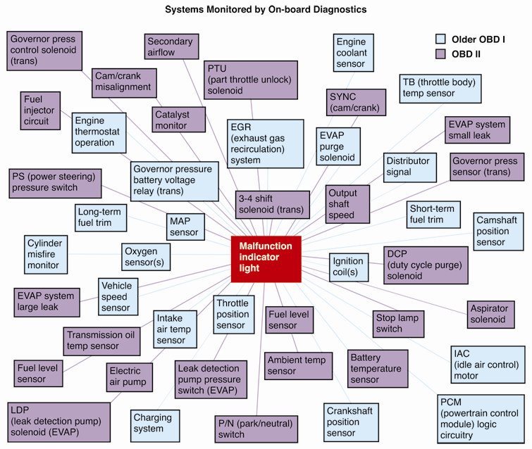
OBD System Comparison

Slide 13
Malfunction Indicator Light (MIL)
In OBD II systems, engine warning light is referred to as malfunction indicator light (MIL)
If MIL glows continuously, trouble is not critical but should be repaired at owner’s convenience
MIL light comes on and then goes out
Problem may be intermittent

Slide 14
Malfunction Indicator Light (Cont.)
A flashing MIL
Means that trouble could damage catalytic converter and is considered critical
Trouble code chart
Will state what each number code represents
Trouble code conversion
Scan tool converts number code into abbreviated words

Slide 15
Diagnostic Trouble Codes
Diagnostic trouble codes (DTC)
Digital signals produced and stored by computer
Operating parameter
Acceptable minimum and maximum value

Slide 16
Computer System Problems
Loose electrical connection
Corroded electrical connection
Failed sensor
Failed actuator
Vacuum leak
Electrical short
Ignition system problems
Fuel system problems
Emission system problems
Engine problems

Slide 17
Computer System Problems (Cont.)
Computer malfunction
Weak or lazy component
Transmission problems
Anti-lock brake system problems
Air conditioning problems
Air bag problems
Hybrid electric drive train part and circuit malfunctions

Slide 18
Scan Tools
Retrieve trouble codes from computer’s memory and display these codes as numbers and words
Basic scan tool
Designed to read and erase vehicle trouble codes
Advanced scan tool
Troubleshooting guides
More manufacturer specific tests and circuit readings

Slide 19
Data Link Connector
Data link connector (DLC)
Multipin terminal used to link scan tool to computer
In the past, this connector was called
Diagnostic connector
Assembly line diagnostic link (ALDL)

Slide 20
Data Link Connector (Cont.)
OBD I data link connectors
Came in various shapes and sizes
Equipped with varying number of pins or terminals
OBD II, DLC is standardized 16-pin connector

Slide 21
Connecting the Scan Tool
On late-model vehicles, data link connector mounts under dash
Easily accessible from driver’s seat
In older vehicles, adapter is needed, so scan tool’s connector will fit vehicle’s pre-OBD II pin configurations

Slide 22
Using Scan Tools
Modern scan tools give prompts in display windows
Scan tool may ask you to input VIN information
Lets scan tool know which engine, transmission, and options are installed on that car or truck

Slide 23
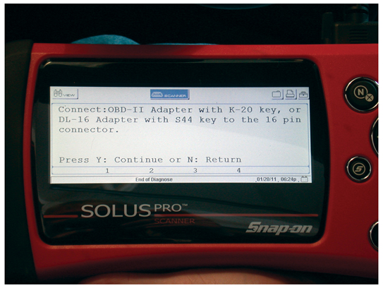
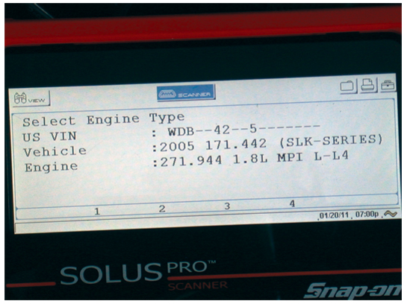
Using Scan Tools (Cont.)
(Snap-on Tool Corp.)

Slide 24
Information a Scan Tool Can Request
Stored diagnostic trouble codes
Fault description
Datastream information
Run tests
Oxygen sensor monitoring
Failure record
Freeze frame
Troubleshooting

Slide 25
Failure Record
Failure record or failure recorder
Stores information on number of times trouble code occurs
OBD II systems
Counts number of times engine reached operating temperature since last trouble code occurred

Slide 26
Diagnostic Trouble Code Identification
OBD II requires use of set of standardized alpha-numeric trouble codes
Each trouble code identifies same problem in all vehicles, regardless of manufacturer

Slide 27
OBD II Codes
Contain a letter and a four-digit number
Letter indicates general function of affected system
First digit indicates whether code is standard trouble code or nonuniform code

Slide 28
OBD II Codes (Cont.)
Standard trouble codes, or SAE codes
Indicated by zero (0)
Nonuniform codes
Nonstandard codes assigned by manufacturers
One (1) after system
Second digit indicates specific system function where fault is located

Slide 29
OBD II Codes (Cont.)
Code’s last two digits
Refer to specific fault designation
Pinpoint exactly which component or circuit of system might be at fault and problem type

Slide 30
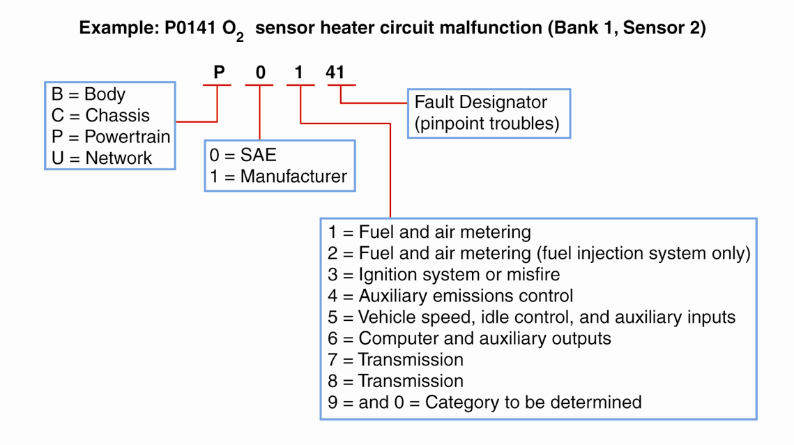
OBD II Codes (Cont.)

Slide 31
Failure Types
Hard failure
Problem that is always present in a computer system
Disconnected wire
Soft failure or intermittent failure
Problem only occurs under certain conditions

Slide 32
Computer System Failure Types
General circuit failure
Low-input failure
High-input failure
Improper range/performance failure

Slide 33
Datastream Values
Datastream values or diagnostic scan values
Produced by vehicle’s computer
Give electrical operating values of sensors, actuators, and circuits
Values can be read on scan tool’s digital display
Compared to known normal values in service manual

Slide 34
Key-On/Engine-Off Diagnostics
Performed by triggering ECM’s on-board diagnostic system with ignition key in on position but without engine running
Allows access to any stored trouble codes
Usually performed before key-on/engine-on diagnostics

Slide 35
Wiggle Test
Wiggle test or “flex” test
Many computer system failures, especially intermittent failures, caused by loose, dirty, or corroded connections
If engine operation changes suddenly when connector or wire is flexed, problem located at or near that point

Slide 36
Key-On/Engine-On Diagnostics
Performed with engine running at full operating temperature
Check condition of sensors, actuators, computer, and wiring while operating under normal conditions

Slide 37
Switch Diagnostic Test
Involves activating various switches while using scan tool
To instruct which switch to move and monitor operation
Quickly indicate if switch works normally

Slide 38
Actuator Diagnostic Test
Uses scan tool to order vehicle’s computer to energize specific output devices with engine on or off
Lets you find out if actuators work
Actuator diagnostic tests considered intrusive tests

Slide 39
Actuator Diagnostic Test (Cont.)
Actuator diagnostic tests might
Fire or prevent firing of ignition coil
Open and close fuel injectors
Cycle idle speed motor or solenoid
Energize digital EGR valve solenoids
Scan tool will give readouts showing whether there is trouble with any actuators

Slide 40
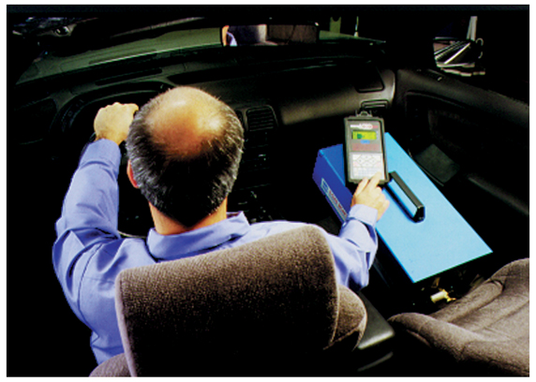
Scanning during a Test-Drive
With a scan tool
Check for problems while driving vehicle
Simulate conditions present when trouble happens

Slide 41
Erasing Trouble Codes
Erasing trouble codes or clearing diagnostic codes
Clears stored codes from computer memory after system repairs have been made
In most cases, codes automatically erase after 30–50 engine starts or warm-ups

Slide 42
Erasing Trouble Codes (Cont.)
Various methods used to erase trouble codes
Use a scan tool
Disconnect battery ground cable or strap
Unplug fuse to ECM

