Slide 1
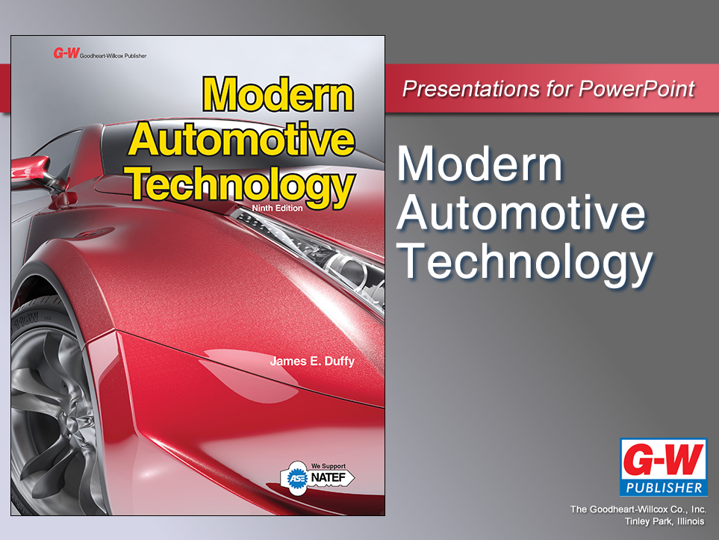

Slide 2
27
Chapter
Hybrid Drive Systems Diagnosis and Repair

Slide 3
Objectives
After studying this chapter, you will be able to:
Use on-board diagnostics to find the source of problems in a hybrid drive system.
Recall the safety measures that must be followed when working on high-voltage, high-current hybrid drive systems.
Perform basic tests to verify hybrid drive trouble codes.

Slide 4
Objectives
Carry out proper procedures for safely removing and replacing a battery pack, an HV power control module, HV power cables, control modules, and motor-generator assembly.
Correctly answer ASE certification test questions about hybrid drive systems diagnosis and repair.

Slide 5
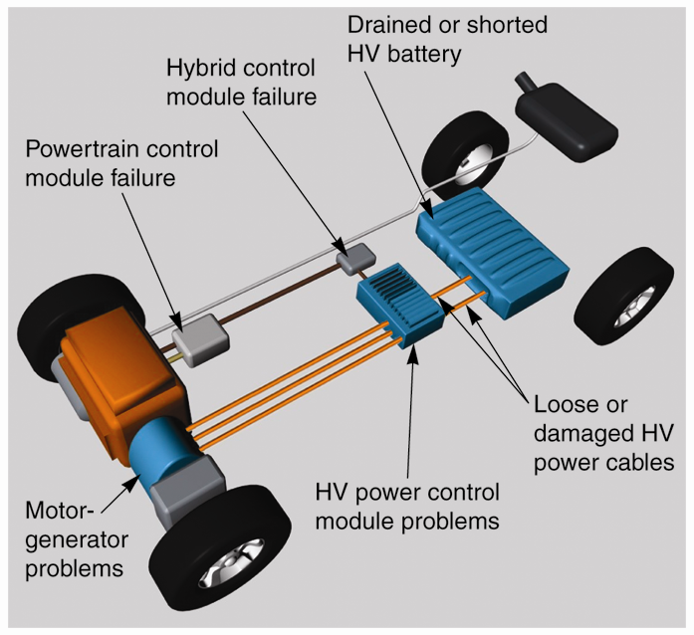
Hybrid Problem Diagnosis
Extensive on-board diagnostic systems
Locate source of system problems
Monitor hundreds of operating conditions
Turn on warning lights

Slide 6
Hybrid Problem Diagnosis (Cont.)
Hybrid ground fault interrupter
Constantly monitors system for high-voltage leakage into chassis
Glowing malfunction indicator light means use a scan tool to retrieve stored trouble codes

Slide 7
Hybrid Service Safety
Remove your jewelry
Wear eye protection
Wear insulating gloves
Wear rubber-soled shoes
Keep a fire extinguisher nearby
Follow towing safety procedures
Disable the hybrid drive when working
Set up a high-voltage buffer zone
Remove the high-voltage disconnect

Slide 8
HV Battery Service
Hybrid battery packs have a warranty from manufacturer
Some offer full HV battery replacement for up to 8 years or 100,000 miles
HV batteries very dependable and seldom fail
Can lose efficiency after extended service

Slide 9
Diagnosing HV Battery Problems
Hybrid control module will check
Circuit conditions when HV battery is discharging
While powering electric drive motor(s)
While being recharged by motor-generator
Trouble codes stored in control module if any electrical value is not within specifications

Slide 10
Diagnosing HV Battery Problems (Cont.)
Hybrid dash displays that show
HV battery charge
Temperature and condition
Display will warn driver if diagnostic system detects problems with
HV battery
HV power cables
HV power control module
Other components

Slide 11
Diagnosing HV Battery Problems (Cont.)
Scan tool will also quickly identify problems with
HV battery
Motor-generator
High-voltage electrical connections
Hybrid control module
HV power control module
Scan tool can also be used to compare actual operating voltages to those on dash display

Slide 12
Diagnosing HV Battery Problems (Cont.)
If HV battery fails to accept and hold charge, trouble code will be set
Hybrid control module will trigger malfunction indicator light in dash display
Replace failed HV batteries with new or reconditioned units

Slide 13
Checking HV Battery Relays and Contactors
Very large relays with contact points
Turn such high electrical load on and off, lugs become burned and pitted
If burned enough, lugs develop high resistance
Not able to carry enough current to HV PCM and motor-generator

Slide 14
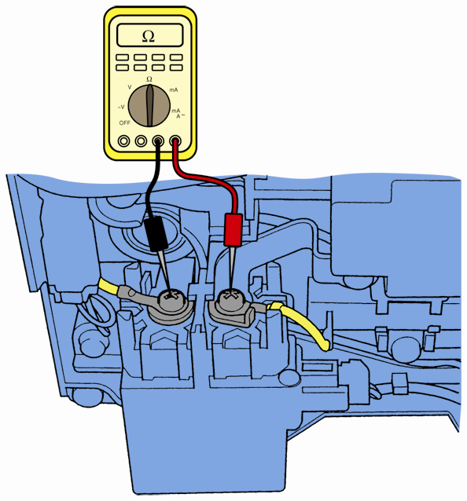
Checking HV Battery Relays and Contactors (Cont.)
Pinpoint test on high-voltage contactor
Remove or disconnect HV battery
Measure resistance across closed contactors with key on
Then with key off
If measurements not within specifications, replace contactors

Slide 15
HV Power Cable Service
Note conductor resistance values on scan tool
If not within specifications
Tighten or repair cable ends
Replace HV power cables, if needed

Slide 16
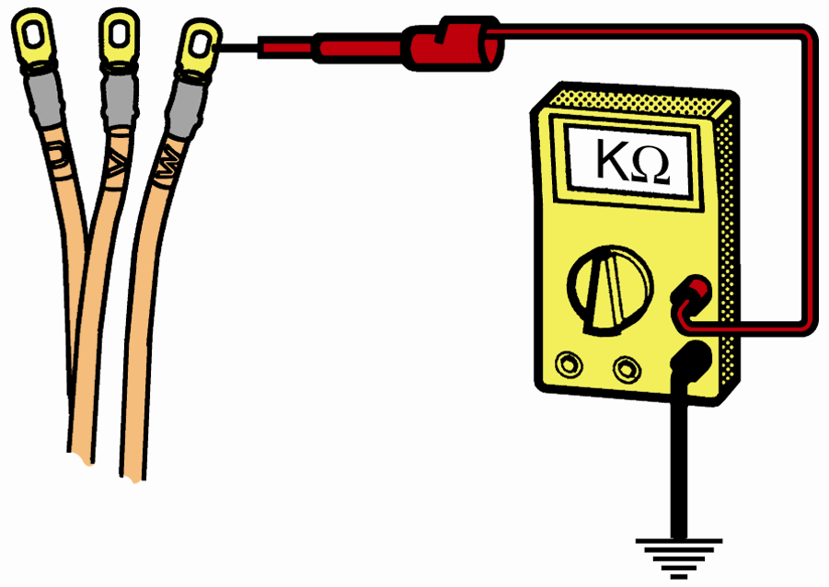
HV Power Cable Service (Cont.)
If scan tool shows ground fault problem
Place test lead on one end of cable terminal
Place other to frame or body ground
If reading lower than specifications, insulation may be leaking high voltage to ground
(Toyota)

Slide 17
HV Power Cable Service (Cont.)
To replace HV power cable
Disconnect both ends of cable
Remove clips securing power cable to vehicle
Install new power cable in reverse order

Slide 18
HV Power Control Module Service
Faulty HV PCM trip various trouble codes, indicating which circuit might be faulty
Some hybrid vehicles use separate converter, rectifier, and three-phase circuits
If scan tool indicates specific circuit board problem, consider replacing just failed circuit board

Slide 19
HV Power Control Module Service (Cont.)
Bad high-power contactor lugs in HV PCM
Burn and develop high resistance after prolonged service
Bad contactor lugs
Prevent normal current flow through HV PCM and to motor-generator
Some hybrid vehicles use discrete inverters
Remove and replace defective inverter
Sometimes circuit board in HV PCM can fail and require replacement

Slide 20
HV Power Control Module Replacement
Use high-voltage safety gear and tools
Disable HV battery
Disconnect low-voltage connections and wiring harness from HV PCM
Drain HV cooling system
Remove coolant lines from side of HV PCM

Slide 21
HV Power Control Module Replacement (Cont.)
Disconnect five or more high-power cables from the HV PCM
Wrap electrical tape around each exposed HV battery cable end
Remove hold-down machine screws connecting HV PCM to body
Reinstall in reverse order
Erase stored trouble codes
Rescan hybrid drive system

Slide 22
Hybrid Cooling System Service
If cooling system fails, components overheat
If air cooled, listen for normal operation of cooling fan
If water cooled, place stethoscope on electric pump to determine if running when under high electrical load

Slide 23
Hybrid Cooling System Service (Cont.)
If you find inoperative cooling fan blower motor, replace it like a climate control blower
With liquid system, disconnect hoses and wires going to pump motor before replacement

Slide 24
Motor-Generator Service
Normally, motor-generator is trouble free
If car is hit by lightning or used for extended period
Motor-generator can fail
Stator coil windings in unit can short or burn open

Slide 25
Motor-Generator Service (Cont.)
Motor-generator trouble code can indicate various problems
Short coils
Poor power cable connections
Permanent magnet armature damage
Motor speed sensor failure
Other things

Slide 26
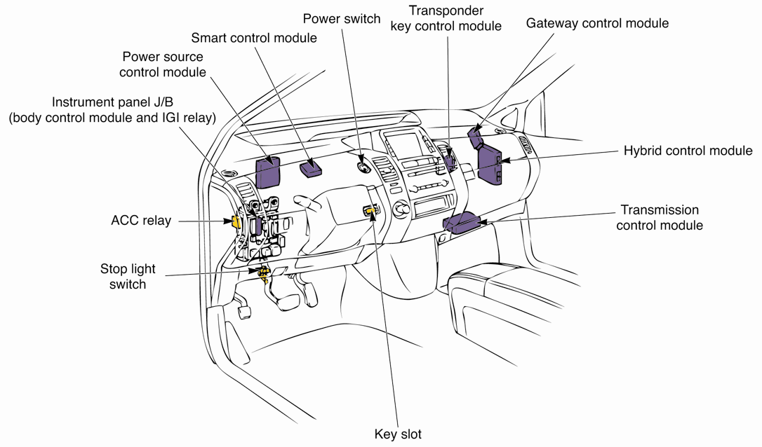
ECM’s That Can Affect Motor-Generator Operation
(Toyota)

Slide 27
Testing a Motor-Generator
To perform motor-generator resistance test
Wear insulated gloves and safety glasses, and use insulated tools
Disable or disconnect HV battery
Disconnect three power cables connected to motor-generator
Inspect both sets of orange cable conductor terminals for damage from overheating and burning

Slide 28
Testing a Motor-Generator (Cont.)
Connect ohmmeter to each conductor going to motor-generator stator windings and to ground
Record and compare ohmmeter reading for each of three legs
Normally, each leg of stator windings should have same reading

Slide 29
Testing a Motor-Generator (Cont.)
Using stethoscope
Raise vehicle
Drive in all-electric mode until system attempts to start engine
Listen during electric propulsion and engine starting
Place stethoscope against traction motor’s side
Listen for mechanical noises that indicate failure

Slide 30
Removing and Installing a Motor-Generator
Disable electric drive system and HV battery
Remove CV axles or drive shaft, wires, fluid lines, linkages, and body to-transmission mounting fasteners
Remove transaxle or transmission
Disconnect any cooling lines, wires, and flex or end plates from motor generator housing

Slide 31
Removing and Installing a Motor-Generator (Cont.)
Install plastic ring tool between armature and stator
Remove armature bolts and pull armature off crankshaft flange with wheel puller
Unbolt and remove stator housing from engine block

Slide 32
Removing and Installing a Motor-Generator (Cont.)
Check resistance and condition of armature sensor
Install new motor-generator in reverse order
Bolt and torque armature to crankshaft
Install plastic spacer ring tool over armature
Torque stator housing bolts to specs

Slide 33
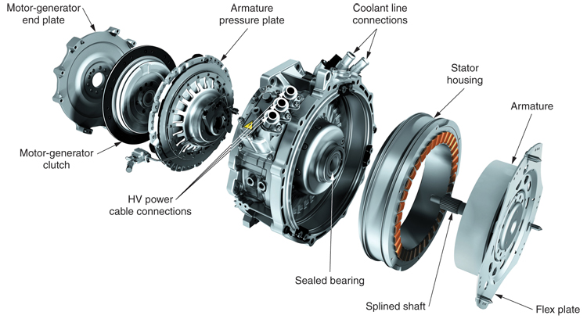
Typical Engine-Mounted Motor-Generator
(Porsche)

Slide 34
Hybrid Wiring Problems
Certain electrical/electronic circuit issues are difficult to diagnose and repair
Poor electrical connections
Broken wire conductors
Shorted wires

Slide 35
Hybrid Wiring Problems (Cont.)
If scan tool shows issue with component that tests good, check for wiring problems in corresponding circuit
Use factory diagrams to locate items possibly affecting operation of that circuit

Slide 36
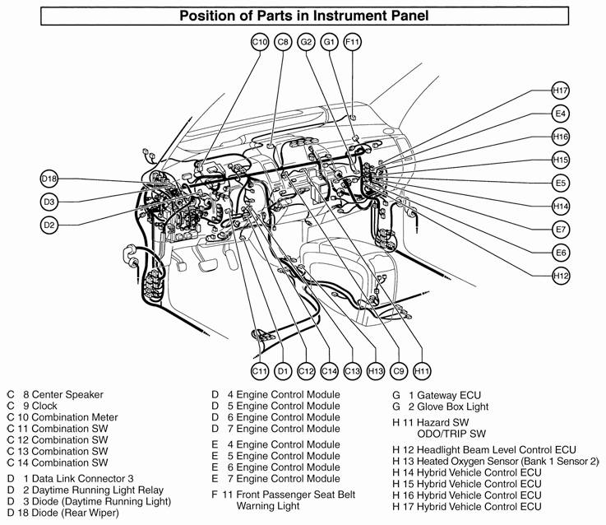
Factory Diagram

