Slide 1


Slide 2
29
Chapter
12-Volt and HV Battery Service

Slide 3
Objectives
After studying this chapter, you will be able to:
Visually inspect a 12-volt battery for obvious problems.
Perform common tests on 12-volt and HV batteries.
Charge 12-volt and HV batteries.
Replace a defective battery or battery pack.

Slide 4
Objectives
Describe safety practices to follow when testing and servicing 12-volt and HV batteries.
Identify the major steps for safely removing and replacing an HV battery.
Explain how to inspect, clean, and torque HV power cable connections.
Correctly answer ASE certification test questions on battery service.

Slide 5
12-Volt and HV Battery Service Introduction
Dead battery (discharged battery) very common problem for 12-volt starting system
Hybrid vehicles seldom suffer from fully-discharged HV battery
Inspect, test, and service both 12-volt and HV batteries

Slide 6
12-Volt Battery Maintenance
Average service life of 12-volt battery
3–5 years
Much lower if not serviced properly
Maintenance done periodically
During tune-ups
Grease jobs
Any time symptoms indicate battery problems

Slide 7
12-Volt Battery Maintenance (Cont.)
Inspecting battery for corrosion and damage
Removing and cleaning terminal connections
Washing off top of battery case with soap or baking soda and water
Repairing battery tray, if rusted or broken
Inspecting electrolyte level

Slide 8
12-Volt Battery Service
If regular maintenance tasks reveal problems or do not correct existing problems
Further testing required to identify and solve

Slide 9
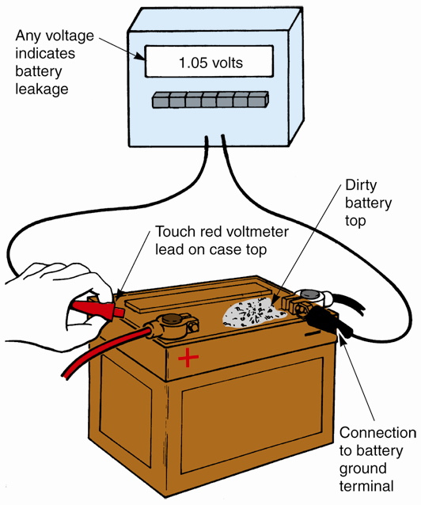
12-Volt Battery Leakage Test
Determines if electrical energy is draining and discharging across top of battery case
If top of battery is dirty, wash it with baking soda and water

Slide 10
12-Volt Battery Terminal Test
Connect negative voltmeter lead to cable end
Touch positive voltmeter lead on battery terminal
Remove fuses to disable ignition and fuel injection systems
Crank engine while watching voltmeter reading

Slide 11
Cleaning 12-Volt Battery Terminals
Remove battery cable ends
Use battery cleaning tool to remove surface corrosion from post and cable
When reinstalling cables
Coat terminals with conductive, dielectric compound or white grease
Tighten fasteners just enough to secure connection

Slide 12
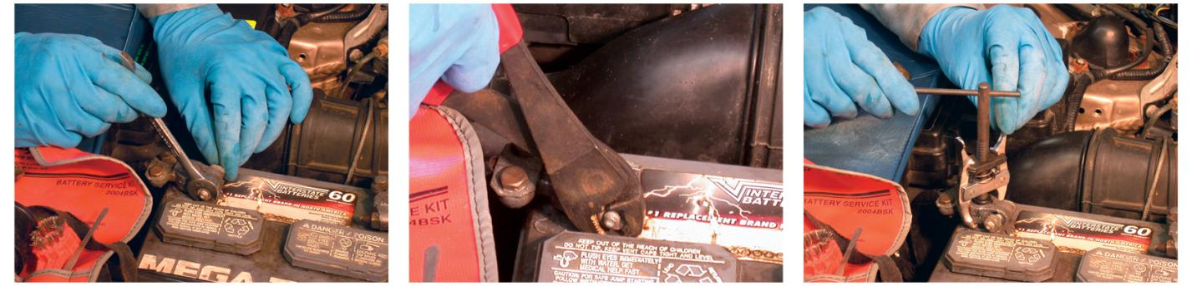
Cleaning 12-Volt Battery Terminals (Cont.)

Slide 13
Checking 12-Volt Battery Electrolyte Level
Maintenance-free batteries
Do not need periodic electrolyte service
Batteries with removable vent caps
Electrolyte level should be checked yearly
Electrolyte should just cover top of plates and separators
Most batteries have fill ring
If electrolyte is low, fill cells to correct level with distilled water

Slide 14
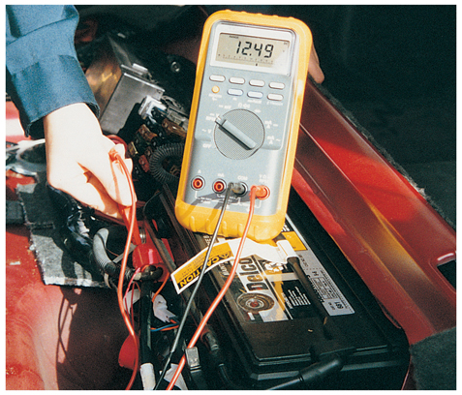
12-Volt Battery Voltage Test
Connect voltmeter across battery terminals or posts
Turn on headlights or blower motor to provide small current load
Voltmeter should read 12.5 volts
(Fluke)

Slide 15
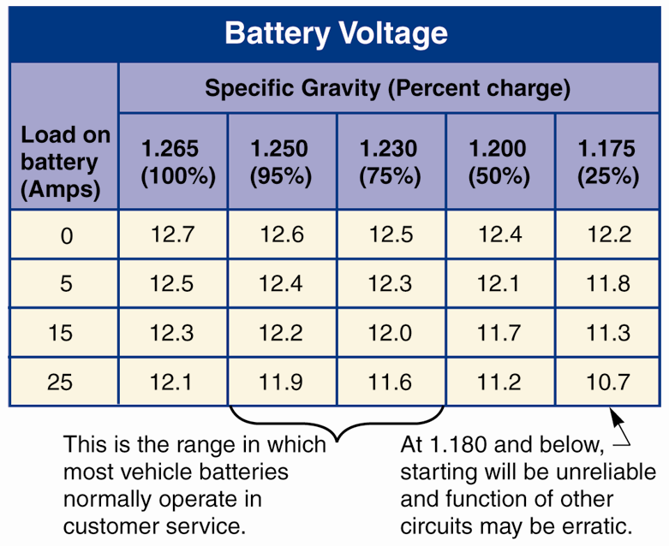
Hydrometer Check
Battery hydrometer measures specific gravity of battery electrolyte
Indicates battery’s state of charge
As battery discharges, electrolyte has larger percentage of water
(Chrysler)

Slide 16
Hydrometer Check (Cont.)
Fully charged batteries should have hydrometer readings of at least 1.265
If reading is lower, battery needs recharging or may be defective
Defective battery can be found with hydrometer by checking every cell
Cells with low readings may have shorted or deteriorated plates

Slide 17
Cell Voltage Test
Set voltmeter to read low voltage
Ground black tester lead on battery negative terminal
Insert other special cadmium (acid-resistant metal) tip into cell
Carefully test each cell starting at one end of battery and working down to other end

Slide 18
Discharged 12-Volt Battery Causes
Defective battery
Cell shorts, low electrolyte, or freezing damage
Charging system problem
Poor cable connections
Engine performance problem requiring excessive cranking time
Electrical problem drawing current out of battery with ignition key off

Slide 19
Parasitic Loads
Current draw present when engine and all electrical devices are shut off
Includes circuits that require small current when vehicle is not running
Clock vehicle alarm ECMs, etc
Over time, drains 12-volt batteries enough to prevent starting

Slide 20
Battery Drain Test
Will check for abnormal current draw (high parasitic load) with ignition key off
Make ammeter connections
Close doors and trunk, and turn off all electric components
Unscrew underhood lightbulb, if needed
Read ammeter and compare your reading to specifications

Slide 21
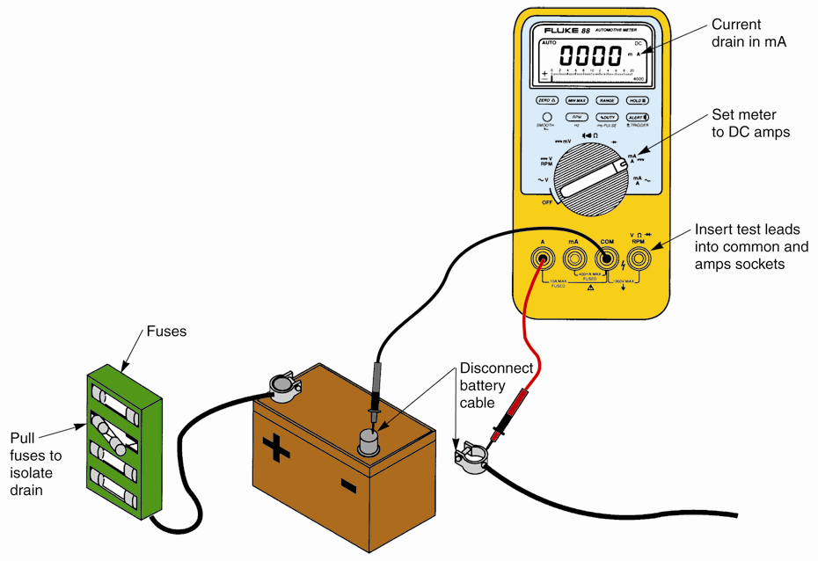
Battery Drain Test (Cont.)
(Fluke)

Slide 22
12-Volt Battery Chargers
When tests show that battery is discharged, use battery charger to re-energize it
Slow charger or trickle charger
Feeds small amount of current into battery
Fast charger
Quick charger or boost charger
Forces high current flow into battery

Slide 23
Charging a 12-Volt Battery
To use battery charger
Connect red charger lead to positive battery terminal
Connect black charger lead to negative terminal of battery
With side terminal batteries, use adapters
Set battery charger controls and turn on power

Slide 24
12-Volt Jump Starting
Jump start engine by connecting another battery to discharged battery
Connect red jumper cable to positive terminal of both batteries
Connect one end of black jumper cable to negative terminal of good battery
Connect other end of black jumper cable to good ground

Slide 25
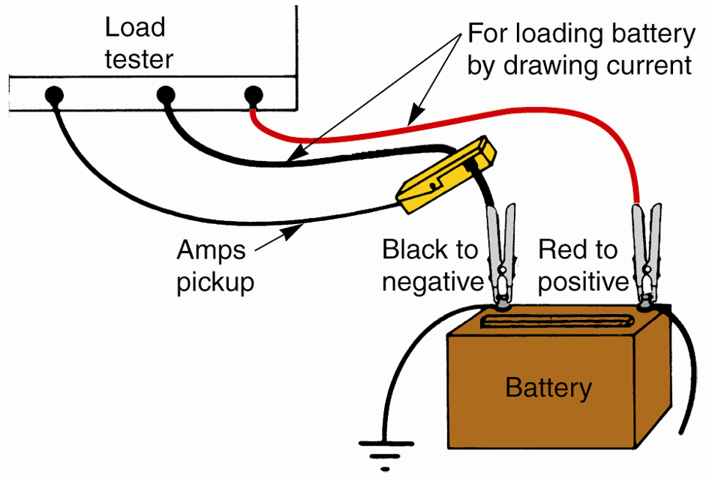
12-Volt Battery Load Test
Battery load test or battery capacity test
Tests battery under full-current load
Connect
Positive-to-positive
Negative to-negative
Clamp inductive amp pickup over negative battery cable so it can measure magnetic field and current
(Marquette)

Slide 26
Determine 12-Volt Battery Load
Before load testing 12-volt battery, calculate load test value (amp load) needed
If amp-hour rating is given, load battery to three times its amp-hour rating
Many 12-volt batteries rated in SAE cold cranking amps (CCA), rather than amp-hours
To determine these load test values, divide cold cranking amps rating by two

Slide 27
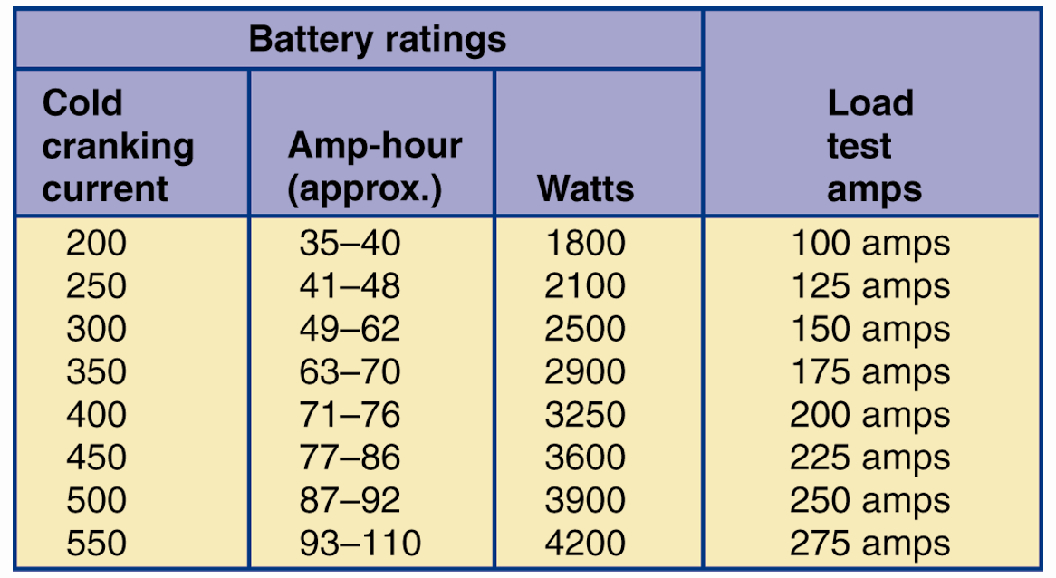
Determine 12-Volt Battery Load (Cont.)
Load conversion chart normally provided with load testing equipment
Shows load test values for various battery ratings
Refer to this material when in doubt
(Marquette)

Slide 28
Loading the 12-Volt Battery
Double-check that load tester cables and leads connected properly
Turn load control knob until ammeter reads correct amp load for your battery
Hold load for 15 seconds to draw high current out of battery

Slide 29
Loading the 12-Volt Battery (Cont.)
Read voltmeter while load is applied
If voltmeter reads 9.5 volts or more at room temperature, battery is good
Turn load control completely off so battery will not be discharged or drained fully

Slide 30
Activating Dry-Charged 12-Volt Batteries
Wet-charged battery
Filled with electrolyte and charged at factory
Dry-charged battery
Contains fully-charged elements, does not contain electrolyte
Leaves factory in dry state

Slide 31
Activating Dry-Charged 12-Volt Batteries (Cont.)
Put on safety glasses and rubber gloves
Remove cell caps or covers
Using plastic funnel, pour electrolyte into each cell
Pour in enough electrolyte to just cover plates and separators
Replace caps
Charge battery as recommended by manufacturer
After charging, recheck electrolyte level

Slide 32
Removing and Installing a 12-Volt Battery
To remove battery
Disconnect its cable end clamps
Loosen and remove battery hold-down
Use battery strap or battery carrier to carefully lift battery from vehicle

Slide 33
Removing and Installing a 12-Volt Battery (Cont.)
To install battery
Gently place battery into clean tray or box
Check that battery fits properly
Old and new batteries should be same size
Height, width, and depth
Tray edge must not cut through plastic battery case
Tighten hold-down and install cables

Slide 34
HV Battery Service
Service life averages about 150,000 miles (240,000 km)
Some HV batteries have failed in as few as 60,000 miles (100,000 km)
Many last almost 10 years and/or 200,000 miles (320,000 km)

Slide 35
HV Battery Service (Cont.)
Serviced differently from conventional 12-volt batteries
HV batteries are very dependable and seldom fail
Lose electrical storage and output after extended service
Electrolyte and plates deteriorate and become depleted

Slide 36
HV Battery Service (Cont.)
If hybrid drive system functioning normally, motor-generator and HV power control module should keep HV battery at normal, or nominal, state-of-charge
Hybrid dash display
Inform if HV battery has low state of charge or other problem

Slide 37
Hybrid Jump Starting
Avoid jump-starting hybrid vehicle
Unless it has 12-volt battery and 12-volt starting motor
Some late-model full-electric drive trains cannot be jump-started
Full hybrids or full-electric vehicles
Towed if dead or discharged HV battery

Slide 38
Checking HV Battery Condition
Use vehicle’s dash display to observe HV battery readings
To check general HV battery performance
Connect scan tool to diagnostic connector
Test-drive hybrid

Slide 39
Checking HV Battery Condition (Cont.)
HV battery control module monitors
Battery pack temperatures
Current input and output levels
Recharge and discharge voltages
Battery state-of-charge
HV battery state-of-charge should be at least 80% of maximum voltage rating after full recharge

Slide 40
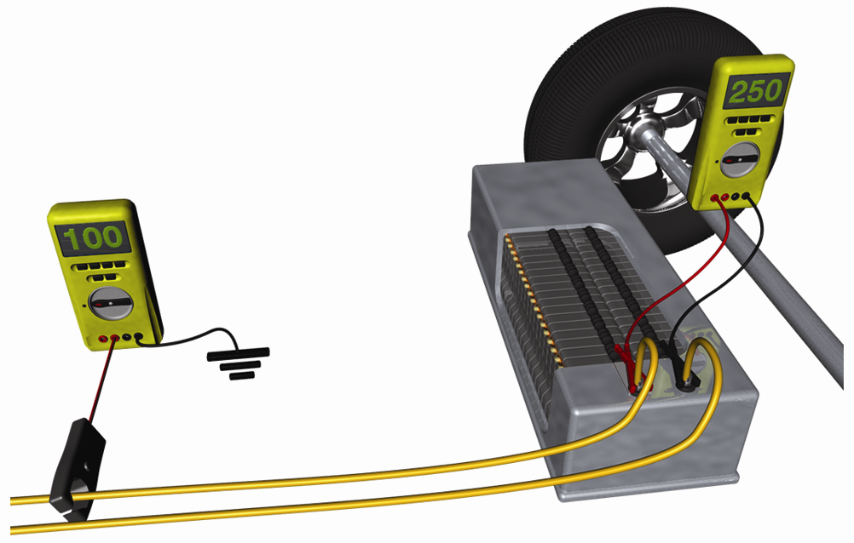
Testing HV Battery Voltage
Fully recharge battery
Connect high-voltage voltmeter across two HV battery cables
Compare meter reading to known acceptable voltages

Slide 41
Charging an HV Battery
Set up buffer zone around vehicle
Plug in hybrid battery charger
Charger will require either 120 volts ac or
240 volts ac
Connect hybrid charger leads to hybrid vehicle
Set battery charging rate and turn charger on

Slide 42
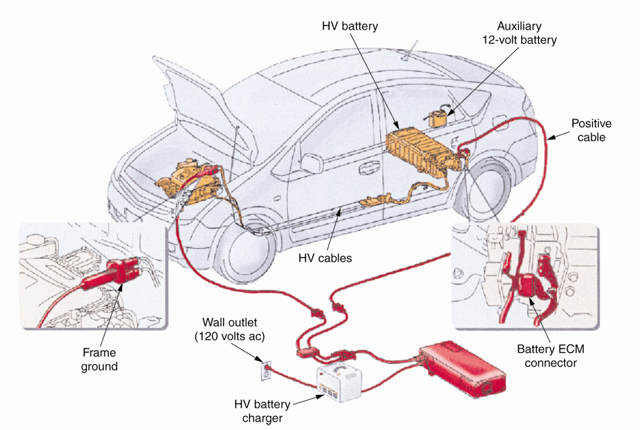
Charging an HV Battery (Cont.)
(Toyota)

Slide 43
HV Battery Load Test Drive
Fully recharge HV battery with external battery charger, or plug battery into HV charging station
Connect laptop or scan tool to vehicle’s diagnostic connector
Adjust diagnostic tool to take live readings
Test drive vehicle while recording live data on laptop or advanced scan tool

Slide 44
In-Shop HV Battery Load Test
Make sure HV battery is fully recharged
Connect inductive ammeter around positive battery cable
Attach voltmeter leads to HV battery
Press electric drive train Start button and put transmission in Drive
Press accelerator pedal gently to slowly spin drive wheels

Slide 45
In-Shop HV Battery Load Test (Cont.)
If possible, keep vehicle in full-electric mode
To increase current draw on motor-generator
To pull more current from HV battery
Compare battery performance to known good battery or to specifications

Slide 46
HV Battery Removal and Replacement
Most common reasons for HV battery replacement
Age
Physical damage
Before removing battery, depower electrical system
Wear insulated rubber gloves and appropriate eye protection

Slide 47
HV Battery Removal and Replacement (Cont.)
Remove large fasteners or connectors that secure HV power cables to battery
To prevent high-voltage short, wrap electrical tape around metal terminals on ends of power cables
Unbolt battery hold-down flange from vehicle frame

Slide 48
HV Battery Removal and Replacement (Cont.)
Mild hybrid battery assembly can weigh
100–300 lbs (45–136 kg)
HV battery for full-electric drive vehicle can weigh over 1000 lbs (454 kg)
If battery is very heavy, use engine crane and nylon straps to raise large assembly up and out vehicle

Slide 49
HV Battery Removal and Replacement (Cont.)
Dropped HV battery, especially lithium-ion battery, can rupture lithium cells and short them out
Damaged HV battery cells smoke and hiss, as if catching fire
Smoke is acidic and should not be inhaled or contacted with any skin

Slide 50
HV Battery Removal and Replacement (Cont.)
Place HV battery on wooden pallet for shipment to authorized recycler
Wrap electrical tape over battery cables or connectors
Cover battery with thick plastic box and place it in shipping container
Place warning labels on outside of battery module or shipping container to warn others of high voltage and chemical dangers inside

Slide 51
HV Battery Removal and Replacement (Cont.)
To replace HV battery
Use same procedures used during removal
Use torque wrench to tighten HV power cable fasteners
Make sure all electrical connectors are fully engaged and reconnected
Reinstall any air ducts that connect to HV battery housing

Slide 52
HV Battery Removal and Replacement (Cont.)
If water cooled, refill HV battery cooling system
Erase battery trouble codes
Recharge battery
Test-drive

Slide 53
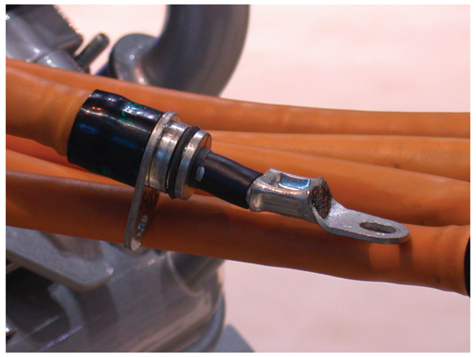
HV Cable Connections Service
Critical that all cables and connections are in good condition
Just a few extra ohms of resistance will greatly affect electric drive train performance

Slide 54
HV Cable Connections Service (Cont.)
Bad connections
Cause cable overheating
Reduce current flow
Lower motor-generator torque
Overall reduce electrical efficiency
Inspect all fasteners and terminals closely
Wiggle each connection by hand
While wearing insulating gloves

Slide 55
HV Cable Connections Service (Cont.)
All orange cable connections
Tight, cannot move by hand
Check HV power cable ends closely for signs of overheating and corroding
Poor current connection
Extremely hot, tends to loosen during heating/cooling cycles

Slide 56
HV Cable Connections Service (Cont.)
If cable end is loose, rusted, or damaged
Remove cable
Clean off cable end with wire brush or stiff scuff pad
Coat cable ends with dielectric grease
Use torque wrench to tighten each HV cable fastener to specifications

Slide 57
HV Power Cable Resistance
Should be less than 0.001 ohm (1 milliohm) per 10 feet of cable
If cable is only 5 feet long, maximum resistance specification should be half, or
0.0005 ohm (0.5 milliohm)
When measuring HV power cable resistance, add approximately 0.025 ohm per electrical connection

Slide 58
HV Power Cable Leakage
Bad orange insulation
Disconnect cable at both ends
Measure resistance to ground
With ohmmeter grounded, touch test lead on metal end of cable
If HV power cable insulation is good, meter should read infinite resistance

Slide 59
HV Battery Control Module Service
Bad HV battery control modules usually trip trouble code
Scan tool
Flag any problem with component and wiring
Sometimes HV battery control module is located inside HV battery

Slide 60
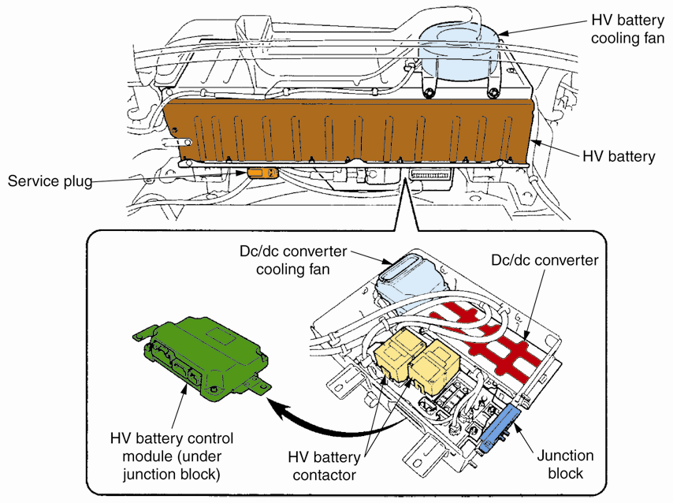
HV Battery Control Module
(Toyota)

