Slide 1


Slide 2
32
Chapter
Charging System Technology

Slide 3
Objectives
After studying this chapter, you will be able to:
Describe the construction of major 12-volt charging system components.
Explain charging system indicators and instrumentation.
Explain the construction and operation of hybrid charging systems.

Slide 4
Objectives
Compare the operation of a 12-volt charging system to that of a hybrid charging system.
Correctly answer ASE certification test questions that require a knowledge of charging system fundamentals.

Slide 5
12-Volt Charging System Functions
Recharges battery after engine cranking or after electrical accessory use with engine shut off
Supplies all12-volt electricity when engine is running
Provides 13-15 volt output, slightly higher than fully-charged battery at 12.6 volts

Slide 6
12-Volt Charging System Functions (Cont.)
Changes current and voltage output to meet different electrical loads
Provides smooth dc for proper function of all vehicle’s electronic circuits

Slide 7
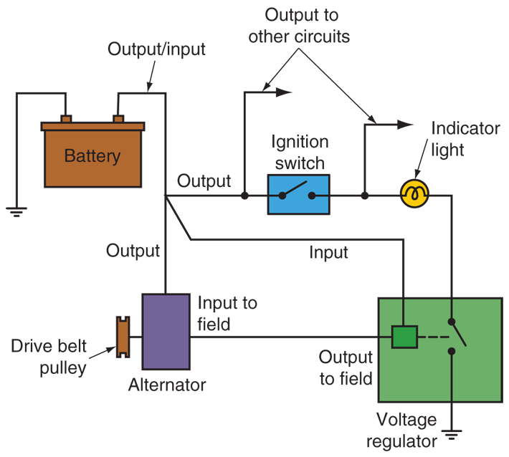
Basic Charging Circuit

Slide 8
12-Volt Charging System Parts
Alternator (ac generator)
Voltage regulator
Drive belt
Charge indicator
Charging system harness
Battery
ECM

Slide 9
12-Volt Charging System
During engine cranking, battery supplies all electricity for use
When engine starts running, charging system takes over
Voltage regulator keeps alternator output at preset charging voltage (13–15 volts)
Since this is higher than battery voltage (12.6 volts), current flows back into battery

Slide 10
Alternator
Simplified alternator has two main parts
Rotor
Located in alternator housing center
Creates rotating magnetic field
Stator
Stationary set of windings surrounds rotor
Output winding in alternator

Slide 11
Alternator (Cont.)
Produces alternating current (ac) output
Automobile electrical systems designed to use direct current (dc)
Cannot use ac as it comes out of alternator’s stator
Alternator current must be rectified before entering electrical system
Changed into direct current

Slide 12
Alternator Components
Rotor
Brush assembly
Rectifier
Stator
Alternator housing
Fan and pulley
Voltage regulator

Slide 13
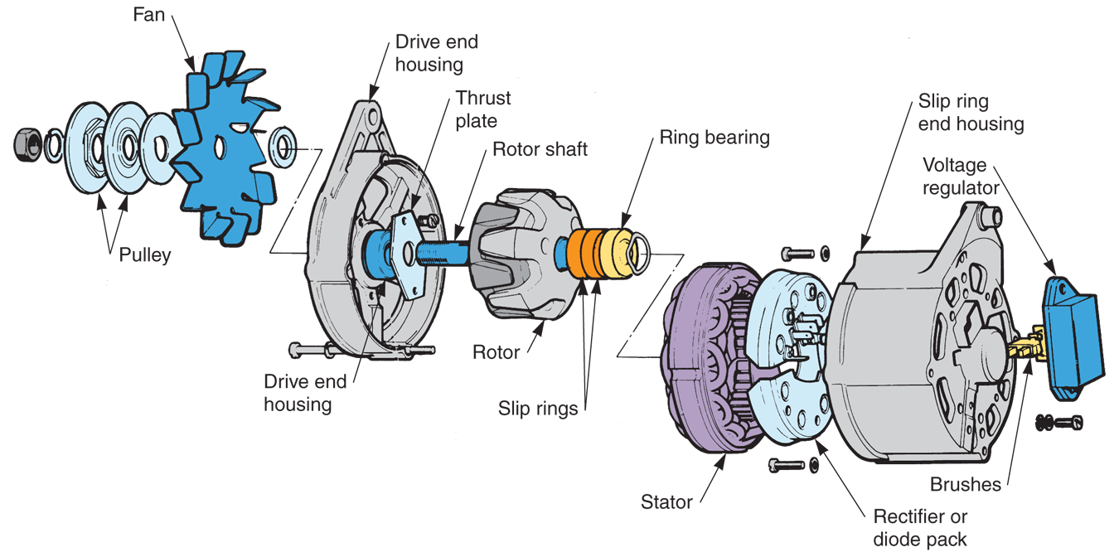
Alternator Components (Cont.)
(Ford)

Slide 14
Alternator Components (Cont.)
Alternator rotor assembly
Consists of field windings mounted on shaft
Alternator bearings
Used to produce low-friction surface for rotor shaft
Needle or ball types

Slide 15
Alternator Components (Cont.)
Alternator slip rings
Mounted on rotor shaft to provide dc current to field windings
Each end of field windings connects to a slip ring
Alternator brushes
Ride on slip rings to make sliding electrical connection
Brush springs
Hold brushes in contact with slip rings

Slide 16
Alternator Rectifier
Or diode assembly
Uses six diodes to convert stator current (ac) to direct current (dc)
Full-wave rectification
Changes both positive and negative polarities into direct current

Slide 17
Alternator Rectifier (Cont.)
Diode trio
Supply current to rotor field windings
Rectifier diodes mounted in diode frame or heat sink
Three positive diodes press-fit in insulated frame
Three negative diodes mounted in uninsulated or grounded frame

Slide 18
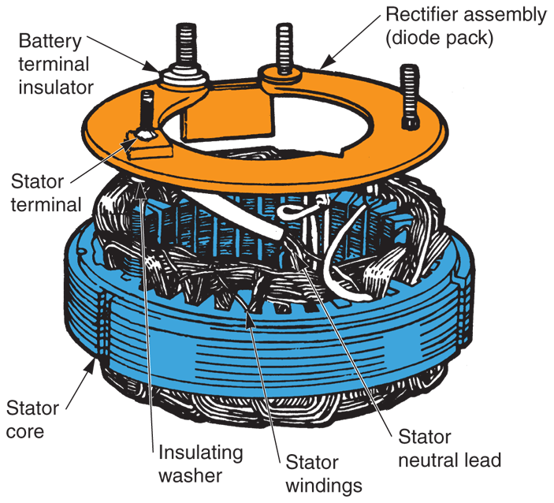
Rectifier Assembly
(Ford)

Slide 19
Alternator Components (Cont.)
Alternator stator
Three sets of windings, each wrapped around laminated iron core
Alternator fan
Mounted on front of rotor shaft
Alternator pulley
Uses a belt to spin rotor

Slide 20
Voltage Regulator
Control alternator output by changing current flowing through rotor’s field windings
Integral voltage regulator
Mounted inside or on alternator rear
Most common type used on today’s vehicles

Slide 21
Voltage Regulator Operation
To increase alternator output
Allows more current into rotor’s field windings
To reduce alternator output
Places more resistance between battery and field windings
Alternator speed and electrical load determine whether regulator increases or decreases charging output

Slide 22
ECM Charging System Monitoring and Control
Control module can monitor charging system output and react to changing operating conditions
Computer controls duty cycle of alternator’s field
Duty cycle is percentage of time current feeds to alternator’s field windings
50% duty cycle is normal

Slide 23
Battery Thermistor/Fail-Safe Circuit
Battery thermistor
Measures battery temperature so charging system can alter charging output as needed
Fail-safe circuits
Disconnect alternator output if voltage levels become too high

Slide 24
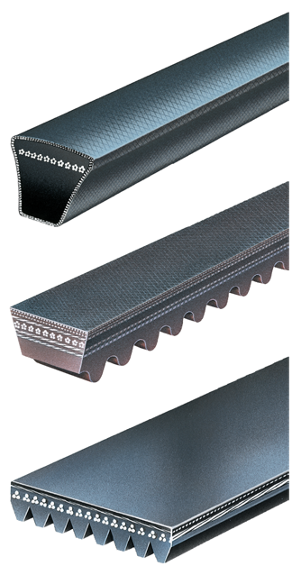
Alternator Drive Belts
Powered by crankshaft pulley
Turns alternator pulley and rotor
Three belt types
V-belt
Cogged V-belt
Ribbed belt
(Gates)

Slide 25
Charge Indicators
Informs driver of operating condition or output of charging system
Three basic types
Warning light
Voltmeter indicator
Ammeter indicator

Slide 26
Alternator Warning Light
Wired into charging system
Will glow when alternator output drops to specified level
In good charging systems, current flow through field will be too low to light bulb

Slide 27
Voltmeter Indicator
Warns driver of charging system problems
Simply shows voltage
Indicator of current output and charging system condition
If reading is too high, overcharging can occur
When excess current is forced through battery

Slide 28
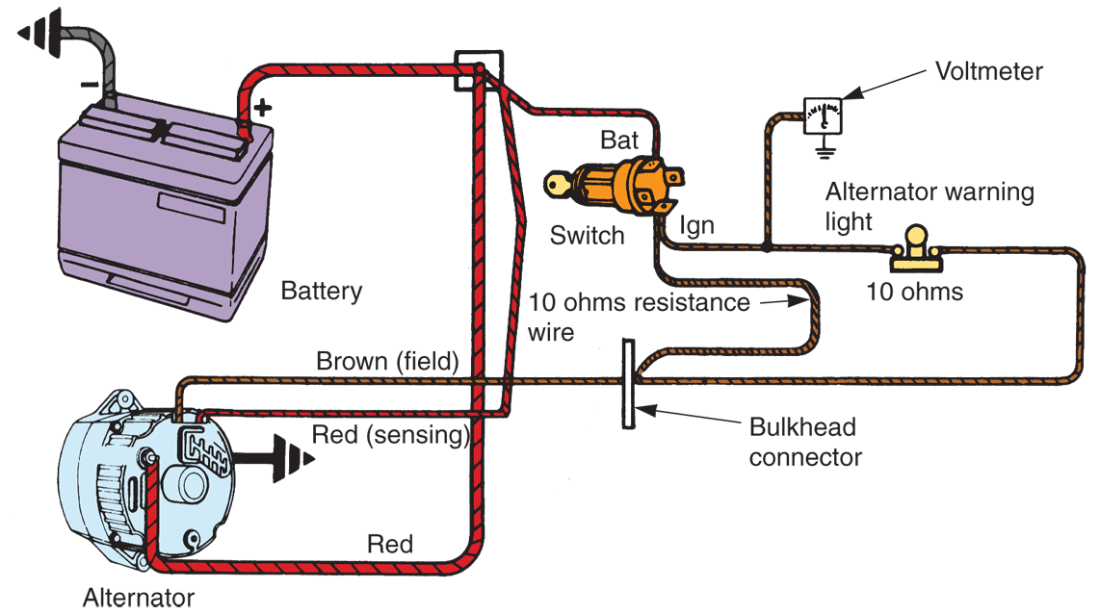
The Charging Circuit

Slide 29
Hybrid Charging Systems
Many hybrid vehicles do not have conventional alternators
Motor-generator recharges high-voltage battery or conventional 12-volt battery

Slide 30
Hybrid Charging System Parts
Major parts of hybrid charging system
Motor-generator
Hybrid instrumentation
HV power control module
HV battery
Hybrid control module

Slide 31
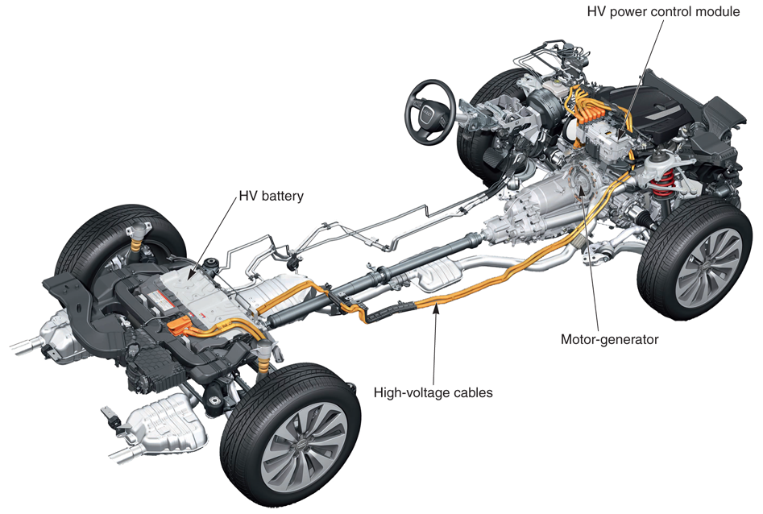
Hybrid Charging System Components
(Audi)

