Slide 1


Slide 2
33
Chapter
Charging System Diagnosis, Testing, and Repair

Slide 3
Objectives
After studying this chapter, you will be able to:
Inspect a 12-volt and high-voltage (HV) charging system to locate obvious troubles.
Diagnose 12-volt and HV charging system troubles.
Test 12-volt charging system with a voltmeter, load tester, and scope.

Slide 4
Objectives
Remove and reinstall an alternator.
Diagnose high voltage hybrid charging system problems
Correctly answer ASE certification test questions on charging system service.

Slide 5
12-Volt Charging System Diagnosis
12-volt charging system has only two major parts
Alternator
Regulator
Troubleshooting can be difficult
Sometimes another system’s fault will appear to be caused by charging system problems
Bad starting motor, defective battery, computer failure, or faulty wiring

Slide 6
12-Volt Charging System Diagnosis (Cont.)
There are four common symptoms
Dead battery
Overcharged battery
Abnormal noises
Indicator shows problem

Slide 7
Preliminary Inspection
Visually inspect charging system parts
Check for battery-related problems
Loose battery cables
Discharged battery
Corroded terminals
Low water level
Damaged battery case
Make sure belt tension is adjusted to specifications

Slide 8
Preliminary Inspection (Cont.)
Check condition of alternator drive belt
Look for
Cracks
Glazing
Grease
Oil contamination
Deterioration

Slide 9
Preliminary Inspection (Cont.)
Check for
Loose or corroded electrical connections
Shorted wires
Missing insulation
Wiring problems
Check electrical connections on back of alternator
Wiggle wiring harness from alternator to firewall or ECM while engine is running

Slide 10
Preliminary Inspection (Cont.)
With engine running, listen closely for abnormal noises
Use stethoscope to listen for
Dry, noisy alternator bearings
Grinding
Worn, dry bearings
Whining
Leaking diodes or overcharging
Any other unusual sounds

Slide 11
Scanning 12-Volt Charging Systems
Connect scan tool to aid in troubleshooting
Scan tool will display
Charging voltage
Battery temperature
Other data useful in finding problems
Capabilities vary with each model

Slide 12
12-Volt Charging System Precautions
Disconnect battery before removing any charging system component
Disconnect battery before connecting it to charger
Never reverse polarity
Connecting battery or jumper cables backward can lead to serious electrical damage

Slide 13
12-Volt Charging System Precautions (Cont.)
Do not operate alternator with output wire disconnected
Never short or ground any charging system terminal
Unless instructed to do so by shop manual

Slide 14
12-Volt Charging System Tests
Scan tool test
Load test
Scope tests
Voltmeter test
Circuit resistance tests

Slide 15
Scan Tool Test
To access alternator charging voltage with scan tool or diagnostic tablet
Start and idle engine
Turn on all electrical accessories to load alternator
Use scan tool to access data stream values
Scroll alternator to alternator or charging system live voltage readings
Output of at least 13 volts indicates normal operation
Below 12.6 volts indicates alternator is bad

Slide 16
Load Test
Connect tester leads, as described by manufacturer
Clip inductive amps pickup around insulation on negative battery cable
Set load tester controls to proper positions and values
Attach vent hose to exhaust and start engine

Slide 17
Load Test (Cont.)
Rotate load control on tester until ammeter displays alternator’s rated amperage
Do not exceed alternator’s output rating in amps
Do not let voltage drop below full battery voltage of 12.6 volts
Note alternator output current at 12.6 volts
Turn off load control and evaluate readings

Slide 18
Scope Tests
Connect red scope test lead to alternator battery (output) terminal
Ground other scope lead
Start engine and observe scope trace (waveform)
Charging system should produce relatively smooth dc voltage trace with minimum ripple

Slide 19
Voltmeter Test
Charge battery, if drained before testing
Set voltmeter to read low voltage
Connect voltmeter test leads across battery terminals
Measure and record battery base voltage
Battery voltage with everything off

Slide 20
Voltmeter Test (Cont.)
Start engine and record no-load voltage
Engine running and electrical accessories off
Voltmeter reading should increase from base reading, but not by more than 2–3 volts
Turn on all electrical accessories to load charging system
Record load voltage

Slide 21
Voltmeter Test (Cont.)
Shows if charging system is providing current for all electrical units and still has enough current to recharge battery
Calculate charge voltage using formula
Load voltage – base voltage = charge voltage

Slide 22
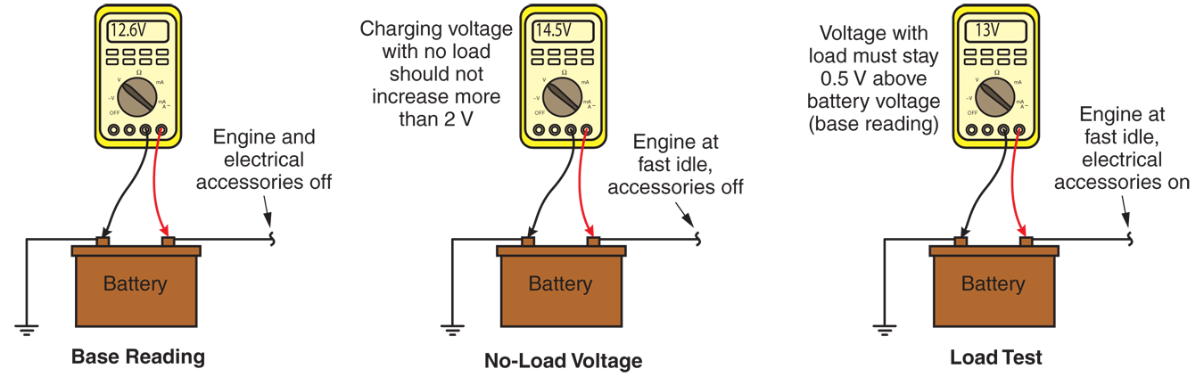
VOM Test
(Fluke)

Slide 23
Circuit Resistance Tests
Locate wiring problems in charging system
Loose connections
Corroded terminals
Partially burned wires
Perform resistance tests when symptoms point to problems other than alternator or regulator

Slide 24
Insulated-Circuit Resistance Test
Connect tester across alternator output terminal and positive battery terminal
With vehicle running at fast idle, set load control to obtain 20 amp current flow
All lights and accessories should be off

Slide 25
Insulated-Circuit Resistance Test (Cont.)
If circuit is in good condition, voltmeter should not read over about 0.7 volts
0.1 volt per electrical connection
If voltage reading is higher than 0.7 volts, circuit resistance is high and poor connection exists in that charging circuit section

Slide 26
Ground-Circuit Resistance Test
Similar to insulated-circuit resistance test
Voltmeter is placed across negative battery terminal and alternator housing
Voltmeter should not read over 0.1 volt per electrical connection
If voltmeter reads higher, look for
Corroded or loose connections
Burned plug socket
Damaged wiring harness

Slide 27
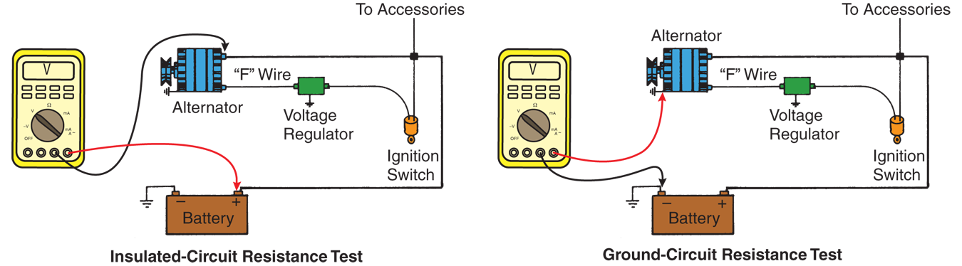
Voltage Drop and Resistance Tests

Slide 28
Alternator Service
Bad alternators show up in tests as low output or unclean dc problem
Most shops replace alternators that exhibit these symptoms

Slide 29
Alternator Removal
Disconnect battery to prevent major electrical short and wiring harness fire
Remove alternator belt off its drive pulley
Disconnect wiring harness from rear of alternator
Remove bolts that secure alternator
Remove alternator wires

Slide 30
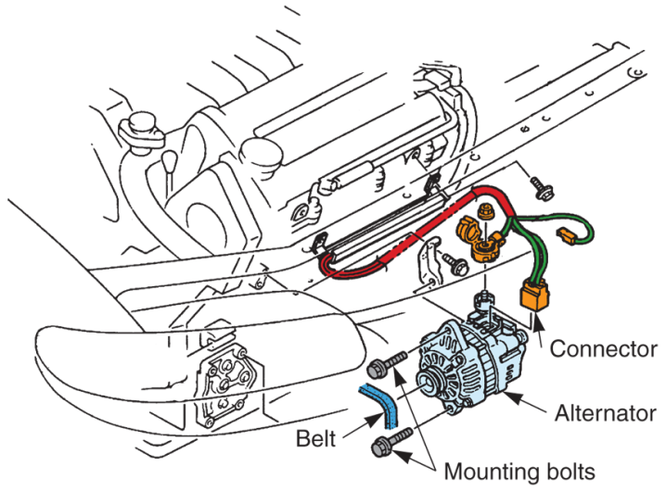
Alternator Removal (Cont.)
(Mazda)

Slide 31
Alternator Rebuild
Alternator rebuild typically involves
Disassembling alternator
Inspecting and testing rotor
Inspecting and testing stator
Testing diodes
Replacing rotor, stator, or diodes if they are defective
Replacing bearings
Replacing brushes
Reassembling and testing alternator

Slide 32
Alternator Installation
With battery still disconnected, fit alternator onto front of engine
Install mounting bolts
Torque to specifications
Reconnect wiring harness
Check alternator belt condition
Replace if needed
Slip belt over engine and alternator pulley, making sure it aligns properly on each pulley

Slide 33
Hybrid Charging System Service
HV power control module (HV PCM) generates different voltage levels for various vehicle electrical systems
13–15 volts dc for conventional circuits
45–110 volts dc for heated windshield circuits
High voltage for recharging HV battery
Check dash instrumentation to verify proper operation

Slide 34
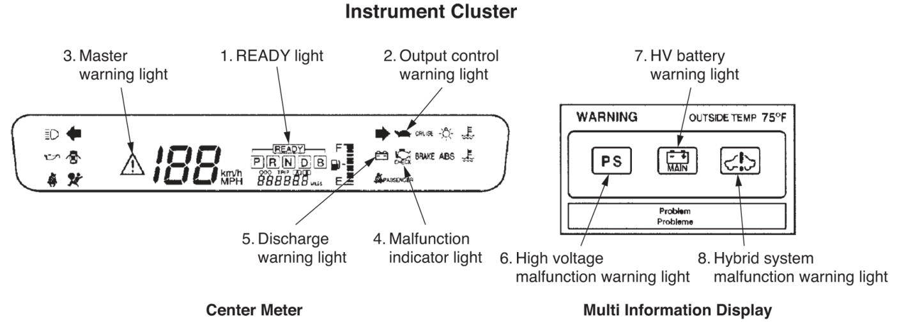
Hybrid Charging System Service
(Toyota)

Slide 35
Scanning Hybrid Charging Systems
Most common problems with HV charging system
Bad HV PCM
Bad motor-generator
Failed hybrid control module
Loose or corroded HV power cables
Bad HV battery

