Slide 1


Slide 2
34
Chapter
Ignition System Technology

Slide 3
Objectives
After studying this chapter, you will be able to:
Explain the operating principles of any type of automotive ignition system.
Sketch the primary and secondary circuits of an ignition system.
Identify and describe the function of major ignition system components.
Compare ignition coil, spark plug, and ignition circuit variations.

Slide 4
Objectives
Distinguish between coil pack and direct ignition systems.
Explain the need for accurate ignition timing control.
Correctly answer ASE certification test questions that require knowledge of ignition system theory and design.

Slide 5
Ignition System Fundamentals
Ignition system
  Amplifies battery voltage or charging system voltage to over 40,000 volts, and delivers it to spark plugs
Gasoline engines use ignition system to initiate combustion on the power stroke
Diesels are compression ignition engines
  Do not need ignition system to start combustion

Slide 6
Ignition System Fundamentals (Cont.)
Basic ignition system parts
Crankshaft position sensor
Primary wires
Ignition control module
Ignition coil
Spark plugs
Secondary wires
Ignition switch

Slide 7
Ignition System Operation
Ignition system supply voltage feeds to ignition system by battery or alternator
Battery provides electricity for starting engine
After engine is running, alternator supplies slightly higher voltage to battery and ignition system

Slide 8
Primary and Secondary Circuits
Primary circuit
  All components and wires operating on low 12-volt dc from battery, alternator, or current from HV power control module
Secondary circuit
  All parts carrying high-voltage current
  Wires and parts between coil output windings and spark plug ground

Slide 9
Primary and Secondary Circuits (Cont.)
Secondary operating voltage of ignition system ranges from 4,000–100,000 volts, depending on system design

Slide 10
Ignition System Supply Voltage
Fed to ignition system by battery, alternator, or HV power control module
12-volt or HV battery provides electricity for starting engine
  After engine is running, alternator or HV PCM supply slightly higher voltage

Slide 11
Secondary Wires
Also called spark plug wires
Carry high voltage ignition coil current
Boots protect metal connectors from corrosion, oil, and moisture

Slide 12
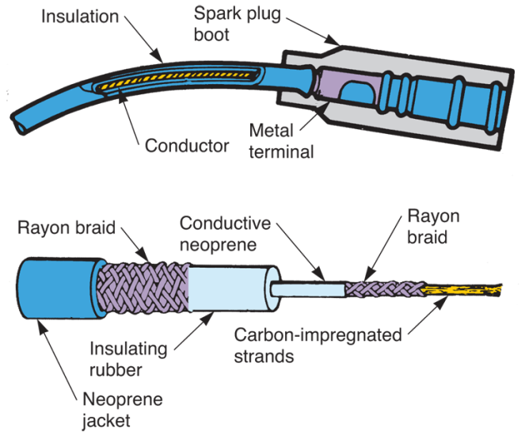
Secondary Wires (Cont.)
Resistance wires or radio suppression wires
  Used for secondary wire applications because they contain internal resistance, which helps prevent radio interference
(Champion Spark Plugs)

Slide 13
Spark Plugs
Use ignition coil high voltage to ignite fuel mixture
Basic parts
  Center terminal (center electrode)
  Grounded side electrode
  Ceramic insulator
  Steel shell

Slide 14
Spark Plugs (Cont.)
Spark plug reach
  Distance between end of plug threads and seat or sealing surface on plug shell
Resistor spark plug
  Internal resistance (around 10,000 ohms) to reduce static in radios and television sets
Non-resistor spark plug
  Solid metal rod forming center electrode

Slide 15
Spark Plugs (Cont.)
Spark plug gap
  Distance between center and side electrodes
  Normal gap specifications range from 0.030"–0.080" (0.76 mm–2.0 mm)
Spark plug heat range
  Rating of spark plug tip’s operating temperature

Slide 16
Spark Plugs (Cont.)
Hot spark plug
  Long insulator tip and tends to burn off deposits
Cold spark plug
  Shorter insulator tip
    Operates at cooler temperature
  Used in engines that operate at high speeds

Slide 17
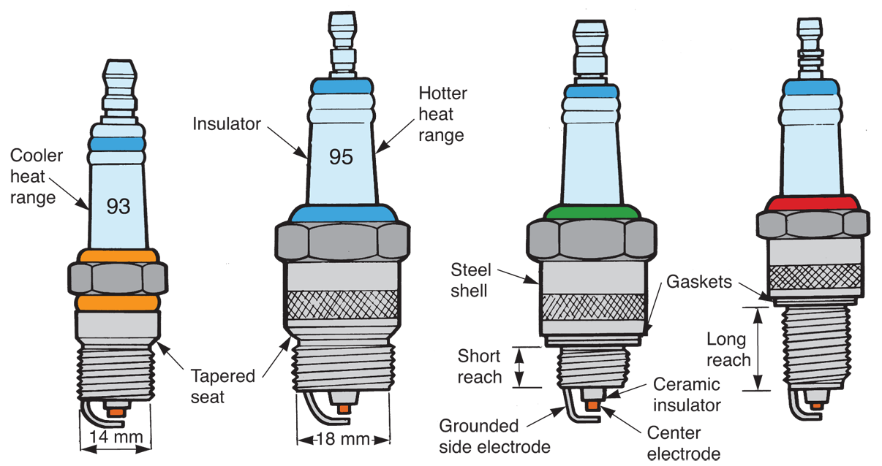
Spark Plugs (Cont.)
(Chrysler)

Slide 18
Ignition Coils
Pulse type transformer that produces short bursts of high voltage to pass current through secondary wires and jump spark glug gaps
Two sets of windings
Primary windings
  Several hundred turns of heavy wire
Secondary windings
  Several thousand turns of very fine wire

Slide 19
Ignition Coils (Cont.)
Ignition systems in late-model vehicles operate at about 15,000 volts
  Depending on design and condition
Ignition coil open-circuit voltage
  Maximum voltage potential
  Ranges from 40,000–100,000 volts in late-model designs

Slide 20
Ignition Coil Operation
Current flows through ICM and primary windings creating a strong magnetic field
  Iron core concentrates and strengthens this field
When current is interrupted by the ICM, magnetic field collapses
Secondary windings have more turns than primary windings
  Up to 60,000 volts induced

Slide 21
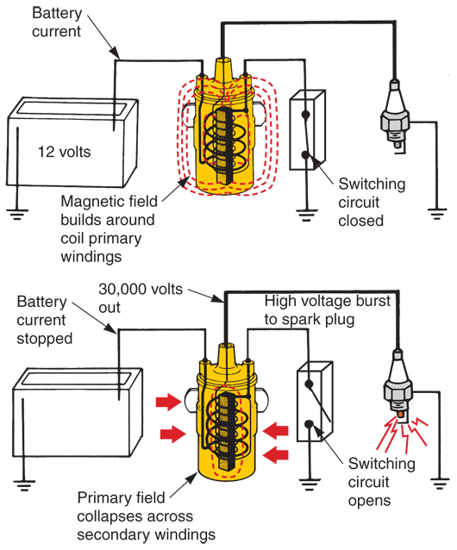
Ignition Coil Operation (Cont.)
High voltage shoots out of high-voltage terminal
Traveling through secondary circuit to spark plug
(Saab)

Slide 22
Ignition Coil Designs
Coil pack
  Several ignition coils combined into one assembly
  Used in coil pack ignition systems
Each coil is wired so it fires two spark plugs at the same time
Direct ignition coil
  Bolts directly over top of spark plug on top of engine
  Fires only on power strokes for maximum efficiency

Slide 23
Coil Pack Ignition System
Also called distributorless or computer-coil ignition
  Multiple ignition coils
  Coil control unit
  Engine sensors
  Computer (engine control module)
Operate sparks plugs

Slide 24
Coil Pack Ignition System (Cont.)
Electronic coil module
  Consists of two or more ignition coils and coil control unit
  Each coil in module serves two cylinders

Slide 25
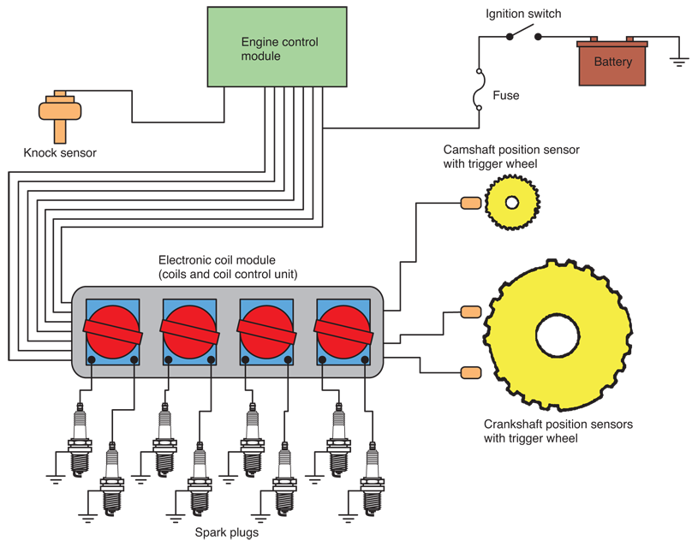
Coil Pack Ignition System (Cont.)

Slide 26
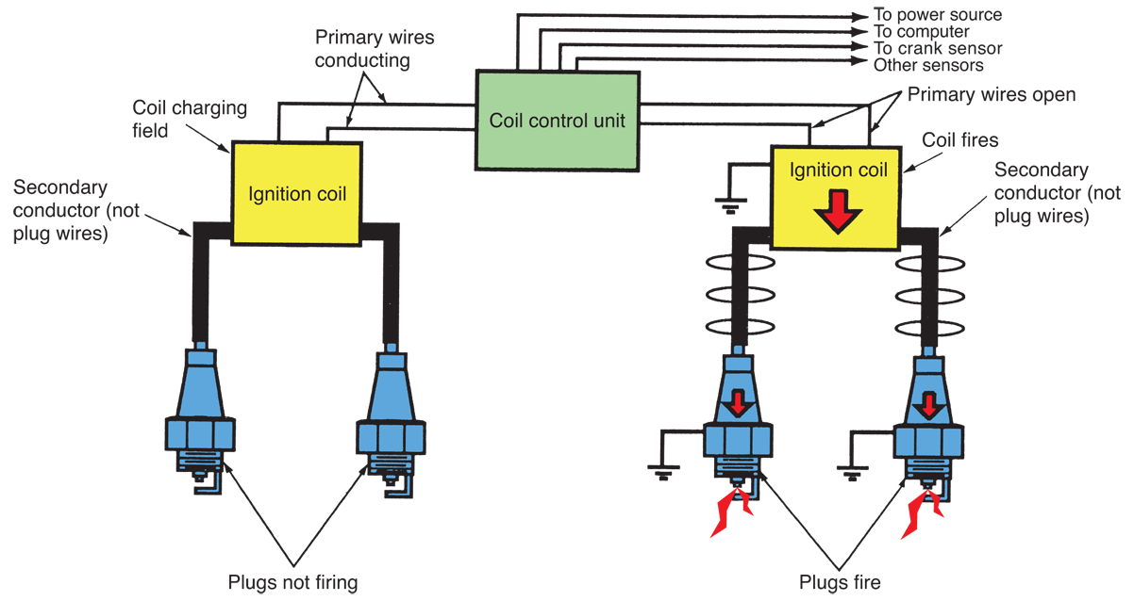
Coil Pack Ignition System Operation

Slide 27
Direct Ignition System
One coil assembly mounted directly above each spark plug
Eliminates need for spark plug wires
Allows use of smaller ignition coils
Other components in direct ignition system are the same as those in coil pack system

Slide 28
Direct Ignition System (Cont.)
Ionization knock sensing system
  Detects abnormal combustion and knocking
Dual spark plug ignition system
  Two spark plugs used in each cylinder
Multiple discharge ignition system
  Fires spark plugs more than once during each power stroke

Slide 29
Distributor Ignition Systems
Used in older ignition systems
Actuates on/off cycles of current flow through ignition coil primary windings
Distributes coil’s high-voltage pulses to spark plug wires
It causes spark to occur at each plug earlier in compression stroke as engine speed increases and vice versa
It changes spark timing with changes in engine load

Slide 30
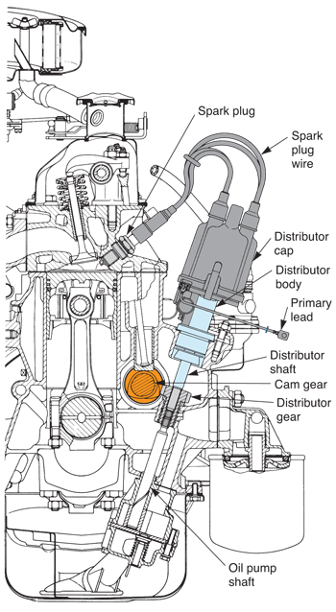
Distributor Ignition Systems (Cont.)
Sometimes, bottom of distributor shaft powers engine oil pump
Some distributors house ignition coil and electronic switching circuit in one assembly
  Unitized distributors

Slide 31
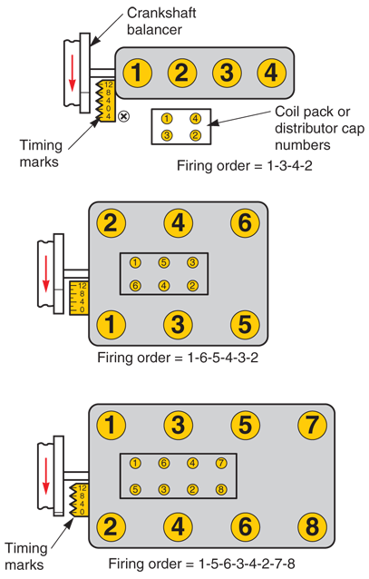
Engine Firing Order
Sequence in which spark plugs fire to cause combustion in each cylinder
Firing order information used when
  Installing plug wires
  Checking ignition timing
(Mitchell Manuals and Echlin)

Slide 32
Ignition Timing
Ignition timing or called spark timing
  How early or late spark plugs fire in relation to engine pistons’ position
Timing advance
  Occurs when spark plugs fire sooner during engine’s compression strokes
Timing retard
  Occurs when spark plugs fire later during compression strokes

Slide 33
Spark Advance Systems
Engine sensors, ignition control module, and/or engine or power train ECM adjusts ignition timing
Engine sensors
  Check various operating conditions
  Send data to computer
  Computer analyzes data
  Changes timing for maximum efficiency

Slide 34
Spark Advance Systems (Cont.)
Sensors that influence ignition timing
Crankshaft position sensor
Camshaft position sensor
Manifold absolute pressure sensor
Intake air temperature sensor
Engine coolant temperature sensor
Knock sensor
Throttle position sensor

