Slide 1


Slide 2
35
Chapter
Ignition System Diagnosis, Testing, and Repair

Slide 3
Objectives
After studying this chapter, you will be able to:
List the symptoms produced by faulty ignition system components.
Diagnose typical ignition system problems.
Describe common tests used to find ignition system troubles.
Explain how to replace or repair ignition system parts.

Slide 4
Objectives
Describe safety practices to follow when testing or repairing an ignition system.
Correctly answer ASE certification test questions on the diagnosis and repair of ignition systems.

Slide 5
Ignition System Diagnosis
Visually inspect ignition system with and without engine running
Look for obvious problems
  Loose primary connections
  Disconnected spark plug
  Loose direct ignition coil fasteners
  Deteriorated secondary wire insulation
  Damaged coil pack
  Burned control module fuse

Slide 6
Scanning Ignition System Problems
Scan tool can detect troubles in
  Crankshaft position sensor
  Camshaft position sensor
  Knock sensor
  Ignition coil(s) primary circuit
  Ignition coil(s) secondary circuit
  Timing reference signal and timing advance circuit
  Spark plug and coil secondary wire radio interference
  Engine misfire

Slide 7
Scan Tool Misfire Code
Means engine failed to ignite and burn air-fuel mixture properly
Indicates which engine cylinder is not producing combustion normally
Misfire can be caused by problems in
  Ignition system
  Fuel injection system
  Emission control system
  Engine itself

Slide 8
Spark Tester
Spark intensity test or spark test
  Checks strength of electric arc produced by ignition system
Spark tester
  Used to check ignition system output voltage

Slide 9
Spark Intensity Testing
Remove one of secondary wires from spark plug or from suspect direct ignition coil
Insert spark tester into wire or coil’s secondary conductor terminal
Ground spark tester by connecting alligator clip to good ground on engine or unibody (frame)
Crank or start engine and observe spark at tester’s air gap

Slide 10
Spark Test Results
Strong spark
  Shows ignition system primary and secondary voltages are good
  Shows ignition coil, pickup coil, electronic control unit, and other ignition system parts are functioning
Weak spark or no spark
  Indicates something is wrong inside ignition circuit

Slide 11
Checking for a Dead Cylinder
Dead cylinder
  Engine combustion chamber not igniting and burning fuel-air mixture on that cylinder’s power stroke
Symptoms include very rough idle and puffing noise at tailpipe

Slide 12
Checking for a Dead Cylinder (Cont.)
Pull off suspect cylinder’s ignition coil primary connector
On “live” or firing cylinder
  Engine speed will drop and idle will become rougher
On dead cylinder
  Idle smoothness and engine speed will not change

Slide 13
High-Voltage Leakage Test
Place hood cover over engine compartment to fully darken inspection area
  Helps view any electric sparks on ignition components
Install vent hose
Chock wheels, put transmission in Park, and set emergency brake

Slide 14
High-Voltage Leakage Test (Cont.)
Start engine
Wear rubber gloves and eye protection
Look under hood cover for high-voltage leakage
Move primary and secondary conductors in their connectors
Watch for sparks jumping off components

Slide 15
High-Voltage Leakage Test (Cont.)
Ground non-powered test light and move it over secondary wires and conductors
  Metal probe will attract any electrical leakage and glow
Replace any components that show leakage
If engine has direct ignition, remove each ignition coil to inspect high-voltage connection to spark plug

Slide 16
Ignition Primary Voltage Testing
Disconnect primary connector from one of ignition coils on engine
Install test jumper between harness and coil connectors
Connect high-impedance meter leads to bare metal conductors on jumper wires
Measure voltage applied to ignition coil with ignition switch in run position

Slide 17

Ignition Circuit Scope Testing
Oscilloscope or scope
  Measures operating voltages of analog and digital signals
  Often built into advanced scan tools
  Uses a display screen
  Shows changes in voltage over periods of time
(OTC)

Slide 18
Evaluating Ignition System Test Results
Evaluate results and narrow down possible causes
  Use knowledge of system operation
  Read service manual troubleshooting chart
  Use basic testing methods
  Use common sense

Slide 19
Spark Plug Service
Bad spark plugs cause many problems
  Misfiring
  Lack of engine power
  Poor fuel economy
  Exhaust odor
  Hard starting
Test with oscilloscope or scan tool
  Will show up as abnormal waveforms or misfire code

Slide 20
Spark Plug Removal
Remove ignition coils, coil module, or spark plug wires
Remove screws securing direct ignition coils or coil module to engine
Wiggle coil or module while pulling it straight up
If spark plugs have wires, make sure they are numbered or located correctly in clips

Slide 21
Spark Plug Removal (Cont.)
Grasp spark plug wire by boot and pull to disconnect
Twist boot back and forth if stuck on plug
Use blow nozzle to clean off debris collected on top of engine

Slide 22
Spark Plug Removal (Cont.)
Unscrew each spark plug using spark plug socket, extension, and ratchet
Lay each removed plug (in order) on fender cover or workbench
  Do not mix up plugs
Inspect color and condition of electrodes to diagnose condition of engine and fuel system

Slide 23
Reading Spark Plugs
Closely inspect and analyze condition of tip and insulator
Properly burning plug should have brown to grayish-tan color
Black or wet plug indicates that it is not firing or problem in engine

Slide 24
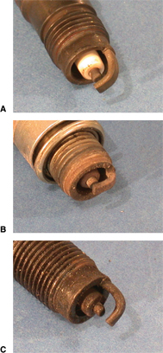
Reading Spark Plugs (Cont.)
A—Properly burning plug, minimal deposits and grayish-tan color
B—Carbon-fouled plug from prolonged rich air-fuel mixture
C—High-mileage plug shows erosion at gap

Slide 25
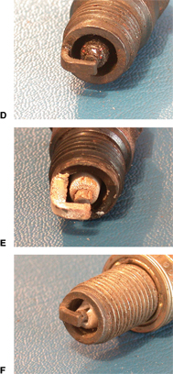
Reading Spark Plugs (Cont.)
D—Oil-fouled plug, shiny and dark gray or black in color
E—Ash-fouled plug from burning low-quality gasoline
F—Physical damage on spark plug indicates internal engine failure

Slide 26
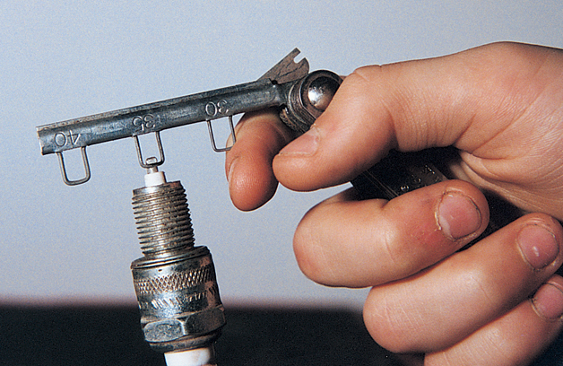
Gapping Spark Plugs
Set spark plug gap by spacing side electrode the correct distance from center electrode
Wire feeler gauge measures spark plug gap
  Should drag lightly when pulled in and out

Slide 27
Installing Spark Plugs
Spark plugs set to correct gap are ready for installation
Use your fingers, spark plug socket, or short piece of vacuum hose to start plugs in their holes
After threading a few turns by hand
  Turn them in with ratchet
  Tighten spark plugs to specifications

Slide 28
Secondary Wire Service
Faulty secondary or spark plug wire
  Burned or broken conductor
  Deteriorated insulation
Resistance conductors can be easily damaged
Secondary wire insulation test
  Checks for sparks arcing through insulation to ground

Slide 29
Secondary Wire Insulation Test
Darken shop or place fender covers over sides of vehicle’s hood
Start engine and visually inspect each wire for sparks of electric arcing leakage
  Listen for popping or clicking sound

Slide 30
Secondary Wire Insulation Test
(Cont.)
If arcing not evident during visual inspection
  Move high-impedance test light or grounded screwdriver along length of each wire
  Hold tip of tool about 1" from wire insulation
If arc jumps through insulation and onto test light probe or screwdriver, wire is bad and must be replaced

Slide 31
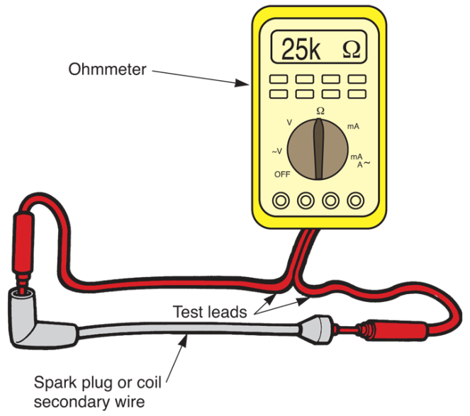
Secondary Wire Resistance Test
Remove each wire from its plug and from distributor cap or coil pack
Connect ohmmeter to each end of wire
Meter will measure wire’s internal resistance in ohms
Compare reading to specifications
(Chrysler)

Slide 32
Replacing Spark Plug Wires
Installing new spark plug wires is simple
  Replace one by one
Compare length of old wire with length of new wire
  Replace each wire with one of equal length

Slide 33
Ignition Timing Service
Proper ignition timing critical to engine performance
If ignition timing is incorrect, engine is not firing spark plugs at the right time
If ignition timing is off by even 1° of crankshaft rotation, fuel economy and power can drop considerably

Slide 34
Ignition Timing Service (Cont.)
Over-advanced ignition timing
  Engine will suffer from spark knock or ping, caused by abnormal combustion
Retarded ignition timing
  Engine will have poor fuel economy and lack power, especially during acceleration

Slide 35
Measuring Ignition Timing
Scan tool displays ignition timing as live data so it can be compared to specifications
In late-model vehicles
  Ignition timing cannot be adjusted mechanically
  If timing is incorrect, ECM or another component affecting timing must be replaced or updated

Slide 36
Measuring Ignition Timing (Cont.)
Today’s engines rely on multiple sensors to provide data for electronically adjusting ignition timing
Worn engine timing chain or stretched timing belt cause trouble codes and symptoms related to ignition timing and these sensors

Slide 37
Reprogramming ECM and Ignition Timing
Reprogramming ECM can change ignition timing curve with
  Speed
  Load
  Engine temperature
  Air temperature
Manufacturer sometimes provides software fixes

Slide 38
Ignition Coil (Coil Pack) Service
Faulty ignition coil may result in weak spark, intermittent spark, or no spark at all
Windings inside coil can break producing high resistance or opened coil circuit
If misfiring or dead cylinders correspond to one coil in coil pack, suspect coil pack

Slide 39
Testing Ignition Coils
Coil test may be needed when ignition system fails spark test
Since coil designs are different, testing procedures vary
Use ohmmeter to measure internal resistance of coil windings
  Check resistance of both primary and secondary windings

Slide 40
Testing Ignition Coils (Cont.)
With coil pack, test windings of coil having spark problem
If number two cylinder is not firing, coil for that cylinder should be checked first
Normally, bad coil pack winding will show infinite resistance, or open

Slide 41
Replacing an Ignition Coil
To remove old coil
  Disconnect wiring
  Remove bolts securing old coil
  Lift coil from engine
To install new coil
  Bolt coil in place
  Reconnect wires

Slide 42
Ignition Switch Service
Bad ignition switch can cause several problems
  Engine may not crank or start
  Engine may not shut off when ignition key is turned off
  Starter may not disengage when ignition key is returned to run

Slide 43
Testing an Ignition Switch
Use test light to check ignition switch
  Test light on start terminal
    Light should glow only when key is turned to Start
  In Run position
    Light should glow when touched on Run terminal
  In off position
    Neither terminal should make test light glow

Slide 44
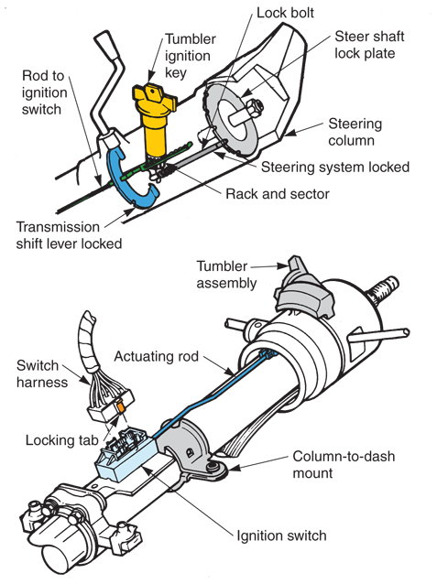
Replacing an Ignition Switch
Before removing dashboard-mounted switch, tumbler must be removed
Steering column-mounted ignition switch is separate from tumbler

Slide 45
Ignition Control Module Service
Faulty ignition control module can produce wide range of problems
  Engine stalls when hot
  Engine cranks but fails to start
  Engine misses at high or low speeds
Ignition control module problems will show up after period of engine operation
  Heat soaks into module and raises its temperature

Slide 46
Fixed and Variable Dwell
Dwell time
Number of degrees of crankshaft rotation that the circuit conducts current to the ignition coil
Fixed dwell
Dwell time should remain the same at all engine speeds
Variable dwell
Ignition control module alters dwell time with engine speed

Slide 47
Fixed and Variable Dwell (Cont.)
Current-limiting dwell
Ignition control module sends high current through ignition coil windings until strong magnetic field is developed around windings
Once module senses saturated ignition coil, it reduces amount of current sent through coil windings
Saturated ignition coil
Coil’s magnetic field is fully formed

Slide 48
Testing an Ignition Control Module
One of last components to test when troubleshooting ignition system
Unplug wires going to module and connect tester to module
Tester indicates if ignition control module fault exists

Slide 49
Heating the Ignition Control Module
Microscopic components inside ignition control module are very sensitive to high temperatures and vibration
Many technicians use heat gun or heat lamp bulb to warm unit
  Simulates engine compartment temperature after engine has been running
  Do not apply too much heat or it may be ruined

Slide 50
Replacing an Ignition Control Module
If control module is mounted in engine compartment or under dash
Carefully unplug wiring harness without damaging small terminal pins and plastic connectors
Unbolt and remove ignition or engine control module
Install new unit
Reconnect wiring harness

Slide 51
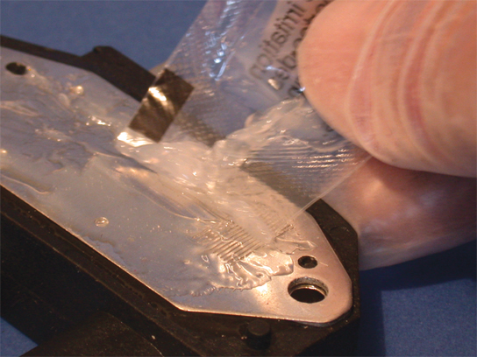
Replacing an Ignition Control Module (Cont.)
In many cases, bottom of ignition control module must be coated with special grease
This grease transfers heat away from circuits
  Protects module from overheating and circuit damage

Slide 52
Replacing a Crankshaft Position Sensor
Most crankshaft position sensors simply lock into place and are not adjustable
  Some require adjustment
Crankshaft position sensor air gap
  Distance from tip of sensor to un-notched area on trigger wheel

Slide 53
Replacing a Crankshaft Position Sensor (Cont.)
To adjust crankshaft position sensor air gap
Loosen mounting screws holding sensor in place
Fit flat feeler gauge between one of the teeth on crank trigger wheel and sensor tip
Adjust sensor position so there is slight drag on feeler gauge
Tighten crank sensor mounting screws so they remain the correct distance from trigger wheel on crankshaft

Slide 54
Knock Sensor Service
Knock sensor used to detect abnormal combustion, or ping
When it “hears” pinging or knocking, sensor retards ignition timing or lowers turbo boost with turbo waste gate
Bad knock sensor can upset ignition timing and affect turbocharger boost pressure

Slide 55
Knock Sensor Service (Cont.)
To check knock sensor operation
Start engine
  Allow it to reach operating temperature
Lightly tap on engine block or on bracket with wrench or small hammer
  Simulates pinging or knocking
  Should make computer retard ignition timing
If tapping has no effect, check sensor with VOM or scope

Slide 56
Camshaft Position Sensor Indexing
Install the sensor with number one piston at TDC on the compression stroke
Camshaft position sensor normally mounted on cylinder head or front timing cover
Special plastic tool may be required to hold sensor in correct orientation as you slide sensor into place before securing it
Arrow on tool must face toward front of vehicle
Always refer to service information for year, make and model car being repaired

Slide 57
Camshaft Position Sensor Indexing (Cont.)
Incorrectly indexed camshaft position sensor (CMP) may be difficult to diagnose
Can slightly affect fuel injection timing
Engine might have poor fuel economy or drivability problems
MIL may illuminate
Surging, hesitation, missing upon acceleration, or lack of engine power may result

