Slide 1


Slide 2
39
Chapter
Automotive Fuels, Combustion Efficiency

Slide 3
Objectives
After studying this chapter, you will be able to:
Summarize how crude oil is converted into gasoline, diesel fuel, liquefied petroleum gas, and other products.
Describe properties of gasoline and diesel fuel.
Explain octane and octane ratings.

Slide 4
Objectives
Describe normal and abnormal combustion of gasoline and diesel fuel.
Summarize the properties of alternative fuels.
Correctly answer ASE certification test questions on automotive fuels and combustion.

Slide 5
Automotive Fuels, Combustion Efficiency Introduction
Automotive fuel
  Any substance easily burned to produce heat
    Liquid, gas, or solid
Combustion
  Chemical reaction that occurs when fuel burns with an oxidant (oxygen)

Slide 6
Automotive Fuels, Combustion Efficiency Introduction (Cont.)
Normal combustion
  Primary factor controlling good fuel economy, maximum engine power, low exhaust emissions, and long engine service life
Abnormal combustion
  Occurs when combustion happens too quickly or too slowly

Slide 7
Automotive Fuels, Combustion Efficiency Introduction (Cont.)
Combustion efficiency
  Measure of how well combustion consumes fuel’s heat energy for maximum cylinder pressure and minimum exhaust by-products
To quickly isolate vehicle problems, understand factors affecting proper fuel combustion

Slide 8
Petroleum (Crude Oil)
Crude oil or petroleum
  Oil taken directly out of the ground
Used to make
  Gasoline
  Diesel fuel
  Liquefied petroleum gas
  Many nonfuel materials
    Asphalt, motor oil, etc

Slide 9
Petroleum (Crude Oil) (Cont.)
Chemically consists of highly flammable hydrocarbons
Hydrocarbons
  About 12% hydrogen and 82% carbon
Also contains sulfur, nitrogen, metals, and saltwater
  These elements must be removed

Slide 10
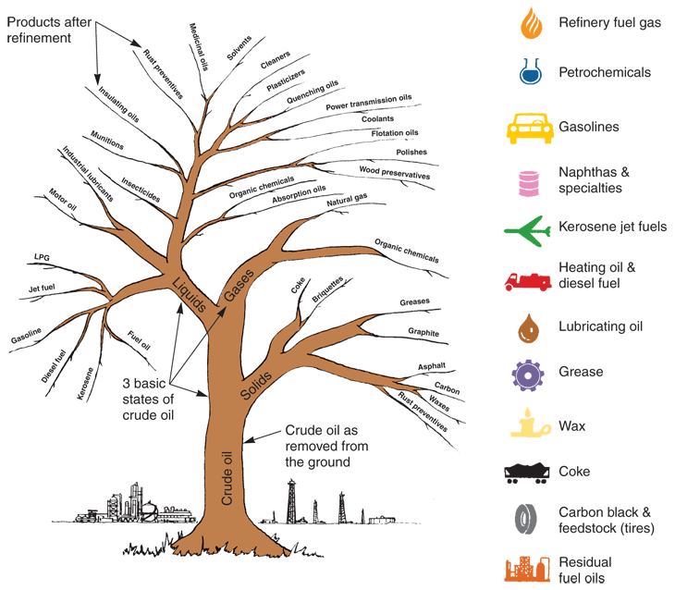
Crude Oil
(Gulf Oil Corp.)

Slide 11
Processing Crude Oil
Crude oil deposits contained inside earth
Oil companies perform exploration tests
  Seismic studies, surface mapping, and test drilling
Refinery
  Converts crude oil into more useful substances
    Motor oil, gasoline, and diesel fuel

Slide 12
Processing Crude Oil (Cont.)
Distillation
  First conversion process
Fractionating tower breaks crude oil down into different parts, or fractions
  LPG, gasoline, kerosene, fuel oil, and lubricating oils
Other processes purify and alter each fraction

Slide 13
Gasoline
Most common type of automotive fuel
Abundant and highly flammable
Antiknock additives
  Slow down burning of gasoline
  Helps prevent engine ping or knock

Slide 14
Gasoline Octane Ratings
Octane rating
  Measurement of fuel’s ability to resist knock or ping
  Given as numbers on gas station pump
Octane enhancers or oxygenates
  Blending components in gasoline to increase octane levels and reduce engine knock

Slide 15
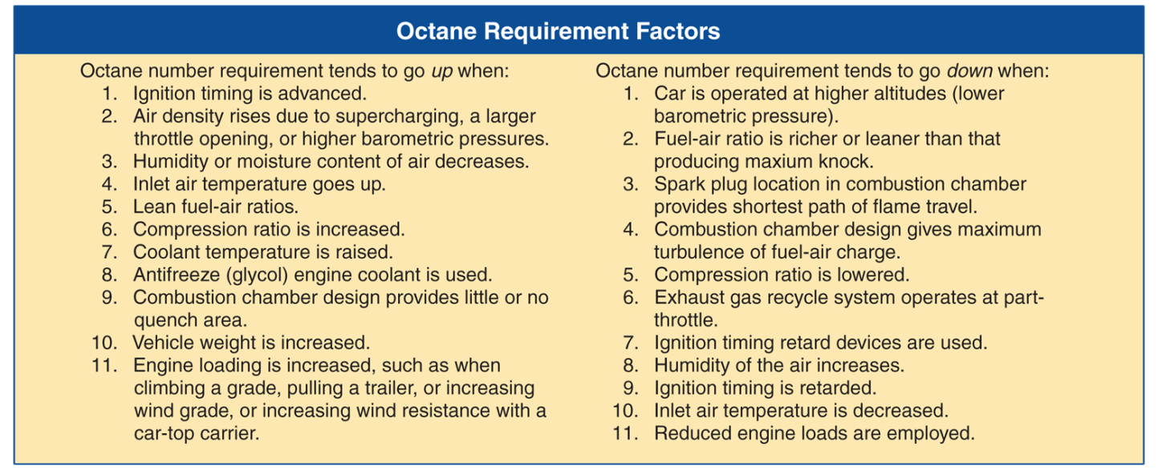
Gasoline Octane Ratings (Cont.)

Slide 16
Gasoline Combustion
Gasoline must mix with right amount of air to burn properly
Volatile air-fuel mixture must be compressed, pressurized, and ignited
Resulting combustion, or rapid oxidation, produces heat, expansion of gases, and engine cylinder pressure

Slide 17
Normal Gasoline Combustion
Spark plug ignites fuel and burning progresses quickly and smoothly through air-fuel mixture
Normal combustion takes only about 3/1000 of a second

Slide 18
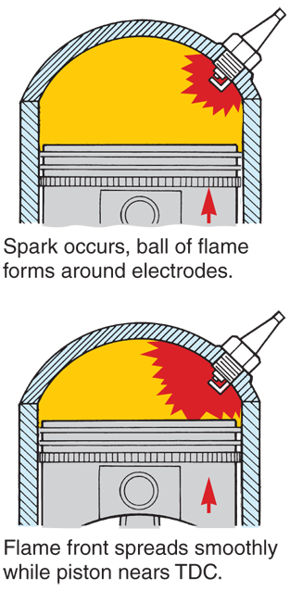
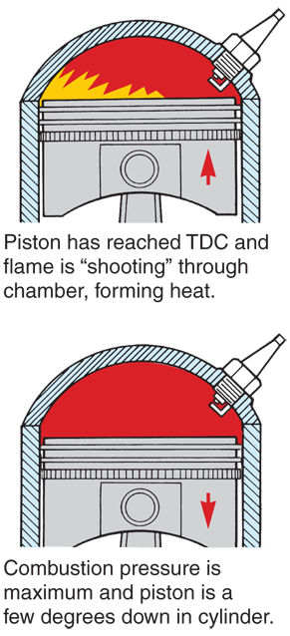
Normal Gasoline Combustion (Cont.)

Slide 19
Air-Fuel Mixture
Stoichiometric fuel mixture
  Chemically correct air-fuel mixture
  For gasoline, mixture ratio of 14.7:1
    14.7 parts air to 1 part fuel, by weight
Lean air-fuel mixture
  Large amount of air compared to fuel
Rich air-fuel mixture
  Large amount of fuel compared to air

Slide 20
Abnormal Combustion
Flame does not spread evenly and smoothly through combustion chamber
Detonation
  Part of unburned air-fuel mixture explodes violently

Slide 21
Abnormal Combustion (Cont.)
Engine knock
  Combustion chamber pressure rises so quickly that engine parts vibrate
  Symptom of detonation
End gas
  Unburned portion of mixture

Slide 22
Abnormal Combustion (Cont.)
Preignition or surface ignition
  When overheated surface in combustion chamber ignites air-fuel mixture
Ping or mild knock
  Light tapping noise heard during preignition
  Not as loud or harmful as detonation knock

Slide 23
Abnormal Combustion (Cont.)
Dieseling, after-running or run-on
  Problem where engine keeps running after turned off
Spark knock
  Spark plug firing too soon in relation to position of piston

Slide 24
Diesel Fuel
Second most popular type of automotive fuel
Gallon is thicker fraction of crude oil containing more heat energy than gasoline
Will not vaporize as easily as gasoline

Slide 25
Diesel Fuel Grades
Ensure diesel fuel has uniform standards
Three diesel fuel grades
  No. 1 diesel
  No. 2 diesel
  No. 4 diesel
Viscosity
  Thickness or weight

Slide 26
Diesel Fuel Grades (Cont.)
No. 1 diesel
  Thinner than No. 2 diesel
    Sometimes recommended as winter fuel
No. 2 diesel
  Normally recommended for use in diesel automotive engines
    Medium viscosity

Slide 27
Diesel Fuel Cloud Point
Paraffin (wax)
  One substance in diesel fuel
  At very cold temperatures, wax can separate from other parts
    Fuel will turn cloudy or milky
Cloud point
  Temperature at which paraffin separates

Slide 28
Diesel Fuel Water Contamination
Water contamination
  Common problem with diesel engines
  Water mixing with diesel fuel can clog filters and corrode components
Water separators
  Prevent water damage
  Used on many late-model diesel injection systems

Slide 29
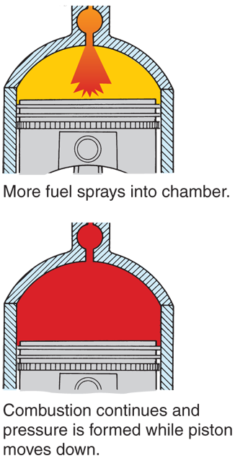
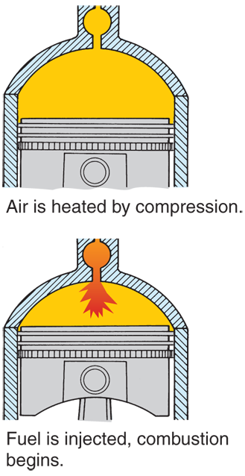
Normal Diesel Combustion

Slide 30
Selective Catalytic Reduction Systems
Automatically spray diesel exhaust fluid (DEF) into the vehicle’s exhaust stream
DEF
Mixture of urea and de-ionized water
“Dosing rate”
Rate of DEF consumption
EPA requires vehicle manufacturers to install safeguards that help prevent vehicle from being operated with out DEF

Slide 31
Alternative Fuels
Any fuel other than gasoline and diesel fuel
Examples of alternative fuels
  Liquefied petroleum gas
  Alcohol
  Methane gas
  Hydrogen

Slide 32
Liquefied Petroleum Gas
Liquefied petroleum gas (LPG)
  One of lightest fractions of crude oil
  Sometimes used as fuel for automobiles and trucks
Chemically similar to gasoline
A vapor at room temperature and pressure
Requires special fuel system

Slide 33
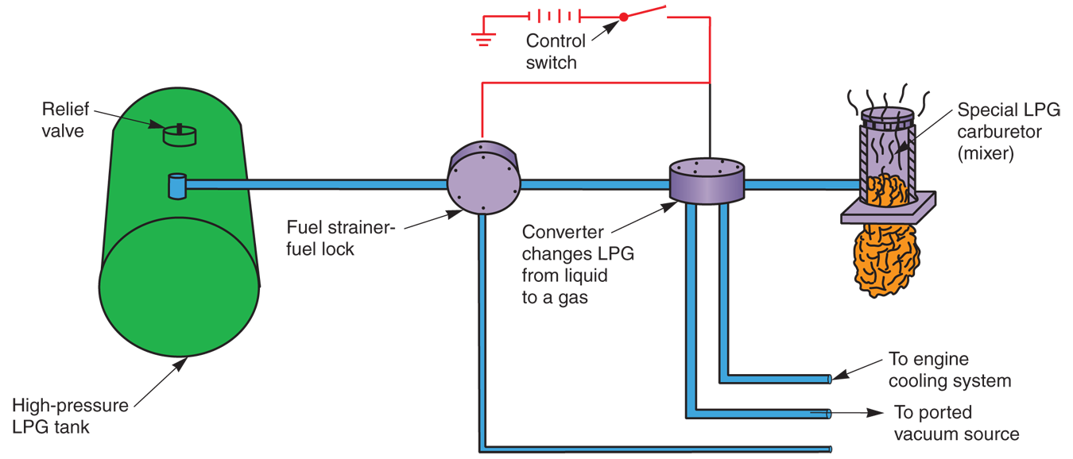
LPG Fuel System

Slide 34
Alcohol
Potential to be excellent alternative fuel for automotive engines
Two types of alcohol used in automobiles
  Ethyl alcohol
  Methyl alcohol

Slide 35
Ethyl Alcohol
Made from farm crops rich in carbohydrates (grain, wheat, oats, etc.)
  Grain alcohol or ethanol
Colorless
Harsh tasting
Toxic
Highly flammable

Slide 36
Methyl Alcohol
Methyl alcohol, “wood alcohol” or methanol
Can be made out of wood chips, petroleum, garbage, and animal manure
Strong odor, colorless, poisonous, and very flammable

Slide 37
Alcohol—Advantages and Disadvantages
Clean-burning fuel for automobiles
Expensive to use and produce
Fuel systems require modification before they can burn straight alcohol
Almost twice as much alcohol must be burned, compared to gasoline
  Reduces fuel economy by 50%

Slide 38
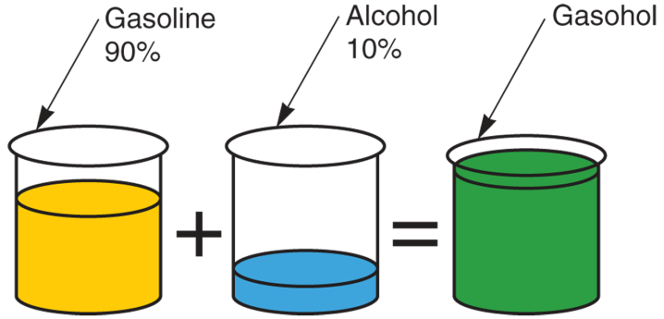
Gasohol
Mixture of gasoline and alcohol
  Usually 87 octane gasoline
  Usually grain alcohol
Range from 2–20% alcohol
Gasohol typically blends 10% alcohol and 90% gasoline

Slide 39
Gasohol (Cont.)
Commonly used as alternative fuel in motor vehicles
Fuel system and engine modifications not needed
Many gas stations sell gasohol as high-octane fuel
10% alcohol can increase 87 octane gasoline to 91 octane

Slide 40
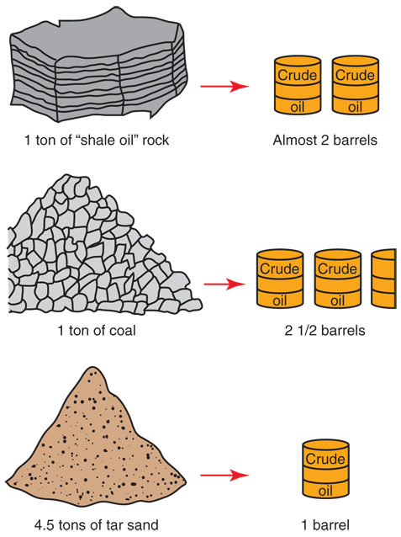
Synthetic Fuels
Made from
Coal
Shale oil rock
Tar sand
Synthetic fuels synthesized from solid hydrocarbon state to liquid or gaseous state

Slide 41
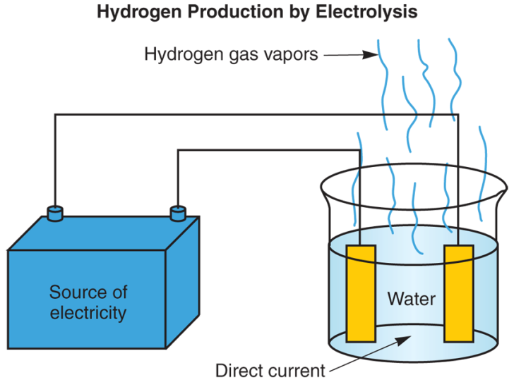
Hydrogen
Highly flammable gas
Promising future alternative fuel
One of earth’s most abundant elements
Produced through electrolysis of water
  Electric current through saltwater

