Slide 1
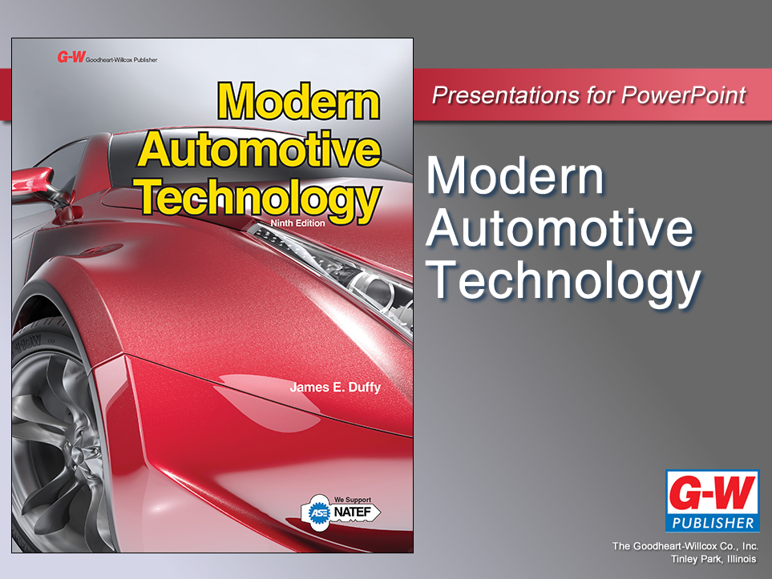

Slide 2
40
Chapter
Fuel Tanks, Pumps, Lines, and Filters

Slide 3
Objectives
After studying this chapter, you will be able to:
Define the major parts of a fuel supply system.
Describe the operation of mechanical and electric fuel pumps.
Explain the tests used to diagnose problems with fuel pumps, fuel filters, and fuel lines.
Repair a fuel line or replace a fuel hose.

Slide 4
Objectives
Locate and replace fuel filters in both gasoline and diesel fuel systems.
State safety rules for working on fuel supply systems.
Describe the construction and action of air filters.
Correctly answer ASE certification test questions on fuel tanks, fuel pumps, fuel lines, fuel filters, and air filters.

Slide 5
Fuel Tanks, Pumps, Lines, and Filters Introduction
Fuel system
Provides combustible air-fuel mixture to power engine
This chapter explains construction, operation, and service of fuel tanks, fuel lines, fuel filters, air filters, and fuel pumps

Slide 6
Fuel System Technology
Utilizes three subsystems
Fuel supply system
Provides clean, filtered gasoline, diesel oil, or alternate fuel to fuel injectors
Air supply system
Allows clean, filtered, air to flow into combustion chambers
Fuel metering system
Meters correct amount of fuel into engine cylinders

Slide 7
Fuel Supply System
Fuel tank
Stores gasoline, diesel fuel, gasohol, alcohol, LPG, or other combustible material safely
Fuel lines
Carry fuel between fuel tank, fuel pumps, fuel hoses, fuel filters, pressure regulator, and other system parts

Slide 8
Fuel Supply System (Cont.)
Fuel pumps
Draw fuel from tank and force it to engine and fuel injectors
Fuel filters
Remove contaminants such as water, rust, and other debris

Slide 9
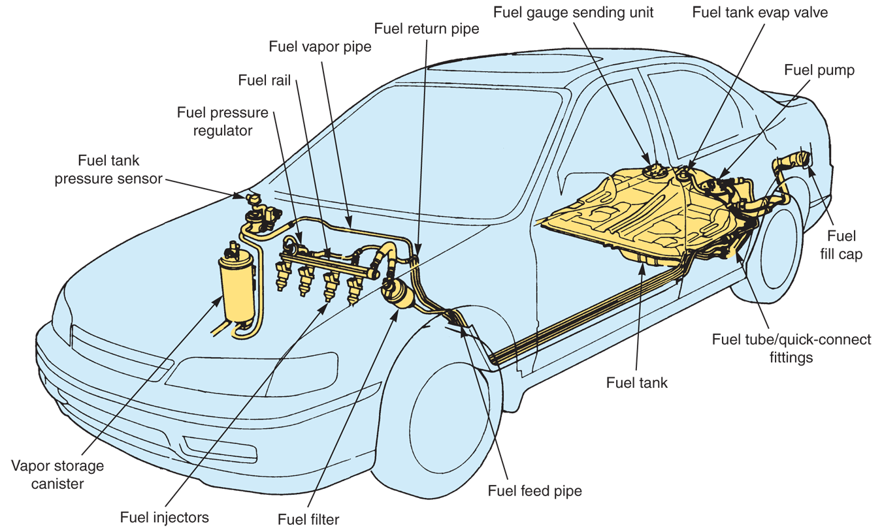
Fuel Supply System Components
(Honda)

Slide 10
Fuel Tanks
Safely hold supply of fuel so vehicle can be driven reasonable distance without refueling
Mounted in rear of car, under trunk or rear seat
Driving range
Driving distance without stopping for fuel
Fuel tank capacity
Volume of fuel a fuel tank can hold
Average 12–25 gallons or 45–95 liters

Slide 11
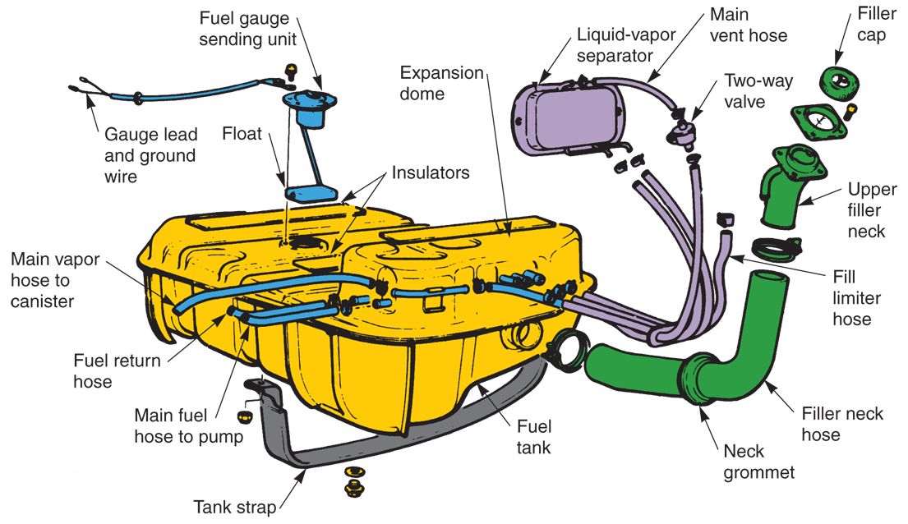
Fuel Tank Construction
(Chrysler)

Slide 12
Fuel Tank Construction (Cont.)
Made of sheet steel, aluminum, or injection molded plastic
Filler neck
Extension tube that allows gas pump nozzle to be used to fill tank with fuel
Filler cap
Fits on end of filler neck

Slide 13
Fuel Tank Construction (Cont.)
Spillback ball
Large “ping pong-type” ball in filler neck to prevent fuel from leaking out of vehicle
Fuel tank baffles
Located inside fuel tank to keep fuel from sloshing, or splashing, around
Fuel tank straps
Secure tank to vehicle

Slide 14
Fuel Tank Construction (Cont.)
Pickup-sending unit
Extends down into tank to draw out fuel and operate fuel gauge
Variable resistor
Resistance changes with changes in fuel level
Fuel tank pressure sensor
Monitors buildup pressure in late-model vehicles equipped with OBD II systems

Slide 15
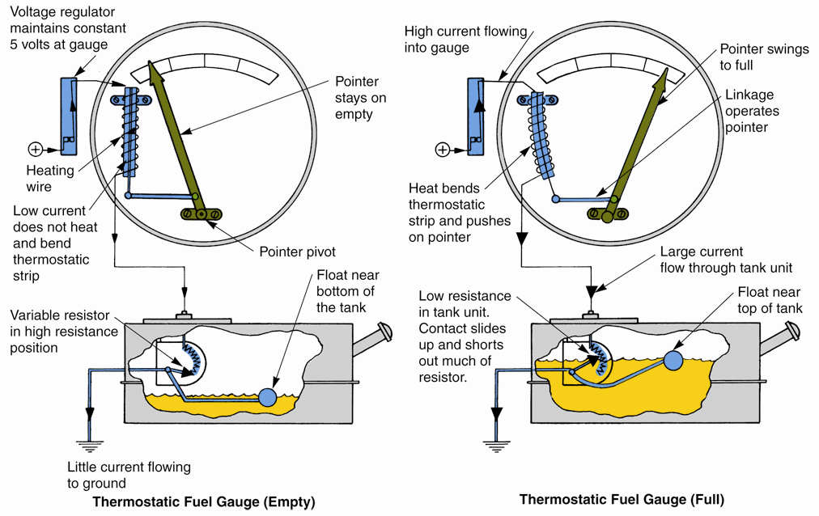
Fuel Tank Pickup-Sending Unit

Slide 16
Fuel Lines and Hoses
Fuel hoses
Carry fuel from tank to engine
Fuel rail
Large-diameter fuel line feeding to inlet openings of fuel injectors
Hose clamps
Secure hoses to fuel lines or metal fittings

Slide 17
Fuel Lines and Hoses (Cont.)
Plastic fuel lines or fuel pipes
Made of high-strength nylon tubing
Withstand chemical action, pressure, and heat of fuel system applications
Fuel return system
Cools gasoline and prevents vapor lock
Bubbles form in overheated fuel and stop fuel flow
Keeps engine heat from overheating gasoline

Slide 18
Returnless Fuel Injection Systems
Returnless fuel injection systems
No fuel return lines
Help reduce evaporative emissions by minimizing fuel vaporization
Control fuel system pressure by varying fuel pump output

Slide 19
Fuel Filters
Stop contaminants
Sand, dirt, water
Rust
Corrosion
Damage
Fuel pump
Fuel lines
Pressure regulator
Fuel rail
Injectors

Slide 20
Fuel Filters (Cont.)
Pleated fuel filter
Made of coated paper or plastic
Most common fuel filter element found in gasoline fuel systems
Bowl fuel filter
Found on modern diesel engines
Easily trap water since water is heavier than fuel

Slide 21
Fuel Filters (Cont.)
Canister fuel filter
Housed inside metal container
Mounted in fuel line
Fuel strainer or soft metal sock
Inlet of in-tank fuel pump
Keeps debris from entering system

Slide 22
Fuel Filter Locations
In fuel tank at end of fuel pickup tube
In fuel line before fuel rail, fuel injectors, diesel injection pump, or carburetor
Inside fuel pump
In fuel line right after electric fuel pump
Under fuel line fitting in antique carburetors

Slide 23
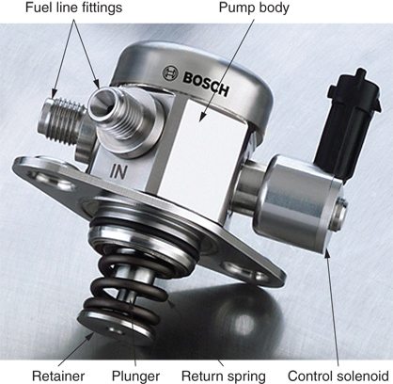
Fuel Pumps
Draw fuel out of tank and force it into engine under pressure
Many engines use two fuel pumps
One in tank and one in fuel line
Connected in series using fuel hoses and metal fuel lines
(Bosch)

Slide 24
Mechanical Fuel Pumps
Powered by engine camshaft eccentric
Egg-shaped lobe
Produces reciprocating motion on piston or plunger
Classified as reciprocating pump

Slide 25
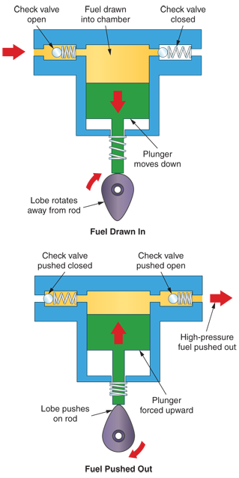
Mechanical Fuel Pump Check Valves
Two check valves
Inlet check valve
Outlet check valve
Fuel flows easily through valves in one direction
Cannot flow through in other direction

Slide 26
High-Pressure Mechanical Fuel Pump Operation
Fuel pump pressure stroke
Eccentric lobe pushes on fuel pump rod and plunger
Pressure pushes fuel past outlet check valve
Fuel pump charging stroke
Eccentric lobe rotates away from fuel pump
Pumping chamber refills with fuel from tank

Slide 27
Fuel Pump Pressures
Mechanical fuel pump pressures can range from 1500–2000 psi
Enough pressure to cause serious injury
If it ignites and burns
Like a large blow torch
If it does not ignite
Puncture skin
Inject gasoline into bloodstream
Could be fatal

Slide 28
Electric Fuel Pumps
Produces fuel pressure and flow for fuel metering section
Located in fuel tank or in series with fuel line
In many late-model vehicles, tank sending unit is integral part of in-tank fuel pump assembly

Slide 29
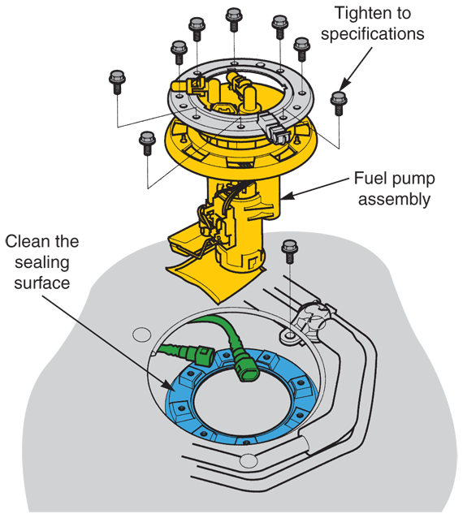
Electric Fuel Pumps (Cont.)
Electric pumps produce almost instant fuel pressure
Rotary-type pumps produce smoother flow of fuel
Pressure ranges from 10–50 psi
(Honda)

Slide 30
Rotary Fuel Pumps
Rotary fuel pump types include
Impeller
Roller vane
Sliding vane
All use circular, or spinning, motion to produce pressure

Slide 31
Rotary Fuel Pumps (Cont.)
Impeller electric fuel pump
Centrifugal pump
located inside the fuel tank
Uses small dc motor to spin impeller
Roller vane electric fuel pump
Positive displacement pump
Each pump rotation moves specific amount of fuel
Located in main fuel line

Slide 32
Rotary Fuel Pumps (Cont.)
Sliding vane electric fuel pump
Similar to roller vane pump
Square vanes instead of round rollers
Reciprocating electric fuel pump
Same basic action as mechanical fuel pump
Uses solenoid instead of rocker arm to produce pumping motion

Slide 33
Electric Fuel Pump Circuits
Must send controlled amount of current to pump motor
Inertia switch circuit
Cuts electric fuel pump power in event of serious auto collision or accident
Oil pressure switch
Safety feature that shuts off fuel pump if oil pressure is low

Slide 34
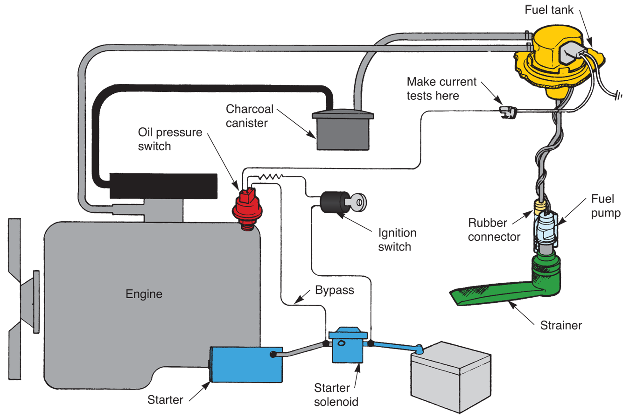
Typical Electric Fuel Pump Circuit
(Ford)

Slide 35
Fuel Supply System Service
Fuel supply system scanning
Scan for trouble codes before starting fuel supply system repairs
OBD II systems
Monitor fuel tank pressure, fuel line pressure, fuel level, and other conditions
Scan tool
Quickly finds any stored codes
Displays operating values for electrical circuit, and speeds troubleshooting

Slide 36
Fuel Supply System Service (Cont.)
Vapor lock
When bubbles in overheated fuel reduce or stop fuel flow
Fuel tank problems
Fuel leakage
Physical damage
Dents, holes, etc.
Contamination
Rust, dirt, and water

Slide 37
Fuel Tank Removal and Replacement
Before servicing a fuel tank, empty it
Full tank is very heavy and can rupture if dropped
Drain fuel into approved safety can
Disconnect hose at main fuel line and route it into approved gas can
Turn ignition key on
Allow fuel pump to force fuel from tank into can

Slide 38
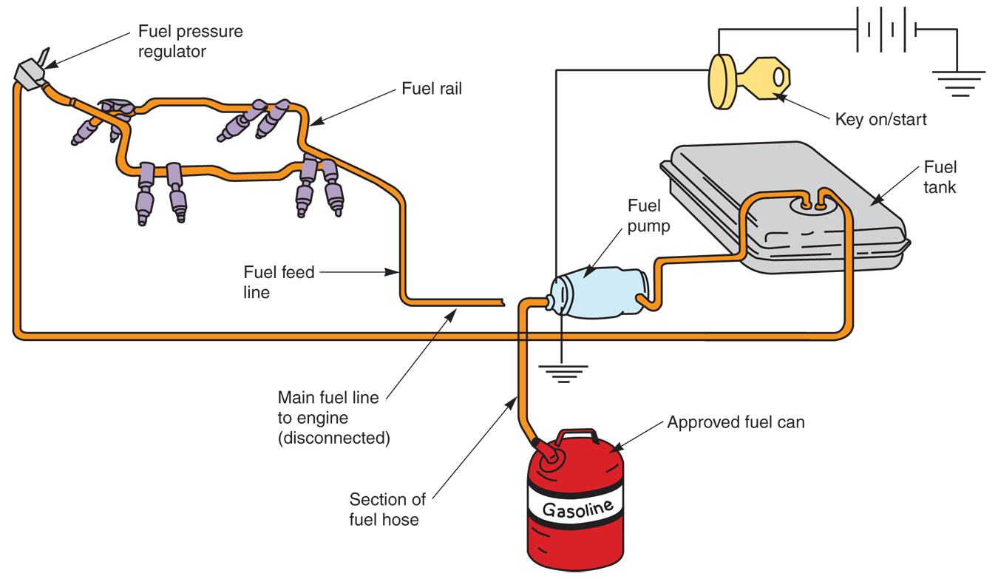
Fuel Tank Removal and Replacement (Cont.)

Slide 39
Fuel Tank Removal and Replacement (Cont.)
After draining, remove tank from vehicle
Disconnect filler neck, fuel lines, wires, and other components
Remove straps or bolts securing tank to body
Slowly and carefully lower tank
Remove old electric fuel pump and sending unit assembly from bad fuel tank

Slide 40
Fuel Tank Removal and Replacement (Cont.)
Install fuel pump into new tank
Use rubber O-ring to make sure new fuel tank does not leak
If working alone
Secure fuel tank on transmission jack and raise it up under vehicle
Make sure to replace rubber insulators
Check that all fuel lines are properly secured
Replace fuel in tank and check for leaks

Slide 41
Fuel Tank Sending Unit Service
Faulty fuel tank sending unit can make fuel gauge reading inaccurate
Usually, variable resistor in sending unit fails
Sometimes fuel gauge or gauge circuit may be at fault

Slide 42
Fuel Tank Sending Unit Service (Cont.)
First, test fuel gauge
Connect factory fuel gauge tester to fuel gauge feed wire
When tester is set on full
Fuel gauge should read full
If gauge does not function
Either gauge or gauge circuit is faulty
If fuel gauge begins to work
Fuel tank sending unit is bad

Slide 43
Fuel Tank Sending Unit Service (Cont.)
If tests indicate inoperative fuel tank sending unit, remove unit after draining tank
Unscrew cam lock or screws holding sending unit in fuel tank
If without special cam tool, use drift punch and hammer to rotate lock tabs
Lift unit out of tank

Slide 44
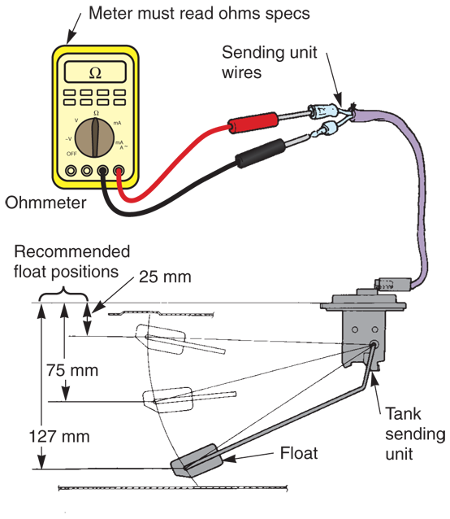
Fuel Tank Sending Unit Service (Cont.)
Measure resistance with ohmmeter
If resistance is not within specifications
Or does not change when float arm moves
Install new sending unit
Also check float for leakage
(Honda)

Slide 45
Fuel Line and Hose Service
Faulty fuel lines and hoses are common sources of fuel leaks
Fuel hoses can become hard and brittle
Engine oil softens and swells hoses
Inspect fuel lines and hoses closely
Replace any in poor condition

Slide 46
Fuel Line and Hose Service Rules
Wear proper apparel
Work gloves and eye protection
Release residual fuel pressure
Place shop rag around fuel line fitting during removal
Only use approved double-wall steel tubing for fuel lines

Slide 47
Fuel Line and Hose Service Rules (Cont.)
Make smooth bends when forming new fuel line
Form double-lap flares on ends of fuel line
Reinstall fuel line hold-down clamps and brackets
Route all fuel lines and hoses away from hot or moving parts

Slide 48
Fuel Line and Hose Service Rules (Cont.)
Route plastic fuel lines in their original locations
Plastic line will kink if bent too sharply
Use factory-recommended tool to release snap-type fittings used to secure plastic fuel lines
If plastic line or fitting is damaged, replace it

Slide 49
Fuel Line and Hose Service Rules (Cont.)
Do not use non-OEM plastic tubing to repair fuel systems
Plastic lines tend to stiffen in service
Avoid bending or rerouting used plastic lines
Always cover plastic fuel lines with wet towel when welding, torch cutting, or grinding near them

Slide 50
Fuel Line and Hose Service Rules (Cont.)
Never allow battery acid to contact metal or plastic fuel line
Use only approved synthetic rubber hoses in fuel system
Make sure fuel hose fully covers its fitting or line before installing clamps

Slide 51
Fuel Line and Hose Service Rules (Cont.)
When servicing press-fit fuel line fittings, O-ring seal may need replacing to prevent fuel leakage
Double-check all fittings for leaks
Start engine and inspect connections closely

Slide 52
Fuel Filter Service
Involves periodic replacement or cleaning of system filters
May also include locating clogged fuel filters
Partially clogged fuel filter may cause engine to temporarily lose power or stall when specific speed is reached
Clogged in-tank strainer is common and difficult-to-diagnose problem

Slide 53
Fuel Pump Service
Problems include
Low fuel pressure
Inadequate fuel flow
Abnormal pump noise
Fuel leakage

Slide 54
Fuel Pump Service (Cont.)
Low fuel pump pressure causes
Worn pump bearings
High resistance in electric pump circuit
Leaking check valves
Physical wear of moving parts
With low fuel pump pressure, engine starves for fuel at high speeds

Slide 55
Fuel Pump Service (Cont.)
High fuel pump pressure is commonly caused by inoperative pressure relief valve
Faulty fuel pressure regulator is another cause
Mechanical fuel pump noise
Clacking sound from inside pump
Caused by weak or broken return spring or other pump part failure

Slide 56
Fuel Pump Tests
Fuel pump testing
Measuring fuel pump pressure and volume
Exact procedures vary, depending on fuel system type
Refer to manual
Sometimes, fuel pump vacuum is measured to find air leaks in fuel supply lines

Slide 57
Fuel Pump Tests (Cont.)
Before testing fuel pump, use scan tool to check for
Restricted fuel filters
Smashed or kinked fuel lines or hoses
Air leak into vacuum side of pump or line
Injection system troubles
Ignition system problems
Low engine compression

Slide 58
Measuring Fuel Pump Pressure
Relieve any residual pressure in system
Connect pressure gauge to output line of fuel pump
Or test fitting on engine fuel rail
May need to install test fitting in fuel line
If mechanical fuel pump, start engine
Inspect all test fittings for leakage
Compare pressure readings with specifications

Slide 59
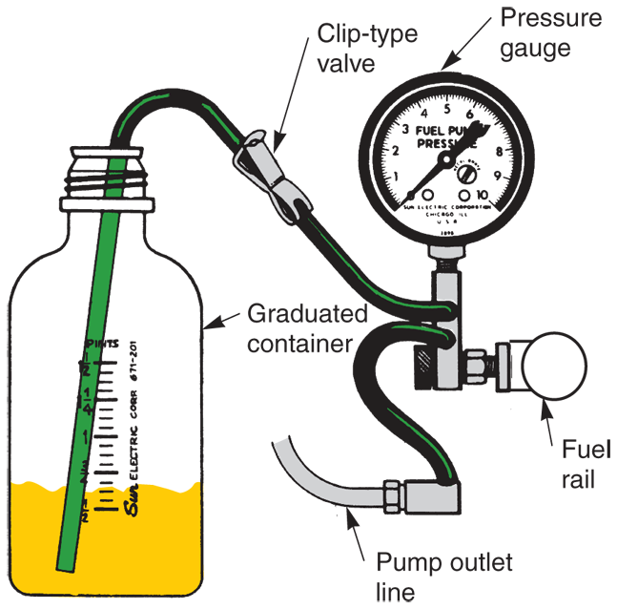
Measuring Fuel Pump Pressure (Cont.)
To test electric fuel pump
Activate electric pump motor
Press hybrid start button, or start engine
Compare pressure readings to specifications
(Chrysler)

Slide 60
Measuring Fuel Pump Pressure (Cont.)
Fuel pressure for gasoline injection system can vary from 50–2000 psi
Diesel supply pump should produce around 10–15 psi
Old carburetor-type fuel systems should be very low, about 4–6 psi
Older fuel-injected vehicles may run 30–50 psi

Slide 61
Measuring Fuel Pump Volume
Route output line from fuel pump into graduated container
For safety, use valve or clip to control fuel flow into container
With engine idling at specified speed, allow fuel to pour into container for prescribed amount of time
Normally 30 seconds
Close off clip or valve, and shut off engine
Compare volume output to specifications

Slide 62
Measuring Fuel Pump Volume (Cont.)
Fuel pump volume or fuel pump capacity
Fuel amount pump can deliver in specific amount of time
Fuel pump volume output should be minimum of one pint in 30 seconds for small automobile engines
Larger engines will require slightly higher fuel volume output

Slide 63
Measuring Fuel Pump Vacuum
Should be checked when fuel pump fails pressure and volume tests
Connect vacuum gauge to inlet side of pump
Leave fuel hose, from volume test, in graduated container
Open valve and activate pump
Compare vacuum reading to specifications
Fuel pump vacuum should be about 7–10" Hg

Slide 64
Electric Fuel Pump Circuit Tests
Many electric fuel pump problems caused by circuit problems
Broken wires, bad relays, shorts, blown fuses, computer malfunctions, and other troubles affect operation
Measure supply voltage being fed to pump motor
If voltage is low, problem is in electrical circuit to pump

Slide 65
Fuel Pump Shutoff Circuits
Inertia switch
Blocks current flow to electric fuel pump after severe impact or collision
After collision, you must press a button on switch before pump will function again

Slide 66
Fuel Pump Shutoff Circuits (Cont.)
Low oil pressure safety circuit
Protect engine from major mechanical damage
Signals ECM to shut off electric fuel pump if engine oil pressure drops too low

Slide 67
Mechanical Fuel Pump Replacement
Disconnect battery to keep electric sparks from starting fuel fires
On hybrid, also disable HV battery
Following factory service manual procedures, relieve any residual fuel pressure
Use tubing wrenches to disconnect fuel lines going to fuel pump

Slide 68
Mechanical Fuel Pump Replacement (Cont.)
Unbolt pump from engine
Compare old mechanical pump with new one to make sure identical
Scrape off any remaining gasket material on engine cylinder head or front cover

Slide 69
Mechanical Fuel Pump Replacement (Cont.)
If used, install new gasket or seal on new fuel pump
Fit fuel pump onto its mount and hand start fuel pump bolts or nuts
Torque fuel pump bolts to exact specifications

Slide 70
Electric Fuel Pump Replacement
With inline pump, disconnect fuel fittings and remove pump
Usually, in-tank pump must be removed as part of tank pickup-sending unit
Procedure described earlier in chapter

Slide 71
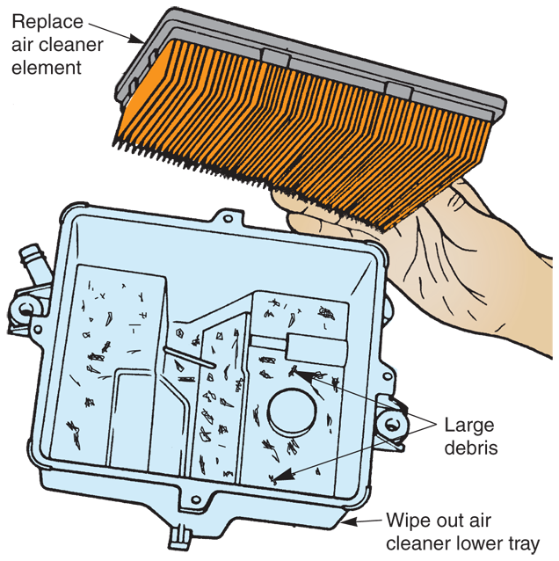
Air Filter Service
Air filter or air cleaner
Removes foreign matter from air entering engine intake manifold
Element
Filter element fits inside metal or plastic housing
When replacing filter element, clean out filter housing
(Ford)

